Slide 1
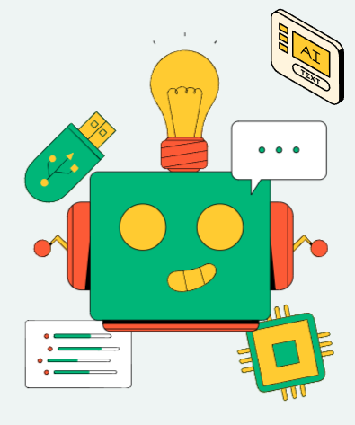
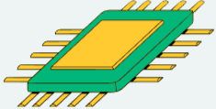
THYNK UNLIMITED
WE LEARN FOR THE FUTURE
ARTIFICIAL INTELLIGENCE & MACHINE LEARNING
PRESENTATION
PRESENTED BY:
CHAD GIBBONS

Slide 2

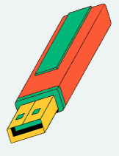


PRESENTATION OUTLINE
Introduction
What is Artifical Intelligence?
Historical Context
Key Concepts
What is Machine Learning?
Types of Machine Learning
Role of Data in Machine Learning
Case Studies
Real World Applications
Ethical Considerations
Deployment and Integration
Preparing for the Future
Questions and Answers

Slide 3

INTRODUCTION
Imagine a world where machines can decipher languages, recognize faces, diagnose diseases, and even make predictions without explicit programming.
We will embark on a journey through the ever-evolving landscape of Artificial Intelligence and Machine Learning. We'll explore the core concepts, real-world applications, and the transformative potential of these technologies.

Slide 4
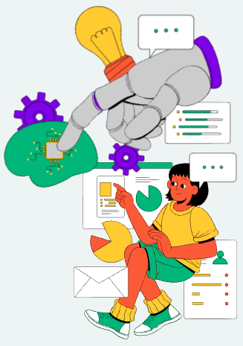
WHAT IS ARTIFICIAL INTELLIGENCE?
Artificial Intelligence is not just a buzzword; it's a transformative force that is reshaping industries, solving complex problems, and revolutionizing the way we live and work.
So, let's dive into the world of Artificial Intelligence, where machines become intelligent companions in our quest for progress and innovation.

Slide 5
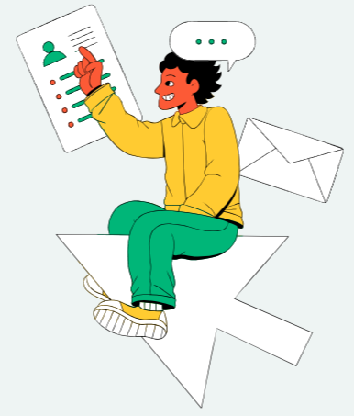
HISTORICAL CONTEXT
the birth of artificial intelligence
the AI resurgence
ethical & philosophical considerations

Slide 6


KEY CONCEPTS
natural language processing
neural networks
reinforcement learning
machine learning
computer vision
ethical AI

Slide 7
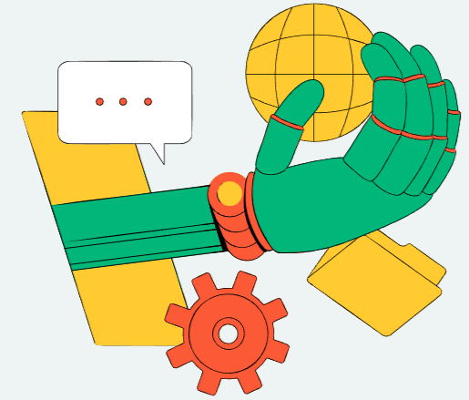
WHAT IS MACHINE LEARNING?
Machine learning is a subset of AI that focuses on the development of algorithms and models that enable computers to learn from and make predictions or decisions based on data.
It's a key driver of AI applications, including natural language processing, image recognition, and recommendation systems.

Slide 8
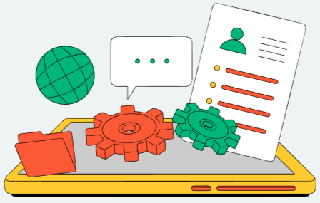
TYPES OF MACHINE LEARNING?
Supervised Learning
Unsupervised Learning
Reinforcement Learning

Slide 9

ROLES OF DATA IN MACHINE LEARNING?
Training Machine Learning Models
Testing and Evaluation
Future Engineering
Anomaly Detection
Data Augmentation

Slide 10

CASE STUDY SAMPLES
HEALTHCARE
FINANCE
RETAIL
Predicting Disease Outcomes
Algorithmic Securities Trading
Personalized Recommendations & Cart Management
MANUFACTURING
TRANSPORTATION
ENERGY
Predictive Tools Maintenance
Autonomous Vehicles (Hybrid)
Energy Consumption Optimization

Slide 11
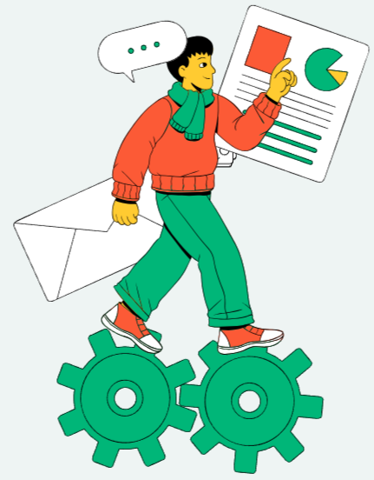

REAL WORLD APPLICATIONS
2025
2030
2035
2040
Radiologists and healthcare professionals employed deep learning algorithms to analyze medical images such as X-rays, MRIs, and CT scans.
An educational platform uses AI to provide personalized learning experiences for students as well as assessments suited to learnings.
A smart grid system utilized AI to optimize energy consumption in urban areas. The system adjusted energy distribution to reduce waste and costs.
By using natural language processing, the chatbot understood and responded to customer queries reducing response times.

Slide 12


ETHICAL CONSIDERATIONS
01
02
03
BIAS AND FAIRNESS
DATA PROTECTION
AUTONOMY AND CONTROL
AI systems can inherit biases from their training data, which may result in unfair or discriminatory outcomes. Ethical AI requires addressing and mitigating bias to ensure that AI systems are fair and equitable for all individuals and groups.
AI often relies on large datasets, raising concerns about data privacy. Ethical AI practices involve protecting individuals' data and ensuring transparency about how data is collected, used, and stored.
Ethical AI considers the degree of autonomy given to AI systems and the control mechanisms in place. Maintaining human oversight and control is important in critical decision-making processes.

Slide 13
DEPLOYMENT AND INTEGRATION
DATA PREPARATION
MODEL DEVELOPMENT
MODEL EVALUATION
Data collection, cleaning, and preprocessing
Ensuring data quality and reliability
Data labeling and annotation
Selection of appropriate machine learning algorithms
Model architecture and hyperparameter tuning
Training process and validation
Cross-validation and testing on validation datasets
Assessing model performance, including accuracy, precision and recall

Slide 14
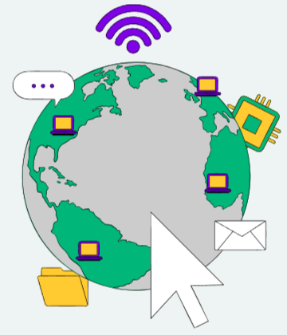
PREPARING FOR THE FUTURE
Preparing for the future with artificial intelligence (AI) involves strategic thinking, adaptability, and a focus on harnessing the potential of AI to drive innovation and address societal challenges.
Here are some key steps and considerations for preparing for the future with AI:
Education and Skills Development
Data Management and Security
Ethical and Responsible AI
AI Integration and Talent
Innovation and Culture

Slide 15
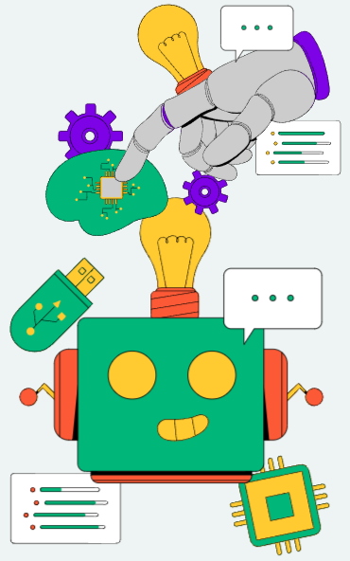
QUESTIONS AND ANSWERS
Your insights and questions are highly valuable to us, and we want to create an engaging and interactive session. Please feel free to send us your questions and concerns for clarifications.
www.reallygreatsite.com
123-456-7890
hello@reallygreatsite.com
123 Anywhere St., Any City, ST 12345

Slide 16

RESOURCE PAGE
B for blur | C for confetti
D for a drumroll | M for mic drop
O for bubbles | Q for quiet
U for unveil | Any number from 0-9 for a timer
Find the magic and fun in presenting with Canva Presentations.
Press the keys on the table while on Present mode to experience the magic.
Be sure to delete or hide this page before presenting.

Slide 17







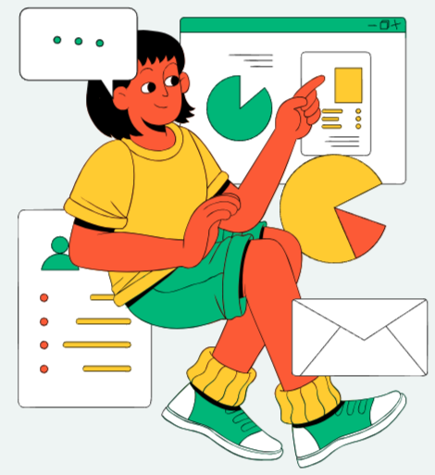

RESOURCE PAGE
You may use these extra design elements in your Canva presentation.
Please be sure to delete or hide this page before presenting so your audience will not be able to see them.

Slide 18
RESOURCE PAGE
Click the Share button on the top right corner of your screen and select 'Present and Record.'
Click ‘Go to recording studio,’ where you can choose the video and audio source for your video presentation.
Feel free to choose the ‘No camera’ option and record your voice only.
Start recording, and press pause in between takes if you have to.
Once you're done, download your Canva Presentation in MP4 file format or get a link to your Talking Presentation and share it with others.
You can also record a video inside the editor! Go to 'Uploads' and click on 'Record yourself'.
Presenting live not your thing? No worries!
Record your Canva Presentation that your audience can watch at their own pace.
Don't forget to delete or hide this page before presenting.

