Slide 1
Sorting
A process of rearranging a sequence of objects so as to put them in some logical order.
Rules of the game Our primary concern is algorithms for rearranging arrays of items where each item contains a key. The objective of the sorting algorithm is to rearrange the items such that their keys are ordered according to some well-defined ordering rule (usually numerical or alphabetical order). We want to rearrange the array so that each entry’s key is no smaller than the key in each entry with a lower index and no larger than the key in each entry with a larger index.

Slide 2
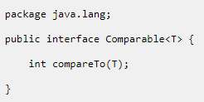
Java object comparison
Comparable: interface used to order the objects of the user-defined class.
compareTo():
Takes a single object as parameter.
Returns an int value which signals whether the object the compareTo() method is called on is larger than (positive), equal to (zero) or smaller than (negative) the parameter object.

Slide 3
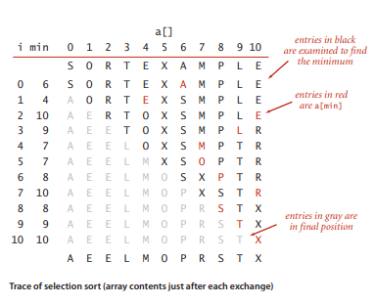
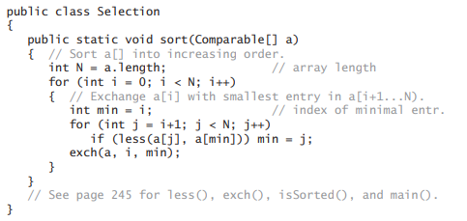
Selection Sort
Simplest sorting algorithm.
First, find the smallest item in the array and exchange it with the first entry (itself if the first entry is already the smallest).
Then, find the next smallest item and exchange it with the second entry.
Continue in this way until the entire array is sorted

Slide 4
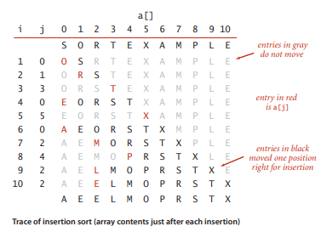
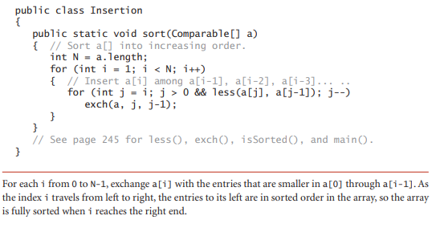
Insertion Sort
The array is virtually split into a sorted and an unsorted part. Values from the unsorted part are picked and placed at the correct position in the sorted part.
To sort an array of size n in ascending order:
Iterate from arr[1] to arr[n] over the array.
Compare the current element (key) to its predecessor.
If the key element is smaller than its predecessor, move the greater elements one position up to make space for the swapped element.
Continue until meet smaller value.

Slide 5
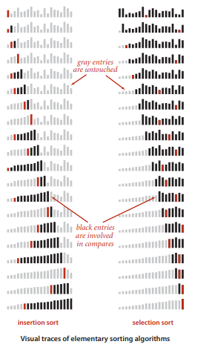
Selection vs Insertion
insertion sort does not touch entries to the right of the scan pointer.
selection sort does not touch entries to the left of the scan pointer.
Since insertion sort also does not touch entries smaller than the inserted item, it uses about half the number of compares as selection sort, on the average.

Slide 6
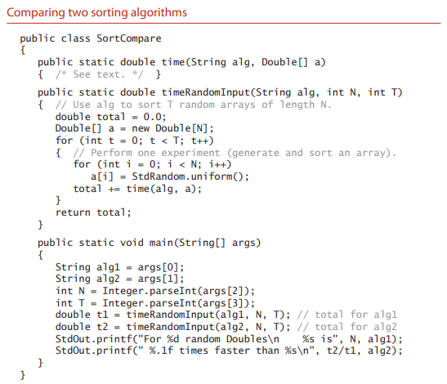
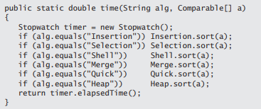

Slide 7
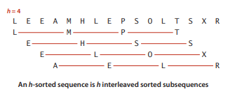
Shell Sort
a fast algorithm based on insertion sort.
Insertion sort is slow for large unordered arrays because the only exchanges it does involve adjacent entries, so items can move through the array only one place at a time.
a simple extension of insertion sort that gains speed by allowing exchanges of array entries that are far apart, to produce partially sorted arrays that can be efficiently sorted, eventually by insertion sort.
The idea is to rearrange the array to give it the property that taking every hth entry (starting anywhere) yields a sorted subsequence.

Slide 8
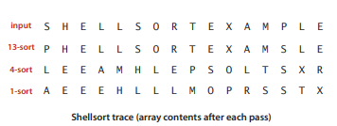
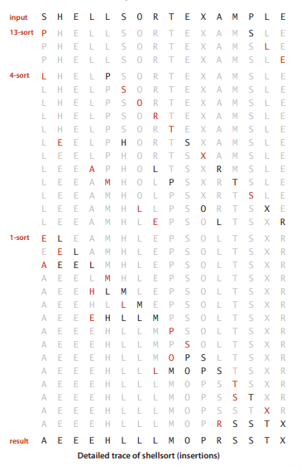
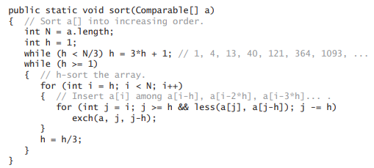
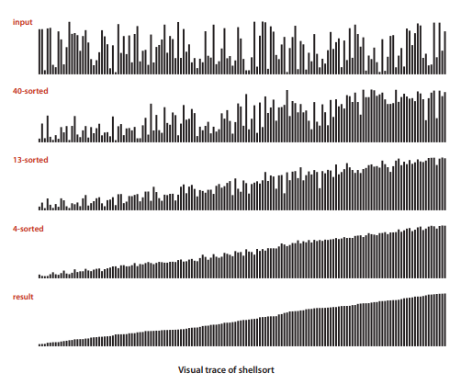

Slide 9
(Homework1) Array Rotation
Write a function rotate(arr[], d) that rotates items of arr[] by d elements to the left.
arr = { 1, 2, 3, 4, 5, 6, 7 }
// rotate all array elements to left by 2 position.
rotate(arr, 2)
arr = { 3, 4, 5, 6, 7, 1, 2 }

Slide 10
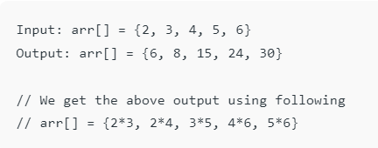
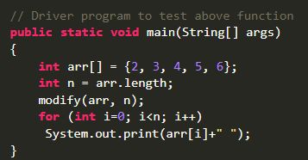
(Homework 2)
Given an array of integers, update every element with multiplication of previous and next elements with following exceptions. a) First element is replaced by multiplication of first and second. b) Last element is replaced by multiplication of last and second last.

Slide 11
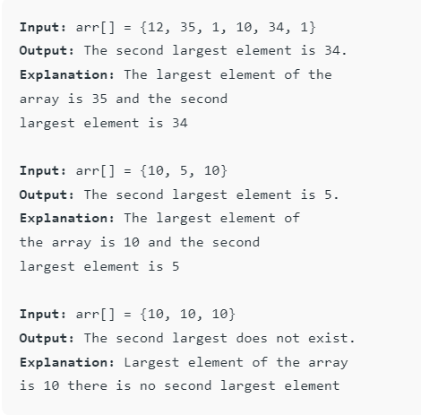
Homework 3
Find second largest element in an array

