Slide 1

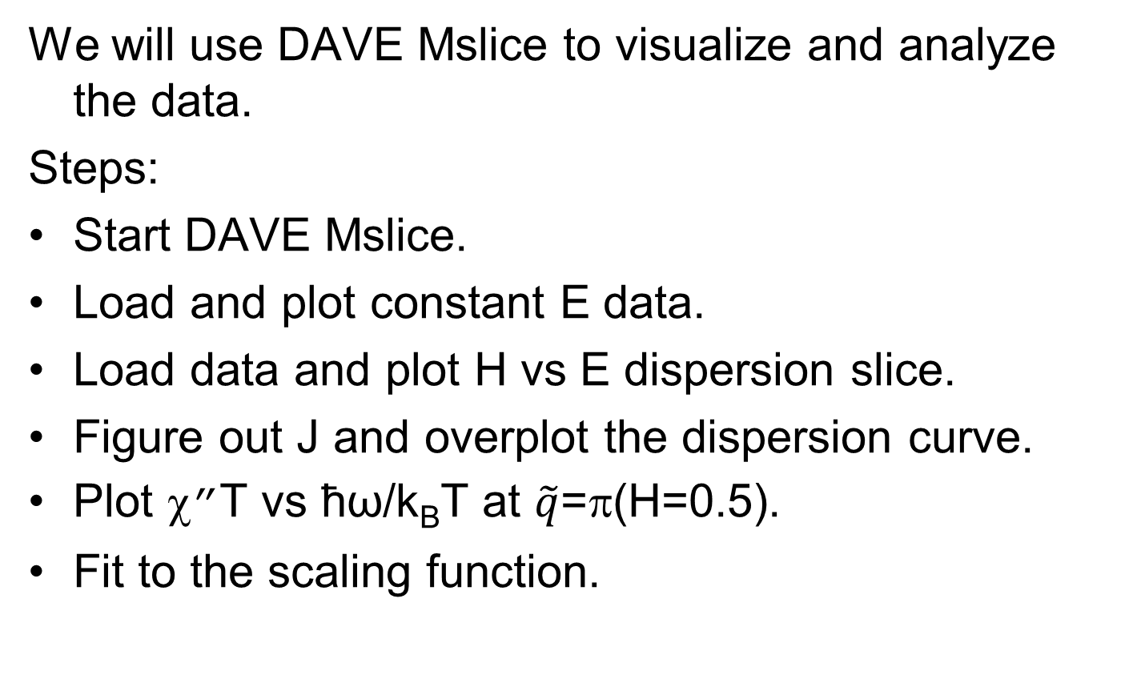

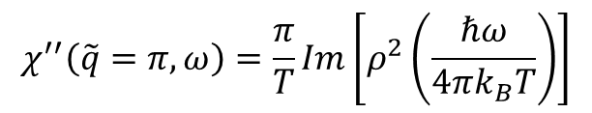
Data Analysis
We will use DAVE Mslice to visualize and analyze the data.
Steps:
Start DAVE Mslice.
Load and plot constant E data.
Load data and plot H vs E dispersion slice.
Figure out J and overplot the dispersion curve.
Plot χ”T vs ħω/k_{B}T at $\tilde{q}$=π(H=0.5).
Fit to the scaling function.
$$ρ(x)=\frac{Γ\left(\frac{1}{4}−ix\right)}{Γ\left(\frac{3}{4}−ix\right)}$$
$$χ^{′′}\left(\tilde{q}=π,ω\right)=\frac{π}{T}Im\left[ρ^{2}\left(\frac{ℏω}{4πk_{B}T}\right)\right]$$

Slide 2
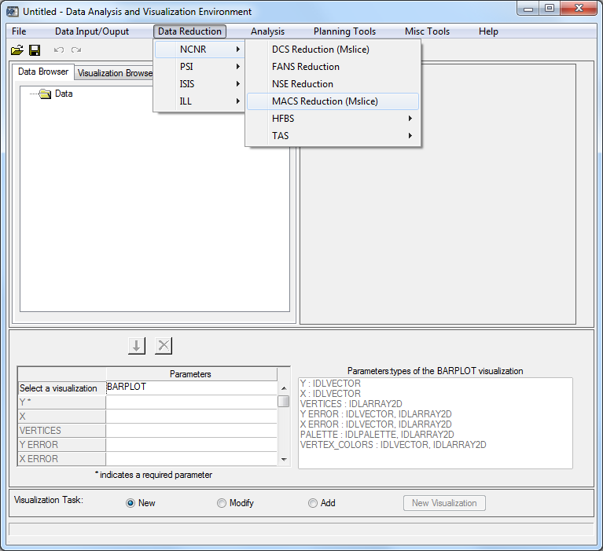
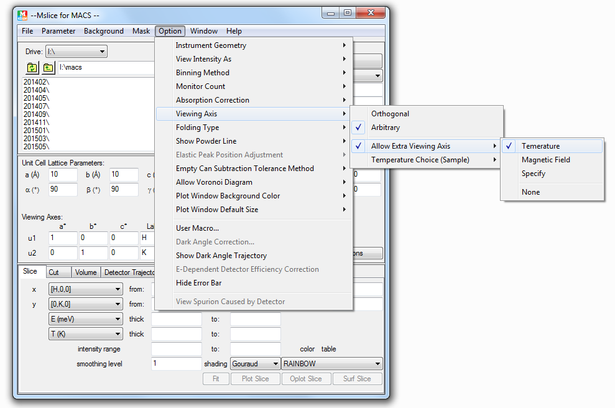
DAVE Mslice
DAVE->Data Reduction->NCNR->MACS Reduction (Mslice)
Mslice->Option->View Intensity As->S(Q,omega)
Mslice->Option->Viewing Axis->Allow Extra Viewing Axis->Temperature

Slide 3
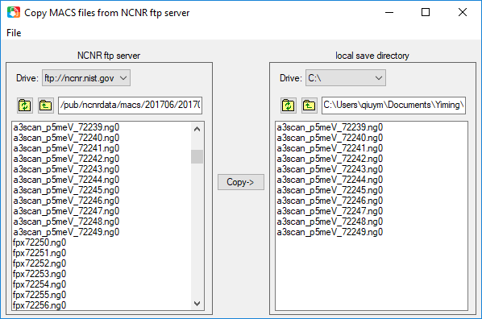
Data Files
Use the NCNR ftp directory in mslice to remotely load data files.
For windows computer, the ftp directory is ftp://ncnr.nist.gov
in the drive list. For Mac computers, the ftp directory is in the NCNR_ftp
directory in the root directory.
Or download the files from the ftp site to you computer and view them
locally. You can use the tool in the mslice menu File->File Tools->Copy
Files from NCNR FTP Server to download the files.
File list:
Constant-E A3 scan files:
macs/201706/20170619/data
72239-72249
Dispersion data files: macs/201304/20130425/data/
Low-T: fpx17722-fpx17879
High-T: fpx18314-fpx18397
Empty can: fpx18023-fpx18100
https://tinyurl.com/acns-eresl https://tinyurl.com/acns-macs

Slide 4
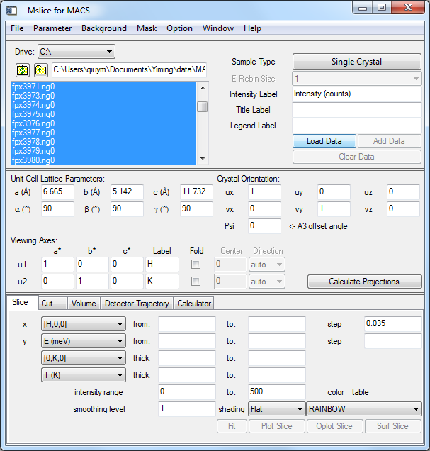
Load Data
Choose the data files in the file list panel. Right click to view file info.
Press Load Data button. Press Add Data button to append data.
For background files, choose them in the file list, then in the background
menu, click Load Empty Can File(s).
Constant-E A3 scan files:
macs/201706/20170619/data
72239-72249
Dispersion data files: macs/201304/20130425/data/
Low-T: fpx17722-fpx17879
High-T: fpx18314-fpx18397
Empty can: fpx18023-fpx18100

Slide 5
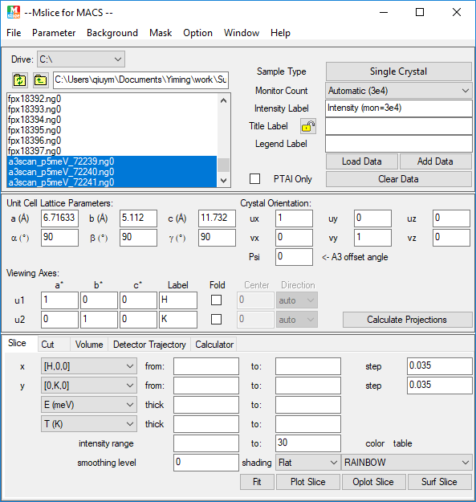
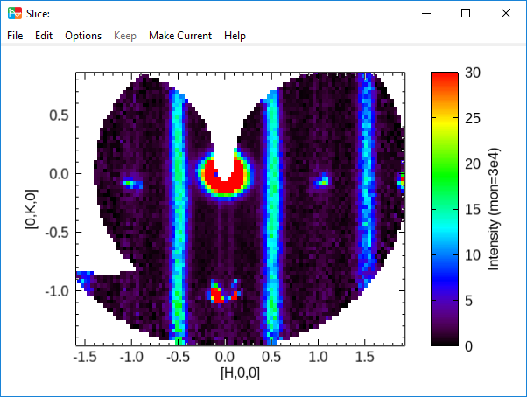
Plot Constant-E Slice
Load a3 scan files 72239-72249
Make sure u1=(1,0,0) and u2=(0,1,0). Press Calculate Projections button.
In the slice panel, choose [H,0,0] as x axis, step 0.035, and [0,K,0] as
y axis, step 0.035. Press Plot Slice button to plot the H vs K contour plot.
Keep the plot window.

Slide 6
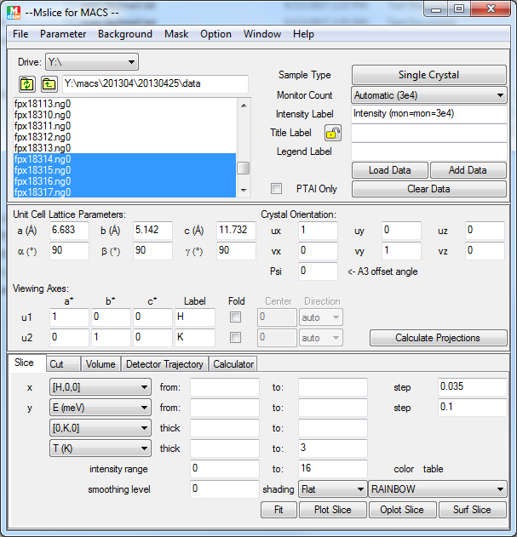
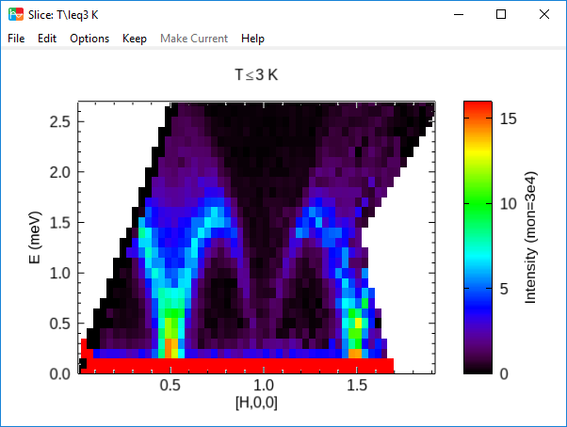
Plot H vs E dispersion Slice
Load low-T (17722-17879 ) and high-T (18314-18397) data files.
Load empty can files (18023-18100) as background.
Disable the monitor lambda/2 correction in the Option menu. Calculate
projection. Increase the empty can subtraction tolerance in the Parameter
menu to 0.015 for energy and 0.15 for kidney.
In the slice panel, choose [H,0,0] as x axis, step 0.035, and E as y axis,
step 0.1. Specify the temperature range. Press Plot Slice button to plot
the H vs E contour plot.
Keep the plot window.

Slide 7
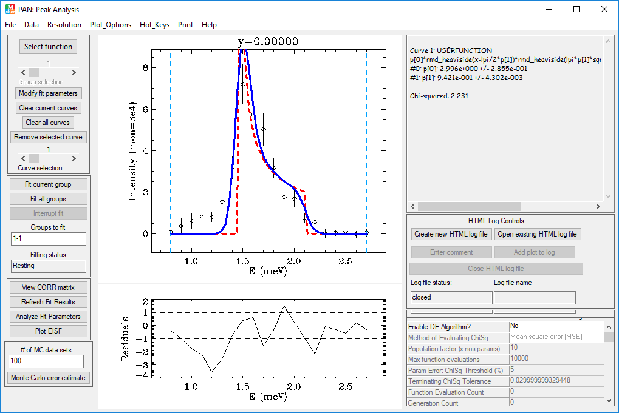
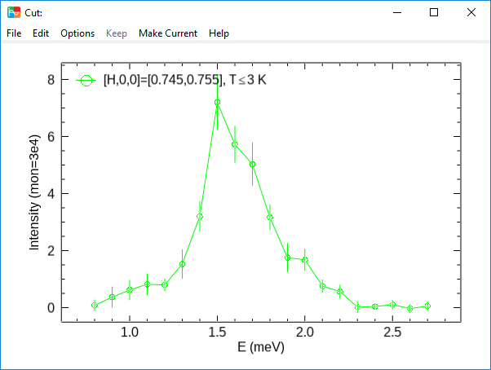
Plot & Fit Cut
Make a cut along E, with [H,0,0] thickness range of [0.745,0.755] and
T<3 K. x range starts from 0.79, step 0.1.
Keep the plot window.
Press Fit button in the Cut panel to fit the data. Use Müller Ansatz equ. as
the user function (in one line, initial p[0]=3, p[1]=0.9):
p[0]*rmd_heaviside(x-!pi/2*p[1])*rmd_heaviside(!pi*p[1]*sqrt(2)/2-x)
/sqrt(abs(x^2-0.25*(!pi*p[1])^2))
Load pre-generated resolution data from Resolution->Load ASCII Res File.

Slide 8
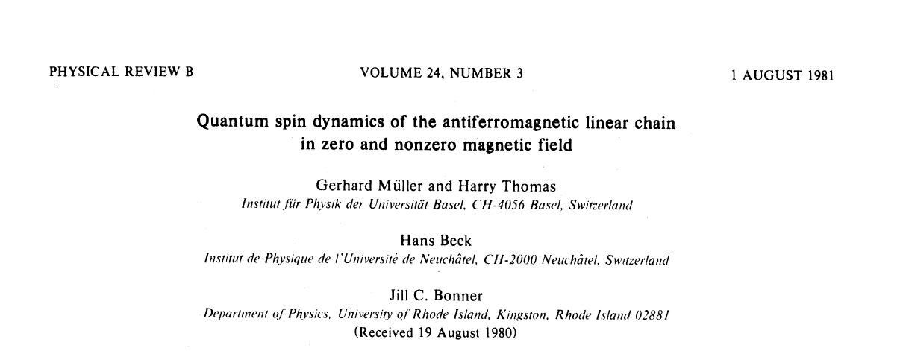
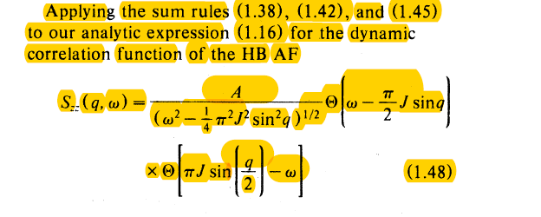


Slide 9
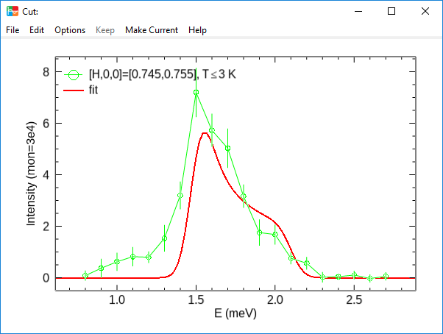
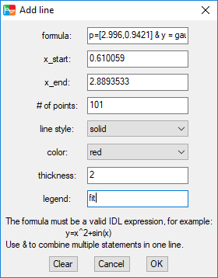
Add a line to the plot from Edit->Add Line :
p=[2.996,0.9421] & y = gauss_smooth(p[0]*rmd_heaviside(x-!pi/2*p[1])*
rmd_heaviside(!pi*p[1]*sqrt(2)/2-x)/sqrt(abs(x^2-0.25*(!pi*p[1])^2)),
0.15/(x[1]-x[0])/sqrt(8.*alog(2)))

Slide 10
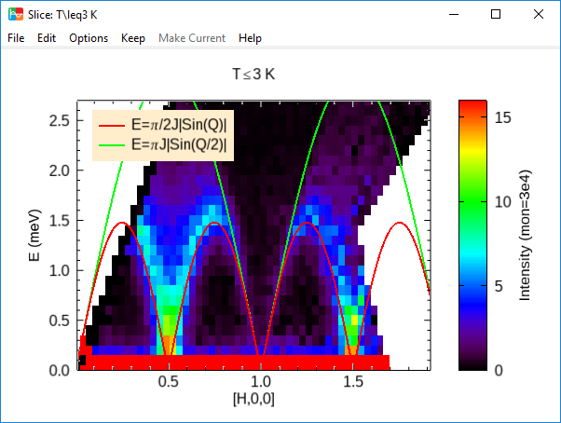
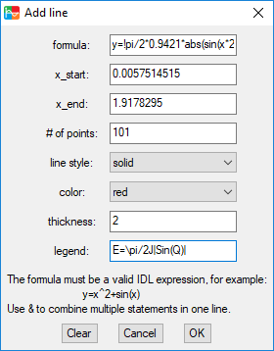
Overplot the Dispersion Curve
Overplot the lower and upper bound of the continuum in the H vs E
window from Edit->Add Line. The formula for the lower bound is
y=!pi/2*0.9421*abs(sin(x*2*!pi)). Use E=\pi/2J|Sin(Q)| as legend.
The fomula for the upper bound is y=!pi*0.9421*abs(sin(x*!pi)). Use
E=\piJ|Sin(Q/2)| as legend.

Slide 11
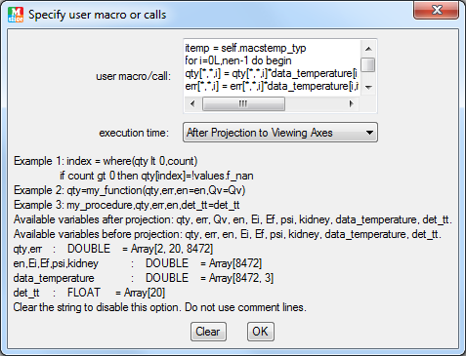
Plot χ”T vs ħω/k_{B}T
In mslice menu Option->User Macro, enter the following script:
itemp = self.macstemp_typ
for i=0L,nen-1 do begin
qty[*,*,i] = qty[*,*,i]*data_temperature[i,itemp]
err[*,*,i] = err[*,*,i]*data_temperature[i,itemp]
endfor
data_temperature[*,itemp] = en/(kb*data_temperature[*,itemp])
Choose the execution time to be After Projection to Viewing Axes.

Slide 12
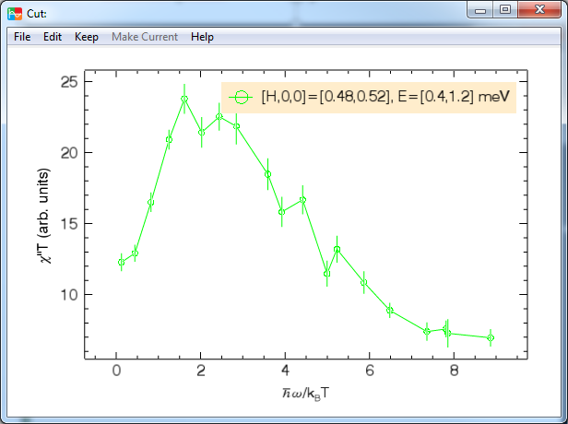
Plot χ”T vs ħω/k_{B}T
Choose Option->View Intensity As-> Chi(Q,omega)
Recalculate the projection.
In the cut panel, cut along T, which is E/k_{B}T now, step 0.4.
Set H thickness range [0.48,0.52], and E thickness range [0.4,1.2].
Plot cut. In the plot window, change the x-axis title to \HW/k!dB!nT,
and y-axis title to \chi’’T (arb. units).

Slide 13
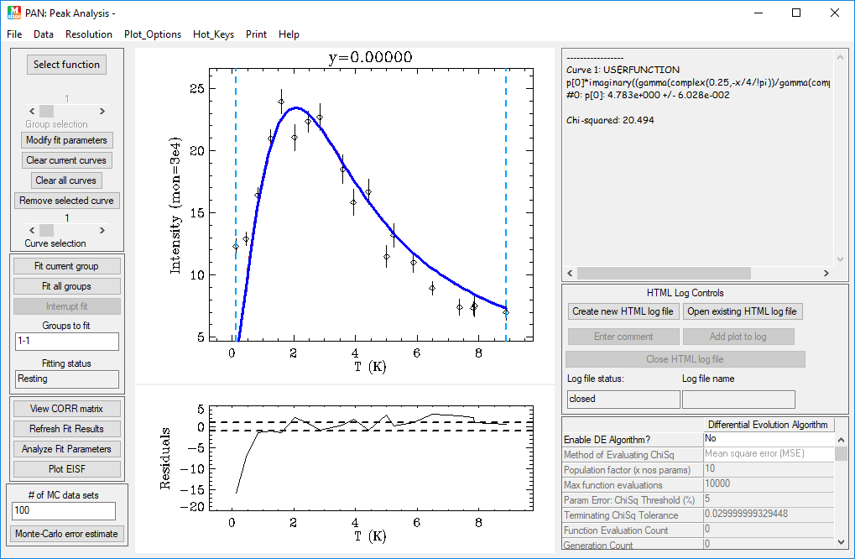
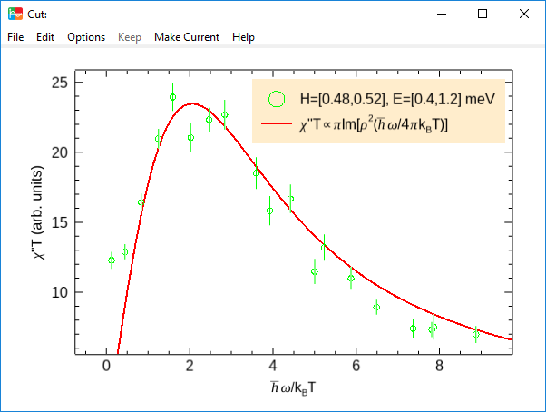
Fit to Scaling Function
Press Fit button. In PAN, choose user function as the fitting function:
p[0]*imaginary((gamma(complex(0.25,-x/4/!pi))/gamma(complex(0.75,-x/4/!pi)))^2)
Add a line of the scaling function to the previous χ”T vs ħω/k_{B}T plot.
y=4.783*imaginary((gamma(complex(0.25,-x/4/!pi))/gamma(complex(0.75,-x/4/!pi)))^2)
with \chi"T\propto\piIm[\rho!u2!n(\HW/4\pik!dB!nT)] as legend.

Slide 14

