Slide 1
DEVELOPMENT OF REINFORCEMENT LEARNING CONTROL OF A BRUSHLESS DC MOTOR ACTUATED PARALLELOGRAM ARM REHABILITATION ROBOT YUNUS Mujahid Olalekan Supervisor: Prof K.P. Ayodele September 2025

Slide 2
Problem Statement
The current control of the platform for upper limb stroke rehabilitation (PULSR) robot is hard coded in C#. This control approach lacks adequate robustness to errors affecting the effectiveness of the rehabilitation and safety of the patient. So, there is a need to train the robot with intelligent models that can make it more robust to errors enhancing the effectiveness and user safety.

Slide 3
Goal of the Project
To develop reinforcement learning model for the PULSR brushless DC motor actuated parallelogram arm robot.
PULSR: Platform for Upper Limb Stroke Rehabilitation

Slide 4
Objectives of the Project
i. establish the State-of-the-art in reinforcement learning for robotic
rehabilitation to identify existing approaches and highlight research gaps;
ii. investigate foundational theories and understand the analysis of the
PULSR2 robot's kinematics and dynamics;
iii. establish the current ability of the PULSR2 robot to anticipate and augment user input and identify specific areas where RL can offer significant improvements;
iv. design and develop RL models that can offer those improvements; and
v. deploy and evaluate the performance of the RL models on PULSR2.

Slide 5
State-of-the-art in RL for Rehab Robotics
In 2020, Zhang et al used Deep Deterministic Policy Gradient (DDPG) to enable adaptive assist-as-needed control, adjusting assistance based on patient performance, and improve motor learning by promoting active patient participation.
Bingjing et al used the SARSA(0) algorithm to adapt the robot’s admittance parameters during active rehabilitation training, in the year 2019.
In the same year, Rovini et al used Deep Q-Learning (DQN) to cluster and select fine-motor exercises in Parkinson’s rehab games, letting the system pick the next task based on patient performance predictions.
In 2015, Hong et al used Gaussian Process RL to facilitate collision-free motion planning for safe rehabilitation while reducing the computational complexity compared to deep RL models.

Slide 6
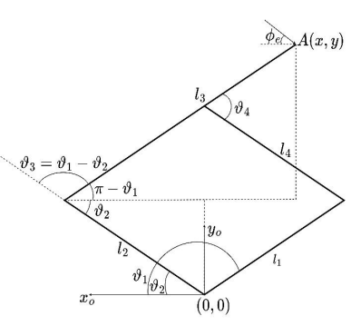
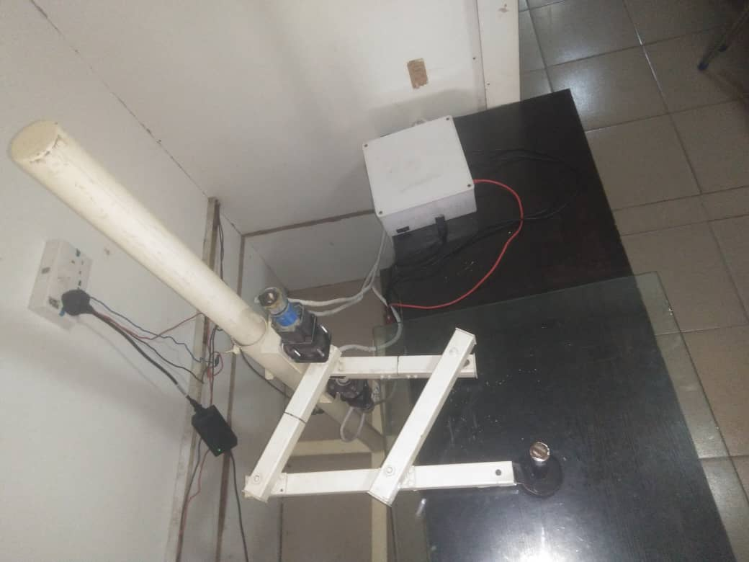

Foundational Theories: PULSR Kinematics

Slide 7

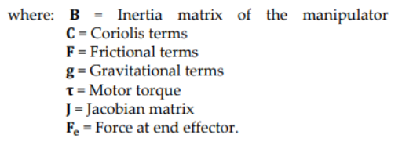
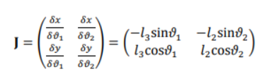
Foundational Theories: PULSR Dynamics

Slide 8



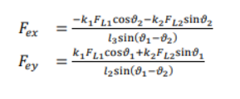
Foundational Theories: PULSR Dynamics
Where k is a 2x1 matrix of constants that can be determined experimentally.

Slide 9

PULSR Current Control

Slide 10
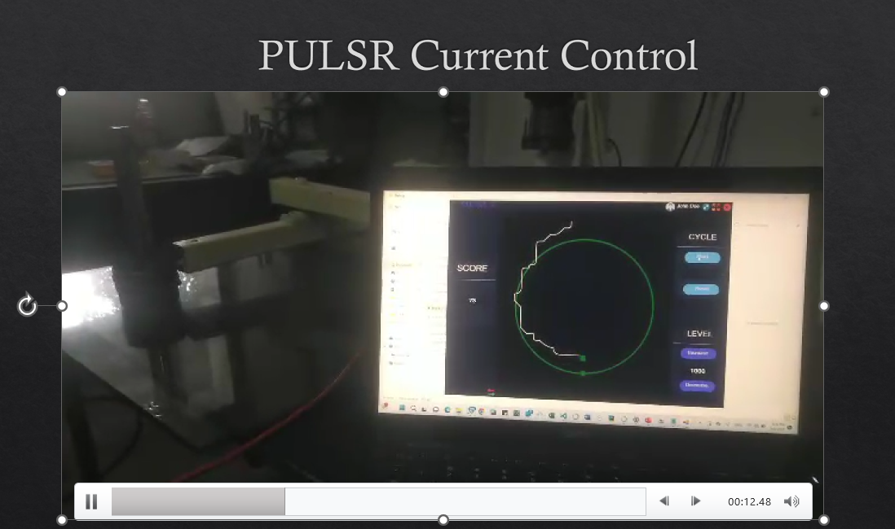

Slide 11
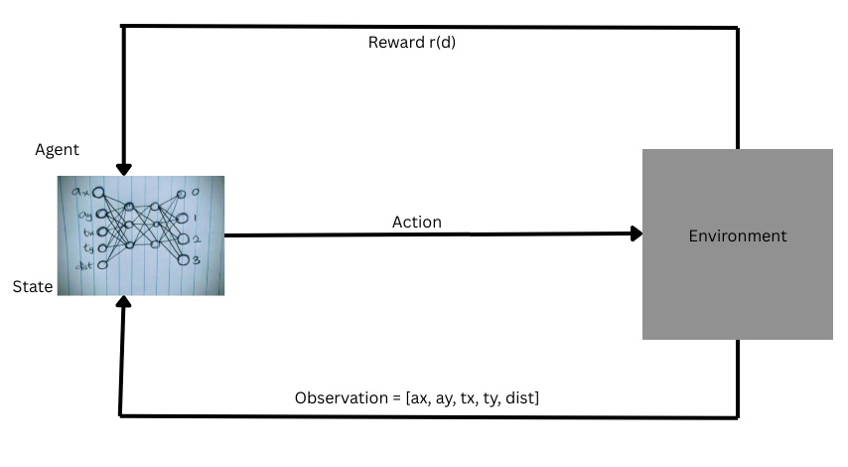
RL Problem Formulation for PULSR

Slide 12
Development of RL Environment for PULSR
Data Collection for PULSR Environment Specifications
Creation of a Data Processing Pipeline
Input: Logged episode data separated in folders by mode
Output:
the logged episode data separated in folders by mode
Reward of each episode
Concatenated x-y coordinates
Definition of environment specifications

Slide 13
Development of RL Environment for PULSR
Action | Mapping
0 | North (Increase y)
1 | East (Increase x)
2 | South ( Decrease y)
3 | West (Decrease x)
Dist | Reward
<=10 | 1
>10 | -1
Where dist = Euclidean distance between the agent and the target

Slide 14
Development of RL Environment for PULSR
Method | Argument(s) | Return Value(s) | Purpose
init | workspace_csv, trajectory_csv |  | Define action and observation space
get_obs |  | [ax, ay, tx, ty, dist] | Compute dist and output the observation list
reset |  | Observation and info | Set agent and target to start point
step | action | Observation, reward, terminated, truncated, info | Execute action, compute reward, send reward and next state to agent

Slide 15
Training
Benchmark Model: Deep Q Network (DQN)
Average Reward Per Episode for the benchmark model: 230.5
Training Timesteps: 100000
Policy Class: DQNPolicy
Q-Network (q_net) Artifacts:
Input Layer: 5 features corresponding to the observation vector: [ax, ay, tx., ty, dist]
Two Hidden Layers: 64 neurons each with ReLu activations
Output Layer: 4 Values corresponding to the 4 possible actions in the environment
Target Q-Network (q_net_target): same structure as the online network (used for stable training).
By keeping the target network stale for a while, DQN avoids instability and oscillation during training.

Slide 16
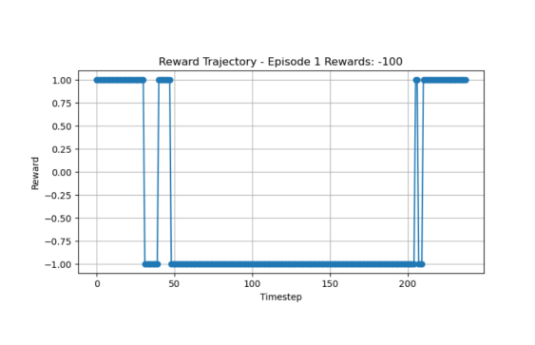
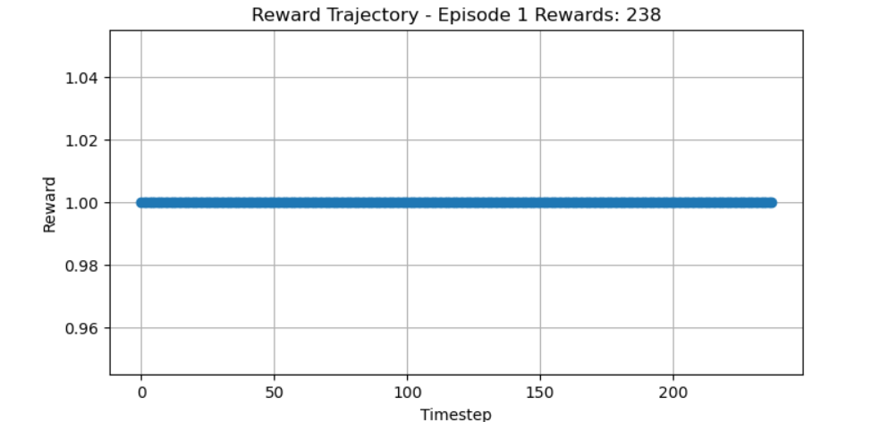
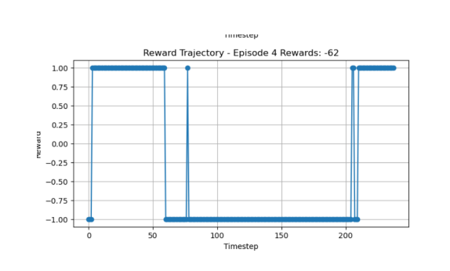
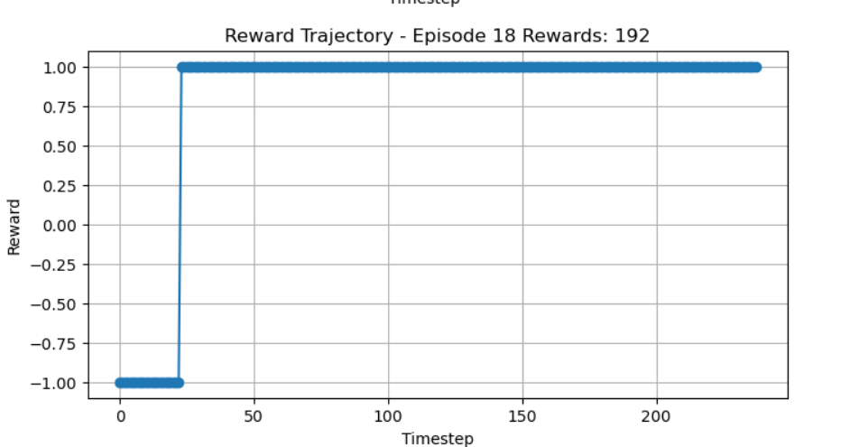
Results

Slide 17
Challenges
Force Sensor Constraints: The reinforcement learning algorithm currently leverages the kinematics of the robot to model the environment, and ignores the dynamics of the robot because of the constraints posed by the force sensors that are used to fetch the variables of the robot dynamics:
Large amount of noise detected in the readings of the force sensor makes it unreliable for further computations and
Non-responsiveness of the force sensor in an unpredictable pattern.
Difference in Language: The current control app of PULSR is harcoded in C# and the reinforcement learning prototype is written in python. Interfacing these two languages poses a huge constraint to the deployment of the reinforcement learning model.

Slide 18
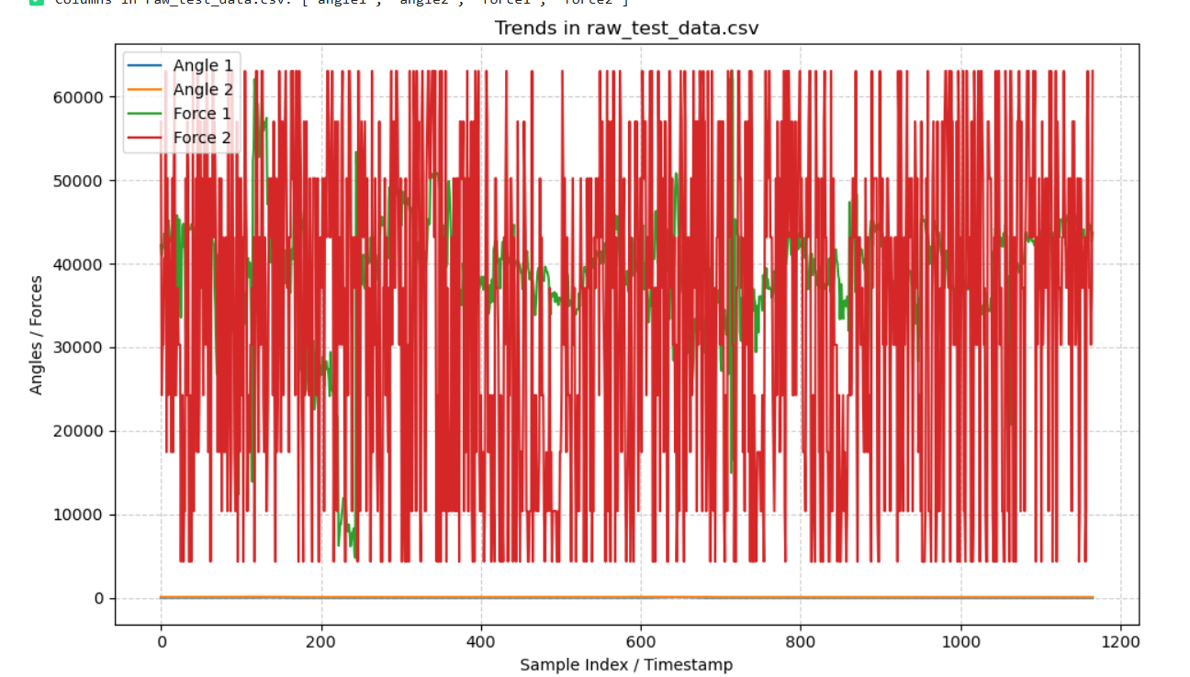
A Visualization of the Large Errors in the Force Sensors

Slide 19
Recommendations
Further research can consider leveraging the dynamics of the robot together with its kinematics to model the environment for RL algorithm.
In subsequent research, the C# codebase could be converted to Python for ease of implementing RL algorithms.
The C# codebase can alternatively be standardized into a fetchable API that will enable RL algorithms to send and receive requests with python.
Reinforcement Learning frameworks like TorchSharp for C#, can also be considered alternatively in further research.

Slide 20
Conclusion
Given the Platform for Upper Limb Stroke Rehabilitation Robot (PULSR) controlled by an app hardcoded in C#, this project successfully designs and develops a high-performance reinforcement learning model for the brushless DC motor actuated parallelogram arm robot, leveraging the kinematics of the robot.

Slide 21
Thank you.

