Slide 1
Data Science Critical Dependence on Computer Science & Data Architecture
Data Science is not standalone — it sits on top of Computer Science and Data Engineering.
1. Algorithms & Computation
ML = algorithmic engineering (complexity, memory, optimization).
High-performance code, feasible models, faster experimenting
2. Software Engineering Foundations
Clean code, versioning, modularity, testing, documentation.
Enables reproducibility and robust pipelines.
3. Data Architecture & Infrastructure
DS relies on CS-designed systems:
Databases (SQL/NoSQL, time-series stores…)
Data formats (Parquet, Arrow, CSV, JSON, HDF5…)
Distributed systems (Spark, cloud storage layers…)
Data warehouses & lakes (Snowflake, BigQuery, S3-based lakes…)
4. Data Pipelines & Orchestration
ETL/ELT workflows (Airflow, Prefect …)
Real-time streaming (Kafka, Kinesis….)
Ensures clean, reliable, timely data at scale

Slide 2
Data Science Critical Dependence on Computer Science & Data Architecture
5. Data Quality & Governance
Schema management, data validation, metadata, lineage.
Data must be accurate, consistent, complete before ML touches it.
6. Storage, Archival, and Access
Tiered storage, backups, archival policies, GDPR/retention rules.
Efficient access patterns matter (indexing, caching, partitioning).
7. Data-Related Risks in ML
Concept drift (relationships change)
Data drift (distribution shifts)
Feature decay (pipelines break)
Data leakage (future info leaks)
CS + monitoring systems are required to detect & fix these.
8. Productionisation & Lifecycle
CI/CD for ML, MLOps, deployment patterns (REST, batch, streaming).
Monitoring performance, drift, latency, resource usage.

Slide 3
Core Language Concepts - Interpreted vs. Compiled
1. Interpreted Languages (Python, R, JavaScript, Julia)
Code is executed line-by-line by an interpreter
Flexible, dynamic, great for rapid development
Slower than compiled languages — but fine for DS when paired with fast libraries (NumPy, PyTorch)
Easy debugging and experimentation → perfect for notebooks
2. Compiled Languages (C, C++, Rust, Java)
Code is translated into machine code before running
Much faster, more memory-efficient
Stricter, harder to prototype

Slide 4
Core Language Concepts - • Procedural vs. Functional vs. Declarative
1. Procedural Languages (C, early Python style)
Program is a sequence of explicit steps
Control flow is everything: loops, conditions, state changes
Simple mental model, great for small scripts
Challenges:
Can become messy and unstructured as complexity grows
Much code duplication of repetitive tasks
2. Functional Programming (modern Python, Scala, F#, data pipelines)
Programs are built from functions, not steps
Emphasizes pure functions (no side effects, no shared state)
Great for data transformations, pipelines, and parallel computation
Reusable
3. Declarative Languages (SQL, HTML, Prolog, dataframe APIs)
You describe what you want, not how to compute it
Under the hood, the engine optimizes execution
Often used for data queries, configuration, analytical expressions
Example:
SELECT avg(price) FROM trades — no loops, no steps, just intent

Slide 5
Core Language Concepts - Object-Oriented Programming (OOP)
OOP structures code around i.e. data and behaviour, therefore easier to manage complexity in larger systems
OOP
Code is organized into classes (templates) and objects (instances).
A class defines:
Attributes → data/state
Methods → functions acting on that data
Pros
Encapsulation: keep data + logic together
Reusability: classes can be reused across projects
Modularity: easier to maintain, extend, and test
Inheritance: build new classes from existing ones
Pseudo standard: ML frameworks (scikit-learn, PyTorch) are OOP at the core
Applications
Model wrappers (scikit-learn estimators)
Simulation frameworks (e.g. state-space models)
Reusable feature engineering pipelines
Complexity
Harder for beginners — abstract concepts (inheritance, polymorphism)
Over-engineering risk — too many small classes = confusion
State management can get messy if not carefully designed

Slide 6
Python Language Fundamentals for Data Science
1. Core Python Syntax & Control Flow
Variables & types (int, float, str)
Loops: for, while
Conditionals: if / elif / else
Functions: def, arguments, return values
List comprehensions (Pythonic iteration)
2. Essential Data Structures
Lists – ordered collections
Tuples – immutable groups
Dictionaries – key/value lookups
Sets – unique elements
Choosing the right structure → faster, cleaner code
3. Numerical & Array Operations
NumPy arrays
Vectorized math
Matrices & linear algebra
Broadcasting rules
Efficient computation for ML & time-series

Slide 7
Python Language Fundamentals for Data Science
4. Data Access & Handling
Reading/writing: CSV, JSON, Parquet, Excel
File I/O (open, with)
APIs (HTTP requests), databases (SQL connectors)
5. DataFrames (pandas, polars) (distributed: dask, spark)
Series vs DataFrame
Filtering, joining, grouping
Missing values, indexing, datetime operations
Core tool for transforming raw data → model-ready data
6. Plotting & Visualization Basics
Matplotlib, Seaborn
Line, scatter, histograms, heatmaps
Quick EDA for understanding data patterns

Slide 8
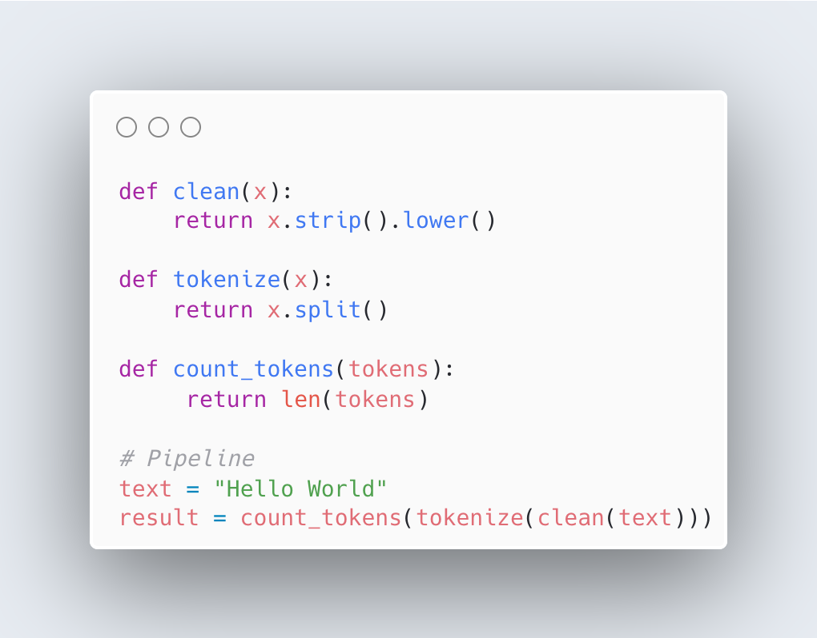
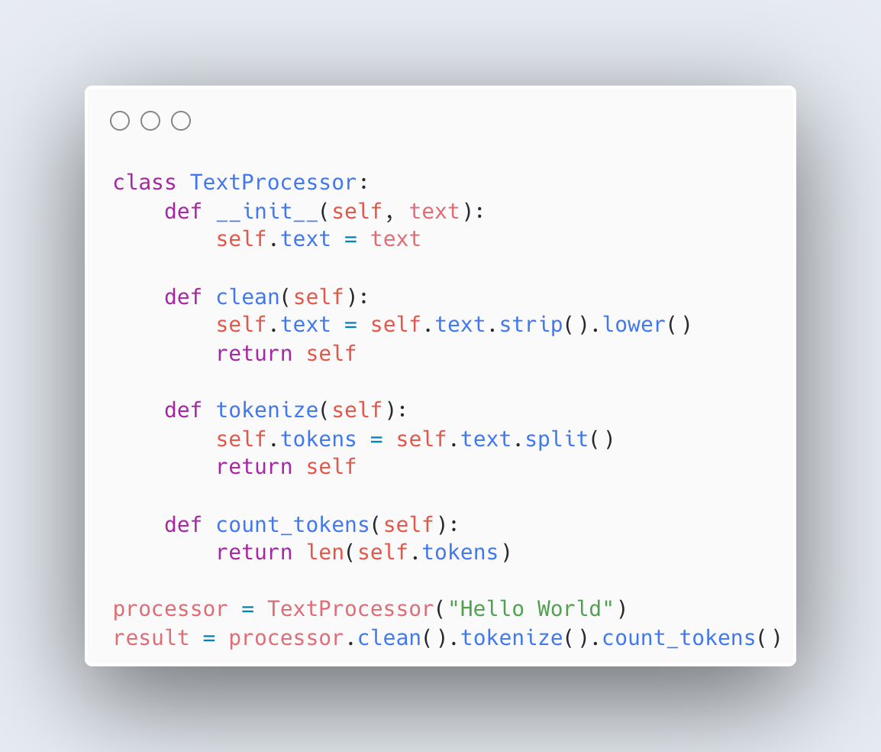
Functional Example to OOP
Functional: stateless, direct, minimal overhead
OOP: structured, reusable, good for complex systems

Slide 9
Core Concepts - Multithreading, Multiprocessing, and GPU’s
Multithreading
Multiple threads inside one Python process
All threads share the same memory
Lightweight and good for I/O-bound tasks ,network calls
Limited by the GIL - one thread can execute Python at a time
Not for CPU-heavy numeric loops written in pure Python
Use cases:
Downloading data
Calling APIs
Reading/writing many files
Handling I/O concurrency
Multiprocessing
Multiple processes, each with its own Python interpreter
Each process has its own memory - avoids GIL completely
Allows true parallelism across CPU cores
More overhead (process creation, data serialization)
Best for CPU-bound tasks that need real parallel computation
Use cases:
Numerical computation
Heavy data transformations
Simulations
Feature engineering across large chunks
Anything that maxes out CPUs
GPU
Thousands of lightweight cores designed for massively parallel math
Best for tensor operations: matrix multiplications, deep learning
Requires CUDA(NVIDIA)/ROCm(AMD) and GPU-friendly libraries (PyTorch, TensorFlow, JAX, CuPy)
Not general-purpose like CPUs — optimized for linear algebra
Deep learning
Vectorized math
Large matrix operations
Acceleration of numerical models

