Slide 1
Colab Notes
Some Positive properties
1. Zero setup / instant environment
No local installs, no dependency hell
2. Free (and paid) GPU / TPU access
Free tier gives limited GPU
Deep learning
LSTM / Transformers
Large matrix ops
3. Cloud-based & portable
Runs entirely in browser
Works on any machine (Mac, Windows, Linux, low-spec laptops)
4. Preinstalled ML stack – for quick prototyping
NumPy, pandas, matplotlib
scikit-learn
PyTorch, TensorFlow
XGBoost, LightGBM

Slide 2
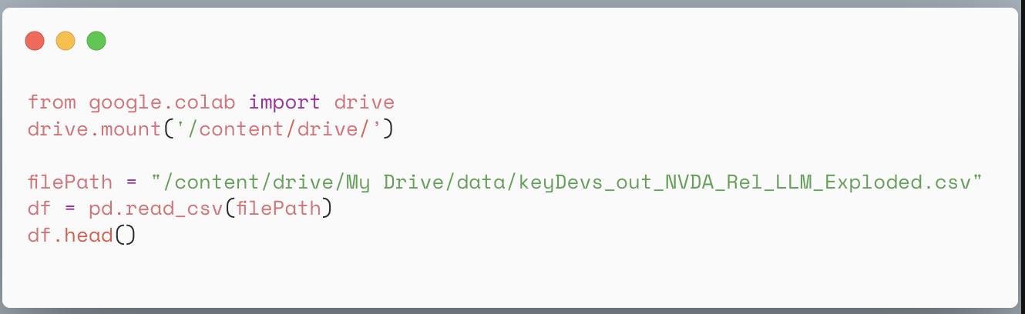
Colab Notes
Some challenging aspects
Sessions reset unexpectedly (long pymc, long MCMC…)
You cannot pin this image – package version control a must beyond core auto installed packages
pip install \
numpy==1.26.4 \
scipy==1.11.4 \
pymc==5.10.0 \
arviz==0.17.0
Etc.
I/O is slow compared to local SSDs
Specific caution wrt. confidence in results without re-running locally

Slide 3
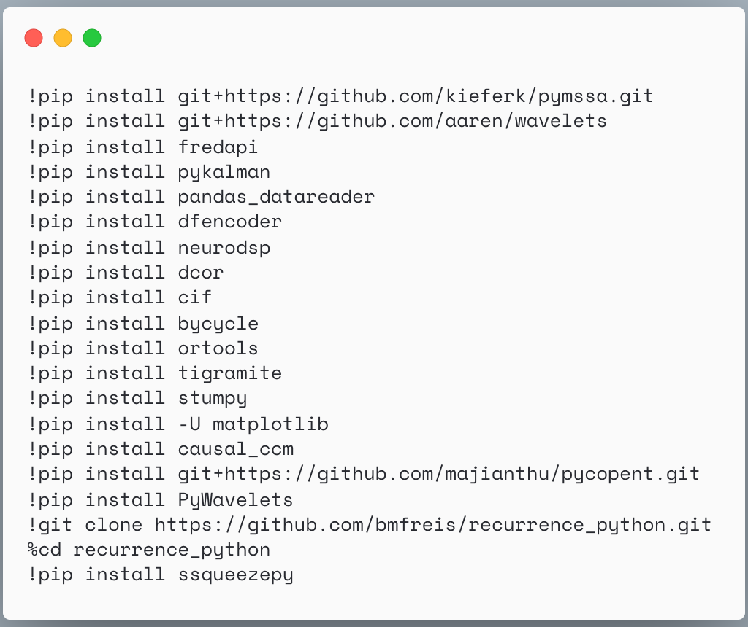
Colab, compressive example
This takes a while to install once you connect to Colab instance

