Slide 1
Loan Default Prediction
Comparing Classic ML and Neural Networks under Class Imbalance
Minwoo Yoo | Nathan
Home Credit Default Risk · Kaggle

Slide 2
Problem & Motivation
Goal
• Predict the probability that a loan applicant defaults on their loan (binary, TARGET ∈ {0, 1}).
Why it matters
• Lenders need accurate risk scoring to balance approval volume and credit losses.
• Defaults are rare (~8% in this dataset) — the data is severely imbalanced.
• A naive "always predict no default" model achieves 92% accuracy yet zero recall.
Imbalance is the central challenge
• Standard classifiers can be biased toward the majority class.
• How models respond to imbalance handling techniques is the focus of this work.

Slide 3
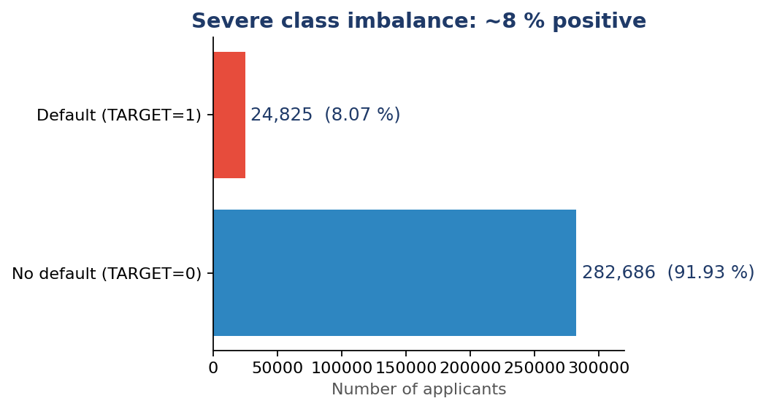
Dataset · Home Credit Default Risk (Kaggle)
Size
• Train: 307,511 applicants × 122 features
• Test: 48,744 applicants (labels held out by Kaggle)
Severe class imbalance
• Default rate ≈ 8.07% (24,825 / 307,511).
• Naive "all-zero" model = 92% accuracy / 0 recall.
Key feature signals
• EXT_SOURCE_1/2/3 (external credit scores) are the strongest predictors (|ρ| ≈ 0.16–0.18).
• DAYS_EMPLOYED sentinel 365,243 flags 18% (unemployed).
• Building-info columns are 50–70% missing.

Slide 4
Research Question
Do classic shallow models and neural networks respond differently to class imbalance handling techniques?
Two-axis study
• Five model families: Logistic Regression, Random Forest, HistGradientBoosting, Shallow MLP, Deep MLP.
• Imbalance handling: baseline · class_weight=balanced · SMOTE · threshold tuning.
• Validation: 80/20 stratified split + GridSearchCV with PredefinedSplit; primary metric ROC AUC.

Slide 5
Methodology · Shared Pipeline
Preprocessing (identical for all models)
• 80% / 20% stratified train–val split (random_state=42).
• Drop SK_ID_CURR; keep IDs only for the submission file.
• Mean imputation for numeric NaN; categorical NaN → all-zero dummy block.
• One-hot encoding for 16 categorical columns (244 features after encoding).
• StandardScaler fitted on train only (essential for LR / MLP).
Hyperparameter tuning
• GridSearchCV with sklearn PredefinedSplit (single train→val fold, no random k-fold).
• Scoring: roc_auc.
• Each model picks the highest-AUC parameter setting; results saved to result/home_credit/cv_results/.

Slide 6
Five Model Families Compared
Model | Family | Owner | Tuned hyperparameters
Logistic Regression | Linear | Nathan | C, tol; class_weight=balanced
Random Forest | Tree (bagging) | Nathan | n_estimators, min_samples_*; class_weight=balanced
HistGradientBoosting | Tree (boosting) | Nathan | learning_rate, max_iter, min_samples_leaf
Shallow MLP — hidden (64,) | Neural network | Minwoo | alpha, learning_rate_init
Deep MLP — hidden (128,64,32) | Neural network | Minwoo | alpha, learning_rate_init
Why this mix?
• Spans the course curriculum: linear → tree (bagging + boosting) → neural networks (shallow + deep).
• Lets us isolate whether NN behaves differently from classic shallow learners under imbalance.

Slide 7
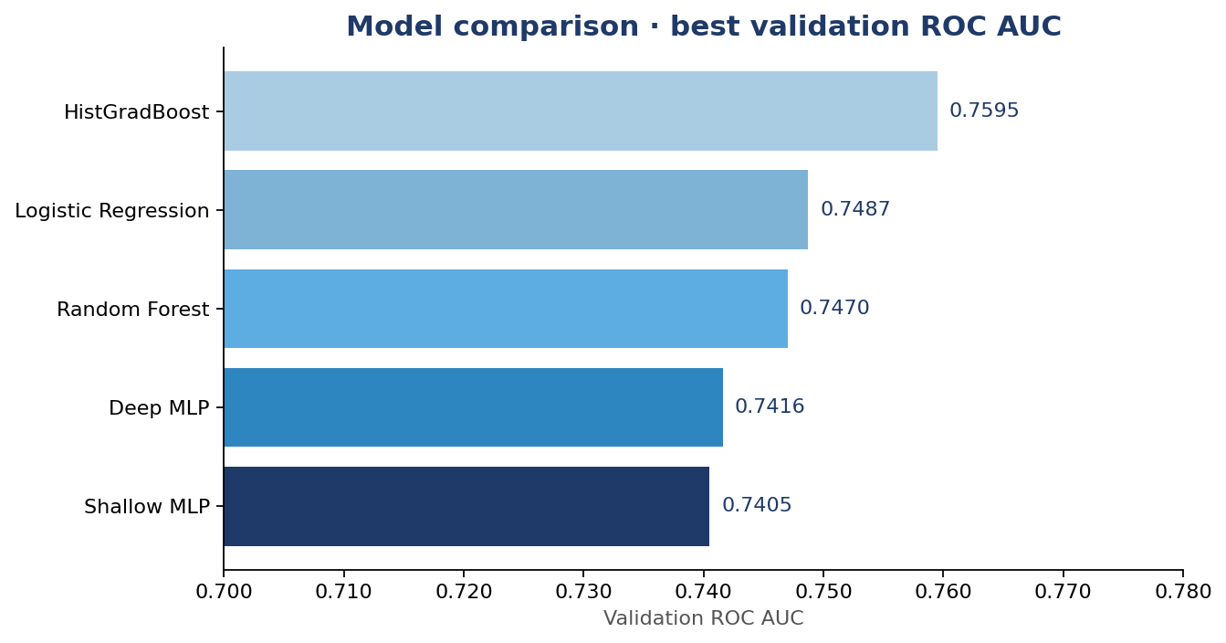
Results · Combined Validation AUC
Model | AUC
HistGradBoost | 0.7595
Logistic Regression | 0.7487
Random Forest | 0.7470
Deep MLP | 0.7416
Shallow MLP | 0.7405
Best model: HistGradBoost (Nathan) (val ROC AUC = 0.7595)
• Tree boosting (HGBC) is competitive on tabular credit data, in line with the literature.
• Neural networks reach a similar regime once features are scaled and regularized.

Slide 8
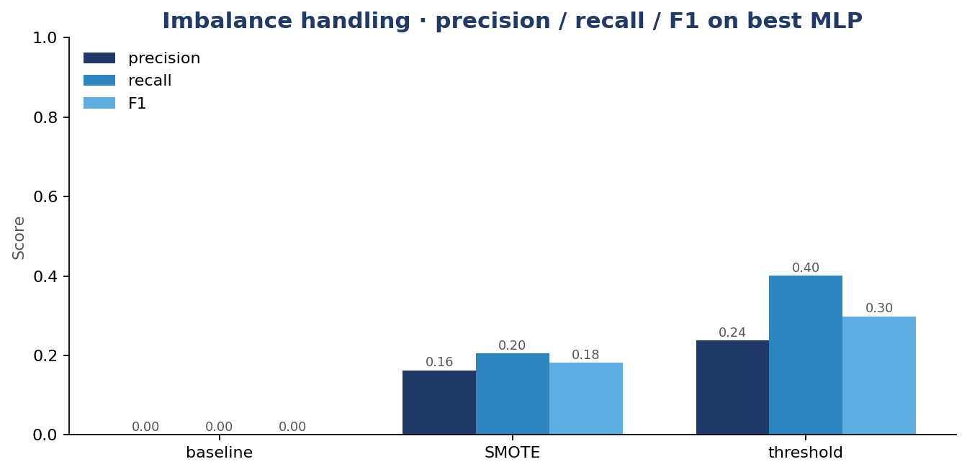
Imbalance Handling on the Best MLP
method | threshold | ROC_AUC | PR_AUC | precision | recall | F1
baseline | 0.5 | 0.745 | 0.2215 | 0.0 | 0.0 | 0.0
SMOTE | 0.5 | 0.6476 | 0.1337 | 0.1625 | 0.205 | 0.1813
threshold | 0.1641 | 0.745 | 0.2215 | 0.238 | 0.4004 | 0.2986
Three handling strategies
• Baseline — original 8/92 split, classify at 0.5.
• SMOTE — oversample minority to 50/50 (train only).
• Threshold tuning — pick the threshold maximizing F1 on val.
Reading the chart
• Threshold tuning swaps precision for recall.
• SMOTE typically lifts recall but can hurt precision.
• ROC AUC barely moves — the model already produces a good ranking.

Slide 9
Conclusions
What we learned
• Best model: HistGradBoost (Nathan) at val ROC AUC = 0.7595; tree boosting wins by about 1 AUC point.
• Neural networks tie Logistic Regression and Random Forest — bottleneck is the feature set, not the model.
• Shallow MLP (0.7405) ≈ Deep MLP (0.7416): going deeper does not help on this tabular data.
• Most actionable finding: at 0.5 threshold the MLP has zero recall — *choosing the threshold matters more than resampling.*
• SMOTE actually hurt this MLP (AUC 0.745 → 0.648); threshold tuning preserved AUC and lifted recall to 40 %.
Limitations & future work
• Only the main application_*.csv tables used — auxiliary tables (bureau, previous_application) typically add several AUC points.
• PredefinedSplit is fast but optimistic; k-fold CV would tighten the confidence intervals.
• Next steps: integrate auxiliary tables; ensemble HGBC + best MLP; calibrate probabilities (Platt / isotonic).

Slide 10
Thank you
Questions?
Recording link
• <<INSERT RECORDING LINK BEFORE SUBMISSION>>
Code
• github.com/ymw0414/loan-default-imbalance-classification

