Slide 1
Loan Default
Prediction
Comparing Classic ML and Neural Networks under Class Imbalance
Minwoo Yoo · Nathan | Home Credit Default Risk · Kaggle

Slide 2
Why this problem?
Minwoo · 1 min
8.07%
Lenders need to rank applicants by default risk
• Imbalance: 92% non-default vs 8% default
• "Always predict 0" → 92% accuracy, 0 recall — useless
• Even a model with ROC AUC = 0.745 can classify 0 defaulters
if every prediction sits below 0.5
Research question:
of applicants actually default
0%
recall at 0.5 threshold (baseline MLP)
Do classic shallow learners and NNs respond differently to imbalance handling?

Slide 3
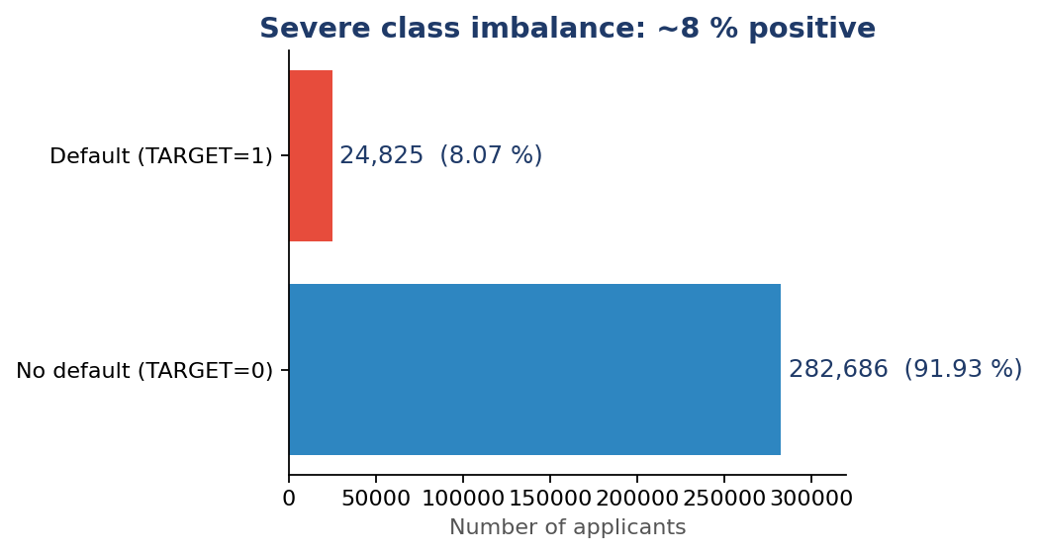
Dataset · Home Credit
Minwoo · 1 min
307K
244
8.07%
applicants in train
features after one-hot
positive class
Strongest signals
EXT_SOURCE_1/2/3 (external credit scores)
DAYS_EMPLOYED 365,243 = unemployed flag
Building-info columns 50–70% missing

Slide 4
Shared pipeline
Nathan · 1 min
Split
Drop ID
Impute
Encode
Scale
Tune
80% / 20%
stratified
remove
SK_ID_CURR
mean for
numeric NaN
one-hot →
244 features
StandardScaler
on train only
GridSearchCV
ROC AUC
Same preprocessing for all five models — fair comparison.
PredefinedSplit (single train→val fold) · scoring = roc_auc · seed = 42

Slide 5
Five models
Nathan · 1.5 min
Logistic Regression
Random Forest
HistGradBoost
Shallow MLP (64,)
Deep MLP (128, 64, 32)
Linear
Tree (bagging)
Tree (boosting)
Neural network
Neural network
by Nathan
by Nathan
by Nathan
by Minwoo
by Minwoo
Spans the curriculum: linear → tree (bagging + boosting) → shallow + deep NN.

Slide 6
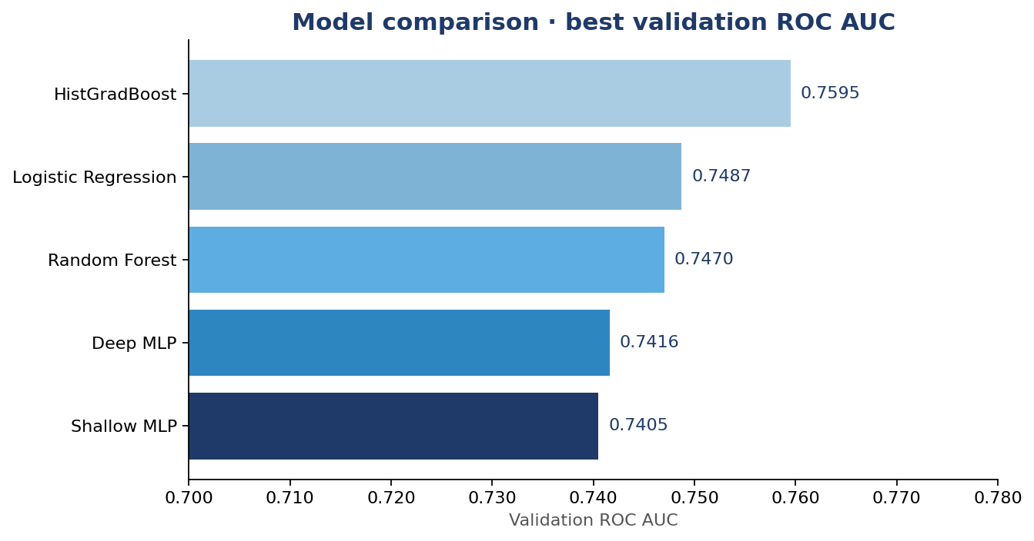
Combined ROC AUC
Nathan · 1 min
0.7595
HistGradBoost (Nathan)
Headline
Tree boosting wins by ~1 AUC point
Consistent with literature on tabular
NN ties LR & RF — not the model, the features

Slide 7
Neural networks
Minwoo · 1.5 min
Shallow MLP
Deep MLP
(64,) · ~15.7K params
(128, 64, 32) · ~42K params
0.7405
0.7416
val ROC AUC
val ROC AUC
+0.001 with 3× the parameters → depth alone does not help on this tabular data.
Best for both: alpha = 1e-3, learning_rate_init = 0.005

Slide 8
Imbalance handling
Minwoo · 1.5 min
Baseline
SMOTE ✗
Threshold ✓
0%
0.648
40%
recall @ 0.5
AUC dropped
recall @ 0.164
AUC 0.745
recall 21%, F1 0.18
AUC 0.745, F1 0.30
Choosing the threshold matters more than rebalancing the data.
Same model, different decision rule — recall jumps from 0% to 40%.

Slide 9
Takeaways
#1
#2
#3
Tree boosting wins
Threshold > resampling
Depth ≈ noise
HistGradBoost (Nathan) at 0.7595 val AUC.
Tabular data favors GBT over NN.
On the MLP, threshold tuning lifted recall
from 0% to 40% — SMOTE hurt AUC.
Shallow vs Deep MLP differ by 0.001 AUC.
Features are the bottleneck.
Limitations: only main tables (auxiliary tables → +2–3 AUC pts) · single split CV.

Slide 10
Recording link
Q&A
<<INSERT RECORDING LINK BEFORE SUBMISSION>>
Code
thank you
github.com/ymw0414/loan-default-imbalance-classification
Team
Minwoo Yoo · Nathan

