Slide 1
Loan Default Prediction
Comparing Classic ML and Neural Networks under Class Imbalance
Minwoo Yoo · Nathan
Home Credit Default Risk · Kaggle

Slide 2
Problem & Motivation
📍 Minwoo · 1 min
The task
• Predict the probability that a loan applicant defaults (binary, TARGET ∈ {0, 1}).
Why class imbalance matters
• Only ~8.07% of applicants default — the data is severely imbalanced.
• A "predict-no-default" baseline scores 92% accuracy with zero recall.
• A model can hit ROC AUC = 0.745 yet classify zero defaulters at the 0.5 threshold.
Research question
• Do classic shallow learners and neural networks respond differently to class imbalance handling?

Slide 3
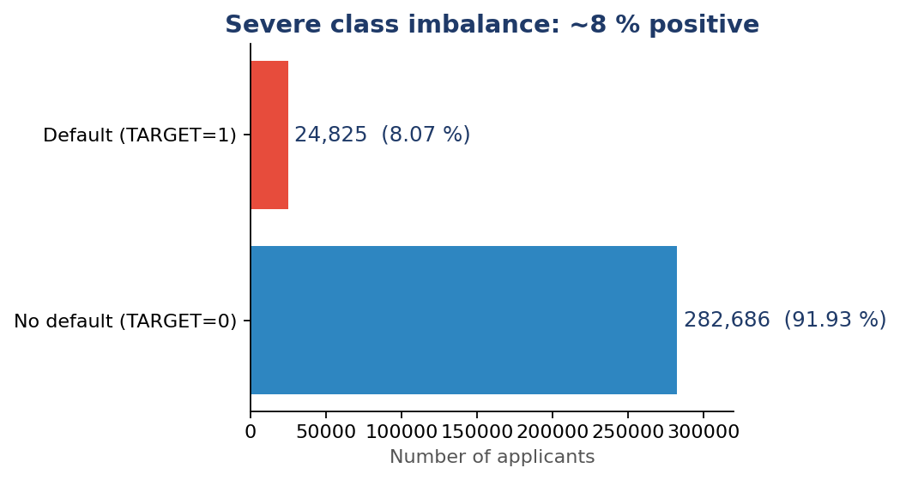
Dataset · Home Credit Default Risk
📍 Minwoo · 1 min
Size
• Train: 307,511 applicants × 122 features.
• Test: 48,744 applicants (Kaggle hidden labels).
Class imbalance
• Default rate ≈ 8.07% (24,825 / 307,511).
Strongest signals
• EXT_SOURCE_1/2/3 (external credit scores), |ρ| ≈ 0.16–0.18.
• DAYS_EMPLOYED sentinel 365,243 flags 18% (unemployed).
• Building-info columns are 50–70% missing.

Slide 4
Methodology · Shared Pipeline
📍 Nathan · 1 min
Preprocessing (identical for all five models)
• 80% / 20% stratified train–val split (random_state = 42)
• Drop SK_ID_CURR identifier · keep IDs only for the submission file
• Mean imputation for numeric NaN · one-hot encode 16 categoricals → 244 features
• StandardScaler fitted on train only (essential for LR / MLP)
Tuning & validation
• GridSearchCV with PredefinedSplit (single train→val fold, no random k-fold)
• Scoring: roc_auc · best parameter setting picked per model
• CV CSVs written to result/home_credit/cv_results/GridSearchCV/

Slide 5
Five Models Compared
📍 Nathan · 1.5 min
Model | Family | Owner | Tuned hyperparameters
Logistic Regression | Linear | Nathan | C, tol · class_weight = balanced
Random Forest | Tree (bagging) | Nathan | n_estimators, min_samples_* · class_weight
HistGradientBoosting | Tree (boosting) | Nathan | learning_rate, max_iter, min_samples_leaf
Shallow MLP — hidden (64,) | Neural network | Minwoo | alpha, learning_rate_init · early stopping
Deep MLP — hidden (128, 64, 32) | Neural network | Minwoo | alpha, learning_rate_init · early stopping
Why this lineup?
• Spans the course curriculum: linear → tree (bagging + boosting) → shallow + deep neural networks.
• Lets us isolate whether NN behaves differently from classic shallow learners under imbalance.
• Same preprocessing, same train/val split, same scoring → fair comparison.

Slide 6
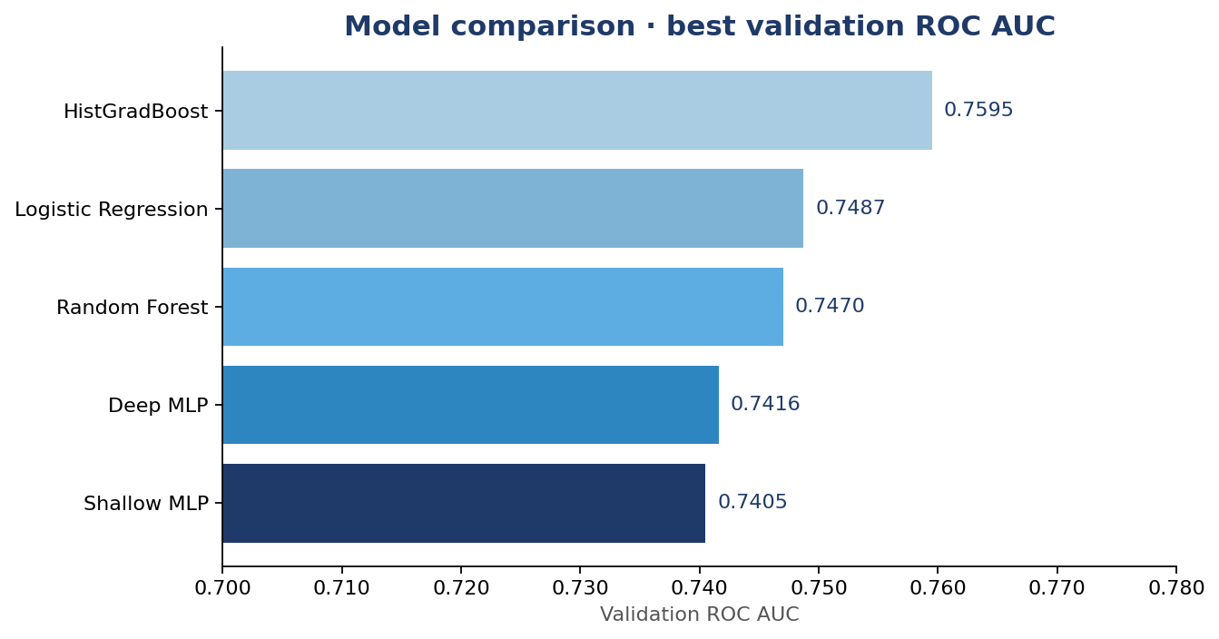
Combined Validation ROC AUC
📍 Nathan · 1 min
Model | AUC
HistGradBoost | 0.7595
Logistic Regression | 0.7487
Random Forest | 0.7470
Deep MLP | 0.7416
Shallow MLP | 0.7405
Best model: HistGradBoost (Nathan) (val ROC AUC = 0.7595)
• Tree boosting wins by ~1 AUC point — consistent with the literature on tabular credit data.
• Neural networks tie LR and Random Forest; depth alone does not unlock new performance.

Slide 7
Neural Network Track
📍 Minwoo · 1.5 min
Findings
• Shallow 0.7405 vs Deep 0.7416 → depth adds ~0.001 AUC (noise).
• NN ranks 4th/5th overall; bottleneck is the feature set, not the model.
Model | Hidden layers | Val AUC
Shallow MLP | (64,) | 0.7405
Deep MLP | (128, 64, 32) | 0.7416

Slide 8
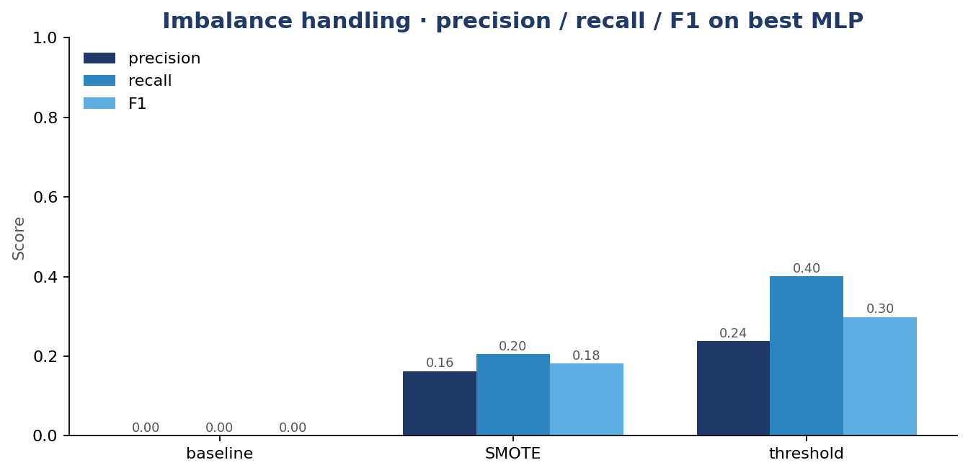
Imbalance Handling on the Best MLP
📍 Minwoo · 1.5 min
method | threshold | ROC_AUC | PR_AUC | precision | recall | F1
baseline | 0.5 | 0.745 | 0.2215 | 0.0 | 0.0 | 0.0
SMOTE | 0.5 | 0.6476 | 0.1337 | 0.1625 | 0.205 | 0.1813
threshold | 0.1641 | 0.745 | 0.2215 | 0.238 | 0.4004 | 0.2986
Headline finding
• Baseline: AUC 0.745, recall 0% (no prediction crosses 0.5)
• SMOTE hurt: AUC 0.745 → 0.648
• Threshold tuning at 0.164: recall 40%, F1 0.30 ✓
• Choosing the threshold matters more than rebalancing the data.

Slide 9
Conclusions
📍 Both · 1 min
Future work
• Integrate auxiliary tables · ensemble HGBC + best MLP · Platt/isotonic calibration

Slide 10
Thank You
📍 Both · 30s
Questions?
Code
• github.com/ymw0414/loan-default-imbalance-classification

