Slide 1


Slide 2
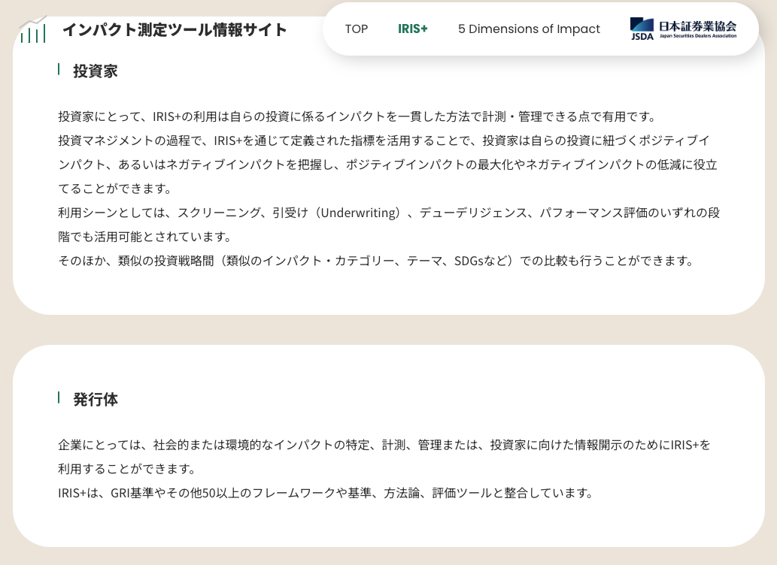
https://www.jsda.or.jp/sdgs/impactmmtool/iris/

Slide 3
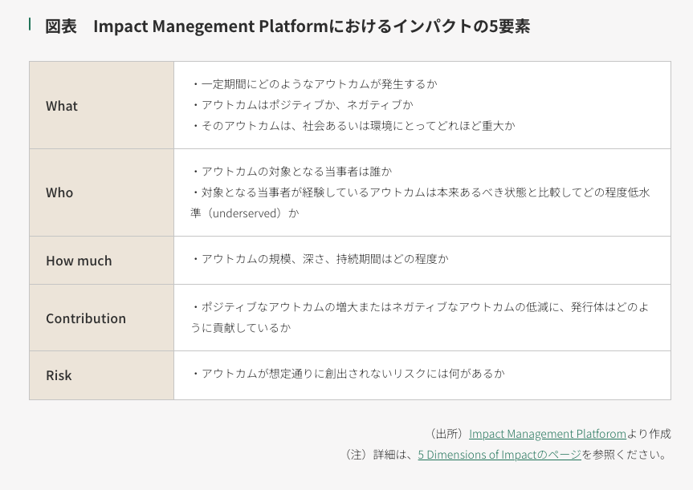

Slide 4
https://s3.amazonaws.com/giin-web-assets/iris/assets/files/research/Evaluating_Impact_Performance_Clean_Energy_Access_webfile.pdf
Five dimensinos exapmples

Slide 5
Impact Frontier
Notes:
what is the relationship btw Impact Management Project and Impact Frontier
volume_up
1
The Impact Management Project (IMP) and Impact Frontiers have a close relationship. The IMP was a global initiative that convened a Practitioner Community of over 3,000 enterprises and investors to develop a common language and framework for managing impact. The resulting consensus, known as the Impact Management Norms, provides a common logic to help enterprises and investors understand their impacts on people and the planet.
Impact Frontiers was established in 2021 to continue the work of the IMP and to advance the field of impact management. It is a peer-learning and market-building collaboration that is developing tools and resources to support investors in managing impact and integrating impact with financial data, analysis, and processes. Impact Frontiers also stewards the Impact Management Norms and continues to build consensus on how to measure, improve, and disclose impact.
In short, Impact Frontiers is the successor to the IMP and continues to carry out the work of the IMP in advancing the field of impact management.
Here are some specific examples of the relationship between the two organizations:
Impact Frontiers stewards the Impact Management Norms, which were developed by the IMP.
Impact Frontiers offers peer-learning communities and other resources to support investors in managing impact, which is aligned with the IMP's goal of helping enterprises and investors understand their impacts on people and the planet.
Impact Frontiers is developing tools and resources to integrate impact with financial data, analysis, and processes, which is a key area of focus for the IMP.
Impact Frontiers is building consensus on how to measure, improve, and disclose impact, which is another key area of focus for the IMP.
Overall, Impact Frontiers and the IMP have a close and complementary relationship. Impact Frontiers is building on the foundation laid by the IMP to advance the field of impact management and to help enterprises and investors make a positive impact on the world.
Sources
info
impactfrontiers.org/mission/#:~:text=Facilitating%20investors%20to%20learn%20together,with%20the%20field%20at%20large.
share
more_vert
what is the relationship btw Impact Management Project, Impact Management Norms and Impact Frontier
edit
View other drafts
volume_up
The Impact Management Project (IMP), Impact Management Norms, and Impact Frontiers are all related to the field of impact management, which is the process of identifying, measuring, managing, and improving the positive and negative impacts of an organization on people and the planet.
Impact Management Project (IMP)
The IMP was a global initiative that convened a Practitioner Community of over 3,000 enterprises and investors to develop a common language and framework for managing impact. The resulting consensus, known as the Impact Management Norms, provides a common logic to help enterprises and investors understand their impacts on people and the planet. The IMP concluded in 2021, but its work is being continued by Impact Frontiers.
Impact Management Norms
The Impact Management Norms are a set of shared principles and practices for managing impact. They were developed by the IMP Practitioner Community and are designed to help enterprises and investors make a positive impact on the world. The Impact Management Norms cover five key areas:
What: What are the impacts that the enterprise is contributing to?
Who: Who is being affected by the enterprise's impacts?
How much: How significant are the enterprise's impacts?
Enterprise contribution: What is the enterprise's role in causing the impacts?
Impact risk: What is the risk that the enterprise's impacts will not be achieved?
Impact Frontiers
Impact Frontiers is a peer-learning and market-building collaboration that is advancing the field of impact management. It was established in 2021 to continue the work of the IMP and to support investors in managing impact and integrating impact with financial data, analysis, and processes. Impact Frontiers also stewards the Impact Management Norms and continues to build consensus on how to measure, improve, and disclose impact.
Relationship between the three
The IMP, Impact Management Norms, and Impact Frontiers are all related to the field of impact management, but they play different roles. The IMP developed the Impact Management Norms, which provide a common logic for managing impact. Impact Frontiers is continuing the work of the IMP by supporting investors in managing impact and integrating impact with financial data, analysis, and processes. Impact Frontiers also stewards the Impact Management Norms and continues to build consensus on how to measure, improve, and disclose impact.
¡
In summary, the IMP developed the Impact Management Norms, which are now being stewarded and promoted by Impact Frontiers. Impact Frontiers is also supporting investors in managing impact and integrating impact with financial data, analysis, and processes.

Slide 6
Impact Management Platform
https://impactmanagementplatform.org/actions/strategy/

Slide 9
gsg

Slide 10
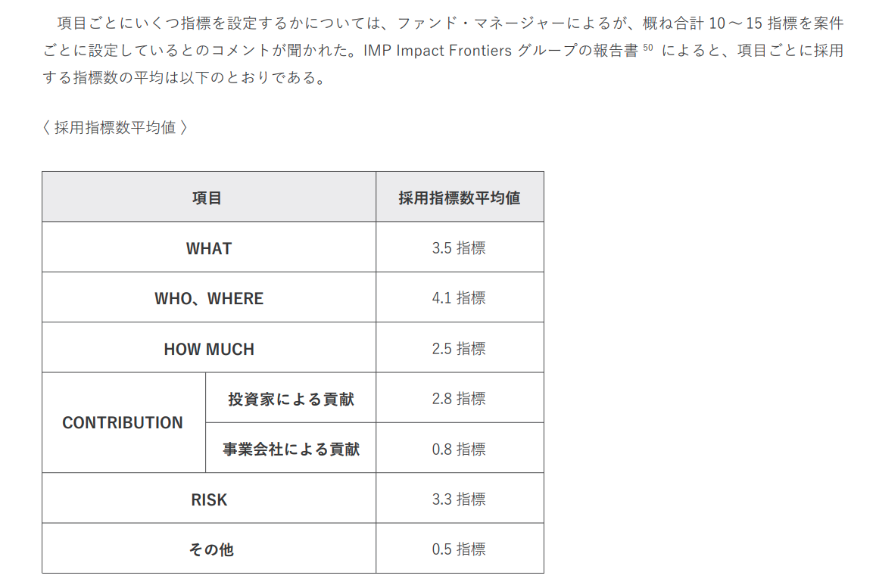
https://impactinvestment.jp/user/media/resources-pdf/Guidebook_for_Impact_Measurement_and_Management.pdf

Slide 11
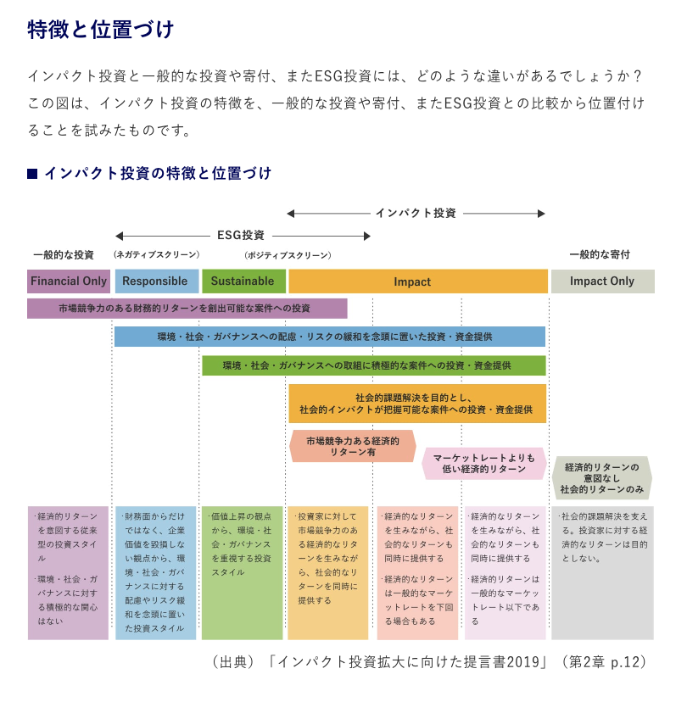
Notes:
https://impactinvestment.jp/impact-investing/about.html

Slide 12
Notes:
https://www.ifc.org/en/our-impact/impact-investing-at-ifc

Slide 13
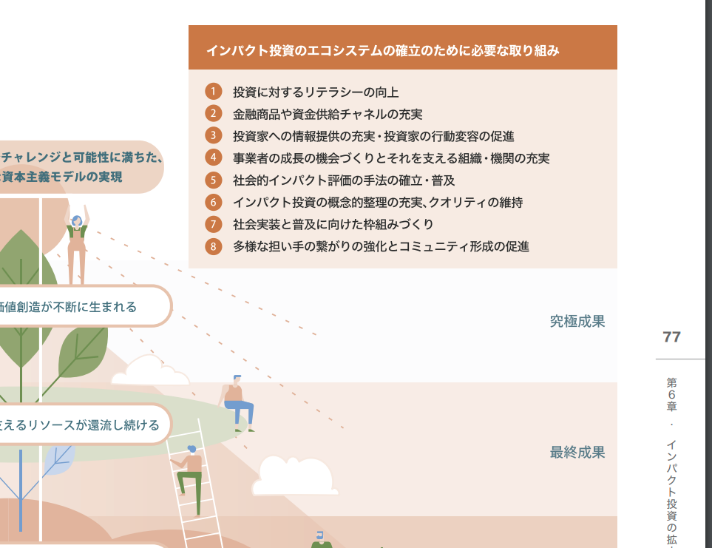
Notes:
https://impactinvestment.jp/user/media/resources-pdf/impact_investment_report_2019.pdf

Slide 15
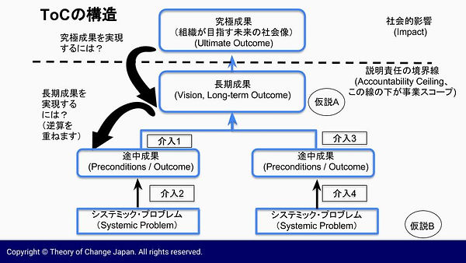
Notes:
http://www.theoryofchange.jp/whatistoc

Slide 16
HIPSO
Notes:
https://indicators.ifipartnership.org/indicators/

Slide 17
IFC
IFC, a member of the World Bank Group, the Global Impact Investing Network (GIIN), and a group of leading impact investors announced today the launch of the Joint Impact Indicators (JII), a set of high-level indicators that impact investors can use to measure and report on their investment activities.
JII is a set of impact indicators – starting with gender, jobs, and climate – aligned between the Harmonized Indicators for Private Sector Operations (HIPSO) and the IRIS Catalogue of Metrics, the two impact indicator sets used by most impact investors.
Notes:
https://pressroom.ifc.org/all/pages/PressDetail.aspx?ID=26260

Slide 18
what is the diff btw logic model and theory of change
Notes:
A logic model and a theory of change are both tools used in program planning and evaluation, but they serve slightly different purposes and have distinct characteristics. Here's an overview of the differences between the two:
Purpose:
Logic Model: A logic model is primarily a visual representation or diagram that illustrates the logical sequence of a program, project, or intervention. It outlines the inputs, activities, outputs, and short-term and intermediate outcomes associated with a program. Logic models are often used to provide a clear and simplified overview of how a program is expected to work.
Theory of Change: A theory of change is a more comprehensive and narrative-based approach to planning and evaluating programs. It goes beyond the linear representation of inputs, activities, and outcomes seen in a logic model. A theory of change focuses on the underlying assumptions, context, and pathways that link activities to long-term outcomes. It seeks to explain the theory or rationale behind how a program's activities will bring about the desired change.
Structure:
Logic Model: A logic model is typically depicted as a flowchart or diagram, with boxes and arrows connecting different components. It provides a visual and simplified representation of the program's components and their relationships.
Theory of Change: A theory of change is typically presented as a narrative or written document. It describes the context, the problem to be addressed, the program's activities, the expected short-term and long-term outcomes, and the underlying assumptions that link them.
Level of Detail:
Logic Model: Logic models tend to be more concise and less detailed in explaining the underlying theory or assumptions. They are often used for communication and visual representation of a program's components and expected outcomes.
Theory of Change: Theories of change are more detailed and aim to provide a comprehensive understanding of the program's theory or rationale. They articulate the logic behind how activities are expected to lead to outcomes and how contextual factors can influence the process.
Flexibility:
Logic Model: Logic models are relatively simple and may not capture the complexity of all the variables and contextual factors that can affect program outcomes.
Theory of Change: Theories of change are more flexible and adaptable because they allow for a deeper exploration of the program's theory, which can be useful when dealing with complex or dynamic situations.
In summary, a logic model is a visual representation that simplifies the program's components and expected outcomes, while a theory of change is a narrative that provides a more detailed and comprehensive explanation of the program's theory and the pathways to achieve change. Both tools are valuable for program planning and evaluation, and the choice between them depends on the specific needs and goals of the evaluation or planning process.

Slide 19
Iwai
「インパクト加重会計イニシアティブ」(IWAI)の日本第1号としての従業員インパクト会計の開示
Notes:
https://diamond.jp/articles/-/308923?page=3
従業員インパクト会計（雇用インパクト会計）

