Slide 1
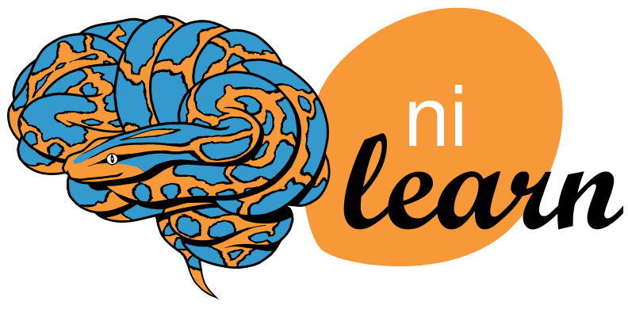
Recent progress in Nilearn
Yasmin Mzayek
Research engineer
Alexis Thual
PhD Student
Nilearn contributors: https://nilearn.github.io/stable/authors.html

Slide 2
About Nilearn
Open-source Python neuroimaging toolbox

Slide 3
About Nilearn
Open-source Python neuroimaging toolbox
Statistical analysis and machine learning on brain images

Slide 4
About Nilearn
Open-source Python neuroimaging toolbox
Statistical analysis and machine learning on brain images
  Connectivity analysis
  Decoding
  General linear models (GLM)
  Image manipulation routines
  Plotting

Slide 5
About Nilearn
Open-source Python neuroimaging toolbox
Statistical analysis and machine learning on brain images
  Connectivity analysis
  Decoding
  General linear models (GLM)
  Image manipulation routines
  Plotting
Documentation: nilearn.github.io

Slide 6
Demo:
Interactive surface plotting with Plotly example

Slide 7
Nilearn at Brainhack

Slide 8
Thank you!
Neurostars for usage questions
Github for bug reports, feature requests, and documentation changes
Weekly office hours, Friday 4pm UTC on Discord (pause for summer break, restart in September)
Nilearn Twitter

