Slide 1


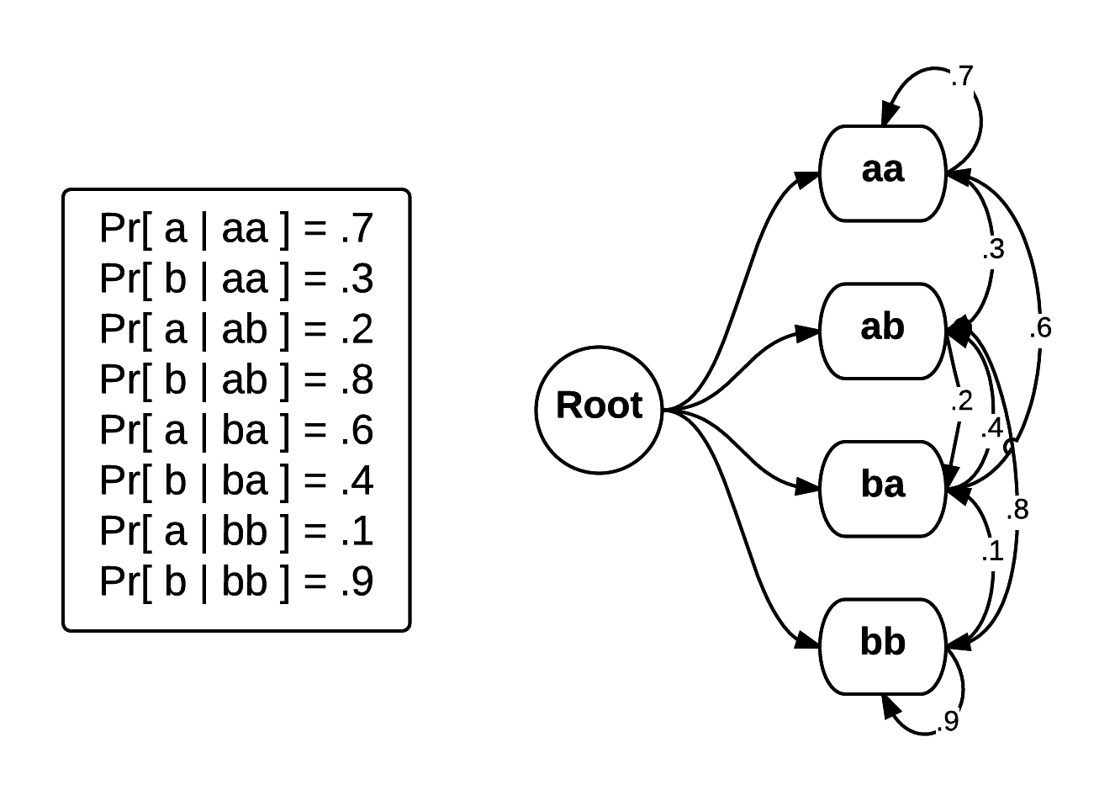
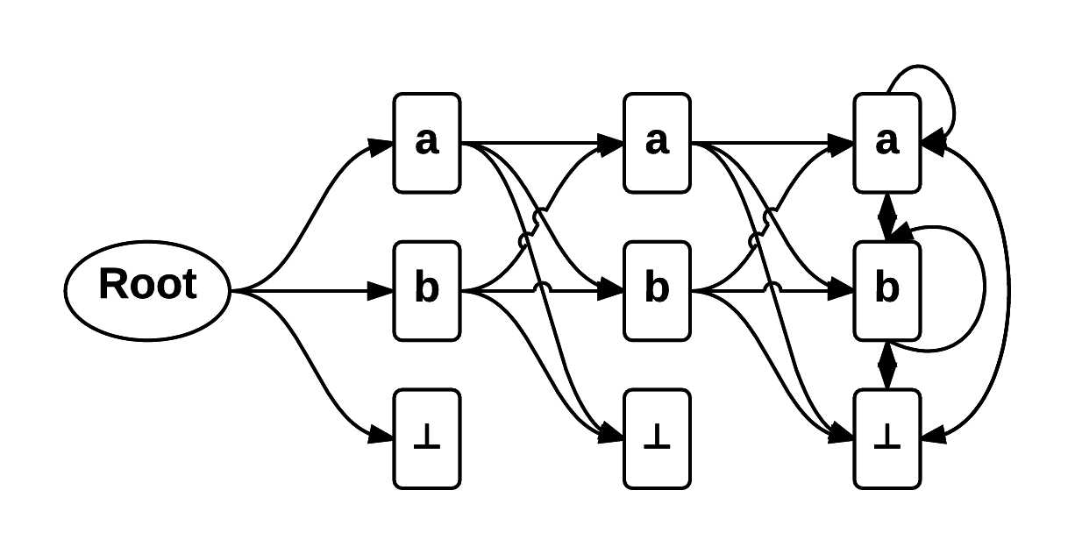
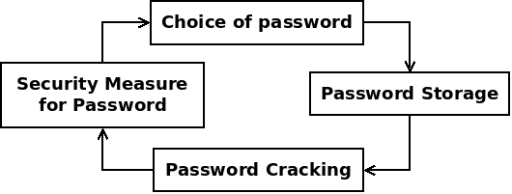
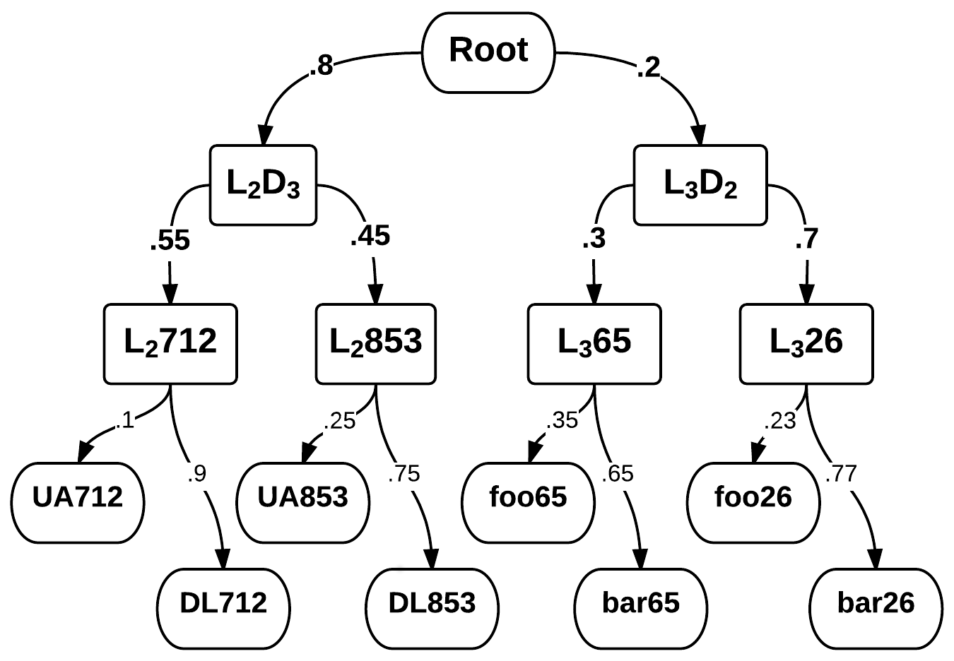
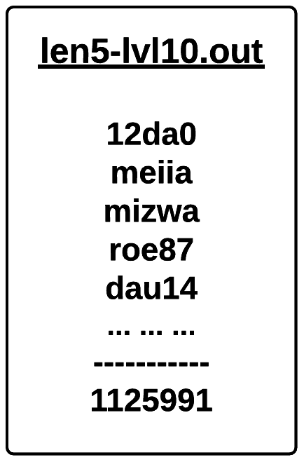
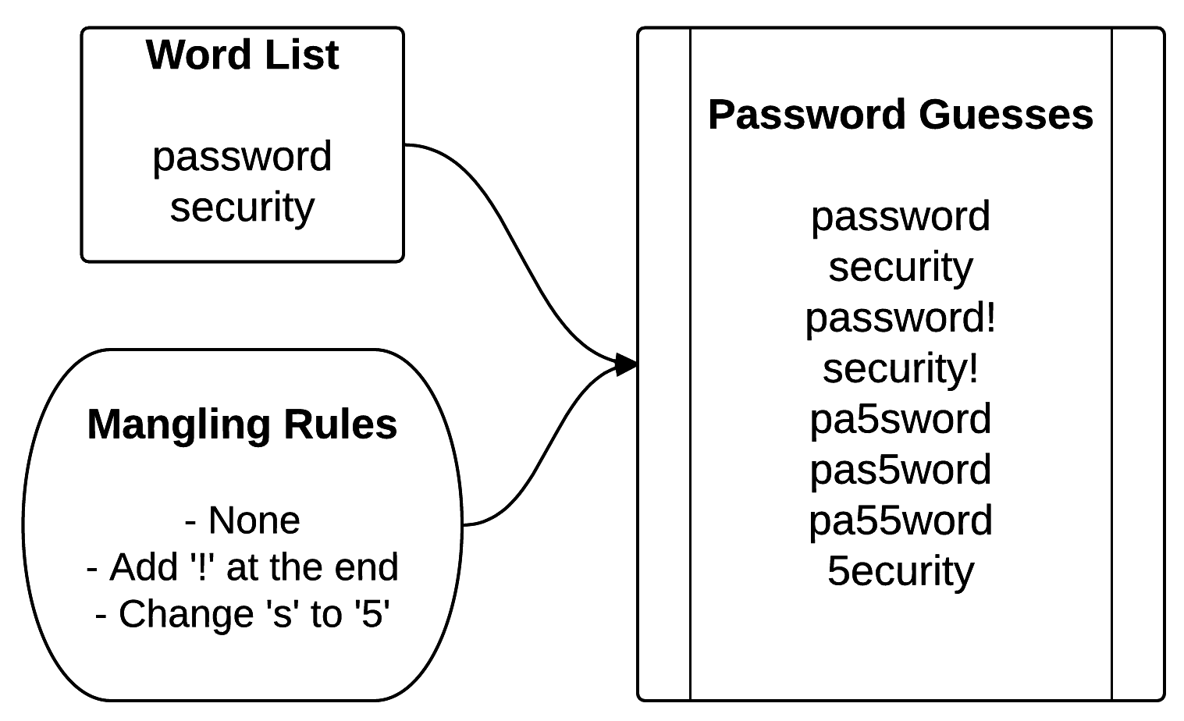
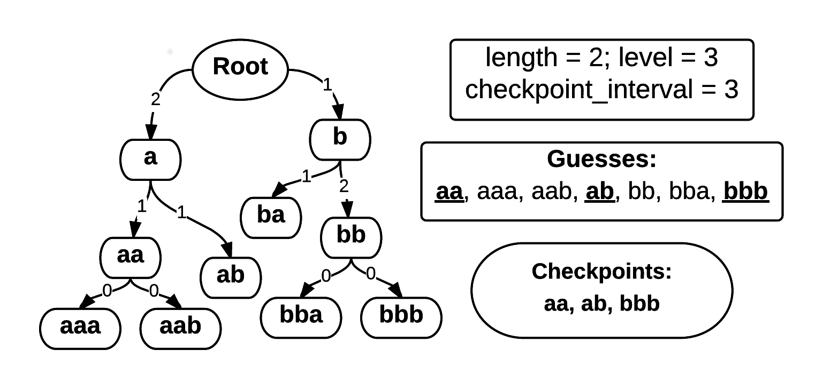

Password Guessability with Markov Model
Derek Tzeng, Yiming Zong
Advisors: Lujo Bauer, Blase Ur
School of Computer Science, Carnegie Mellon University, Pittsburgh, PA
Introduction & Problem Statement
Methodology
Methodology
Methodology (Cont'd)
Remarks & Future Work
Passwords has been and will be the most commonly used method of authentication.
Common question: how many times does an adversary need in order to guess a password?
Our goal: Study state-of-the-art password cracking techniques, and implement a look-up table to allow efficient guessability analysis with Markov model.
Markov Model (k-gram):
  Next character depends on its previous (k-1)-gram, i.e. .
Step One: Learn Probability Parameters
Step Two: Discretize Probabilities
Initially proposed by Duermuth, et al. In 2015
Reduce continuous variables to discrete variables:
Parameters: , satisfying:
Step Three: Build Enumeration Index
Level of a password = sum of the levels of its Markov probabilities, e.g:
For each (length, level)-pair, enumerate passwords with certain length and level with DFS and create “checkpoints” along the way for future use:
Step Four: Guess Count Calculation
Pick up the DFS process from the most recent checkpoint (if exists), and continue until finding the password. Overall, the guess number of password is:
Input data: RockYou leaked passwords (weighted with counts), Unix English dictionary
Performance evaluation on personal machine:
Ubuntu 14.04; Intel i5-3210 @ 2.50GHz; 8G RAM.
Step One: Index Builder
Time taken: 6m52s
Memory usage: peak at 3.625 GB
Storage: 1.6 GB for all modes
Output format:
Step Two: Checkpoint Builder
Data range: All passwords with total level ≤ 22, totaling approx. 10¹¹ passwords
Time taken: 20+ hours
Memory usage: peak at 150 MB / thread
Storage: 55MB for all checkpoints
Output format: passwords & count
Step Three: Guess Count Calculator
Time per password: < 15 seconds (mostly loading index / checkpoints)
Memory usage: peak at 150 MB
Storage: None
Output format:
Overall: Memory likely to hit resource limit first; guess count calculation time strongly correlated to checkpoint frequency.
Time-space tradeoff:
  More storage used for checkpointing gives faster run-time for guess number calculation; vice versa.
Alternative model – layered Markov model
Other smoothing techniques, e.g. Good-Turing:
Fine-tuned implementation based on our algorithm can be incorporated in a Guessability-as-a-Service module, like in [2].
Source code and final report for the project is available in our Github repo [1], and intermediate output data (> 2GB) is available upon request.
Results & Evaluation
Password Cracking Techniques
Brute Force / Masked Brute Force:
  aaa, aab, aac, ..., zzz
  aaaa, aaab, aaac, ..., zzz
Probabilistic Conext-Free Grammar (PCFG):
  Splits password into homogeneous “regions”
  Different regions have different probability
  Each region is filled with chars independently
Word Mangling Rules (used by JtR and HashCat)
Selected References
M. Durmuth, F. Angelstorf, C. Castelluccia, D. Perito, and A. Chaabane. OMEN: faster password guesing using an ordered markov enumerator. In Proc. ESSoS, 2015.
J. Ma, W. Yang, M. Luo, and N. Li. A study of probabilistic password models. In Proc. IEEE Symp. On Security and Privacy, 2014.
B. Ur, S. M. Segreti, L. Bauer, N. Christin, L. F. Cranor, S. Komanduri, D. Kurilova, M. L. Mazurek, W. Melicher, and R. Shay. Measuring real-world accuracies and biases in modeling password guessability. In Proc. USENIX Security, 2015.
(Full list of references is available in the final report.)
Acknowledgements
The authors thank our advisors Lujo Bauer and Blase Ur for proposing the research topic and holding regular meetings to track our progress and review our report. We also thank Blase Ur for pointing us to many of the references, which introduced us to the area of password security.
[1] https://github.com/ymzong/password-guessability
[2] https://pgs.ece.cmu.edu
Password Guessability | 08-731 F15 | Dec 10, 2015

