Slide 1
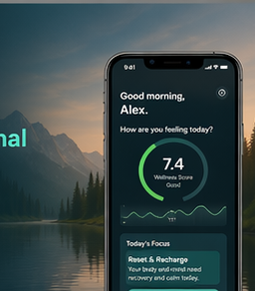
WELLNESS WORKS
A personal wellness app
that learns the user
Proposal for building a mass-market app that feels human, adapts over time, and helps people build better days.
Vision • MVP • AI personalisation • build ask
01

Slide 2
WELLNESS WORKS
Why this app should exist
Most wellness apps either track data or dump content. Very few actually help people change.
The opportunity is to create a simple personal coach: daily check-in, clear next step, visible progress.
The product should feel supportive and practical — not clinical, robotic, or overwhelming.
If it learns what helps each person, it becomes more useful every week.
The core promise
“A wellness app that understands me, adapts to my real life, and gives me small actions I can actually follow.”
That is what makes it mass-market and memorable.
02

Slide 3
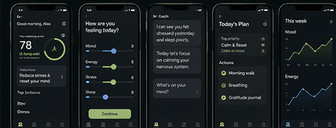
WELLNESS WORKS
The concept and who it is for
Positioning
An AI-powered wellness coach for everyday life — built for the general public, not just athletes or therapy users.
Busy adults
Parents
People feeling stuck
Stress, low energy, too much to juggle.
Need simple support that fits real routines.
Poor habits, burnout risk, low consistency.
Users who want progress
Brand edge
They need wins, trends, and proof that life is improving.
Wellness Works can own a warmer, more human lane than generic health trackers.
03

Slide 4
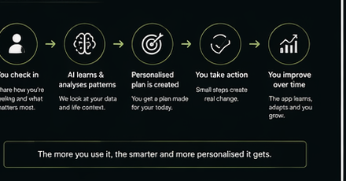
WELLNESS WORKS
How the product should work
A simple loop that creates behaviour change and stronger personalisation.
Check in on mood, energy, stress, sleep, and what is needed today.
Generate a personalised daily focus and 1–3 actions.
Track whether the user follows through and what improves.
Turn repeated behaviour into better timing, tone, and recommendations.
The app wins when it tells people what to do next — not just how they scored.
04

Slide 5
WELLNESS WORKS
Version 1: what to build first
User sign up / login
Onboarding assessment
Daily check-in
Home dashboard with today’s focus
AI coach chat
Personalised daily plan
Habit tracking and reflections
Progress trends and weekly summaries
Not in V1: community, big content library, wearables, advanced ML, company dashboard.
05

Slide 6
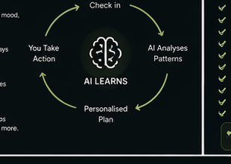
WELLNESS WORKS
How AI learns the user
Start with personalisation, not complicated machine learning.
Inputs
Patterns
Outputs
Check-ins, habits completed, journal notes, usage patterns, preferred coach tone.
What helps, what triggers bad days, best prompt time, likely drop-off points.
Smarter actions, better coaching, stronger daily plans, weekly insights.
Examples
“You tend to feel worse after two poor nights of sleep.”
“Walking helps your evening mood more than journalling.”
“You respond best to short, practical prompts.”
Important boundary: coach for general wellness, not medical diagnosis.
06

Slide 7
WELLNESS WORKS
Recommended build approach
Product layer
Data layer
Intelligence layer
Learning layer
Flutter app
Clean UI, onboarding, check-ins, coach, progress.
Supabase
Auth, database, storage, secure backend functions.
OpenAI
Context-aware coach, summaries, recommendations.
Analytics
Measure retention, actions taken, what improves outcomes.
Suggested roadmap
Phase 1 — MVP
Phase 2 — Learn
Phase 3 — Expand
Onboarding, daily check-in, home, AI coach, progress, notifications.
Refine UX, strengthen personalisation, test pricing, improve retention.
Health integrations, richer insights, more habit types, broader scale.
Build a personalisation platform first, then add complexity.
07

Slide 8
WELLNESS WORKS
What I need from you
Help turn this vision into a simple, high-quality MVP.
Build the core product structure so we can launch, learn, and improve fast.
Keep the user experience clean, calm, and easy to return to every day.
Think long term: this is not just an app, it is a platform that gets smarter with use.
What I’m bringing
• Clear vision and brand • Strong founder drive • Real-world wellness purpose • A product that can grow from consumer to wider impact • Commitment to build something meaningful
Next step: agree scope, build order, and whether we do this together.
08

