Slide 1


Big data fraud detection using pyspark
Name: Aram Tiffany Essim Samb
Module: Big Data Analytics
Notes:
Hi ma’am , today I’ll be presenting my project on fraud detection using big data tools, specifically PySpark. The goal of this project was to analyze transaction data and build a model capable of identifying fraudulent activities.

Slide 2
Table of content
Introduction
What is Big Data?
Project Objective
Data pipeline overview
Tools used
Data preprocessing
Feature engineering
Exploratory Data Analysis (EDA)
Key insights from EDA
Model selection
Model performance
Confusion Matrix and ROC Curve
Challenges faced
Business recommendations
Conclusion
References

Slide 3

Introduction
Rapid growth of digital transactions
Fraud is increasing globally
Need for fast and scalable
Notes:
With the rise of digital banking and online payments, the volume of transactions has increased significantly. Unfortunately, this also increases the risk of fraud. Detecting fraud quickly and accurately has become essential for financial institutions.

Slide 4
What is big Data ?
Large volume of data
01
High speed (real-time data)
02
Variety of data sources
03
Requires scalable systems
04
Notes:
Big data refers to extremely large datasets that cannot be processed using traditional tools. In fraud detection, data comes continuously from multiple sources, which makes scalability and speed very important

Slide 5
Project objective
Analyze
Analyze transaction dataset
Detect
Detect fraudulent transactions
Build
Build a classification model
Use
Use PySpark for scalability
Notes:
The main objective was to analyze transaction behavior and build a model that can classify whether a transaction is fraudulent or not, using PySpark for efficient processing.”

Slide 6
Data pipeline overview
Data Sources (transactions, customer data)
Data Processing (cleaning & transformation)
Model Training
Fraud Detection
Notes:
The project follows a data pipeline approach, which starts from raw data that was given as a resource, cleaning and transforming it, then training a model, and finally detecting fraud

Slide 7



Tools used
PySpark
Google Colab (Cloud)
Python Libraries (Matplotlib, Pandas, etc..)
Notes:
PySpark was used for distributed data processing, Google Colab as the cloud environment. Those two made it possible to process large volumes of data quickly and detect fraud . Also Python libraries were used for visualization.

Slide 8
Data preprocessing
Handling missing values
Removing duplicates
Correct data types
Feature scaling & normalization
Notes:
Before analysis, the data had to be cleaned. This included handling missing values, ensuring correct data types, and preparing features using scaling and normalization

Slide 9
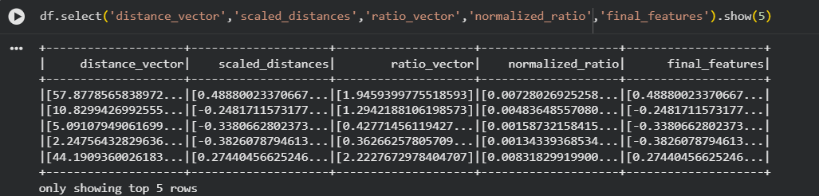
Feature engineering
Created feature vectors
Combined multiple variables
Prepared data for ML model
Notes:
I grouped multiple variables into feature vectors. This step is important because machine learning models in PySpark require data in vector format to scale or normalize them

Slide 10
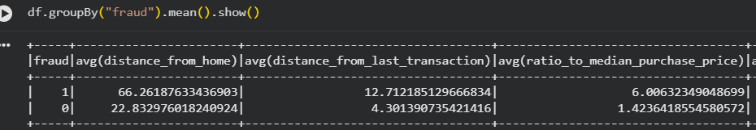
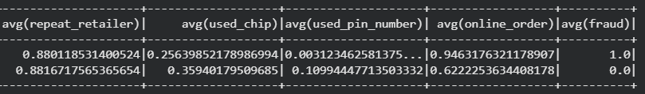
Exploratory data analysis ( EDA)
Analysed distributions
Compared fraud vs non-fraud
Identified patterns
Notes:
In this step, I explored the data to understand patterns. I compared fraudulent and legitimate transactions to identify key differences.

Slide 11
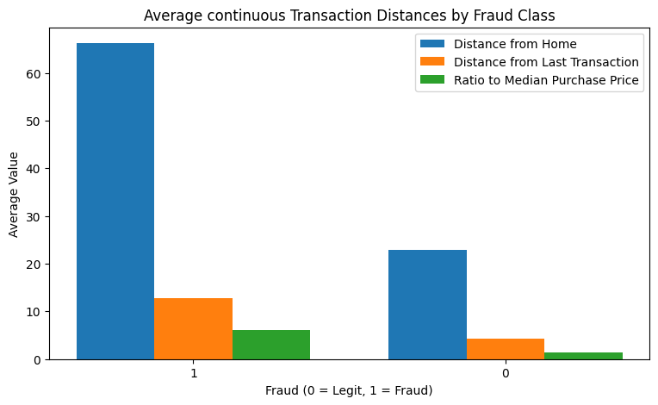
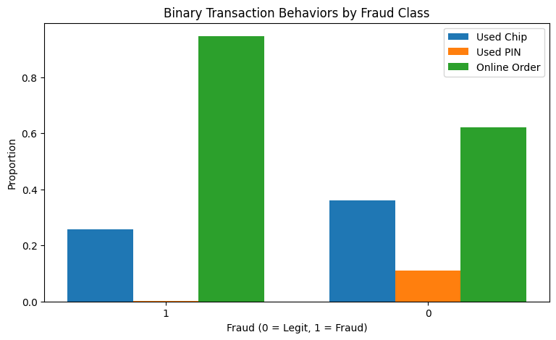
Key inisghts from eda
Fraud transactions occur at larger distances
Higher transaction amounts
More frequent online transactions
Strong class imbalance
Notes:
I observed that fraudulent transactions often happen far from the user’s location, involve larger amounts, and occur more frequently online. Also, fraud cases are much fewer than normal transactions.

Slide 12
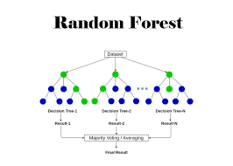
Model selection
Random Forest Classifier
Handles complex patterns
Works well with large datasets
Notes:
I used a Random Forest model( which is a classification model) because it performs well with complex data and can capture non-linear relationships between variables.

Slide 13
Model performance
Accuracy ≈ 94%
F1 Score ≈ 94%
Recall ≈ 94%
Precision≈ 94%
Notes:
The model achieved strong performance, with high accuracy, F1-score., recall and precisions meaning he model has consistently strong and well-balanced performance, accurately classifying most transactions while effectively detecting fraud with relatively few false positives and false negatives.

Slide 14
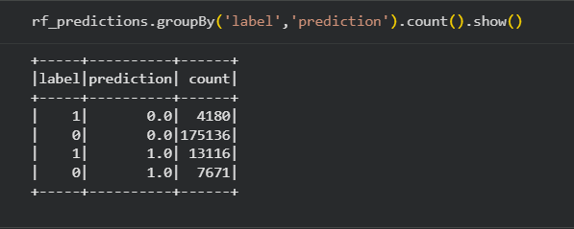
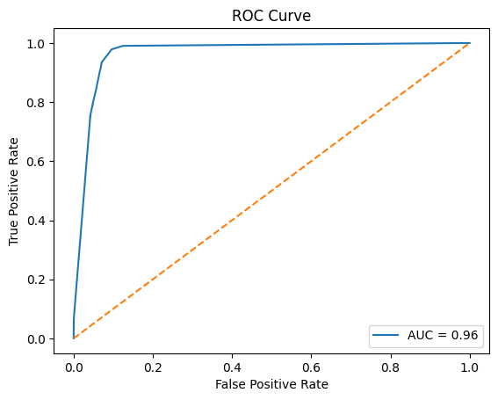
Confusion matrix and roc curve
True Positives: Fraud detected
False Negatives: Missed fraud
False Positives: False alarms
AUC = 0.96
Notes:
The confusion matrix helped to understand how the model performs. It shows that most transactions are correctly classified ( with 0 representing non-fraud and 1’s presenting as frauds). We cann still observe some fraud cases are still missed.

Slide 15
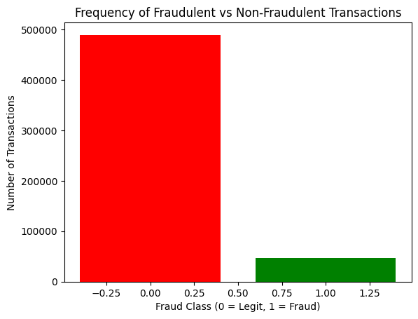
Challenges faced
Imbalanced dataset
Missed fraud cases
Notes:
“One of the biggest challenges was the imbalance in the dataset. Fraud cases are rare, which makes them harder to detect and with missed fraud cases, it meant that there were much optimization to be done to the model selected.

Slide 16
Business recommendations
01
Screen in real time
Score every transaction with the PySpark model and review large, distant, online ones first.
02
Favour recall
Tune the alert threshold to catch more fraud: a missed case costs more than a false alarm.
03
Fix the imbalance
Resample or weight the rare fraud class, and retrain as fraud patterns change.
04
Keep analysts in the loop
Analysts review alerts, while precision and recall are monitored to spot model drift.
Notes:
Based on these results, I would recommend four actions to a financial institution. First, screen transactions in real time with the PySpark model, reviewing large, distant and online transactions first, since those matched the fraud patterns we saw. Second, favour recall when setting the alert threshold, because a missed fraud costs more than a false alarm. Third, address the class imbalance by resampling or weighting the fraud class, and retrain regularly as fraud patterns change. Finally, keep human analysts in the loop and monitor precision and recall over time to detect model drift.

Slide 17

Conclusion
In conclusion, this project demonstrates how big data and machine learning can be combined to build an effective fraud detection system. While improvements are still possible, the results are strong and practical.
Notes:
In conclusion, this project shows how combining big data technologies with machine learning can lead to an effective fraud detection system. Although there is still room for improvement, the results achieved are both robust and practically applicable.

Slide 18
references
5 V’s of big data (2026) Tuple. Available at: https://www.tuple.nl/en/knowledge-base/5-v-s-of-big-data (Accessed: 20 April 2026).
Adinayev, A. (2023) Introduction to spark and PySpark: Unlocking Big Data Processing Power | by Arthur Adinayev | Medium, Medium. Available at: https://arthurarchiproj.medium.com/introduction-to-spark-and-pyspark-unlocking-big-data-processing-power-bd4cfa847823 (Accessed: 19 April 2026).
arora, L. (2020) Want to build machine learning pipelines? A quick introduction using pyspark, Analytics Vidhya. Available at: https://www.analyticsvidhya.com/blog/2019/11/build-machine-learning-pipelines-pyspark/ (Accessed: 20 April 2026).
Avram, M.G.. (2014). Advantages and Challenges of Adopting Cloud Computing from an Enterprise Perspective. Procedia Technology. 12. 10.1016/j.protcy.2013.12.525.
Benlachmi, Yassine & Hasnaoui, Moulay. (2020). Big data and Spark: Comparison with Hadoop. 811-817. 10.1109/WorldS450073.2020.9210353.
Herrera Pinheiro, João & Oliveira, Suzana & Silva, Thiago & Saraiva, Pedro & Souza, Enzo & Vilela de Godoy, Ricardo & Ambrosio, Leonardo & Becker, Marcelo. (2025). The Impact of Feature Scaling In Machine Learning: Effects on Regression and Classification Tasks. IEEE Access. PP. 1-1. 10.1109/ACCESS.2025.3635541.
Patel, Hardik & Patel, Dharmendra. (2024). Exploratory Data Analysis and Feature Selection for Predictive Modeling of Student Academic Performance Using a Proposed Dataset. International Journal of Engineering Trends and Technology. 72. 131-143. 10.14445/22315381/IJETT-V72I11P116.
Patel, K. (2023) ‘Credit Card Analytics: A review of Fraud Detection and risk assessment techniques’, International Journal of Computer Trends and Technology, 71(10), pp. 69–79. doi:10.14445/22312803/ijctt-v71i10p109
Salman, Hasan & Kalakech, Ali & Steiti, Amani. (2024). Random Forest Algorithm Overview. Babylonian Journal of Machine Learning. 2024. 69-79. 10.58496/BJML/2024/007.
Sivarajah, U. et al. (2017) ‘Critical analysis of Big Data Challenges and analytical methods’, Journal of Business Research, 70, pp. 263–286. doi:10.1016/j.jbusres.2016.08.001
Understanding the confusion matrix in Machine Learning (2026) GeeksforGeeks. Available at: https://www.geeksforgeeks.org/machine-learning/confusion-matrix-machine-learning/ (Accessed: 20 April 2026).

Slide 19
Thank you for your attention !!

