Slide 1

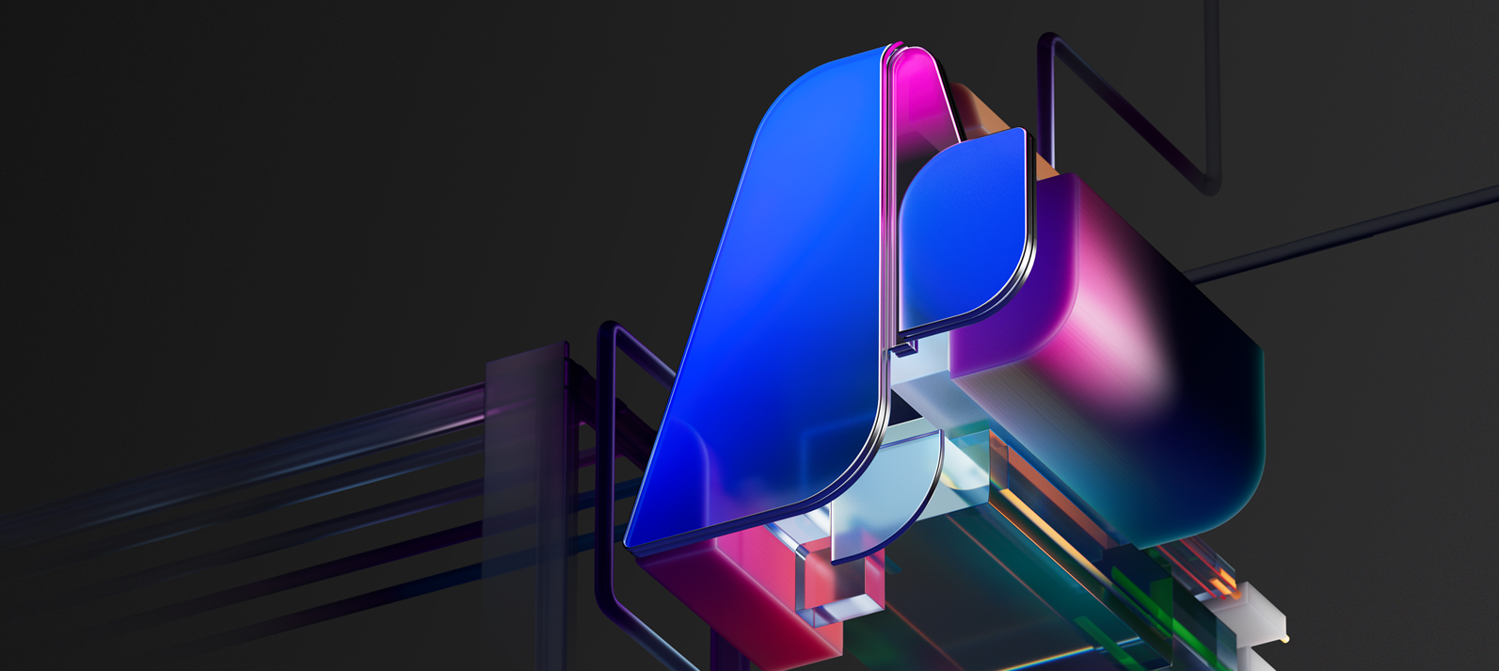
MCP
(a Detailed Breakdown)

Slide 2
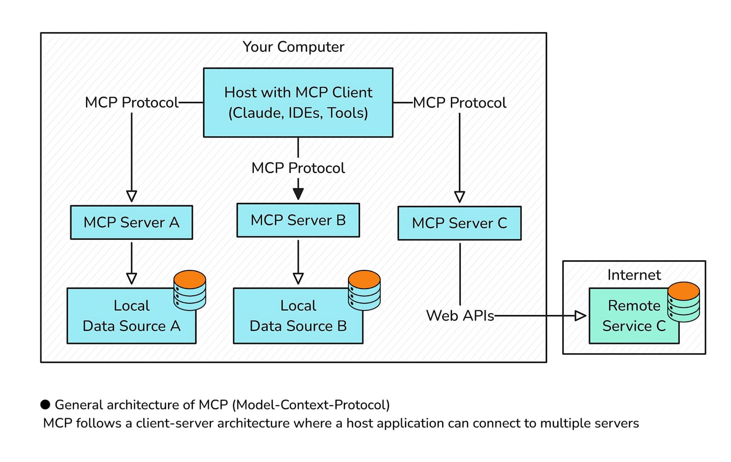
MCP – General Architecture
1) MCP Hosts: Programs like Claude Desktop, IDEs, or AI tools that want to access data through MCP
2)MCP Clients: Protocol clients that maintain 1:1 connections with servers
MCP Servers: Lightweight programs that each expose specific capabilities through the standardized Model Context Protocol
3) Local Data Sources: Your computer’s files, databases, and services that MCP servers can securely access
4) Remote Services: External systems available over the internet (e.g., through APIs) that MCP servers can connect to
At its core, MCP follows a client-server architecture where a host application can connect to multiple servers

Slide 3
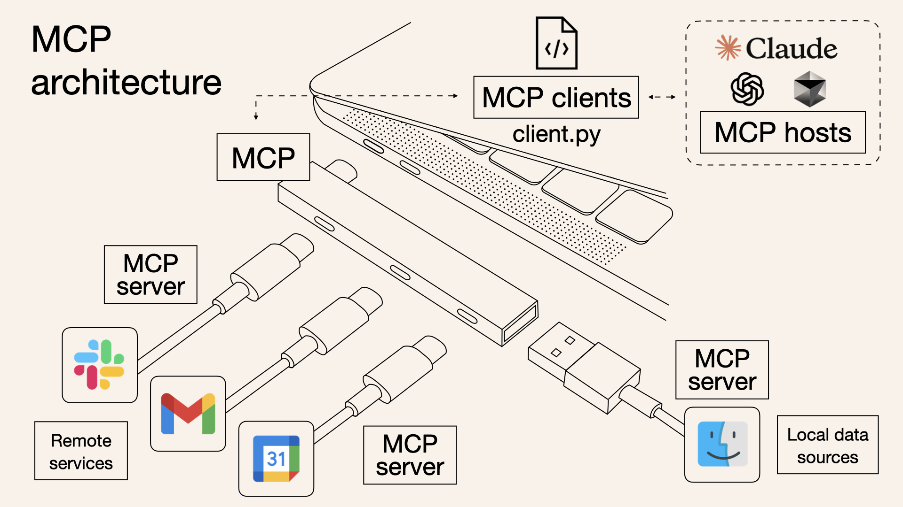
And then it looks something like……
This is EASY!
This is TOUGH!
You would focus on consuming the MCP server information if you are acting as the customer for those enterprises.
MCP Server – this is something you would develop if you are in the Gmail team, Slack Team or even part of a team that sells its API services

Slide 4

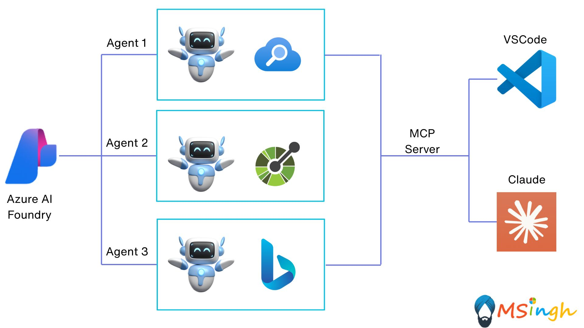
MCP with a Touch of Azure AI

