Slide 1
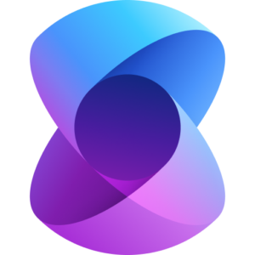

Multi-Agent Systems With Azure AI Agents and Semantic Kernel SDK

Slide 2
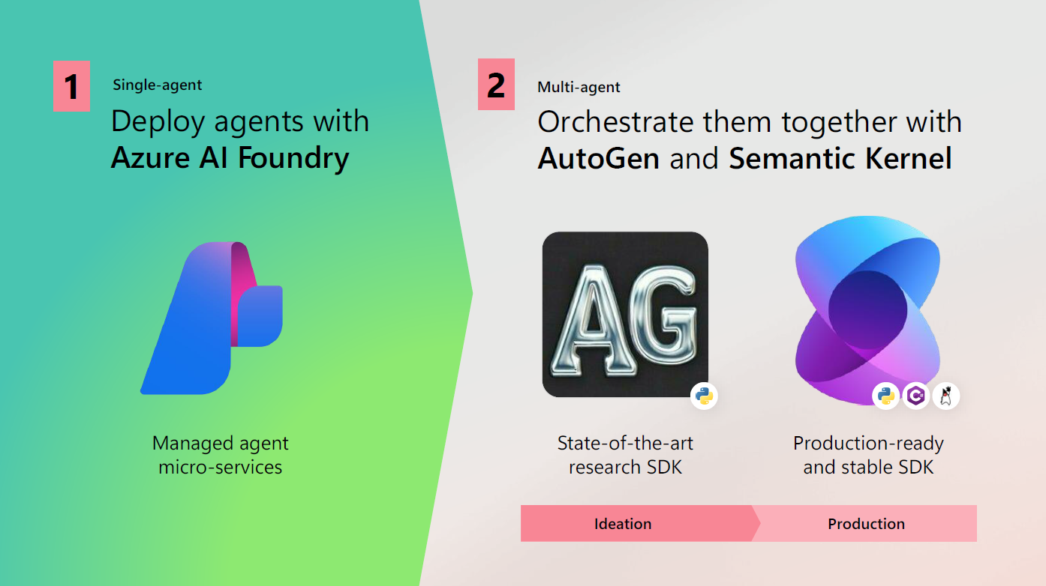

Slide 3
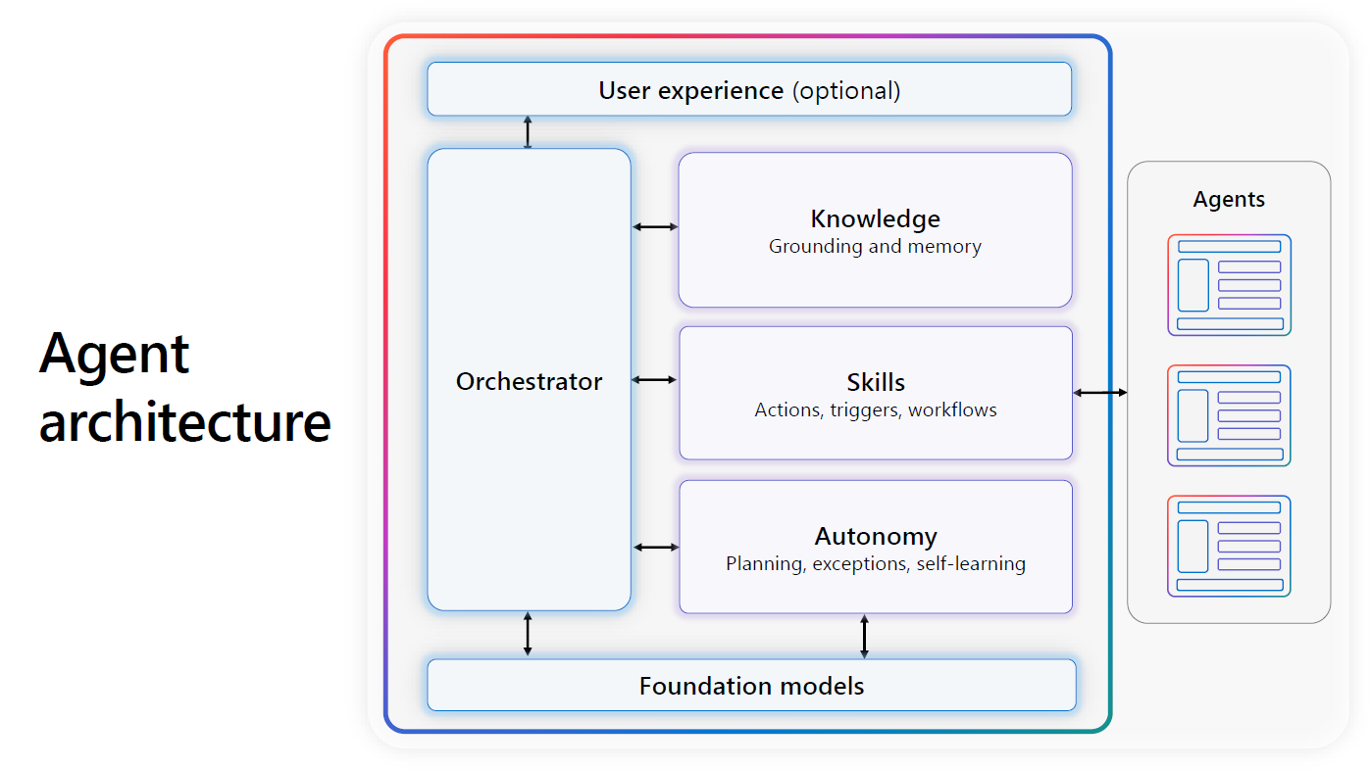

Semantic Kernel SDK
Microsoft AutoGen
Whenever you will be building a multi-agent architecture, you need agents to converse with each other and use agents in a planned manner in accordance with the user query – this is handled by the orchestrator service

Slide 4
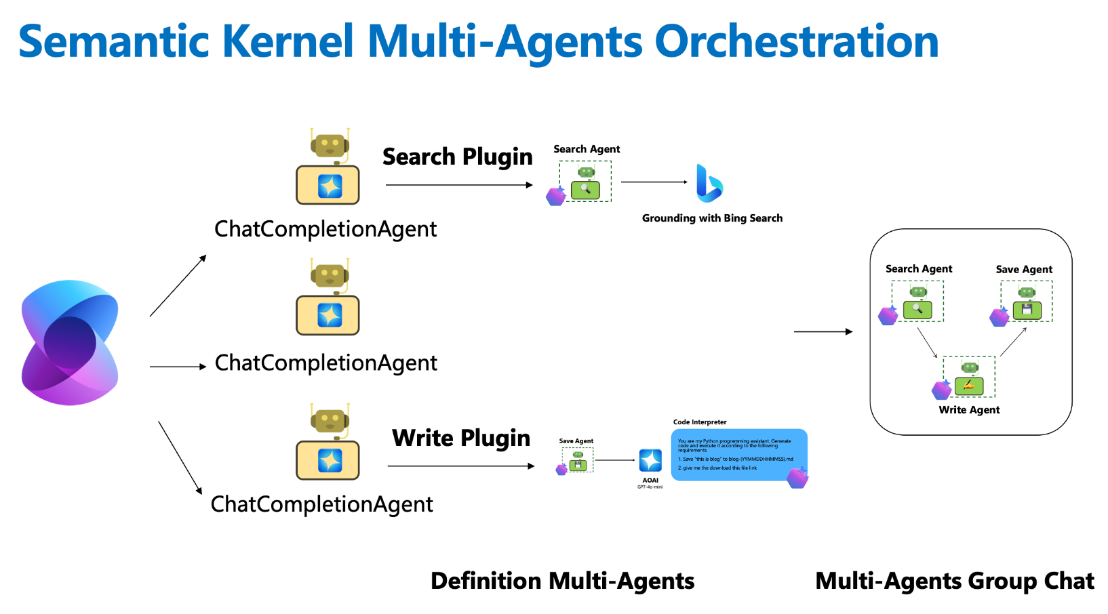

Slide 5
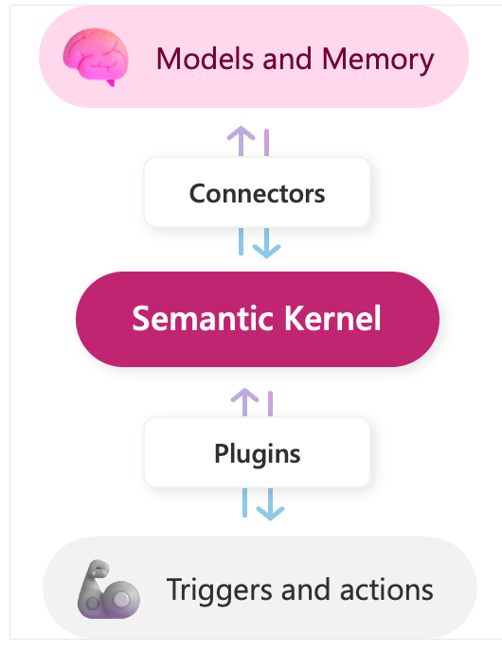
Think like Human Being and Be More Productive
Predictive AI
Generative AI (LLM Based)
Custom Model | Predicted Model ( AI services) | Generative AI( Azure open AI) | Your own AI Agent ( using Semantic SDK) | Multi-Agent Systems using Agents from Azure AI Agent Service and Semantic Kernel SDK
Use Machine Learning tool and create your own Predictive Model Use it as PaaS By using Your own data and maintain and manage it ( end to end) | Use Microsoft Build pre-built Model Use it as SaaS Like AI Vision AI Form Recognizer | Use Azure Open AI Generative AI not Predicted AI Example Chat GPT Consist of GPT/ Summarization / code / image generation models Uses Vector Indexing NLP based Creative | Developer can use Semantic Kernel SDK to build their own custom AI agents. The SDK seamlessly integrates models and customized plugins that enable you to craft unique and impactful user experiences For customer -24*7 available, Offer personalized recommendations. For employees Automate repetitive tasks. Provide relevant insights. Boost efficiency and productivity. | Developers can use Semantic Kernel SDK as the orchestrating service to build their own multi-agent systems with agents sourced from the Azure AI Agent Service. The “Planner” capability of the Semantic Kernel SDK makes a plan to call which agent when and in what workflow. For instance – In a news script creation system, the Semantic Kernel first calls the Bing Research Agent and then the Writer Agent
 | You can improve/ customize these Model with your own data to use in your respective business Domain | Based on language models (LLMs) that are trained on massive amounts of data. | AI agents are powered by large language models (LLMs) that are trained on massive amounts of data. | AI Agents are sourced from Azure AI Agent Service.
LLM Model
Developer can use Semantic Kernel SDK to build their own custom AI agents and also Multi-Agent Systems
Semantic kernel SDK
Prompts and Functions

Slide 6
Understanding the Semantic Kernel
AI Orchestration Layer
The core of the Semantic Kernel stack is an AI orchestration layer
AI orchestration layer that allows the seamless integration of AI models and plugins.
This layer is responsible for combining these components to craft innovative user interactions.

Slide 7
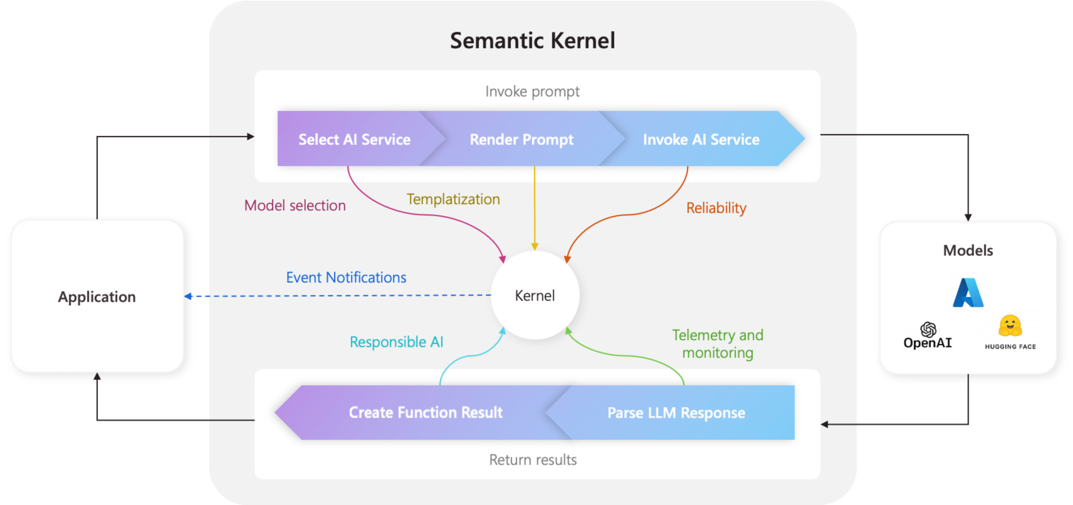
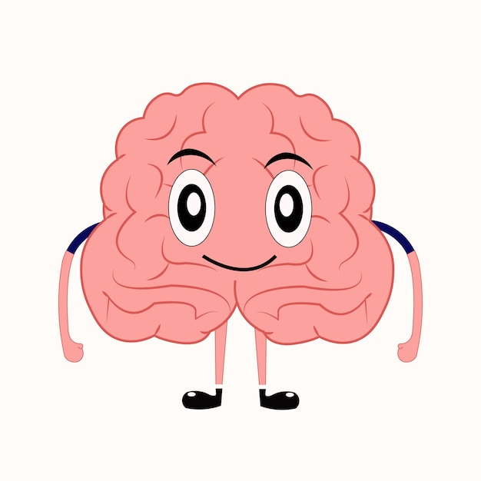
The kernel could be though of as the human brain.
Just like the brain:
The Kernel orchestrates and manages various functions (skills, plugins, and AI models), just as the brain processes inputs and coordinates different body functions.
It integrates different sources of information (AI services, embeddings, memories) like the brain integrates sensory inputs and past experiences.
It helps reason, make decisions, and execute tasks, similar to how the brain processes thoughts and controls actions.

Slide 8
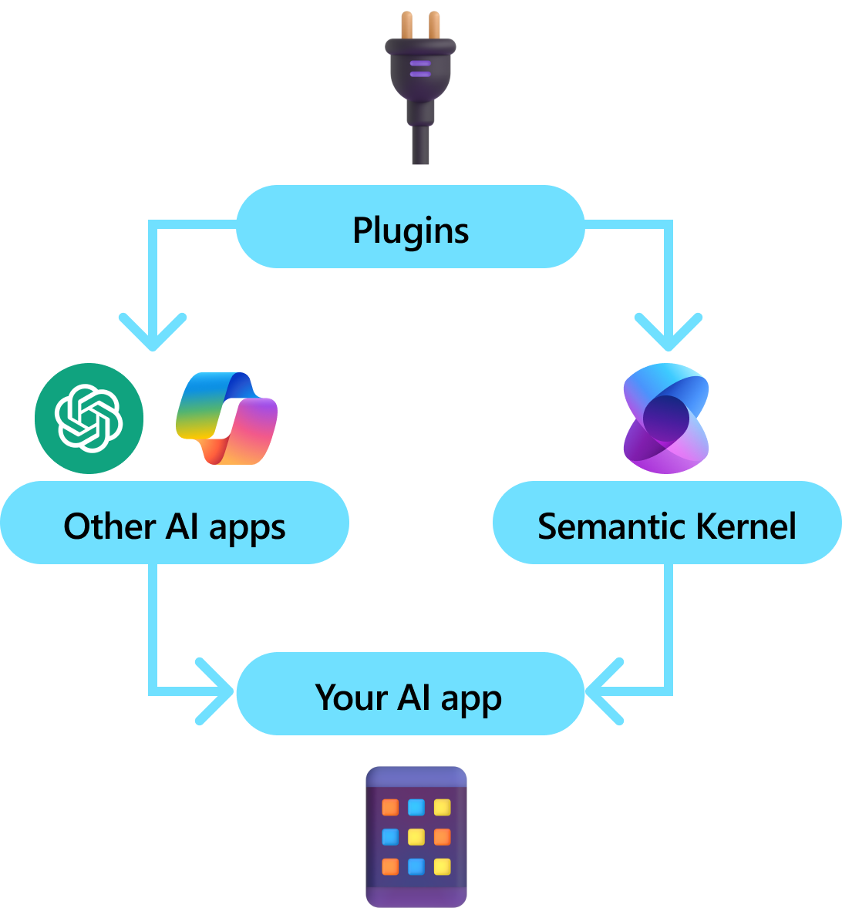

Plugins in Semantic Kernel
These can be Agents sourced from Azure AI Agents Service
The Plugins in the Semantic Kernel SDK can be compared to the organs in the human body.
Just like organs:
Plugins perform specific tasks, just as organs have specialized functions (e.g., the heart pumps blood, the lungs handle respiration, the liver detoxifies).
The Kernel (brain) coordinates the execution of plugins, just as the brain controls different organs based on the body's needs.
Different plugins handle different types of actions (e.g., calling APIs, processing text, retrieving information), similar to how organs work together to maintain bodily functions.

Slide 9
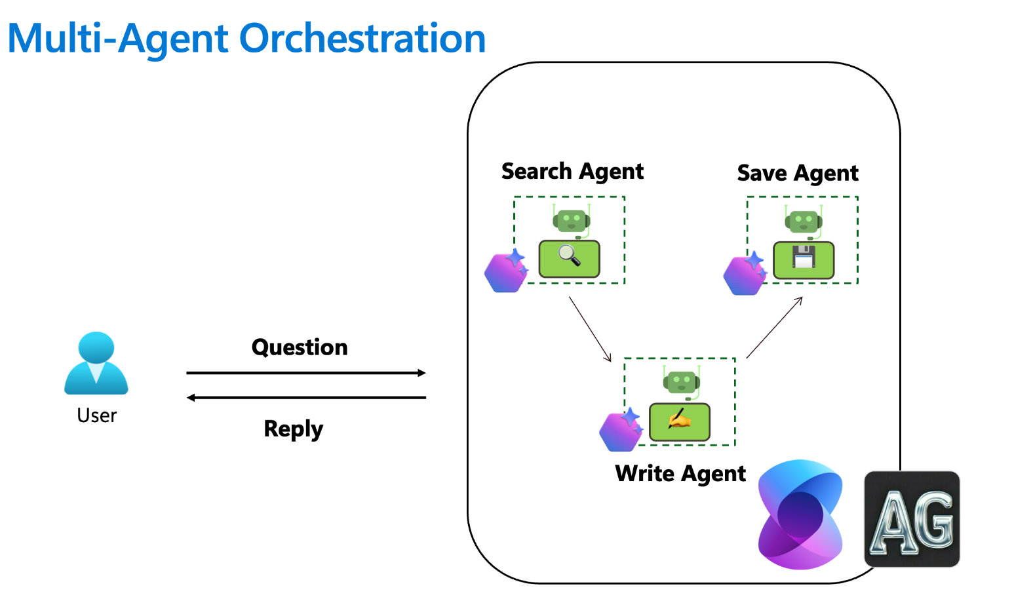
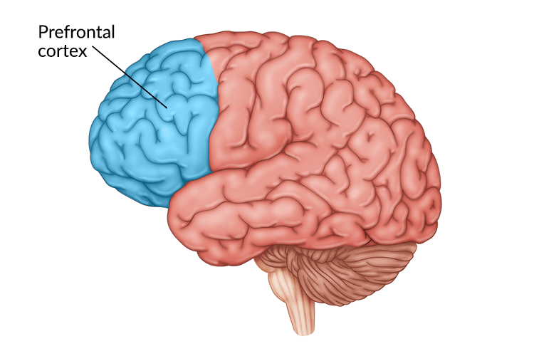
Planner in Semantic Kernel SDK
Sequential call to Agents developed by the Semantic Kernel “Planner”
The Sequential Planner in the Semantic Kernel SDK can be compared to the prefrontal cortex of the human brain.
Just like the prefrontal cortex:
The Sequential Planner is responsible for planning and organizing tasks step by step, just as the prefrontal cortex handles executive functions like decision-making, sequencing, and problem-solving.
It breaks down complex goals into manageable actions and executes them in a structured manner, similar to how the prefrontal cortex helps in strategizing and prioritizing tasks.
It ensures that tasks are executed in the correct order, avoiding conflicts or unnecessary actions, much like how the prefrontal cortex maintains logical thinking and focus.

