Slide 1

Evaluating our GenAI Agents

Slide 2

How is GenAI Evaluation Different
Evaluating Generative AI (GenAI) models is quite different from traditional machine learning (ML) evaluation because of the nature of their outputs.
Output Type
Traditional ML: Outputs are structured (e.g., classification labels, numerical values).
GenAI: Outputs are unstructured (e.g., text, images, code, or speech), making evaluation subjective
Evaluating GenAI apps through the traditional edge case testing isn’t the solution
Real-time & Human-in-the-loop Evaluation
Traditional ML: Can often be evaluated automatically with test datasets.
GenAI: Requires human-in-the-loop evaluation to assess creativity, fairness, and biases

Slide 3
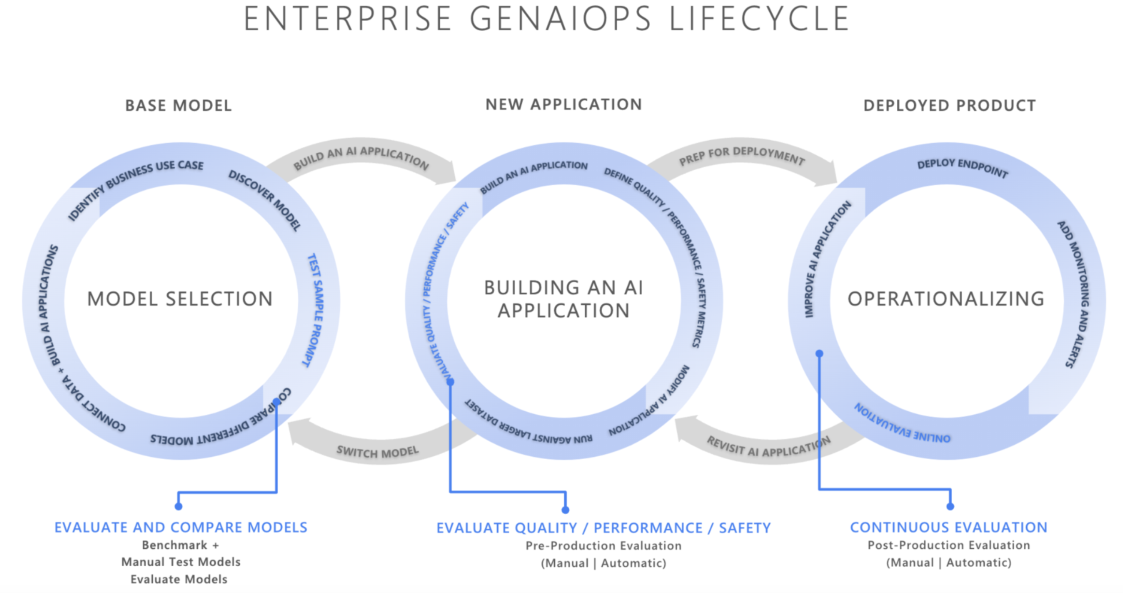
If not designed carefully, these applications can produce outputs that are fabricated and ungrounded in context, irrelevant or incoherent, resulting in poor customer experiences, or worse, perpetuate societal stereotypes, promote misinformation, expose organizations to malicious attacks, or a wide range of other negative impacts.
Performing iterative, systematic evaluations with the right evaluators can help teams measure and address potential response quality, safety, or security concerns throughout the AI development lifecycle, from initial model selection through post-production monitoring. Evaluation within the GenAI Ops Lifecycle production.

Slide 4
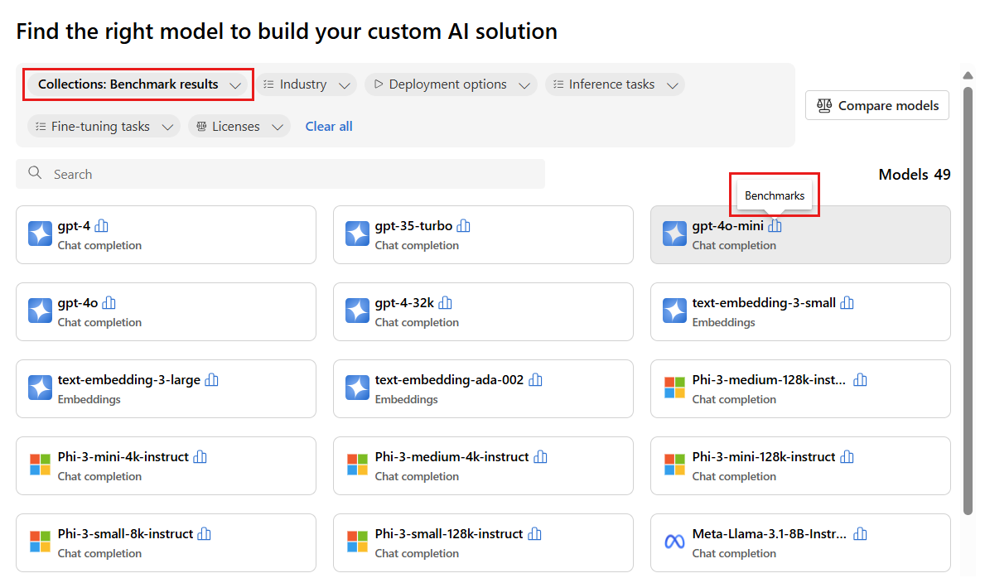
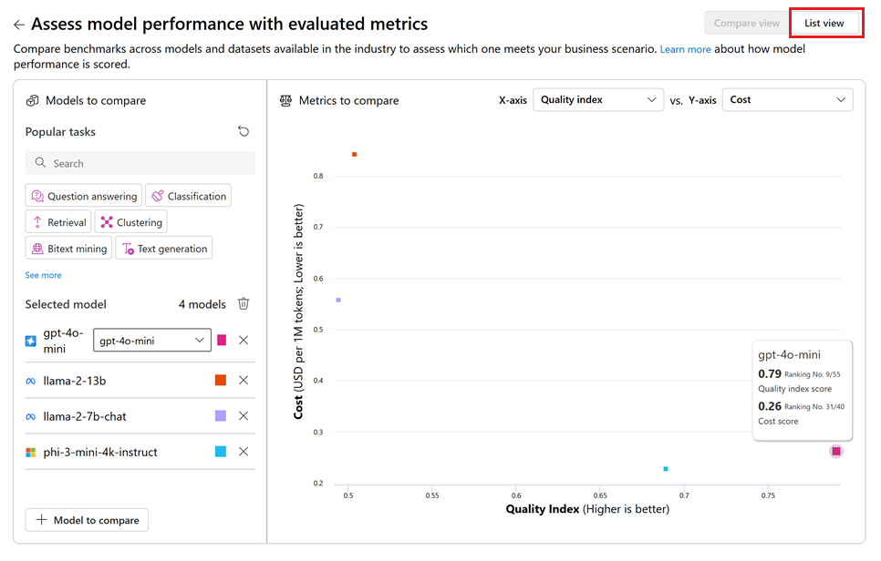
First Stage – Base Model Selection
Key considerations at this stage might include:
Accuracy/quality: How well does the model generate relevant and coherent responses?
Performance on specific tasks: Can the model handle the type of prompts and content required for your use case? How is its latency and cost?
Bias and ethical considerations: Does the model produce any outputs that might perpetuate or promote harmful stereotypes?
Risk and safety: Are there any risks of the model generating unsafe or malicious content?

Slide 5
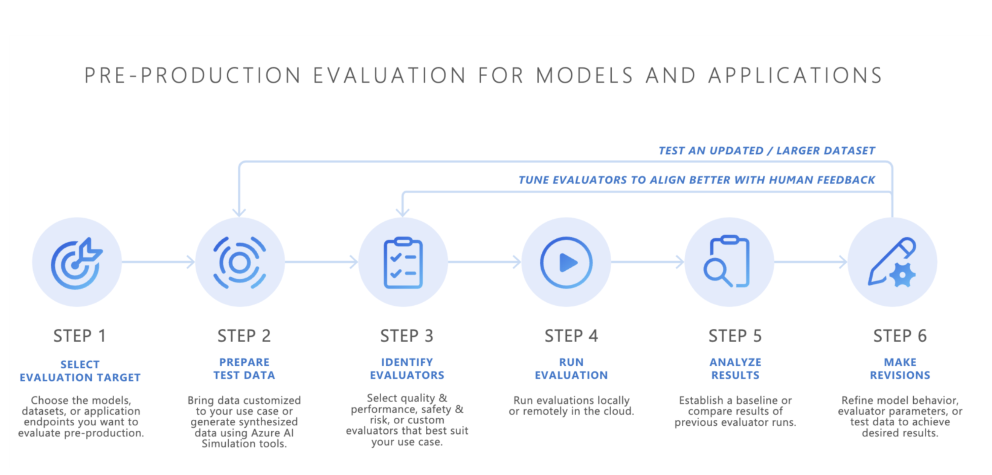
Second Stage – Pre Production Evaluation
After selecting a base model, the next step is to develop an AI application—such as an AI-powered chatbot, a retrieval-augmented generation (RAG) application, an agentic AI application, or any other generative AI tool. Following development, pre-production evaluation begins. Before deploying the application in a production environment, rigorous testing is essential to ensure the model is truly ready for real-world use.

Slide 6
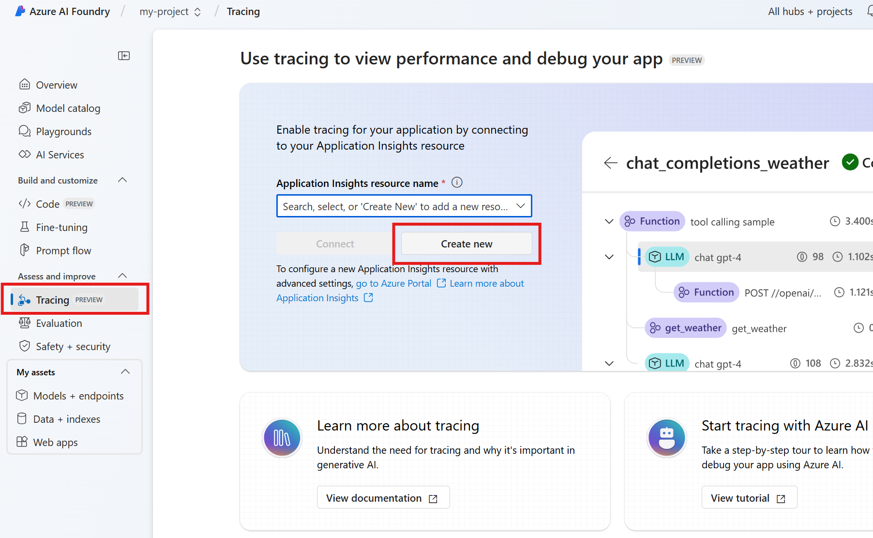
Third Stage – Post-Production Monitoring
Ongoing performance tracking: Regularly measuring AI application’s response using key metrics to ensure consistent output quality.
Incident response: Quickly responding to any harmful, unfair, or inappropriate outputs that might arise during real-world use.

Slide 7
Azure AI Evaluation SDK
pip install azure-ai-evaluation
Base Model Selection
Pre-Production Evaluation
Post-Deployment Evaluation
from azure.ai.evaluation import GroundednessProEvaluator, GroundednessEvaluator
# Initialzing Groundedness and Groundedness Pro evaluators
groundedness_eval = GroundednessEvaluator(model_config)
groundedness_pro_eval = GroundednessProEvaluator(azure_ai_project=azure_ai_project, credential=credential)

