Slide 1

Azure AI Content Understanding

Slide 2
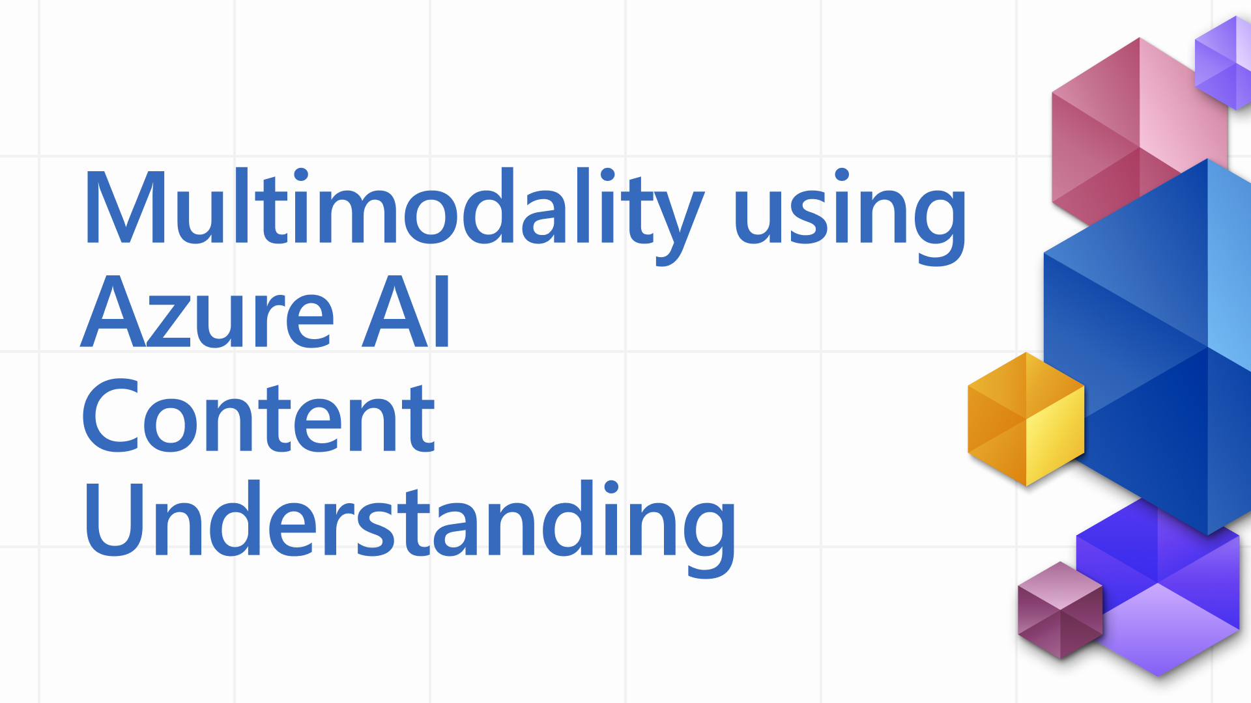
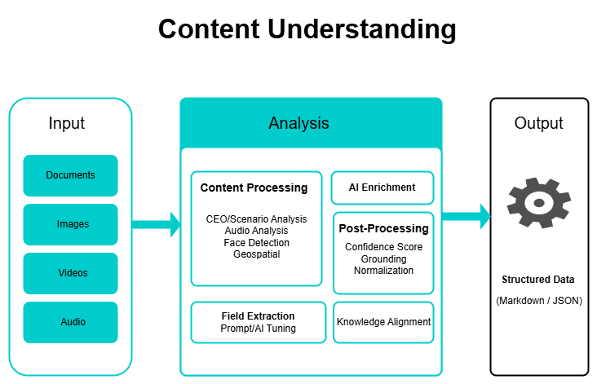
📖 Scenario: Retail Company Using Azure AI Content Understanding
📖 Scenario: Retail Company Using Azure AI Content Understanding
Imagine you are working with EcoMart, a large retail chain that receives tons of unstructured content every day:
Product Catalogs (PDFs) from suppliers
Social Media Posts (Images + Text) about new store launches
Customer Support Chats (Text) with feedback and complaints
In-store CCTV Snaps (Images) showing customer engagement with new displays
The challenge? All of this content is unstructured and stored in different formats, making it very hard to analyze and derive insights.
💡 Solution with Azure AI Content Understanding: EcoMart uses the pre-built analyzers:
Text Analyzer → Extracts topics & key phrases from support chats.
Image Analyzer → Detects logos, products, and even customer emotions in photos.
Video Analyzer → Summarizes CCTV footage into highlights like “Peak footfall at 5:30 PM.”
Multi-modal RAG → Combines product catalog PDFs, customer reviews, and images into a single knowledge base.

Slide 3
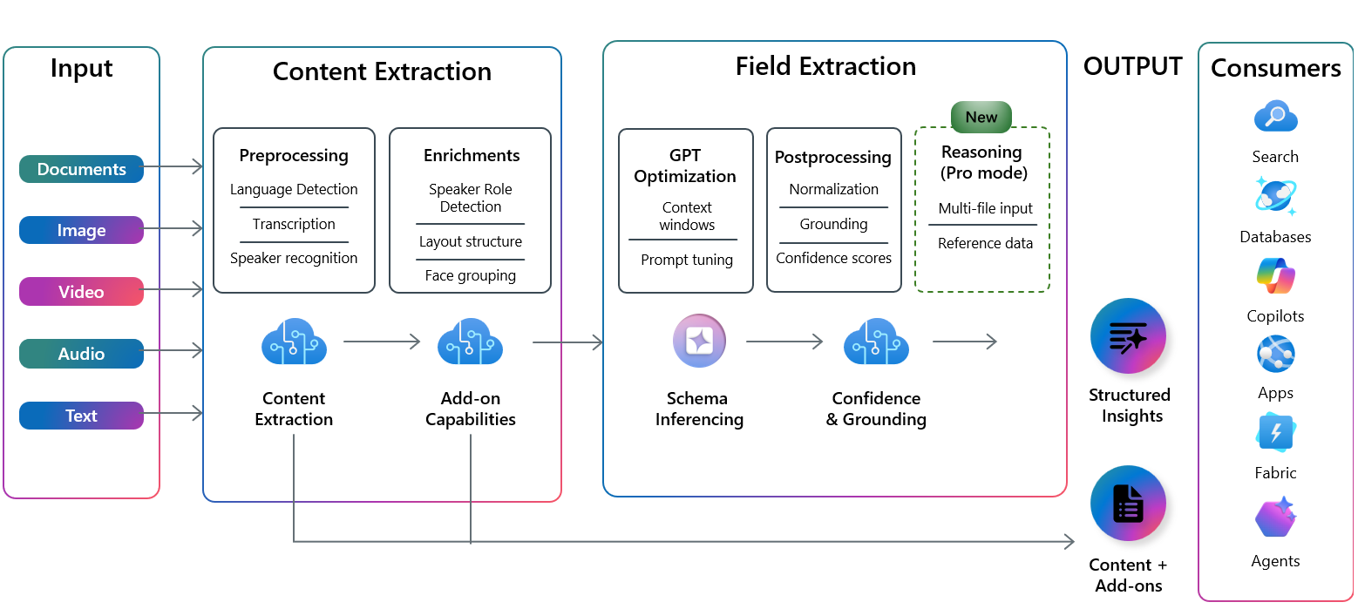
Analyzer: The analyzer is the core component of Content Understanding. It allows customers to configure content extraction settings and field extraction schema. Once configured, the analyzer consistently applies these settings to process all incoming data.
Content Extraction: With content extraction, you specify the types of information to identify and extract from incoming content. This approach lets you focus on extracting the most relevant information for your needs.
Field Extraction: Field extraction allows users to define the structure and schema of the desired fields to extract from input files.

Slide 4
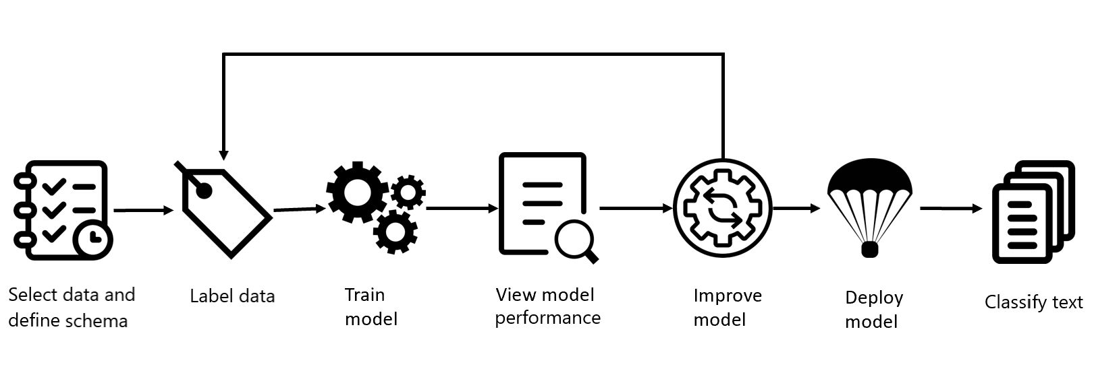
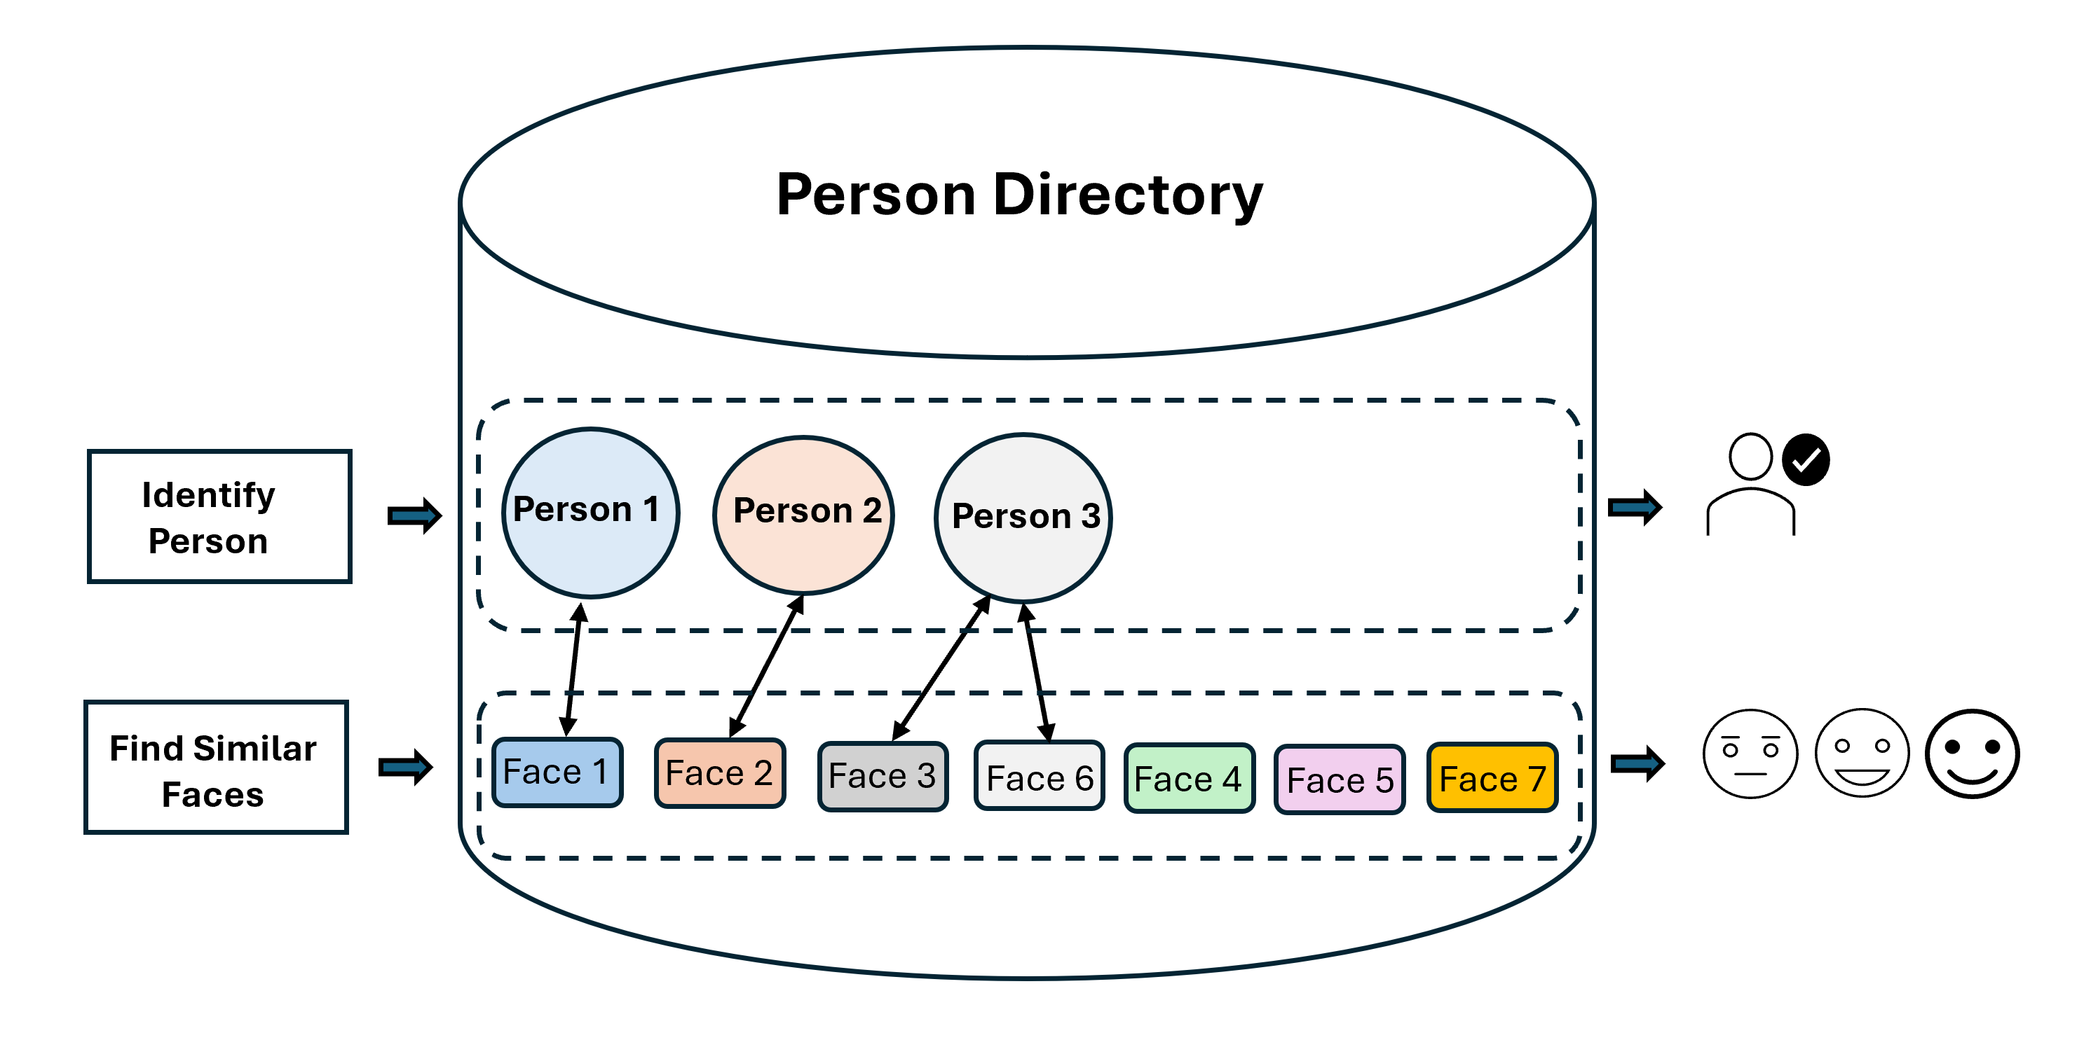
Extra Add-Ons: Classifier and Face Detection
Classifier: You can use the Azure AI Content Understanding classifier to detect and identify documents that you process within your application. The Content Understanding classifier can perform classification of an input file as a whole. It can also identify multiple documents or multiple instances of a single document within an input file.
Face Detection: Azure AI Content Understanding provides a cloud-based solution for face detection, enrollment, and recognition, enabling secure and intelligent applications. Developers can apply these capabilities to detect faces, organize them into a structured directory, and perform recognition tasks for identity verification and content management.

Slide 5
Pro v/s Standard Modes
🧠 Pro Mode = Senior Analyst
Now imagine hiring a senior analyst.
You don’t just give them one file — you give them multiple documents (e.g., invoice + purchase order + contract).
You also hand them reference material (like company policies).
They read, compare, and reason across documents:
“Does the invoice match the contract?”
“Are there inconsistencies?”
They take longer and cost more, but they deliver judgment calls and insights.
✅ Best for: compliance checks, validating contracts, complex decision-making.
👩‍💻 Standard Mode = Efficient Assistant
Imagine you hire a research assistant.
You tell them: “Go through these files (docs, images, videos, audio) and pull out structured notes into my template.”
They work fast, keep costs low, and give you exactly what you asked for — but they don’t think deeply or cross-check across multiple sources.
✅ Best for: OCR, extracting tables, structuring call transcripts, summarizing videos.

Slide 6
🧾 Example Use Case: Invoice Processing
Standard Mode (Assistant)
Company uploads thousands of supplier invoices.
Azure AI Content Understanding extracts fields like:
Invoice Number
Date
Vendor Name
Line Items + Amounts
Output is structured data → ready for databases, RAG search, or dashboards.
✅ Fast, scalable, cost-effective.
Pro Mode (Analyst)
Same invoices are uploaded along with purchase orders & contracts.
Azure AI Content Understanding (Pro) reasons across documents:
“Does this invoice total match the purchase order?”
“Is the vendor billing for items outside the contract?”
“Are there inconsistencies that need review?”
✅ Ideal for compliance, fraud detection, and audits.

Slide 7
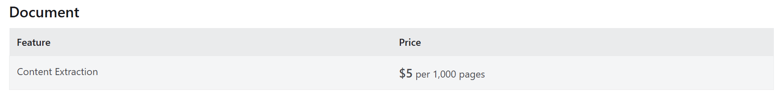
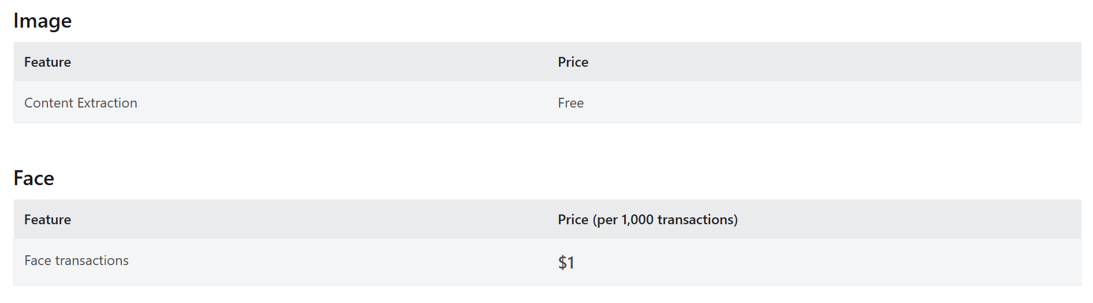
Pricing

Slide 8
