Slide 1
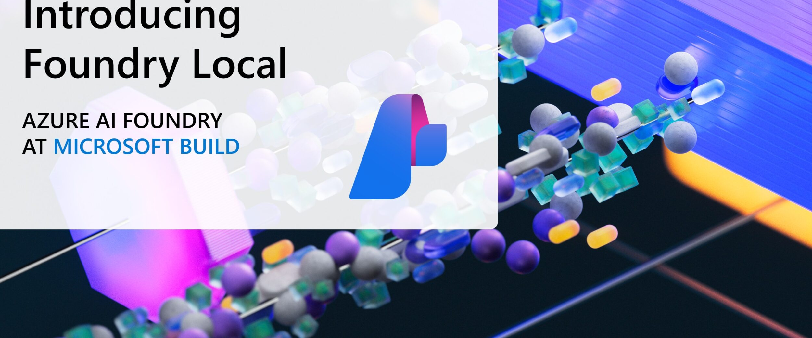
Azure AI Foundry Local
(Local LLMs for the Win!)

Slide 2
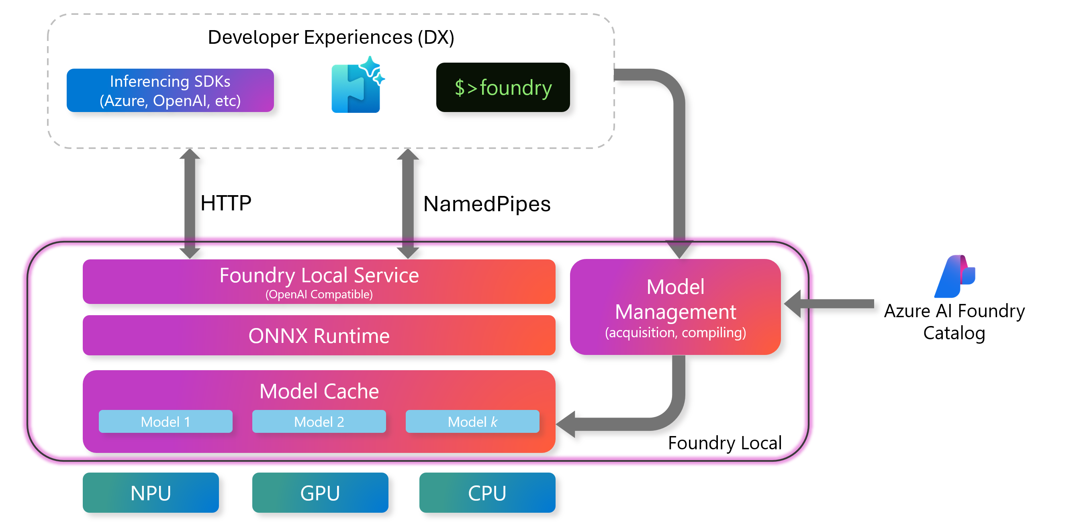
The Foundry Local Service includes an OpenAI-compatible REST server that provides a standard interface for working with the inference engine. It's also possible to manage models over REST. Developers use this API to send requests, run models, and get results programmatically.
Foundry Local enables efficient, secure, and scalable AI model inference directly on your devices.

Slide 3
Compatibility with OpenAI SDK and langchain to build local Agents
Make API calls to localhost:5273/v1/chat/completions endpoint
Download via the terminal (CMD) and interact locally!
In Foundry Local, ONNX Runtime is the backbone of inferencing — it takes the compiled model and executes it efficiently on local hardware.
The model cache stores downloaded AI models locally on your device, which ensures models are ready for inference without needing to download them repeatedly.
The ONNX Runtime is a core component that executes AI models. It runs optimized ONNX models efficiently on local hardware like CPUs, GPUs, or NPUs.
Run models available in the Foundry Catalog offline like phi-3.5-mini, mistral, phi-4-mini

Slide 4
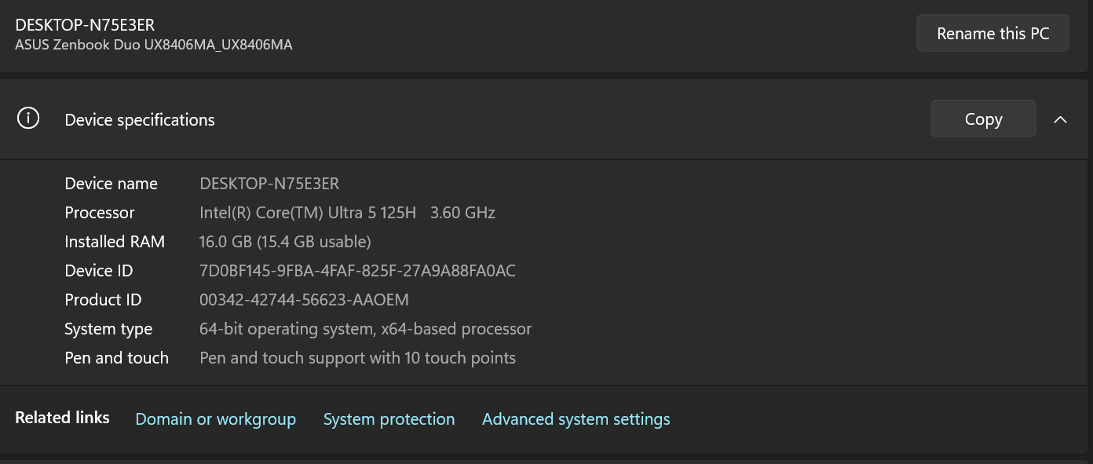

Hardware Prerequisites
Operating System: Windows 10 (x64), Windows 11 (x64/ARM), Windows Server 2025, macOS.
Hardware: Minimum 8GB RAM, 3GB free disk space. Recommended 16GB RAM, 15GB free disk space.
Network: Internet connection for initial model download (optional for offline use)
Acceleration (optional): NVIDIA GPU (2,000 series or newer), AMD GPU (6,000 series or newer), Qualcomm Snapdragon X Elite (8GB or more of memory), or Apple silicon.

Slide 5
This Means a lot of things……
Low Latency: Run models locally to minimize processing time and deliver faster results.
Data Privacy: Process sensitive data locally without sending it to the cloud, helping meet data protection requirements.
Flexibility: Support for diverse hardware configurations lets you choose the optimal setup for your needs.
Scalability: Deploy across various devices, from laptops to servers, to suit different use cases.
Cost-Effectiveness: Reduce cloud computing costs, especially for high-volume applications.
Offline Operation: Work without an internet connection in remote or disconnected environments.
Seamless Integration: Easily incorporate into existing development workflows for smooth adoption.

