Slide 1
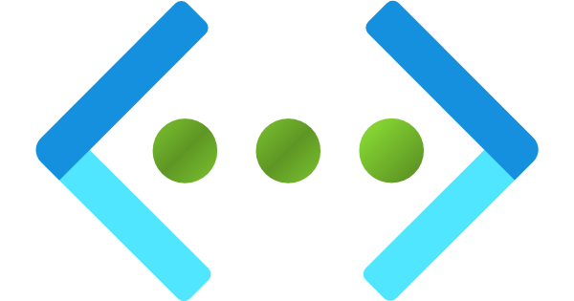
Azure Virtual Network

Slide 2
Problem Statement(s)
Security and Data Integrity Risks
AI agents exchanging sensitive information over networks/internet are vulnerable to cyber threats like man-in-the-middle attacks, spoofing, and data breaches.
Network Latency and Bandwidth Constraints
High latency in virtual networks impacts real-time AI agent interactions, especially in applications like automated trading, gaming, and customer support.

Slide 3
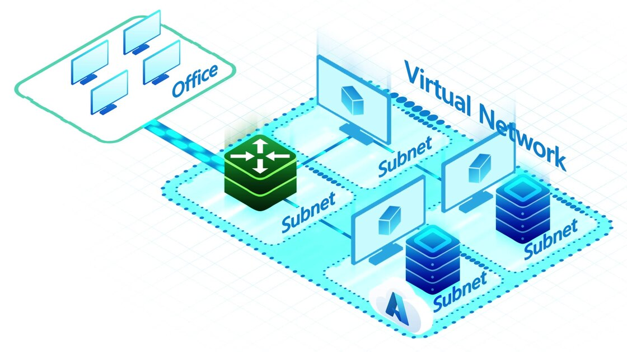
Azure Virtual Networking
Azure Virtual Network is a service that provides the fundamental building block for your private network in Azure.
An instance of the service (a virtual network) enables many types of Azure resources to securely communicate with each other, the internet, and on-premises networks.
All resources in a virtual network can communicate outbound with the internet, by default. You can also use a public IP address, NAT gateway, or public load balancer to manage your outbound connections.

Slide 4
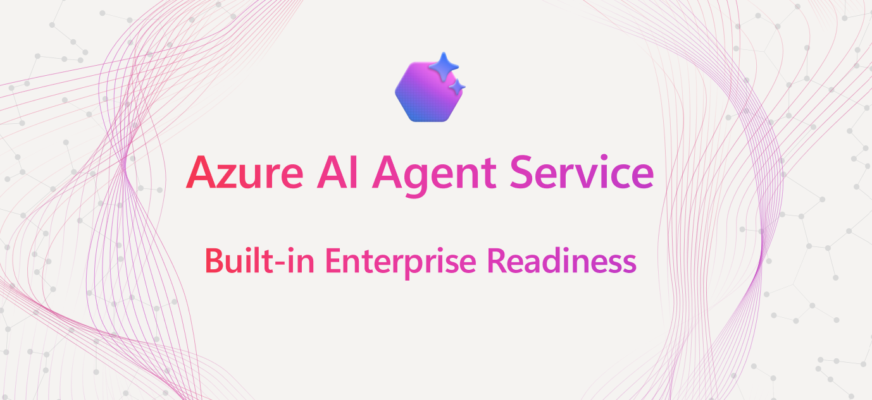
Support for Azure AI Foundry and AI Agents
For enterprises that require private network access, Azure AI Agent Service introduces private network isolation, which enables AI agents to operate entirely within a dedicated, isolated virtual network.
BYO VNet, also known as custom VNet support with injection, is a new private network isolation implementation in Azure AI Foundry.
Evolving enterprise risk-tolerance, compliance, and governance requirements now demand a higher level of control than ever before

