Slide 1
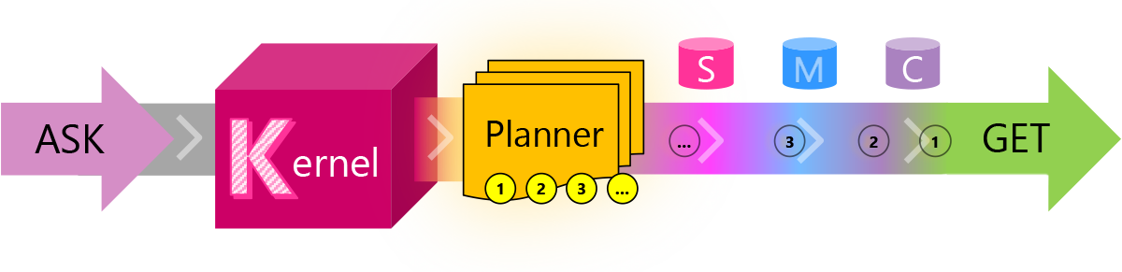
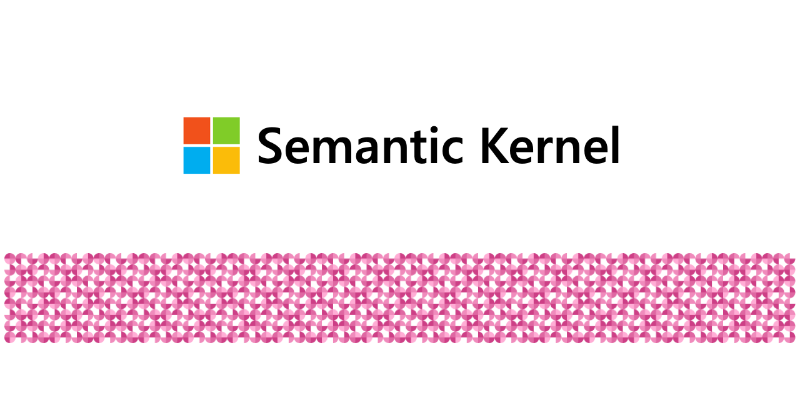
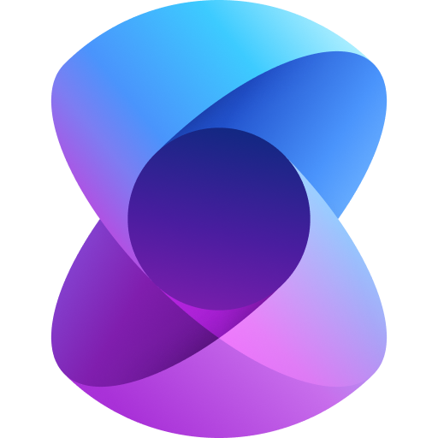
Semantic Kernel
(Agent Framework)

Slide 2
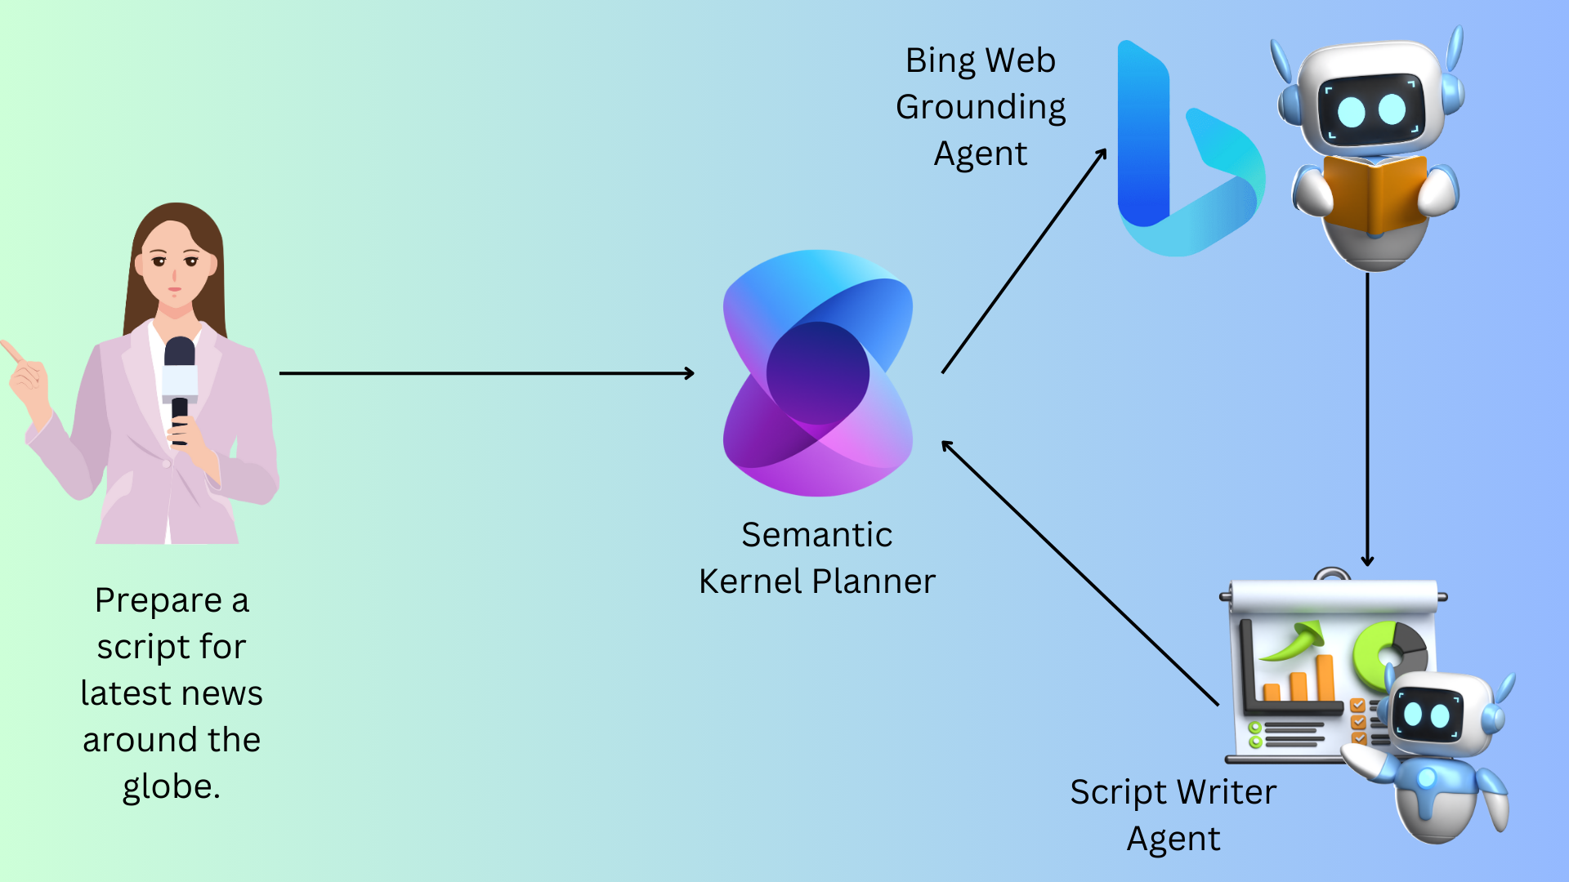
Shortcomings with Raw/Crude AI Agents
Some of the Shortcomings that we as developers face:
No doubt these AI Agents have powerful tools but how do you setup a system where the plan to execute agents is dynamically decided upon?
How do you make this systems of AI Agents more human in nature?
Can you setup a system where these agents interact with each other, then execute either sequentially or in-parallel and output a refined response.
How do I setup a multi-agent system which has a AgentGroupChat or AgentChannel capability?

Slide 3
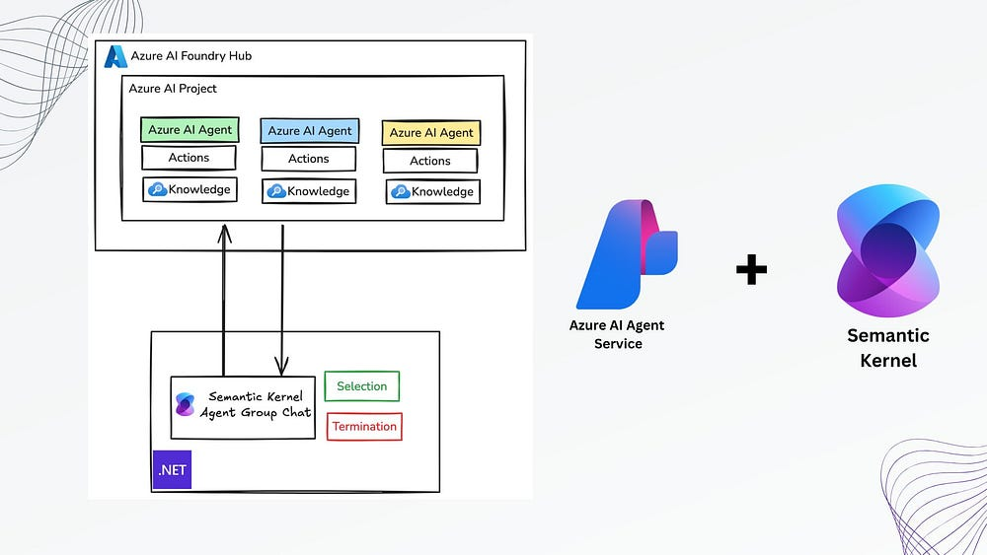
What the SK Agent Framework Solves?
Modular Orchestration: Enables dynamic orchestration of AI functions, plugins, and skills using natural language goals.
Goal-Oriented Agents: Converts user goals into actionable plans, automating complex workflows with minimal coding.
Context Awareness: Maintains short-term and long-term memory for agents, enabling intelligent, contextual decision-making.
Flexible Integration: Seamlessly integrates with external APIs, tools, and enterprise data through plugins.
Extensible Architecture: Offers a pluggable, open-source framework to build, test, and scale AI agents across domains.

Slide 4
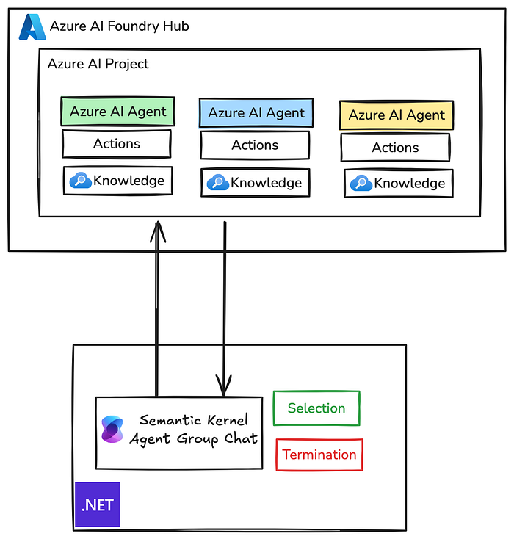
The Semantic Kernel Agent Framework is meant to augment your Azure AI Agent Service – thus unlocking the unopened doors to building enterprise ready multi-agentic systems
Semantic Kernel Agent Framework in no way will replace Azure AI Agent Service but rather amplify it:
Azure AI Agent Service – Place where you build and maintain domain-specific and skilled agents.
SK Agent Framework – Use this to bring orchestrate you AI Agents

Slide 5

Dissecting the SK Agent Framework

Slide 6
Agent Creation With SK Agent Framework
ChatCompletionAgent – a) Azure OpenAI Models
b) Hugging Face Models (Open-Source)
OpenAIAssitantAgent – Make use of the OpenAI Assistant API (not really the best!)
AzureAIAgent – Create Agents in Azure AI Foundry and then create a copy of the agents in the SK Agent Framework

Slide 7
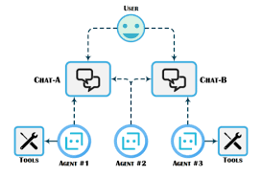
Agent Chat
The AgentChat class serves as the foundational component that enables agents of any type to engage in a specific conversation.
Agent Chat Has two important components:
a) Selection Function
b) Termination Function

Slide 8
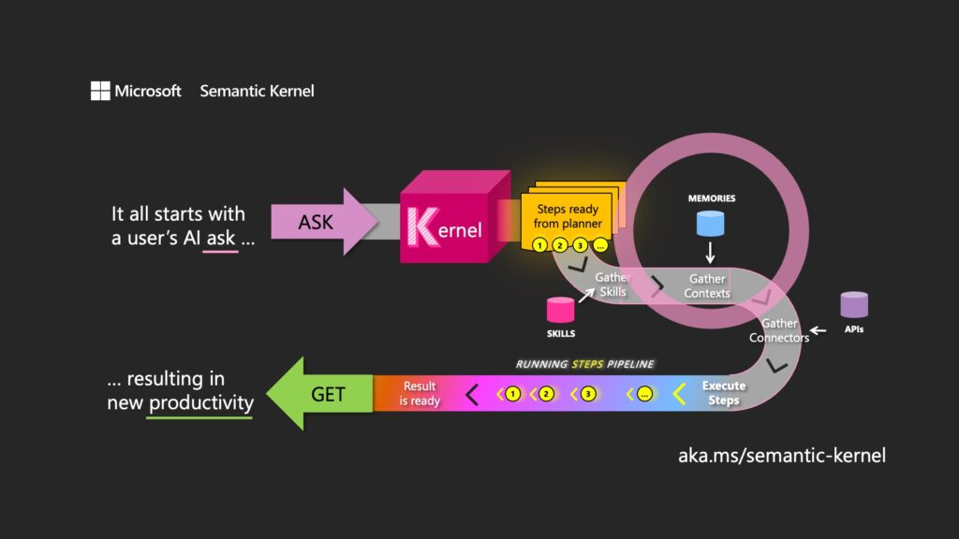
Planner or Agent Chat System
Will be called to utilize the best-suited team of agents
Thread Management is taken care by the SK Agent Framework to store some kind of “RAM” to provide contextual insights
The user gets the response!
You can build native and prompt template plugins for your ChatCompletionAgent or Out-Of-The-Box Plugins like AI Search, Logic Apps etc. in AzureAIAgent

Slide 9
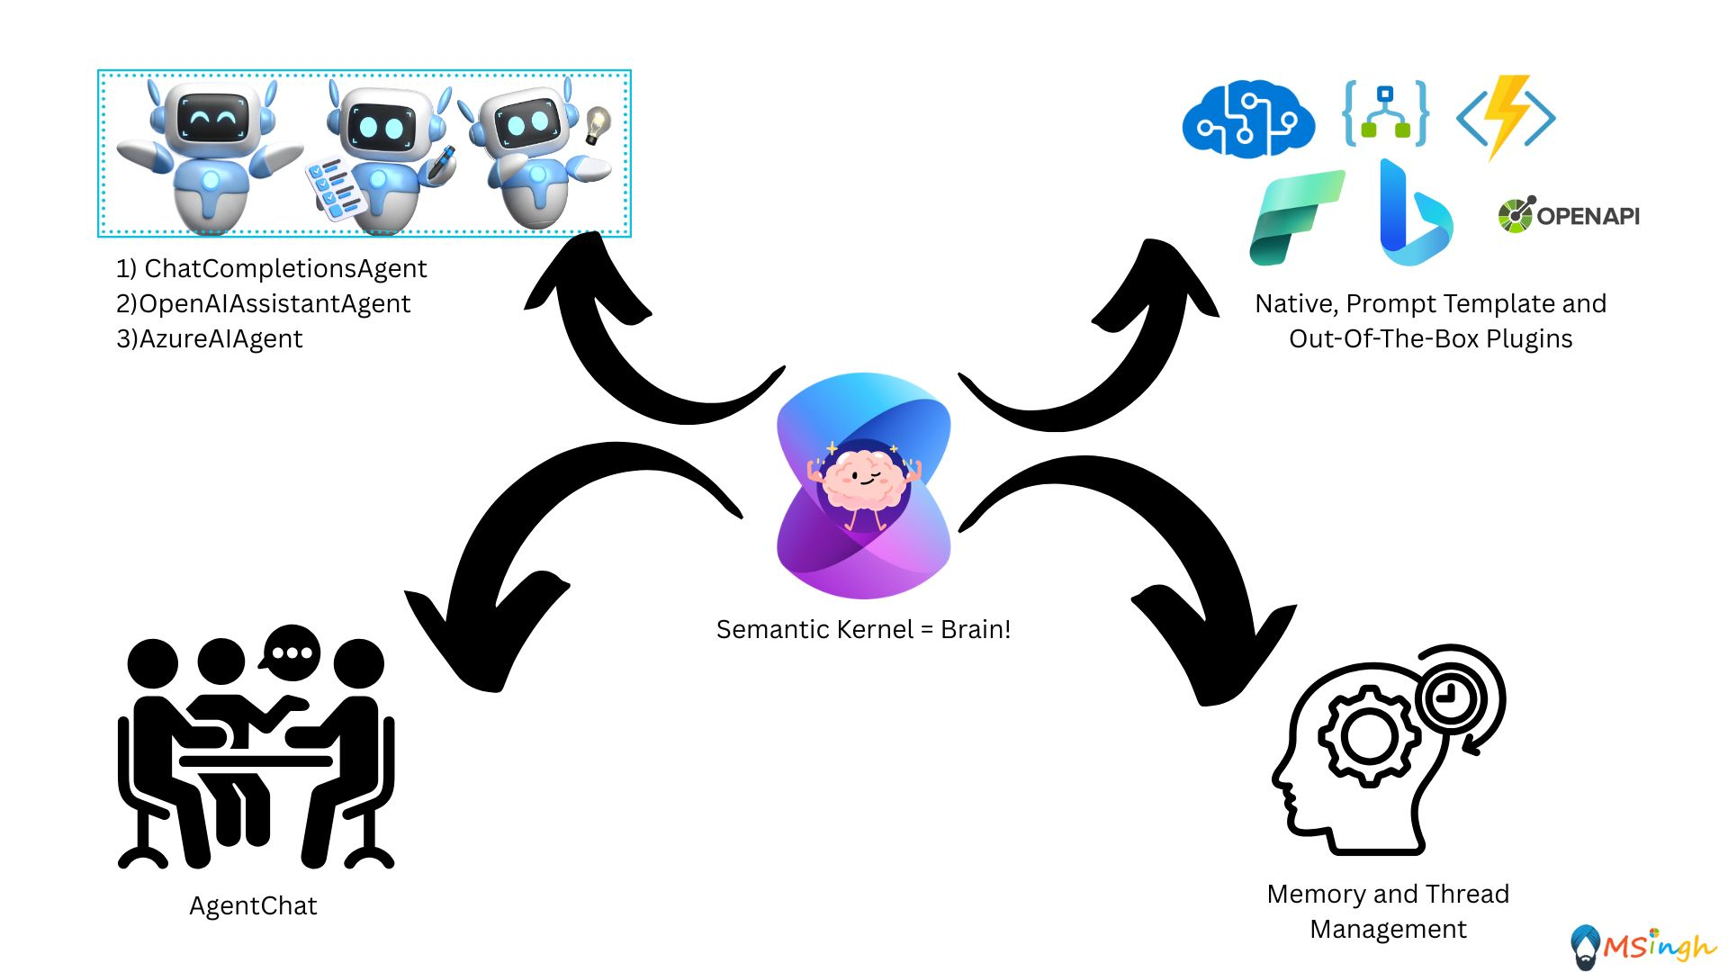
Do I Still require the “Kernel” ?
Even though you have a lot of things to work with now, the “Kernel” will still do the heavy-lifting. You, as a developer, only must worry about building modular components and the kernel will orchestrate these moving-parts/modular components of your application.

