Slide 1
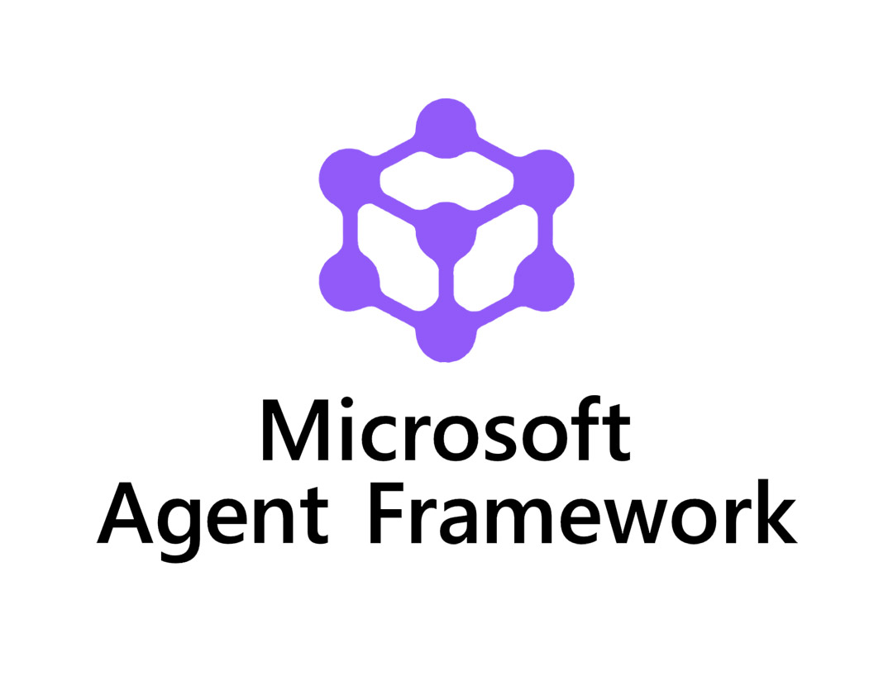
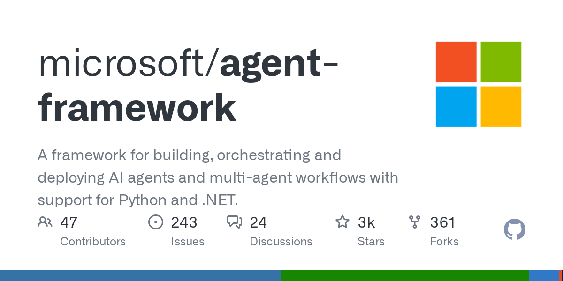
Microsoft Agent Framework
(It’s becoming very difficult now to keep up with these AI updates🫠)

Slide 2

Another AI Agents Update……Of the many more to come 🫠

Slide 3
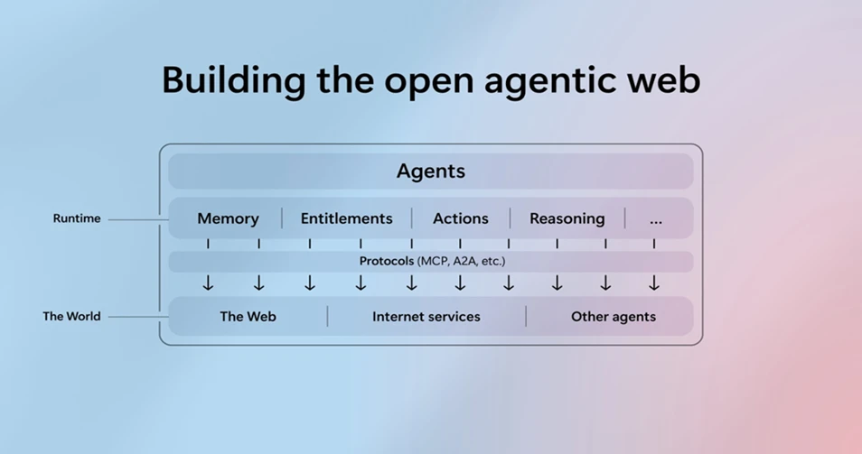
The Open Agentic Web
Agents need a shared “language” to exchange messages, requests, and structured data. Without it, collaboration breaks down into isolated silos. Standards like Model Context Protocol (MCP) and Agent-to-Agent (A2A) provide this foundation
Single agents can handle discrete tasks, but the real breakthroughs come from multi-agent orchestration: teams of agents collaborating across multi-step, distributed processes. Azure AI Foundry delivers this through a unified framework
Just as the web needed directories and search engines, agents need a way to be found and reused. The Catalog serves as the listing of assets—a curated collection of agents, tools, and applications that can be discovered and composed into new solutions. The Registry, by contrast, tracks the deployed instances of those asset
Trust is the lifeblood of the agentic web. Every agent must carry a verifiable identity, enforced through standards like OIDC (OpenID Connect) and JWT (JSON Web Token), and tied into enterprise systems like Microsoft Entra ID.

Slide 4
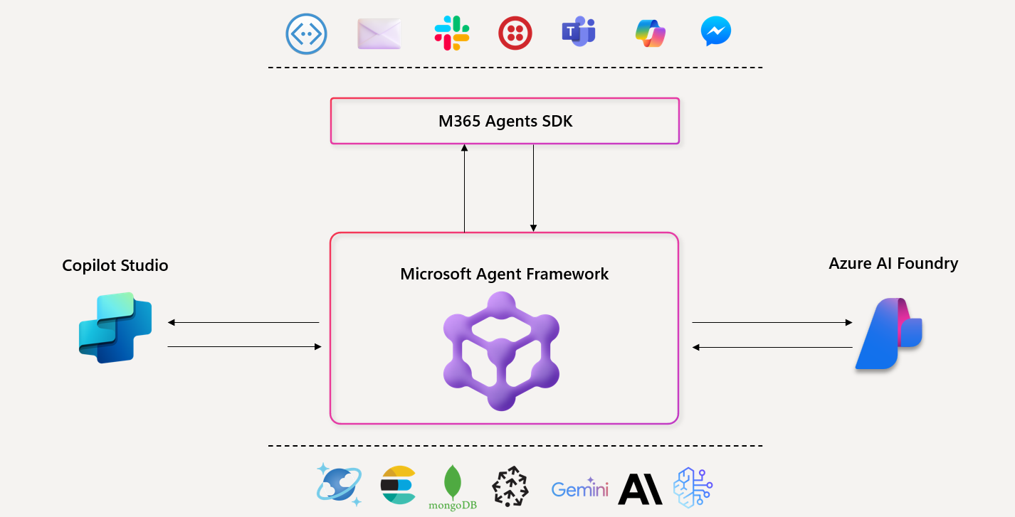
Microsoft Agent Framework
Microsoft Agent Framework = The Best of Semantic Kernel + The Best of Autogen
Foundational Pillar 1 – Open Standards Foundation
Built for interoperability with open protocols like MCP, A2A, and OpenAPI, ensuring seamless integration and cloud-agnostic deployment.
Foundational Pillar 2 - Pipeline for Research
Bridges Microsoft Research innovations like AutoGen into enterprise-ready multi-agent orchestration with durable, auditable, and production-grade workflows.
Extensible by Design & Community-Driven
An open-source, modular framework built for community growth, supporting custom connectors, pluggable memory, declarative agents, and collaborative innovation.
Ready for Production
Built for enterprise deployment with observability, security, compliance, durability, human oversight, and seamless CI/CD integration for scalable, reliable AI systems.

Slide 5
 | Semantic Kernel | AutoGen | Microsoft Agent Framework
Focus | Stable SDK with enterprise connectors, workflows, and observability | Experimental multi-agent orchestration from research | Unified SDK combining innovation + enterprise readiness
Interop | Plugins, connectors, and support for MCP, A2A, OpenAPI | Tool integration supported; lacks standardized cross-runtime protocols | Built-in connectors, MCP + A2A + OpenAPI
Memory | Multiple vector store connectors and memory store abstraction (e.g. Elasticsearch, MongoDB) | Support for in-memory / buffer history + external vector store memory options (ChromaDB, Mem0, etc) | Pluggable memory across stores (first-party and third-party), persistent & adaptive memory stored with retrieval, hybrid approaches
Orchestration | Deterministic + dynamic orchestration (Agent Framework, Process Framework) | Dynamic LLM orchestration (debate, reflection, facilitator/worker, group chat) | Deterministic + dynamic orchestration (Agent Orchestration, Workflow Orchestration)
Enterprise Readiness | Telemetry, observability, compliance hooks | Minimal | Observability, approvals, CI/CD, long-running durability, hydration

