Slide 1

Azure AI Foundry SDK

Slide 2
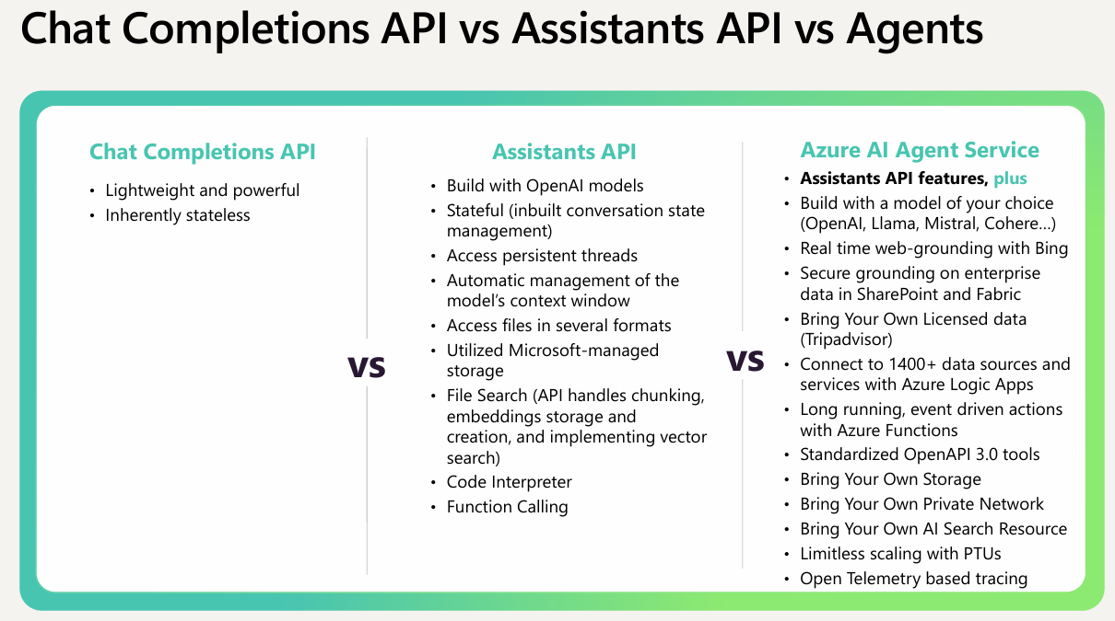
How its going
How It Started
How it Went

Slide 3
The Azure AI Foundry SDK is a comprehensive toolchain designed to simplify the development of AI applications on Azure. It enables developers to:
1)Access popular models from various model providers through a single interface.
2)combine together models, data, and AI services to build AI-powered applications.
3)Evaluate, debug, and improve application quality & safety across development, testing, and production environments
What originally took hundreds of lines of code can now be done in just a few with Azure AI Agent Service.
Pip install azure-ai-projects

