Slide 1

"Where Cloud Meets Creativity — Powered by Passion, Built with Azure 💙" ~ MSingh
Productionize Azure AI Foundry Agents with API Management
https://www.udemy.com/course/productionize-azure-ai-foundry-agents-with-api-management/

Slide 2
Course Roadmap
Introduction to Azure API Management
Introduction to Integration of Azure AI with APIM
Advanced Use Cases: Azure APIM Loves AI
Learn about Azure API Management (APIM)
Learn About Azure AI Foundry and Azure OpenAI
Setup Semantic Cache with Azure Managed Enterprise Cluster.
Learn About API Lifecycle
Deploy and Create APIs in Azure APIM.
Set up Policies in APIM
Set up Monitoring Tools for APIM
Learn Best Practices for API Design
Integrate Azure AI Foundry with APIM.
Integrate Azure OpenAI with APIM with SDK Compatibility.
Create Tokens-Per-Minute (TPM) Rate Limits and Request Throttling Policies.
Integrate Content Safety Filters with Azure APIM Policies.
Setup Backend Pools and perform Entra ID Authentication.
Create Load Balanced Pools with Circuit Breaker Backends.

Slide 3
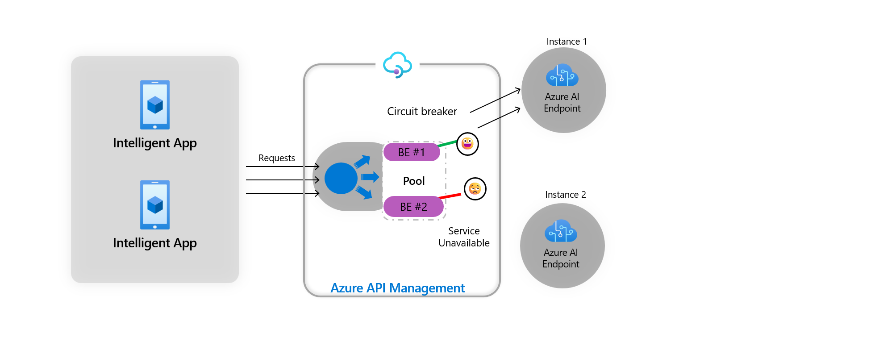
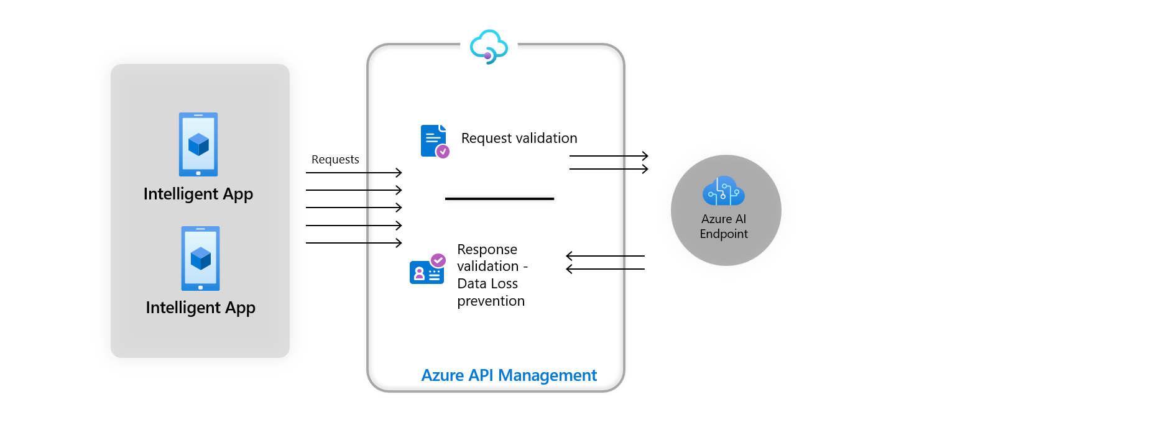
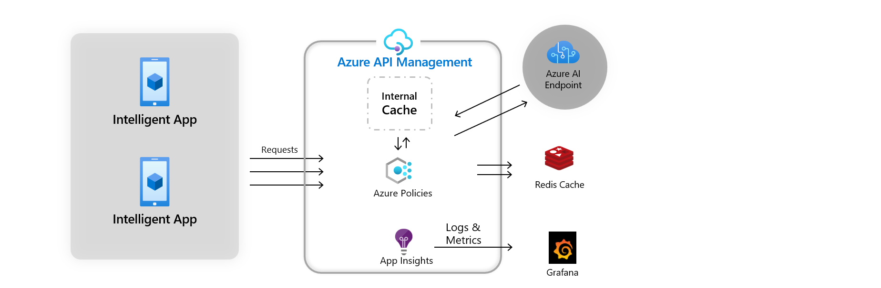
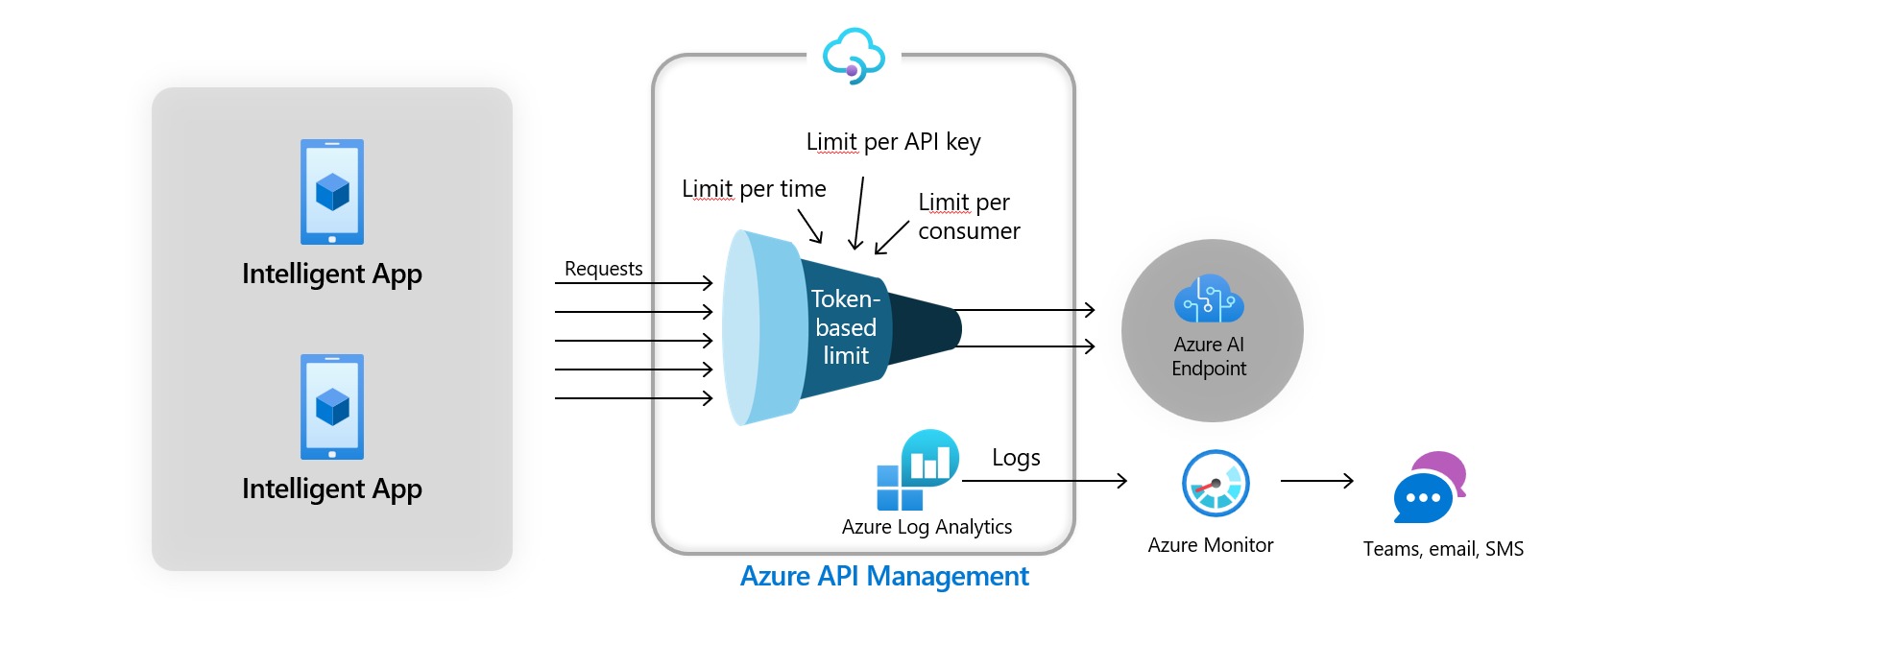
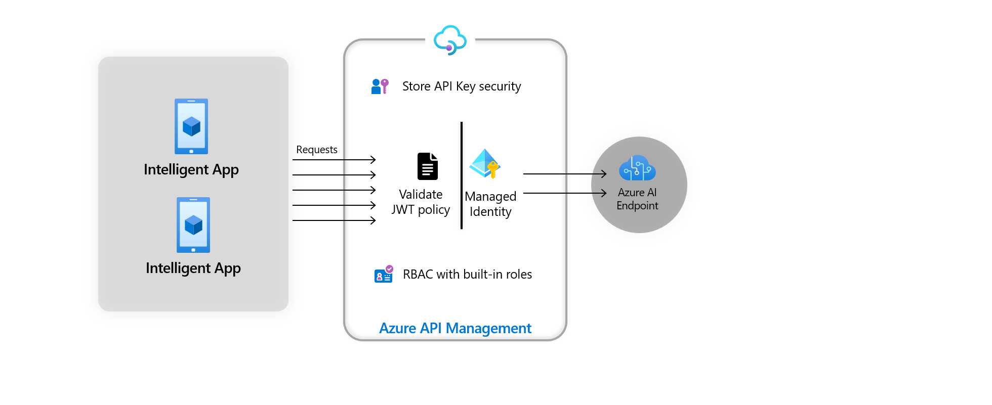
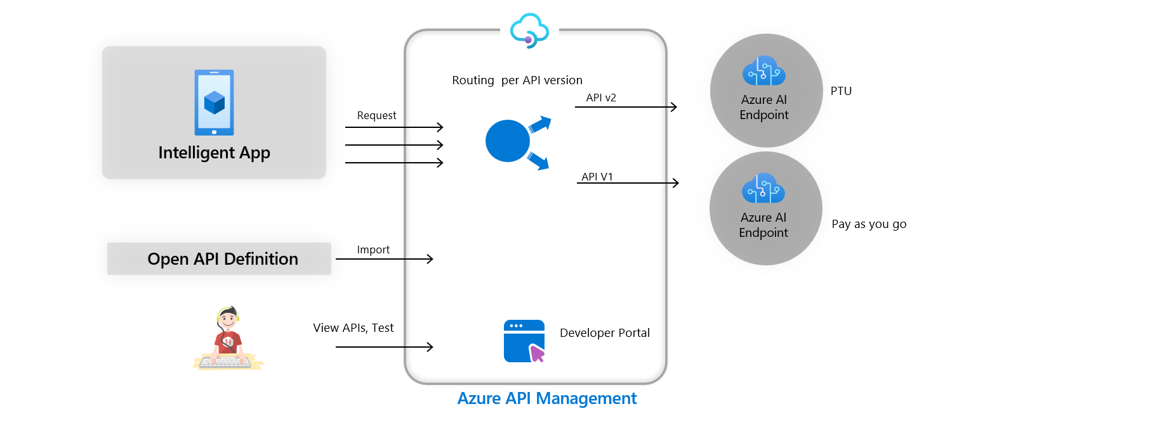
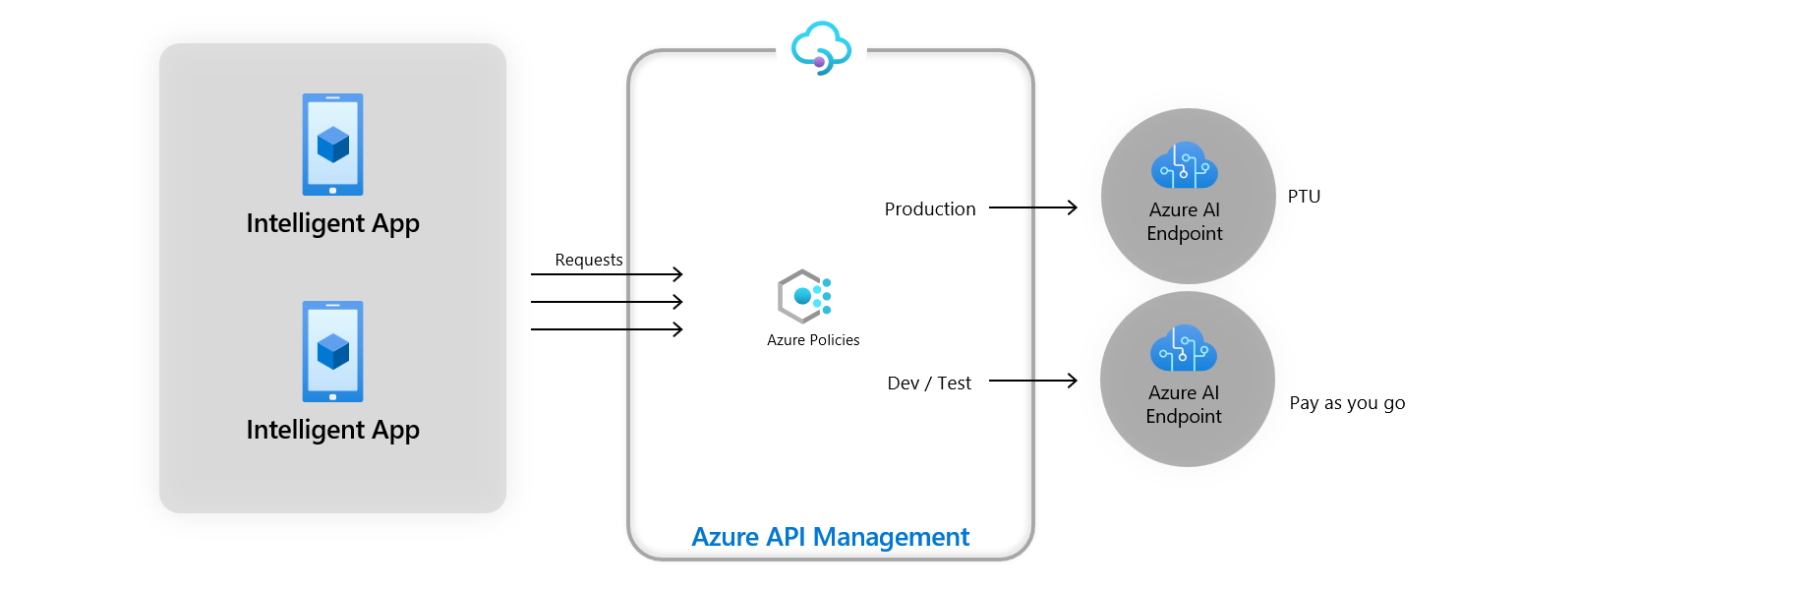
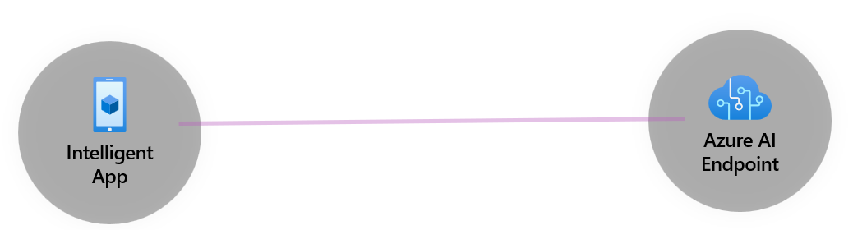
Load Balanced Circuit Breaker Pattern
Request Validation and Security
Semantic Caching for Faster Inferencing
Managed Identity Auth with MS Entra ID
Continuous Development and API Monetization
Request Throttling and Rate Limits
Blue-Green Deployments
Highly Scalable Systems

