Slide 1

Function Calling with Azure AI Agents
(Working with User Defined Functions)

Slide 2
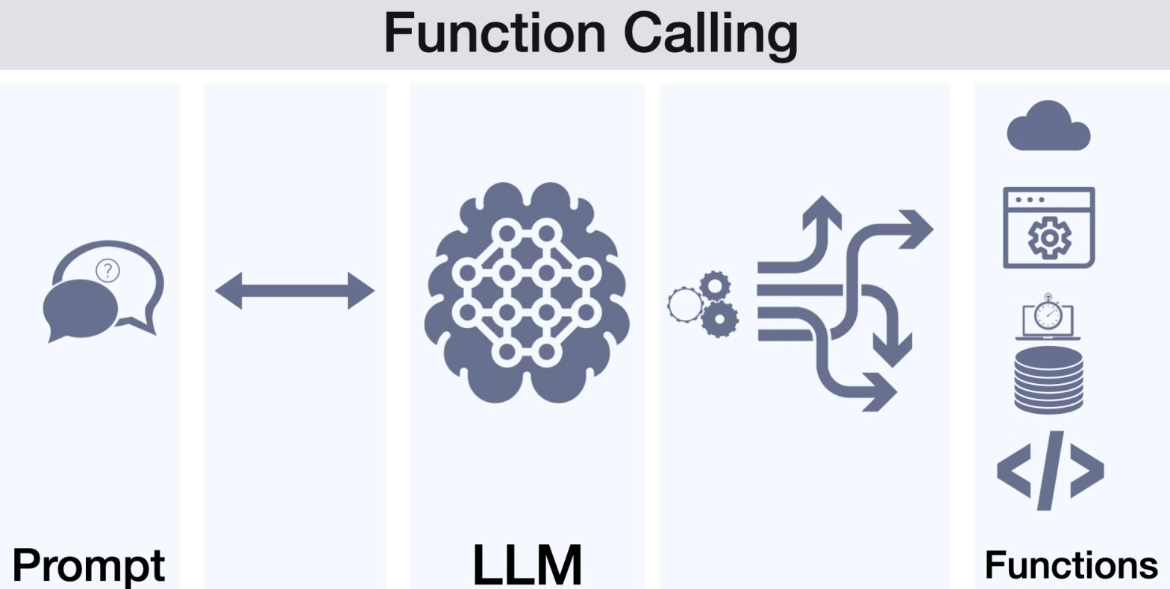
What is Function Calling?
Python custom code
Custom API calls
Function calling in Azure AI Agents refers to the process of invoking external APIs, plugins, or custom functions from within an AI agent to enhance its capabilities beyond simple language responses. This enables the agent to perform actions such as retrieving real-time data, updating databases, calling business logic, or integrating with external systems.

Slide 3
How Function Calling Works in Azure AI Agents:
User Query Processing → The AI agent receives a user request.
Function Selection → The agent determines whether a function is required to fulfill the request.
Function Execution → If needed, the agent calls the appropriate function, API, or service.
Response Generation → The function's output is processed and presented to the user

