Slide 1
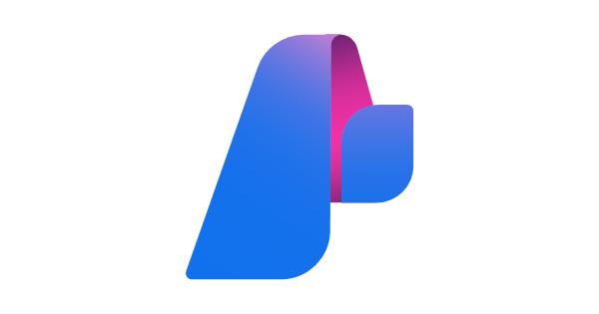
Introduction to Azure AI Studio Hub (Azure AI Foundry)

Slide 2
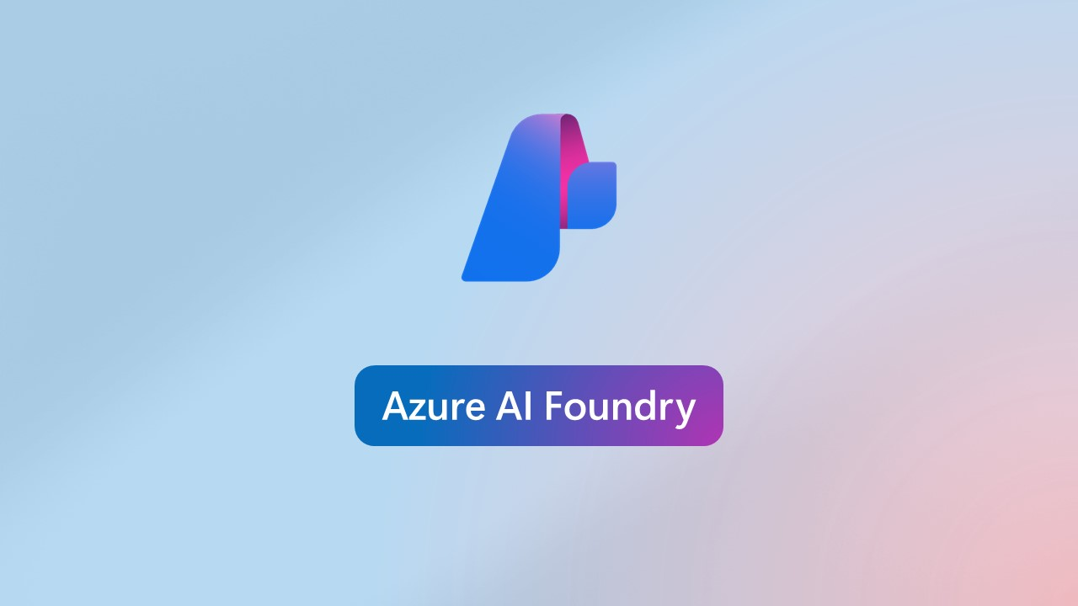
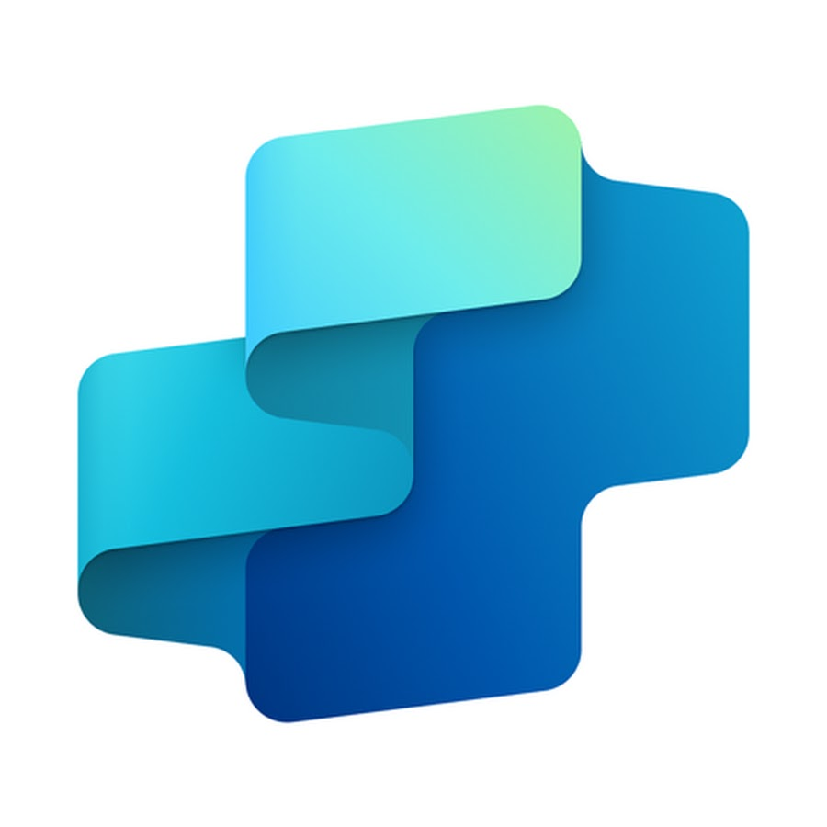

Azure OpenAI Offering World
Azure AI Foundry – Umbrella AI Product by Microsoft
Azure OpenAI Studio
Azure AI Studio Hub
Microsoft Copilot Studio
Concerned only for testing out LLM models such as GPT, Dall-E and text embedding models.
Doesn’t give you a unified experience.
Not suited for collaboration.
Comes in-built with a deployed Azure OpenAI resource.
1)Provides a Unified Governance-like experience.
2)Highly centered around collaboration.
3)Concerned with LLMOps. Can be clubbed with Azure DevOps.
4) Provides excellent monitoring tools for deployed Gen AI applications.
5) Has the Azure AI Agent Service for building AI Agents
1)Low-Code Deployment Tool.
2) Meant for citizen developers.
3)Meant For Extending already existing M365 copilot experience with plugins and power automate flows.

Slide 3
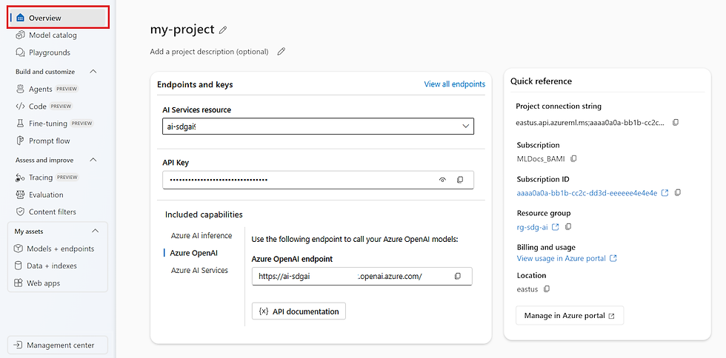

Slide 4
Key Offerings Of Azure AI Studio Hub
Provides a unified experience with every connection to Azure AI services such as Azure OpenAI resource, Azure Speech resource, Language resource etc. all into one place.
Through marketplace you can deploy several models other than GPT models such as Bert, Mistral family, Phi etc. and that too on serverless API hosting.
Provides excellent evaluation toolset for evaluating Gen AI applications on both pre and post deployment scenarios.
Built on the foundational pillars of collaboration and LLMOps.
Has the Azure AI Agent Service useful for building enterprise-level AI Agentic Systems

Slide 5
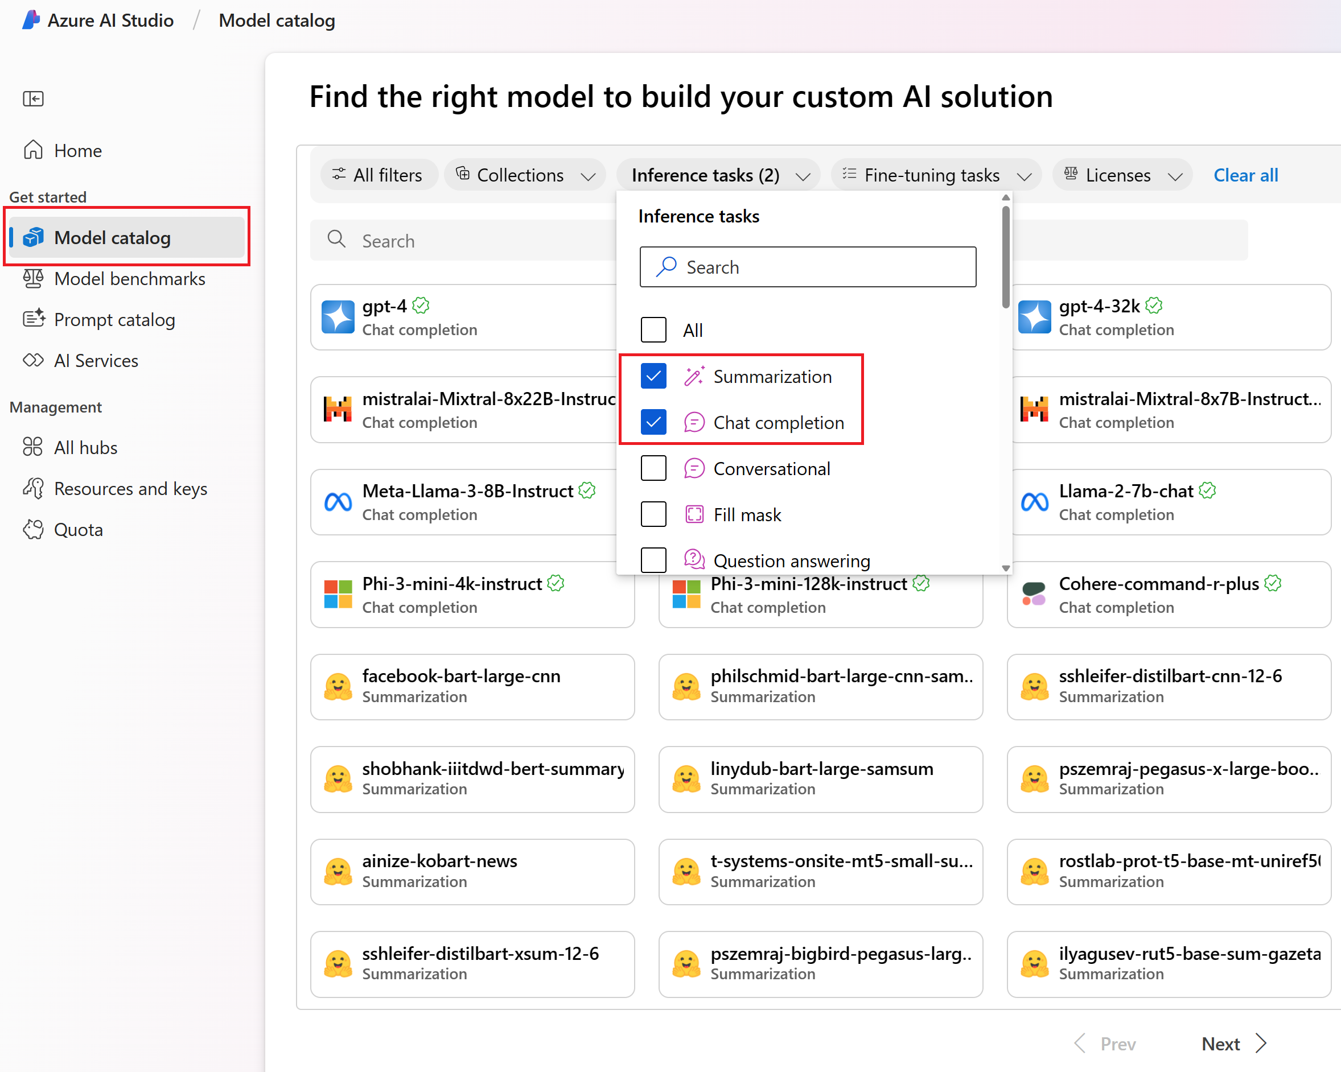
Model Catalog

Slide 6
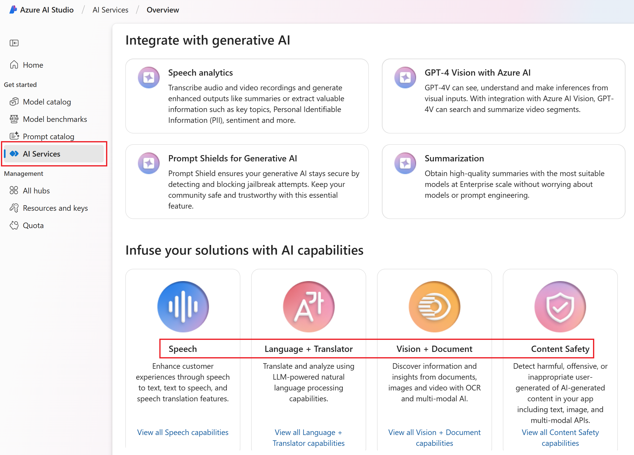
Build Multi-modal Gen AI apps.

Slide 7
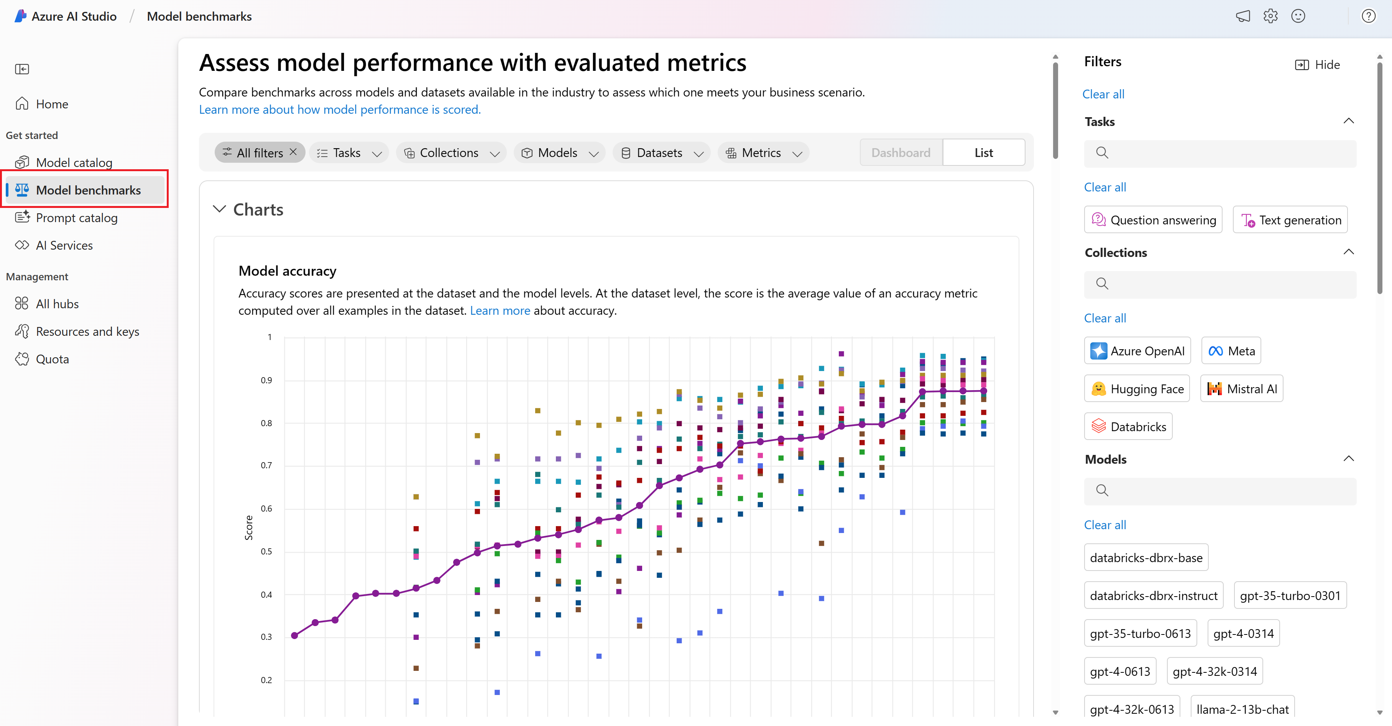
Model Benchmarks

Slide 8

Azure AI Studio Hierarchy
Project
Select Users Can Access
AI Studio resource deployed in Azure
Unique Azure Connections
AI Hub
Shared Azure Connections

Slide 9

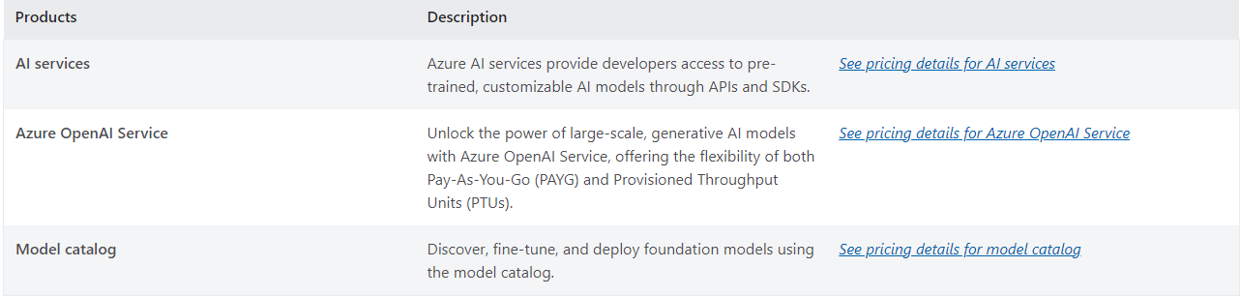
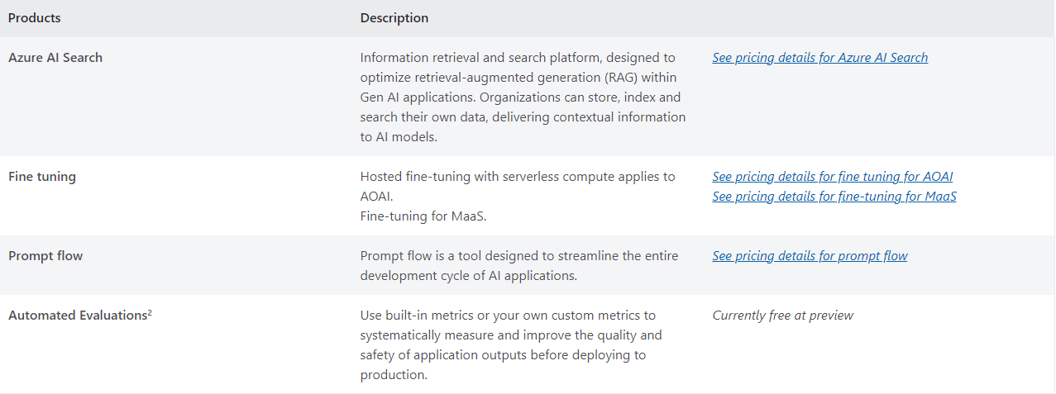
Pricing
The platform is free to use and explore. Pricing occurs at deployment level

