Slide 1
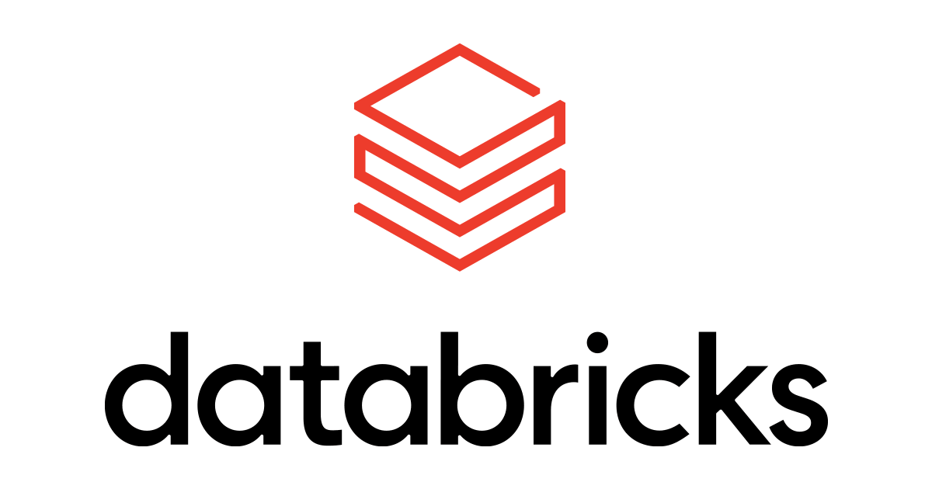
Introduction to Agents

Slide 2
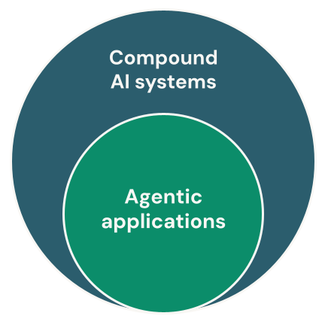
Compound AI Systems
With the advent of GenAI, people initially focused a lot on deploying primary LLMs are simple GenAI applications, but soon they realized its not enough for a good ROI.
This led to birth of Compound AI Systems
Compound AI Systems are systems that tackle AI tasks by combining multiple interacting components.
focus is rapidly changing: state-of-the-art AI results are increasingly obtained by compound systems with multiple components, not just monolithic models.

Slide 3
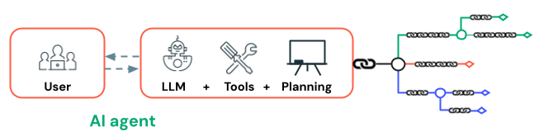
AI Agents as Compound Systems
The industry is still defining AI agents, however it generally understood as an AI system where the model makes some or all of the planning decisions in contrast to hard-coded logic.
Agency is a continuum, the more freedom we provide models to control the behavior of the system, the more agent-like the application becomes.
These agents use large language models (LLMs) to make decisions and accomplish their objectives.

Slide 4
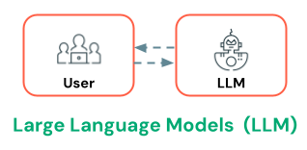
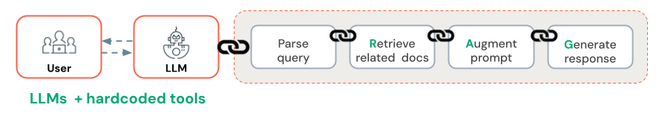
From LLMs to AI Agents
1. LLMs: Initially, large language models simply responded to prompts based on knowledge from a vast training dataset.
LLMs + tool chains: Then, developers added hardcoded tools to expand the LLM’s capabilities. For example, retrieval augmented generation (RAG) expanded an LLM’s knowledge base with custom documentation sets, while API tools allowed LLMs to perform tasks like create support tickets or send emails.
AI agents: Now, AI agents autonomously create plans and execute tasks based on their understanding of the problem. AI agents still use tools but it’s up to them to decide which tool to use and when. The key distinction is in the level of autonomy and decision-making capabilities compared to compound AI systems.

