Slide 1

RAG with Azure AI Search

Slide 2
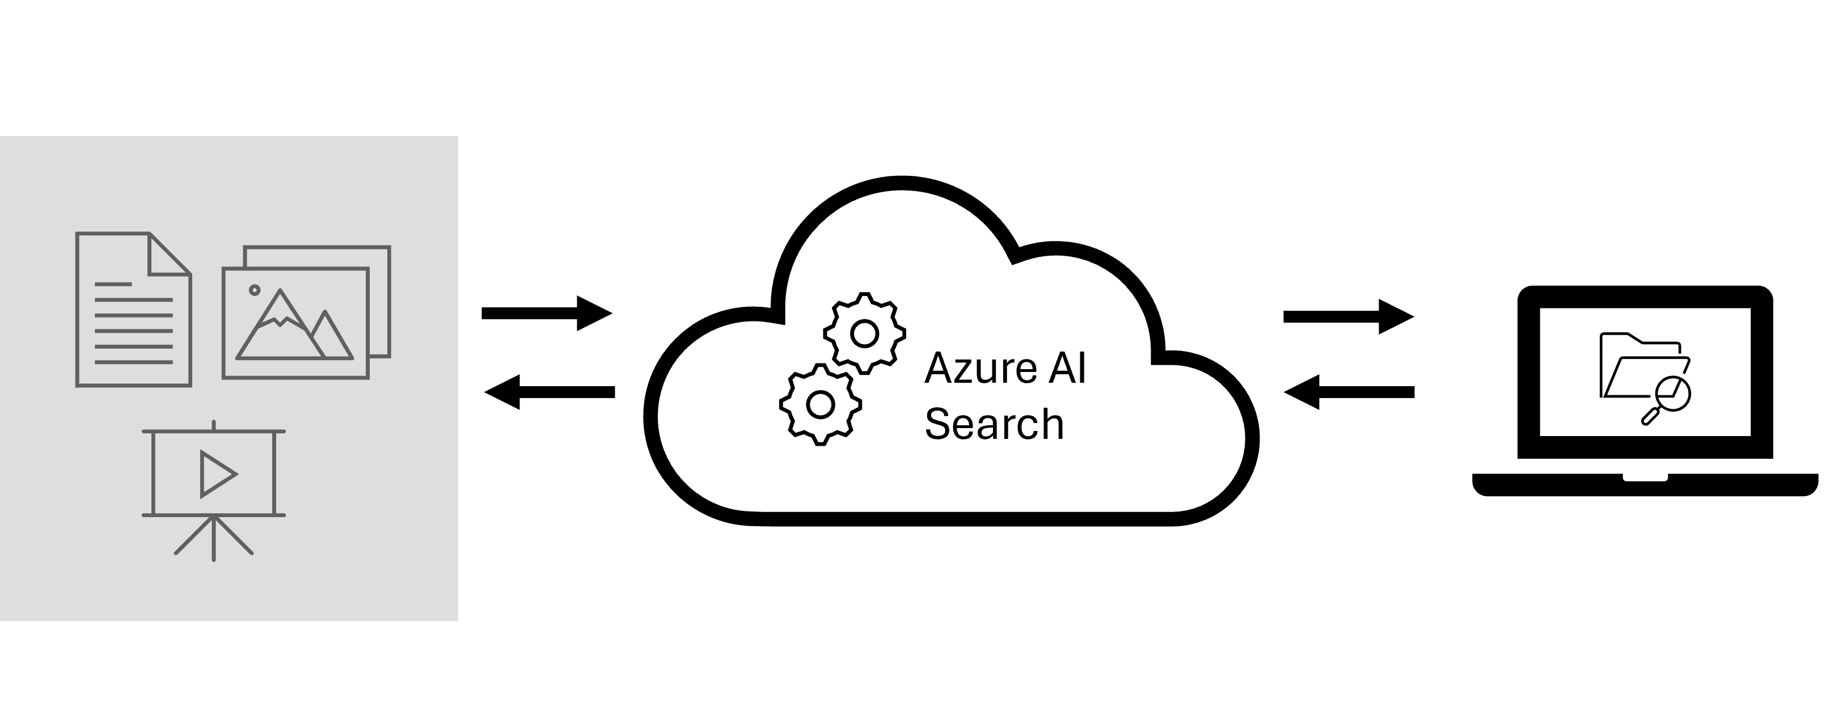
What is Azure AI Search?
Azure AI Search results contain only your data, which can include text inferred or extracted from images, or new entities and key phrases detection through text analytics.
Data sources: JSON format, auto crawling (Azure data sources)
Search & analysis: Vector search, full text, hybrid search
AI enrichment: Azure AI for image, text analysis
Linguistic analysis: 56 languages, phonetic matching, Azure AI Search, Bing, Office
User experience: Query syntax (vector, text, hybrid, fuzzy search), autocomplete, geo-search filtering
Azure integration: Scale, security, machine learning, Azure AI, Azure OpenAI

Slide 3
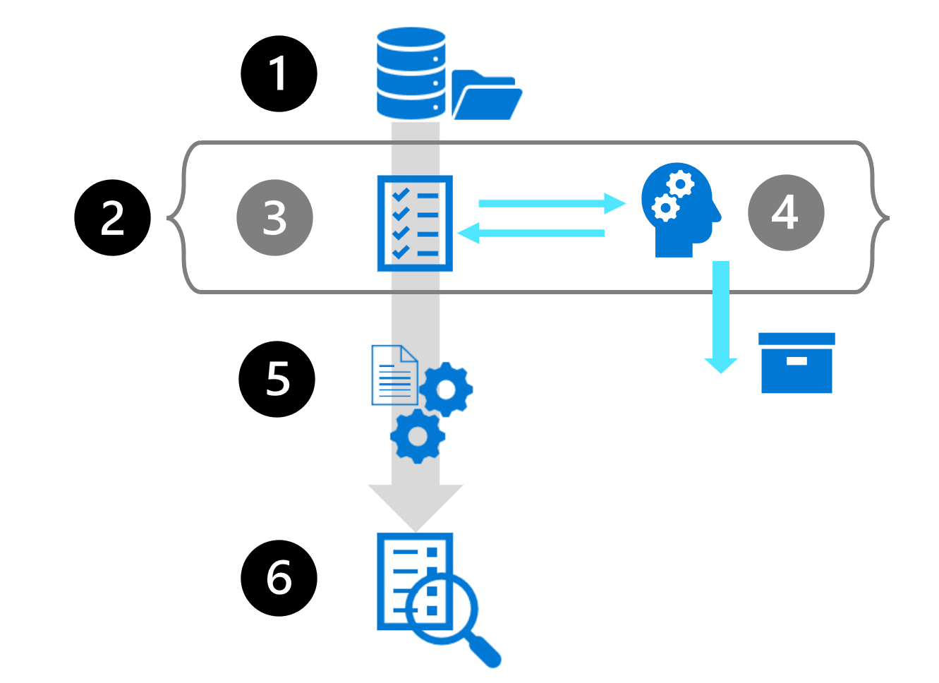
Data Source Integration
Skillset – AI Enrichment
Indexer
Index
User queries the index

Slide 4
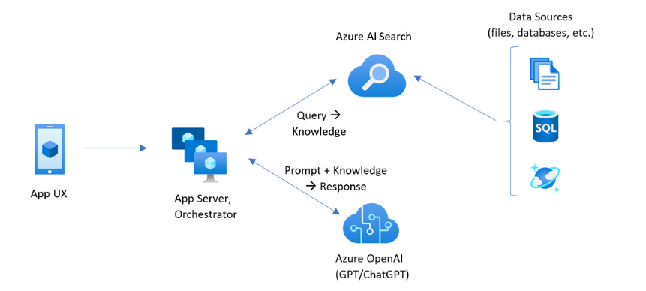
RAG Flow with Azure AI Search

