Slide 1
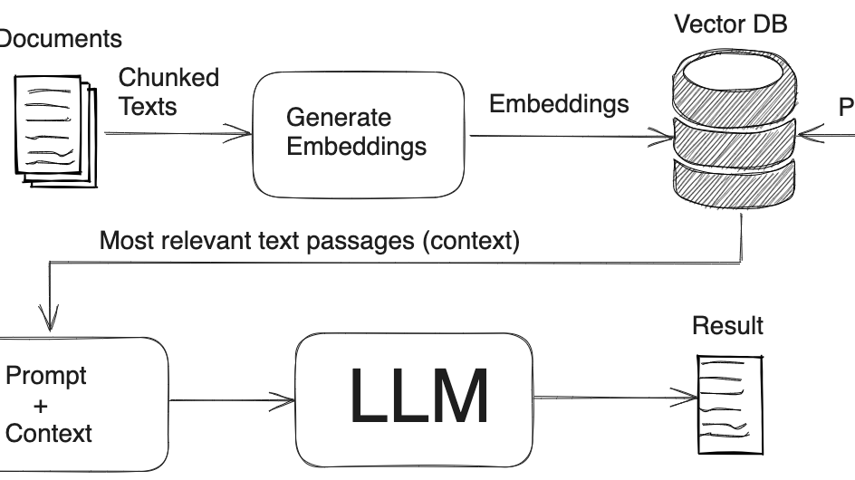
RAG
(Retrieval Augmented Generation)

Slide 2
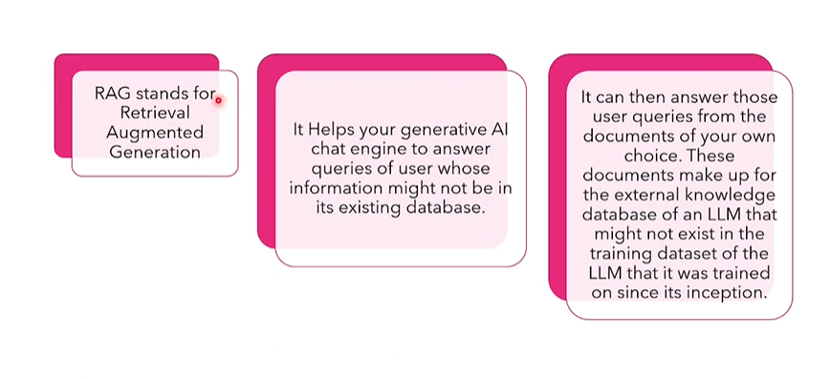

Slide 3
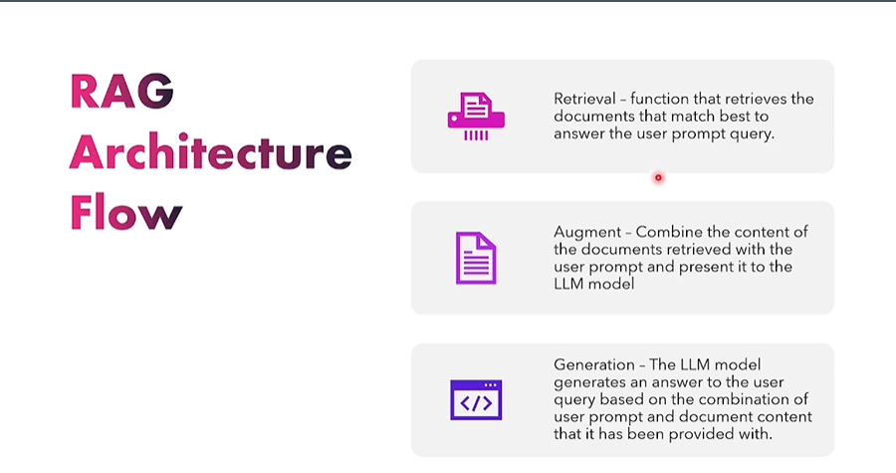

Slide 4
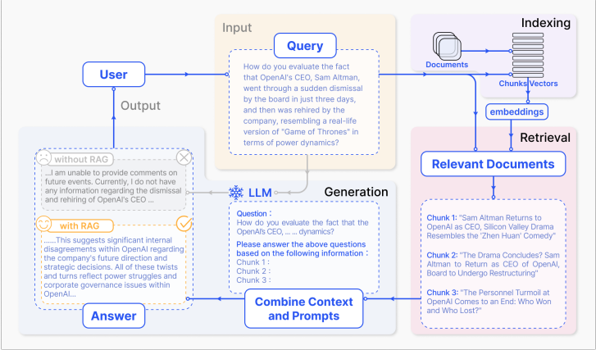

Slide 5

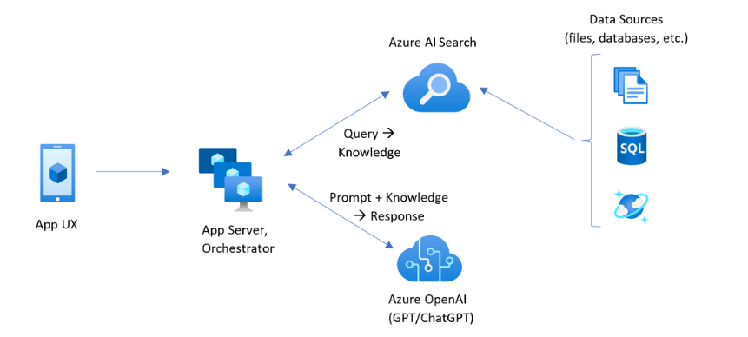
Azure AI Search
Azure AI Search is a proven solution for information retrieval in a RAG architecture. It provides indexing and query capabilities, with the infrastructure and security of the Azure cloud

Slide 6
