Slide 1
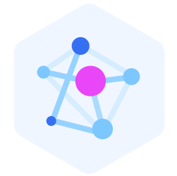
Vector Embeddings
(Heart of “RAG”)

Slide 2




Hello!
Thank you for joining me today
Instructor: Kuljot Singh Bakshi
Microsoft Learn Student Amabassador (MLSA)
B.Tech from IIT Bombay (0.1% selection rate)
3+ years of experience in the IT field
Udemy Instructor with 3500+ students and counting
Love Generative AI and all things Cloud
LinkedIn: https://www.linkedin.com/in/kuljot-bakshi-69101826b/

Slide 3

Learning Objectives
After completing this module, you will be able to:
Understand
Vector Embeddings
Identify
Use Cases for Vector Embeddings
Explore
Azure's Native Vector Storage Options
Learn about
Embedding Engines
Compute
Similarity Scores

Slide 4
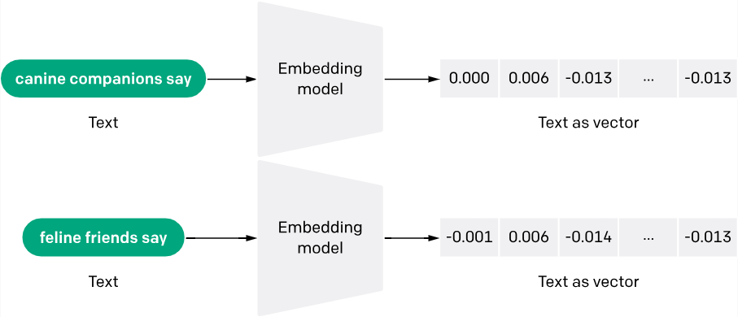
Vector embeddings are a way of representing words, sentences, images, or other data as numerical vectors in a high-dimensional space.
These vectors capture the semantic or contextual information in the data, allowing similar items to be closer together in that space
These vector embeddings are generated by text-embedding models that are offered by Azure OpenAI

Slide 5
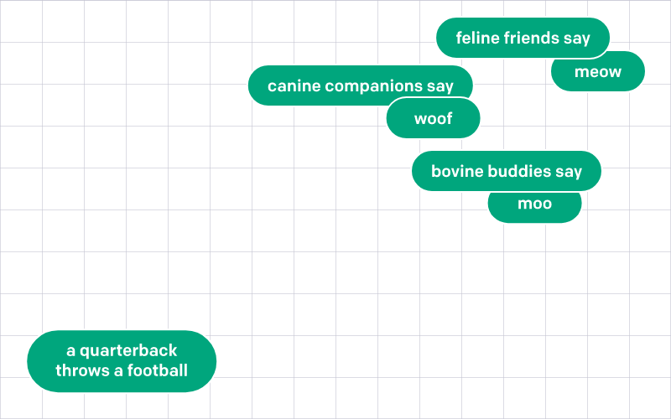

Slide 6
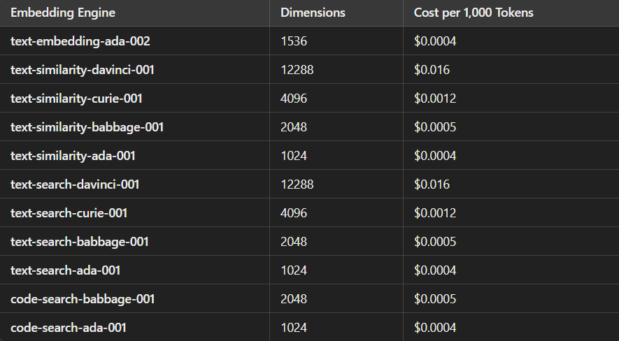
Embedding engines

Slide 7


Slide 8



Native Vector Storage Options in Azure
Azure Cognitive (AI) Search (with Vector Search Preview)
Description: Azure Cognitive Search now supports vector search, allowing for approximate nearest neighbor (ANN) search on vector data.
Use Case: Ideal for scenarios where you need full-text search combined with vector similarity search, such as recommendation engines or semantic search applications.
Features: Provides built-in indexing, similarity scoring (cosine similarity), and integrates with traditional keyword-based search.
Azure Cosmos DB (with Vector Search Preview)
Description: Azure Cosmos DB, a globally distributed NoSQL database, recently added support for vector search. It can store and retrieve high-dimensional vector data.
Use Case: Suitable for applications needing high availability and scalability across multiple regions, like real-time recommendation systems.
Features: Offers built-in support for ANN indexing and provides low-latency queries. It also integrates well with various AI models and vector search.
Azure Redis Cache with Vector Similarity (via Redis Vector Embeddings)
Description: By deploying Redis on Azure with modules for vector similarity search, you can perform efficient vector-based lookups.
Use Case: Suitable for caching and rapid similarity search where low latency is crucial, like real-time recommendations or session-based personalization.
Features: Supports similarity search with fast access times, but may need additional setup for managing large datasets.

Slide 9
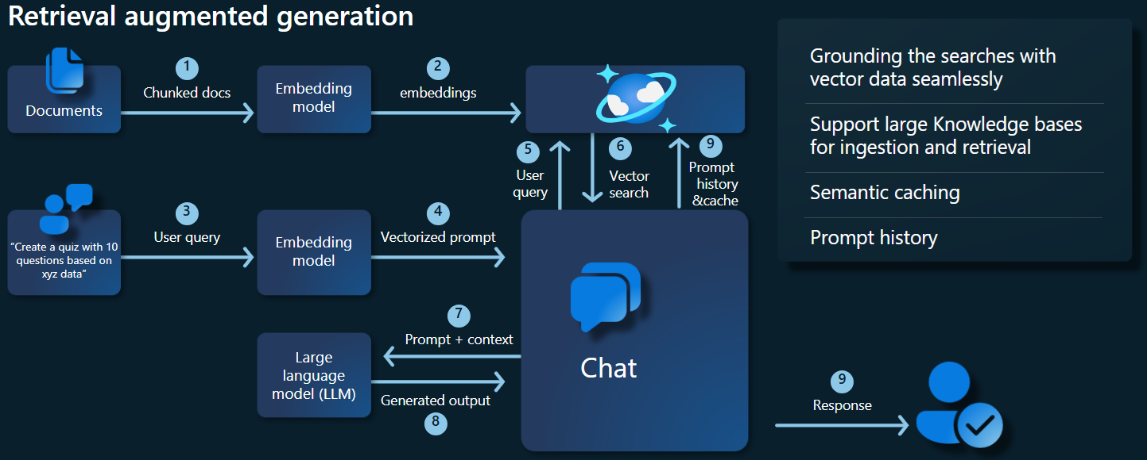
Use of embeddings in RAG
Vector embeddings are indexed through algorithms like DiskANN, ANN etc.
Similarity scores are computed with help of “Vector Distance” functions like cosine similarity, dot product etc.

