Slide 1
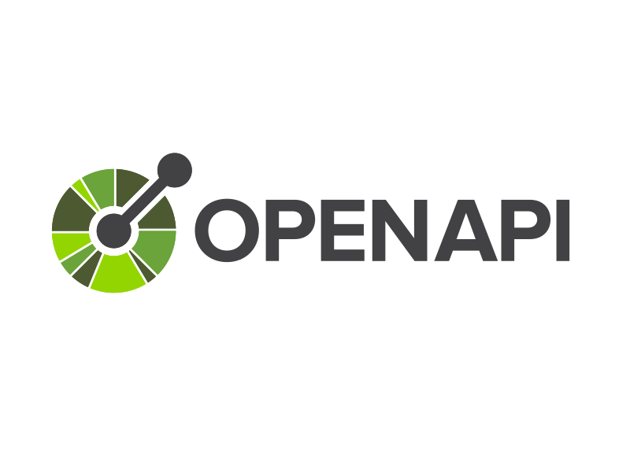
OpenAPI Tools

Slide 2
What is an OpenAPI Schema?
An OpenAPI schema is a formal definition of the structure and data types used in an API
It describes the input and output data formats, including the parameters, request bodies, responses, and objects involved in API operations.
The OpenAPI Specification (OAS) offers a standardized way to define and document APIs, and at the heart of this specification is the OpenAPI schema.

Slide 3
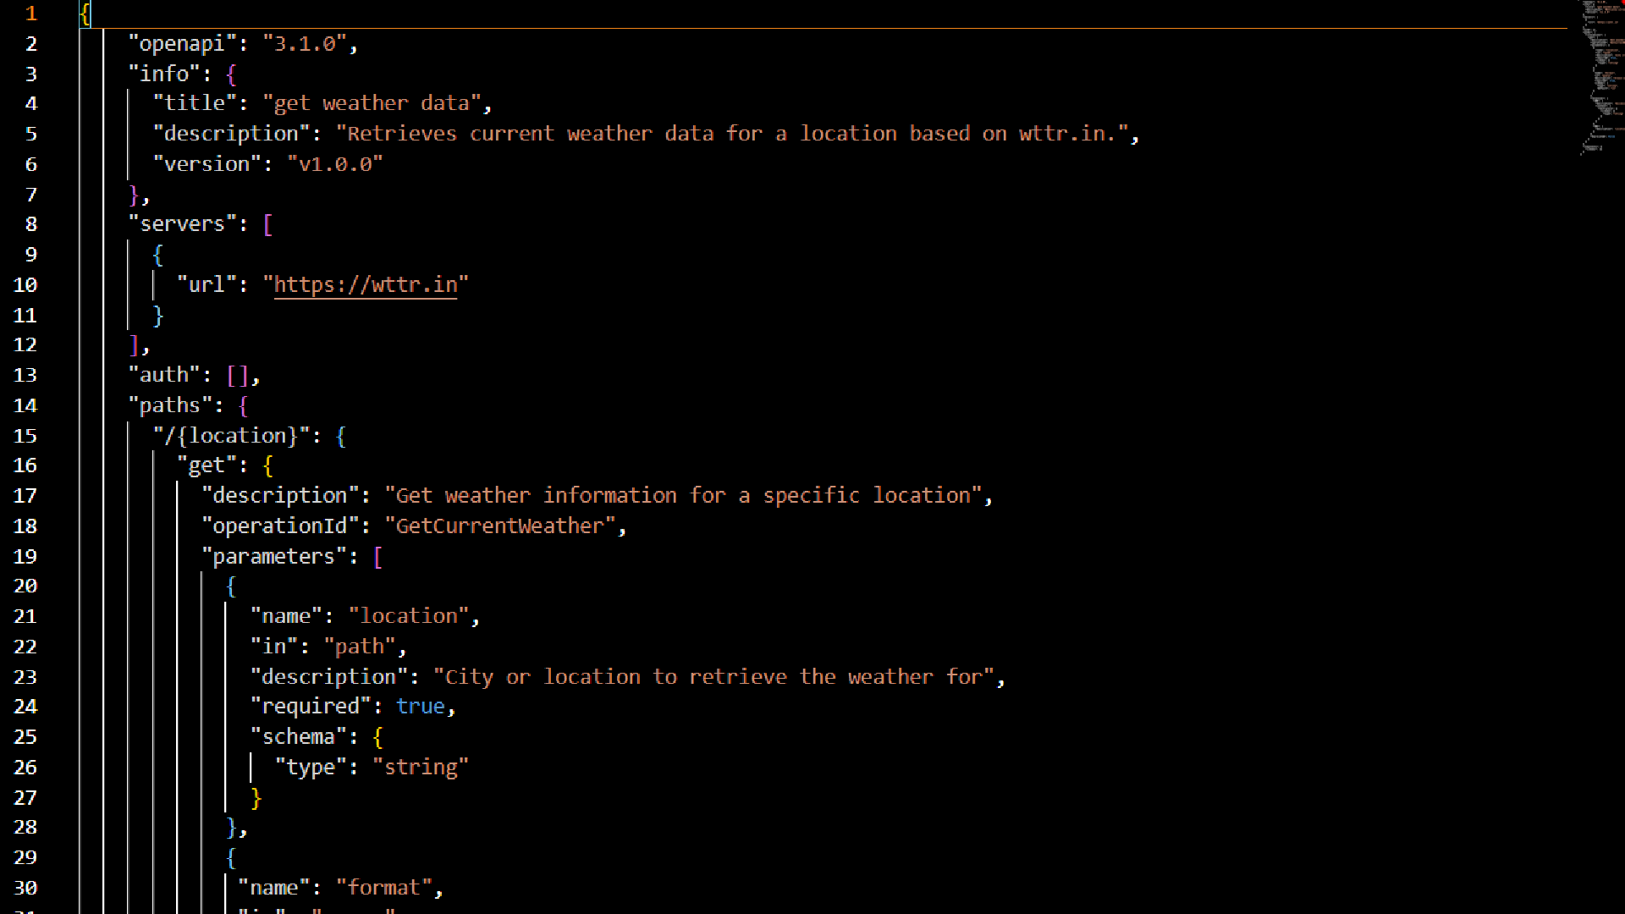

Slide 4

Benefits of OpenAPI Tools
Agents can automatically call APIs based on their capabilities and needs.
Azure AI Agent Service can reason about which API calls to make, reducing manual intervention.
Developers can onboard APIs quickly without manually defining agent capabilities.
Reduces the need for custom API wrappers.

