Slide 1

Dynamic Traffic Signal Control
ME 735 Project
Umang Chhawchharia
Naman Yadav
Divya Pattisapu
Kartavya Singh
160100014
160100012
160040084
16D10007

Slide 2
Contents Page
A. Introduction . . . . . 01
B. Approach . . . . . 04
C. Phase 1- Detection . . . . . 06
D. Phase 2 - Traffic Density . . . . . 13
E. Phase 3 - Signal Control . . . . . 14
F. The Future . . . . . 18
1

Slide 3
Need
Traffic congestion leads to long waiting hours along with fuel and money wastage. So, the traffic management on road is crucial to reduce these problems
Drawbacks of Traditional Traffic Light Controller
Heavy Traffic Jams
No Traffic,
but need to wait
Emergency Car Case
Inadequate traffic information to users
1
2
3
4
Navigating heavy jams especially on main junctions by delaying various lanes
Sometimes there is no traffic yet the light remains red and if rule is broken there is a fine
Emergency vehicles like
ambulance, fire brigade are stuck in heavy traffic
When vehicle density of all the roads are known information
can be provided to users
2

Slide 4
Our Objective
To detect the density of cars in a lane at a given point of time and ultimately be able to control the traffic signal dynamically
Main Aims
Create an algorithm to determine the number of cars in a lane in a given time. Finer resolution can also ultimately aid the police to detect rule breakers and impose fine
Control the traffic signals at a junction dynamically, to minimize delay experienced by passengers and aid in time of emergency (ambulances, police cars etc.)
3

Slide 5
Contents Page
A. Introduction . . . . . 01
B. Approach . . . . . 04
C. Phase 1- Detection . . . . . 06
D. Phase 2 - Traffic Density . . . . . 13
E. Phase 3 - Signal Control . . . . . 14
F. The Future . . . . . 18
1

Slide 6
Approach
The problem was divided into 3 parts – Detection of cars, calculation of traffic density and adjusting the traffic signals dynamically
Phase 1
Image detection code was created by using the pre-trained YOLO algorithm
Non-maxima separation was used to eliminate multiple detections of same object
Phase 2
The traffic density (cars passing a particular zone in given time) was calculated by optimizing the image detection
This required identification whether a given car was in a specific lane or not
Phase 3
An algorithm based on 3 lanes in a road and their possible paths was created
The total waiting time for vehicles was optimized for a 4-way traffic signal
5

Slide 7
Contents Page
A. Introduction . . . . . 01
B. Approach . . . . . 04
C. Phase 1- Detection . . . . . 06
D. Phase 2 - Traffic Density . . . . . 13
E. Phase 3 - Signal Control . . . . . 14
F. The Future . . . . . 18
1

Slide 8
Why YOLO ?
You only look once (YOLO) is a state-of-the-art, real-time object detection system.
On comparing with other detectors YOLO is extremely accurate and fast
 | RetinaNet -101 | SSD321 | YOLO
mAP (mean average precision) | 53.1 | 45.4 | 55.3
FPS | 11 | 16 | 35
Time (ms) | 90 | 61 | 29
Detection Method | Uses classifier-based systems which apply the model to an image at multiple locations and scales |  | Single neural network for the entire image
7

Slide 9
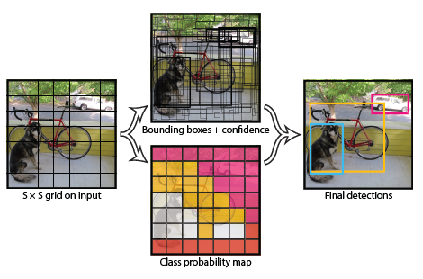
How it works?
YOLO applies a single neural network to the full image which divides the image into regions and predicts bounding boxes and probabilities for each region
Basic Working
The system divides the input image into an S xS grid.
Our system models detection is expressed as a regression problem. For each grid cell predicts B bounding boxes, confidence for those boxes, and C class probabilities. These predictions are encoded as an S xS x(B *5 + C) tensor.
Each bounding box consists of 5 predictions: x, y, w, h, and confidence. x and y are scaled to relative coordinates with a scale of [0, 1] inside grid.
8

Slide 10
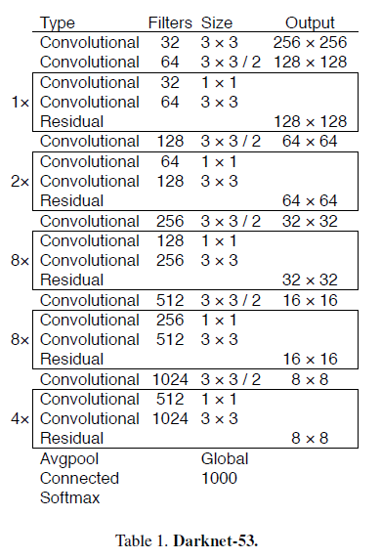
YOLO Version 3
We have used the YOLO v3 algorithm to identify all the vehicles in the videos from the traffic signal cameras.
Advantages
Detection of smaller objects - YOLO v3 makes detections at three different layers which helps address the in detecting small objects. The 13 x 13 layer is responsible for detecting large objects, whereas the 52 x 52 layer detects the smaller objects, with the 26 x 26 layer detecting medium objects.
Fully convolutional network - The detection is done by applying 1 x 1 detection kernels on feature maps of three different sizes at three different places
No loss of low-level features - No form of pooling is used, and a convolutional layer with stride 2 is used to downsample the feature maps. This helps in preventing loss of low-level features often attributed to pooling.
Multilabel classification - We do not use a softmax as it imposes the assumption that each box has exactly one class which is often not the case
YOLO has 75 convolutional layers, with skip connections and upsampling layers.
9

Slide 11
Contents Page
A. Introduction . . . . . 01
B. Approach . . . . . 04
C. Phase 1- Detection . . . . . 06
D. Phase 2 - Traffic Density . . . . . 10
E. Phase 3 - Signal Control . . . . . 14
F. The Future . . . . . 18
10

Slide 12
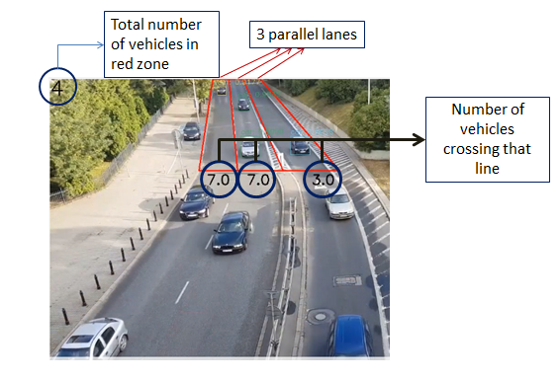
Number of vehicles in a lane - I
The number of cars crossing the horizontal red line were identified by comparing 2 time frames
Algorithm
Step 1 - The midpoint of the cars were sorted by their respective Y coordinates and stored in a list which was carried over to the next frame.
Step 2 - The Y coordinate of the bottommost cars in the current frame was compared with that of the previous frame. If a change of more than 5 in the negative direction was noticed, this means that the car has crossed the red line and gone out of bounds. Now the lowermost Y coordinate belongs to a different car.
Step 3 - This was done for every lane and the numbers of vehicles crossing red line were displayed below each lane.
11

Slide 13
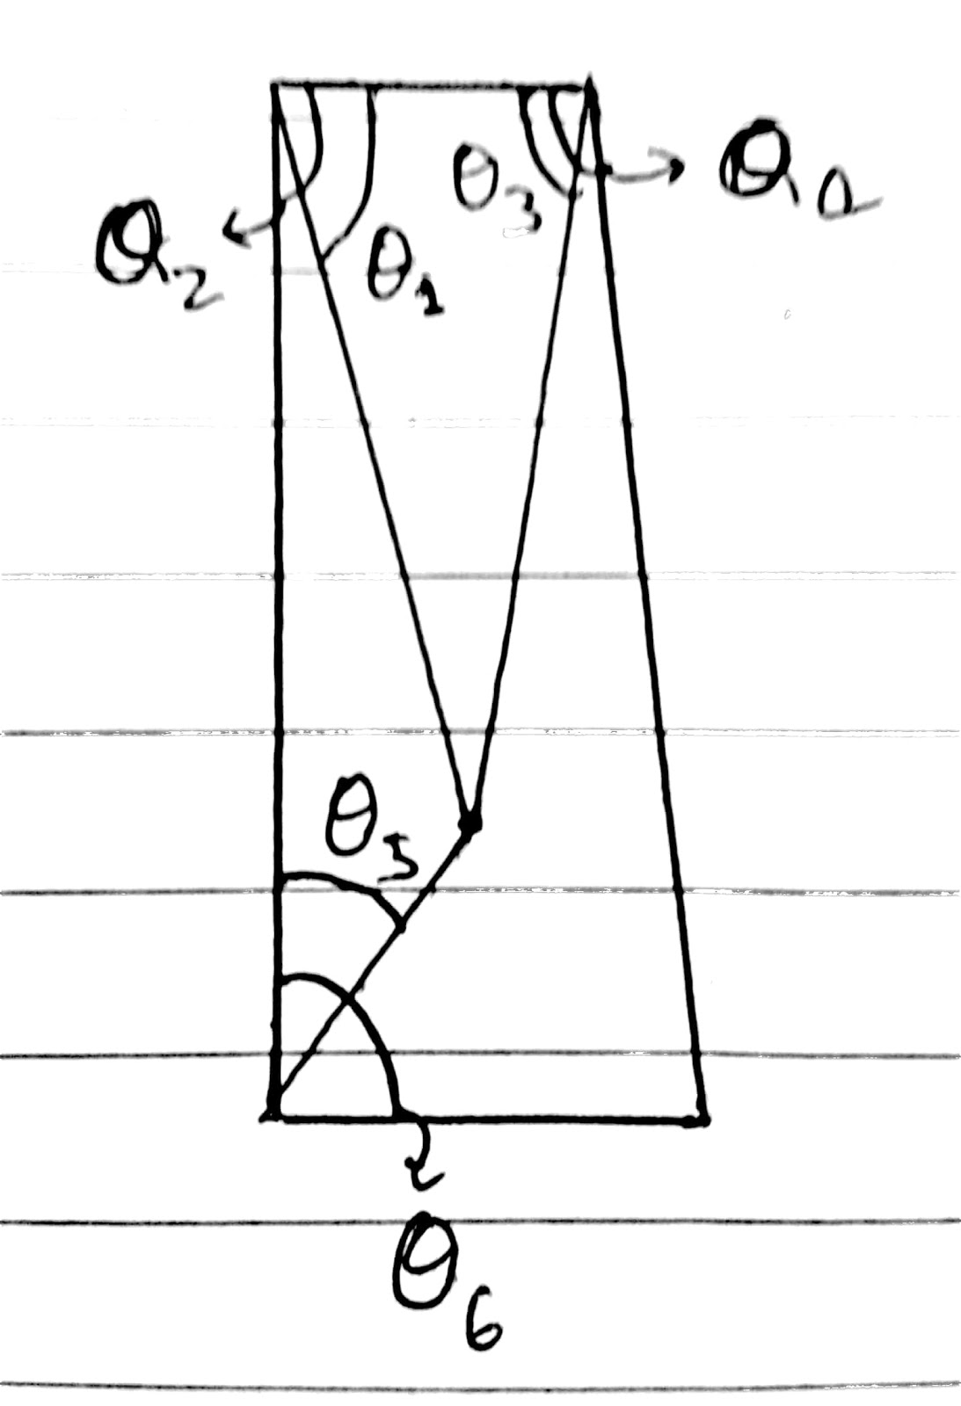
Number of vehicles in a lane - II
Cosines of all the above given angles(in the figure shown above) were calculated using dot products of the adjoining lines. A point is inside the area if -
cos Θ1 > cos Θ2
cos Θ3 > cos Θ4
cos Θ5 > cos Θ6
All the center points of cars that were in the lane were detected and the rest were neglected.
PCU (Passenger Car Unit) equivalent was calculated for each vehicle as following:
Trucks, buses = 3 PCU
Car = 1 PCU
Motorcycle = 0.5 PCU
Output is recorded for each video of 75 s each. The numbers of all the 3 lanes summed up shows the number of vehicles passing the horizontal red line in 75 s. Multiplying this number by 48(=3600/75) gives the number of vehicles passing if an hour
Confirming the presence of a car in a lane
Calculating Passenger Car Unit
12

Slide 14
Traffic Density Output
These are the number of vehicles that crossed each of the lanes in a total of 75 s followed by flow which is calculated for an hour
 | Lane 1 | Lane 2 | Lane 3
1 | 63 | 48 | 28
2 | 47 | 44 | 19
3 | 33 | 52 | 36
4 | 39 | 49 | 27
 | Lane 1 | Lane 2 | Lane 3
1 | 3024 | 2304 | 1344
2 | 2256 | 2112 | 912
3 | 1584 | 2496 | 1728
4 | 1872 | 2352 | 1296
Number of vehicles that crossed each of the lanes in a total of 75 s
Number of Vehicles in a road per hour (flow)
13

Slide 15
Contents Page
A. Introduction . . . . . 01
B. Approach . . . . . 04
C. Phase 1- Detection . . . . . 06
D. Phase 2 - Traffic Density . . . . . 10
E. Phase 3 - Signal Control . . . . . 14
F. The Future . . . . . 18
14

Slide 16
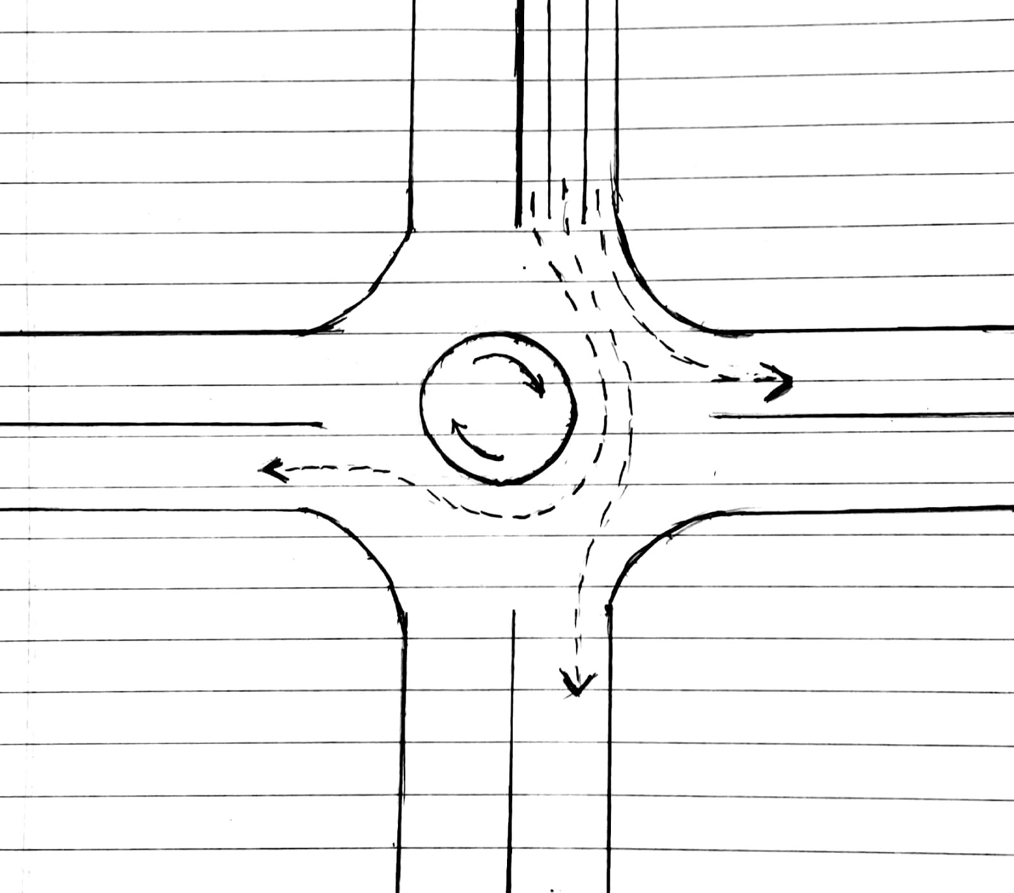

4 way traffic signal
To detect the density of cars in a lane at a given point of time and ultimately be able to control the traffic signal dynamically
Basic Algorithm
The algorithm that we use is as follows
Where,
Cmin = The signal cycle time
L = Total time lost per cycle
Xc = Intersection desired value to Capacity ratio
vi = Critical flow rate in ith phase
s = Saturation flow rate
Possible paths from a given lane is into the 3 other lanes
15

Slide 17
Calculating the signal cycle
To detect the density of cars in a lane at a given point of time and ultimately be able to control the traffic signal dynamically
Variable | Formula | Factors |  | Result
L | L = N x Lt | N = Number of phases = 4 | Lt (total late time for one lane group) = L1(driver reaction time) + L2(clearance loss time) | 12
Xc | Xc= 0.9 for standard conditions | - |  | 0.9
vi | vi = Vi / PHF | PHF = Peak Hour Factor = 0.95 for standard conditions | Vi = Max flow rate for each phase from table | (Per phase)
s | s = 3600/h vehicles/hr | h = saturation head-way (time between 2 consecutive cars) = 2.3 s |  | 1565.2 vehicles/hr
16

Slide 18
Calculating Green Light time
To detect the density of cars in a lane at a given point of time and ultimately be able to control the traffic signal dynamically
 | Formula | Factors
Effective Total Green light time | Gt=C –N x Lt | C = Signal Cycle Time, N x Lt = Lost Time
Effective Green light time | Gi = (Gt x vi) / Vc | Vc= Vi for all paths going into the intersection
Actual Green light signal time for phase i | Gi’ = Gi-Yi+Lt | where, Yi (Yellow Time) = 3s for Standard conditions..
Effective Red light time | Ri=C – Gi’
Actual Red light time | Ri’=Ri-Lt
17

Slide 19
Contents Page
A. Introduction . . . . . 01
B. Approach . . . . . 04
C. Phase 1- Detection . . . . . 06
D. Phase 2 - Traffic Density . . . . . 10
E. Phase 3 - Signal Control . . . . . 14
F. The Future . . . . . 18
18

Slide 20
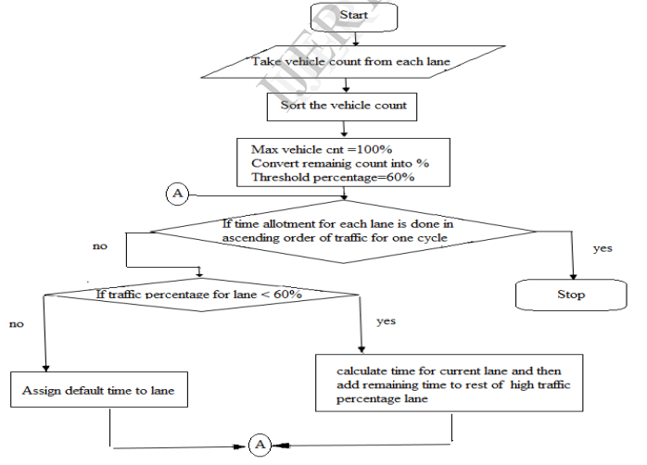
The Future
Optimizing the system for high flow rate, passing of emergency vehicles and high resolution image detection
Alternative Method
Future scope of the project
High Flow Rate - Since, our video is very short and the flow is also continuous, which is not what happens in reality, the values obtained are not completely accurate. This problem can be sorted by having better detectors and better data
Emergency Vehicles - The code can be adjusted to help in case of passing of an emergency vehicle. As soon as it detects an emergency vehicle it will stop the traffic in the other lanes of the junction
Plate Detection - With improvement in the detection systems, the plate number of the vehicles can be obtained which can aid the traffic police to collect evidence against rule breakers
The threshold value taken in the flowchart is 60% but that can be chosen by us depending on the condition .
19

Slide 21
Thank You

