Slide 1
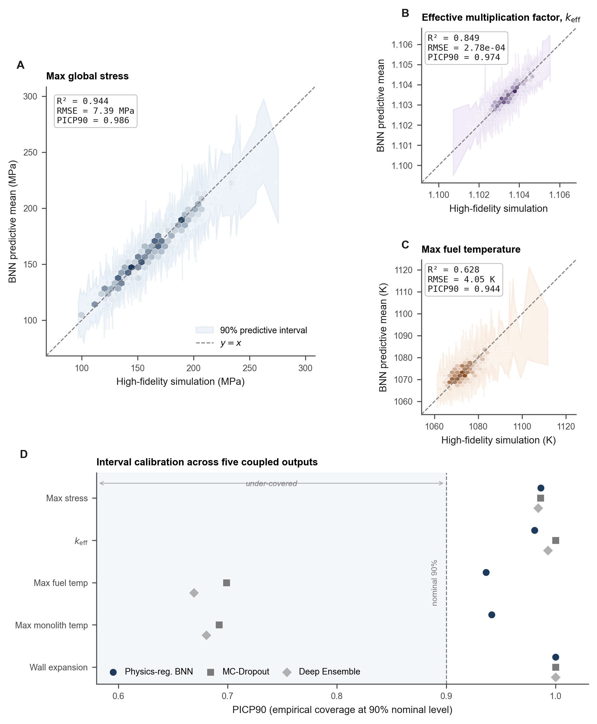
Figure 2 | Posterior predictive behaviour of the selected Bayesian surrogate
A
B
C
D
Notes:
Figure 2: Posterior predictive behaviour.
Panels A-C: parity hexbin, Panel D: PICP90 strip.
All text on Slide 2 is editable — copy to this slide as needed.

Slide 2
Figure 2 — Editable text elements
Editable panel titles and annotations
A. Max global stress (parity plot)
B. Effective multiplication factor, k_eff (parity plot)
C. Max fuel temperature (parity plot)
D. Interval calibration across five coupled outputs
Key metric annotations (editable):
• Panel A — R², RMSE (MPa), PICP90
• Panel B — R², RMSE, PICP90
• Panel C — R², RMSE (K), PICP90
• Panel D — PICP90 at 90% nominal level
Legend entries (editable):
• 90% predictive interval
• y = x (identity line)
• Physics-regularized BNN
• MC-Dropout
• Deep Ensemble
Caption: Panels A–C show parity hexbin plots for coupled steady-state max stress, k_eff, and max fuel temperature respectively, with 90% predictive intervals. Panel D compares interval calibration (PICP90) of BNN vs baselines across all five coupled outputs.

