Slide 1
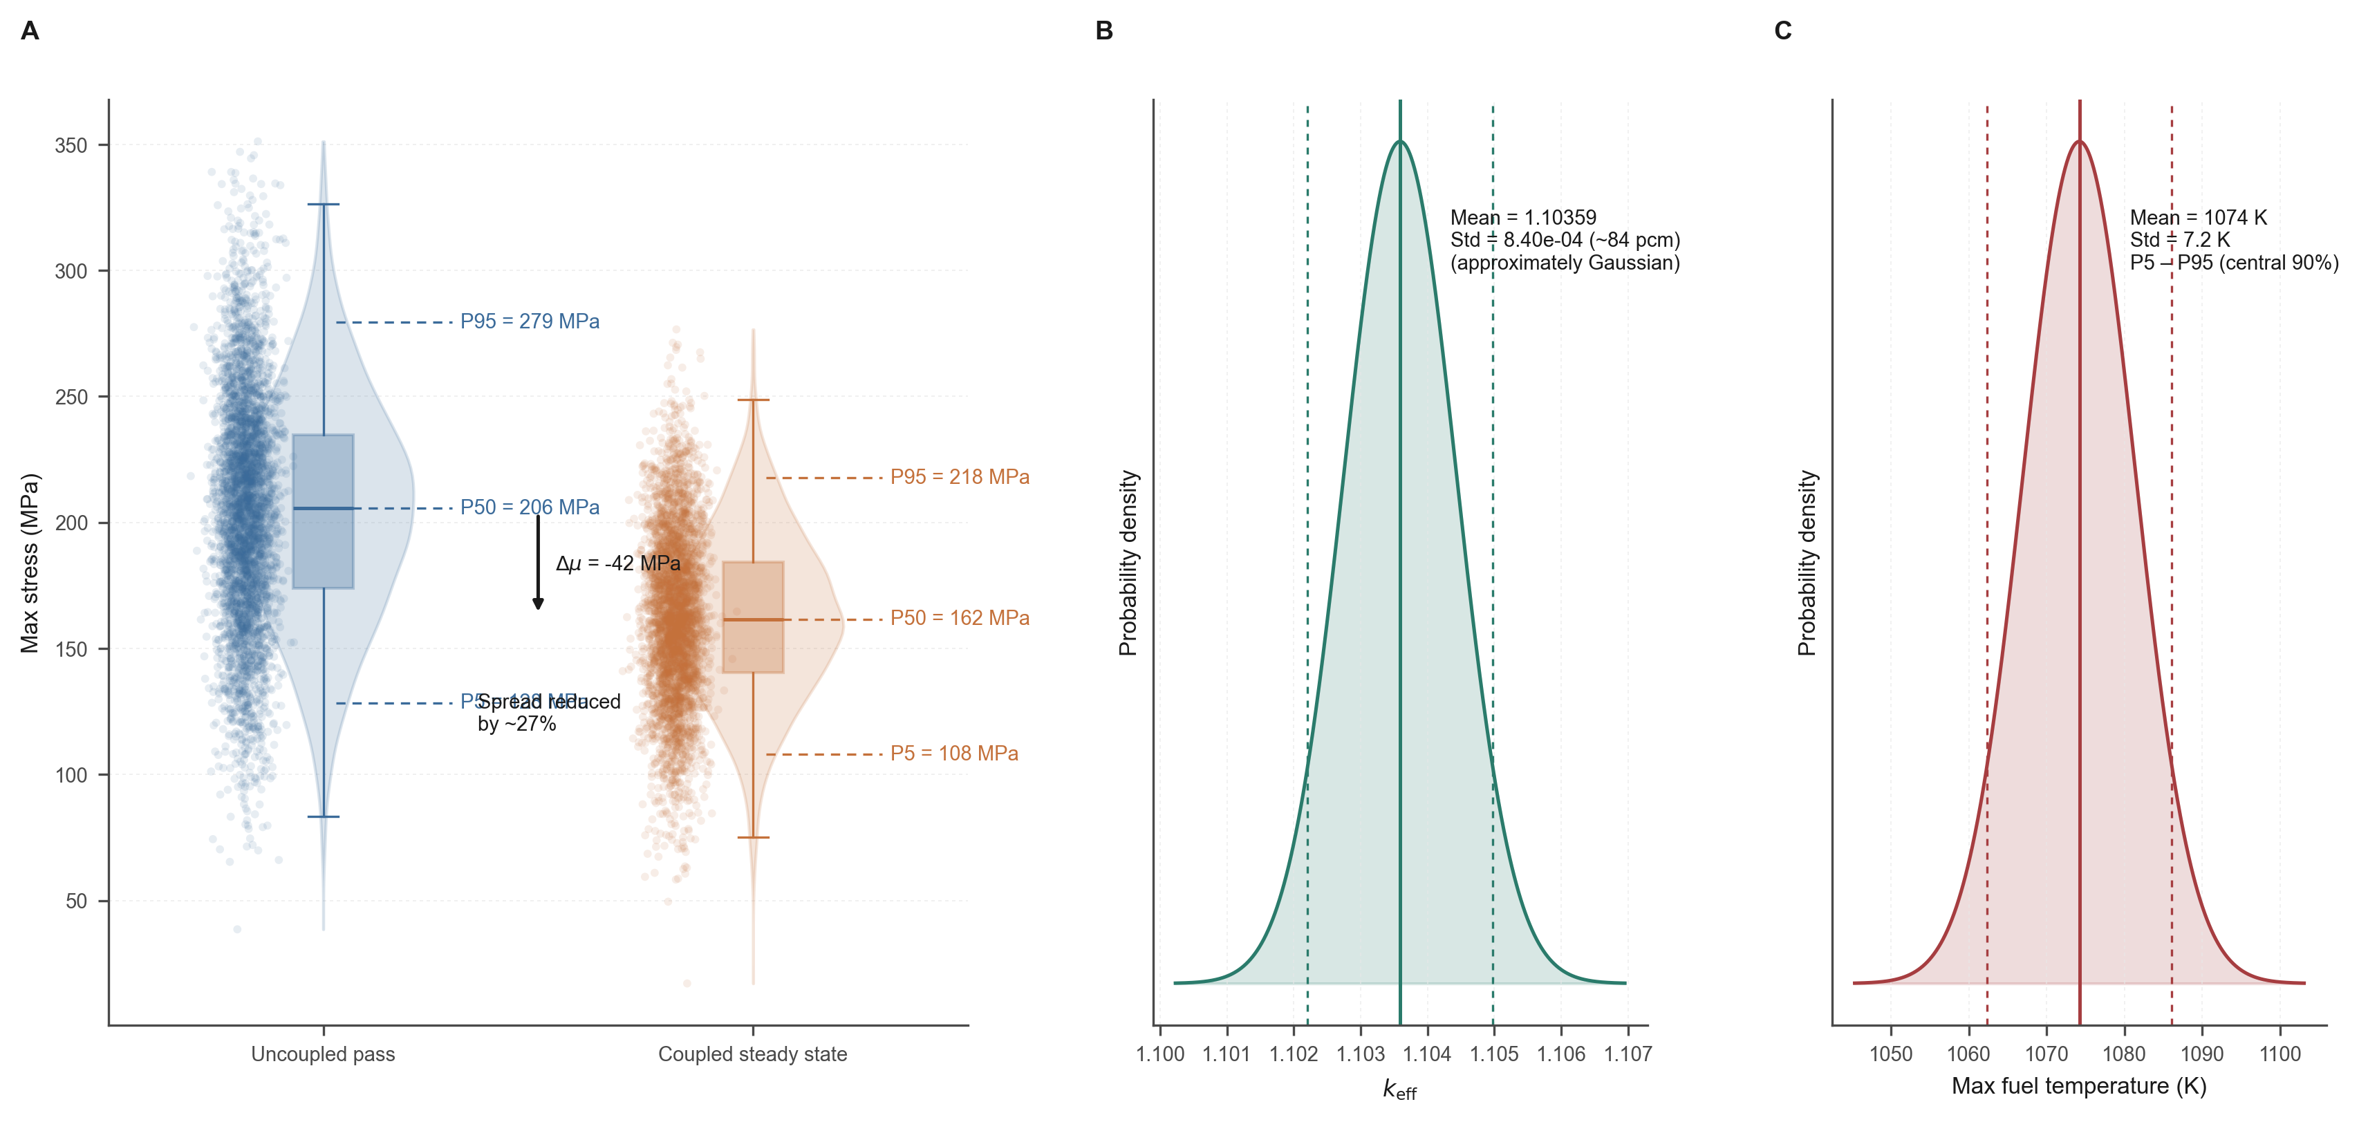
Figure 3 | Coupling reshapes forward response distributions
A
B
C
Notes:
Figure 3 — Forward UQ.
Panel A: stress, Panel B: k_eff, Panel C: fuel temp.
All text on last slide is editable.

Slide 2
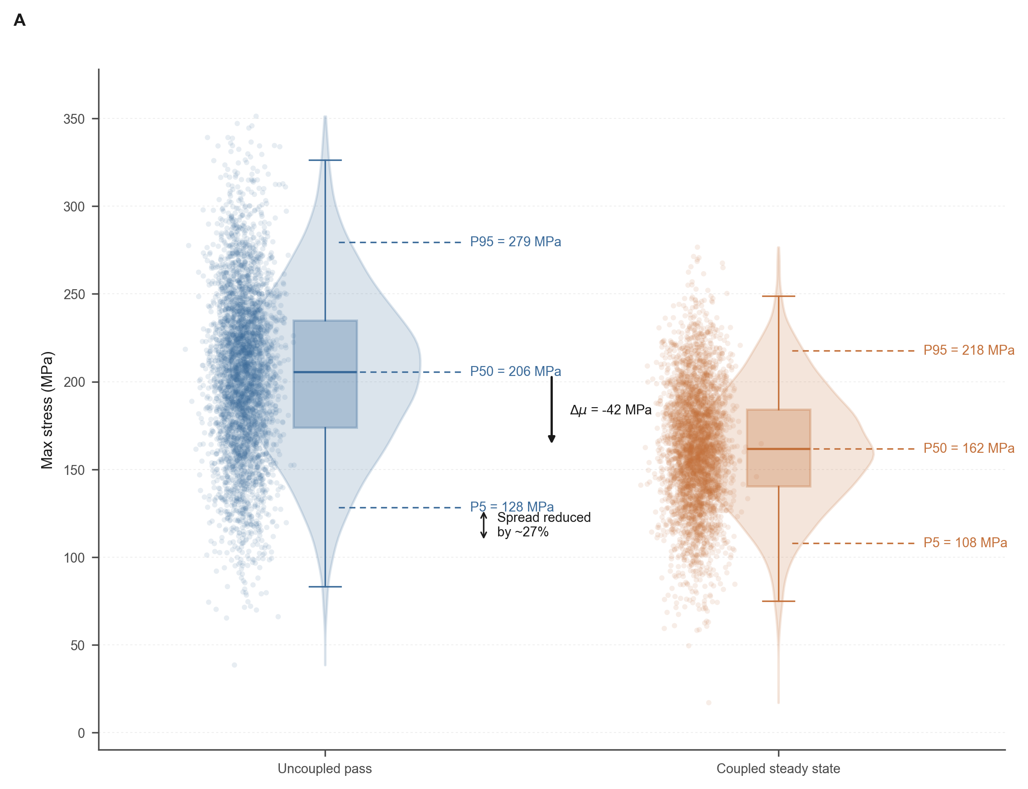
Figure 3A | Coupling reshapes stress distribution
A

Slide 3
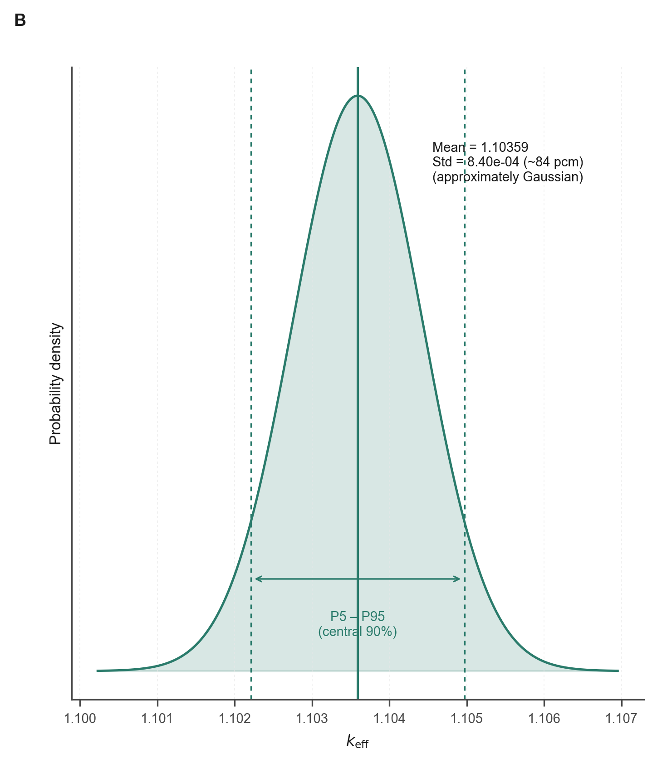
Figure 3B | Coupled k_eff distribution
B

Slide 4
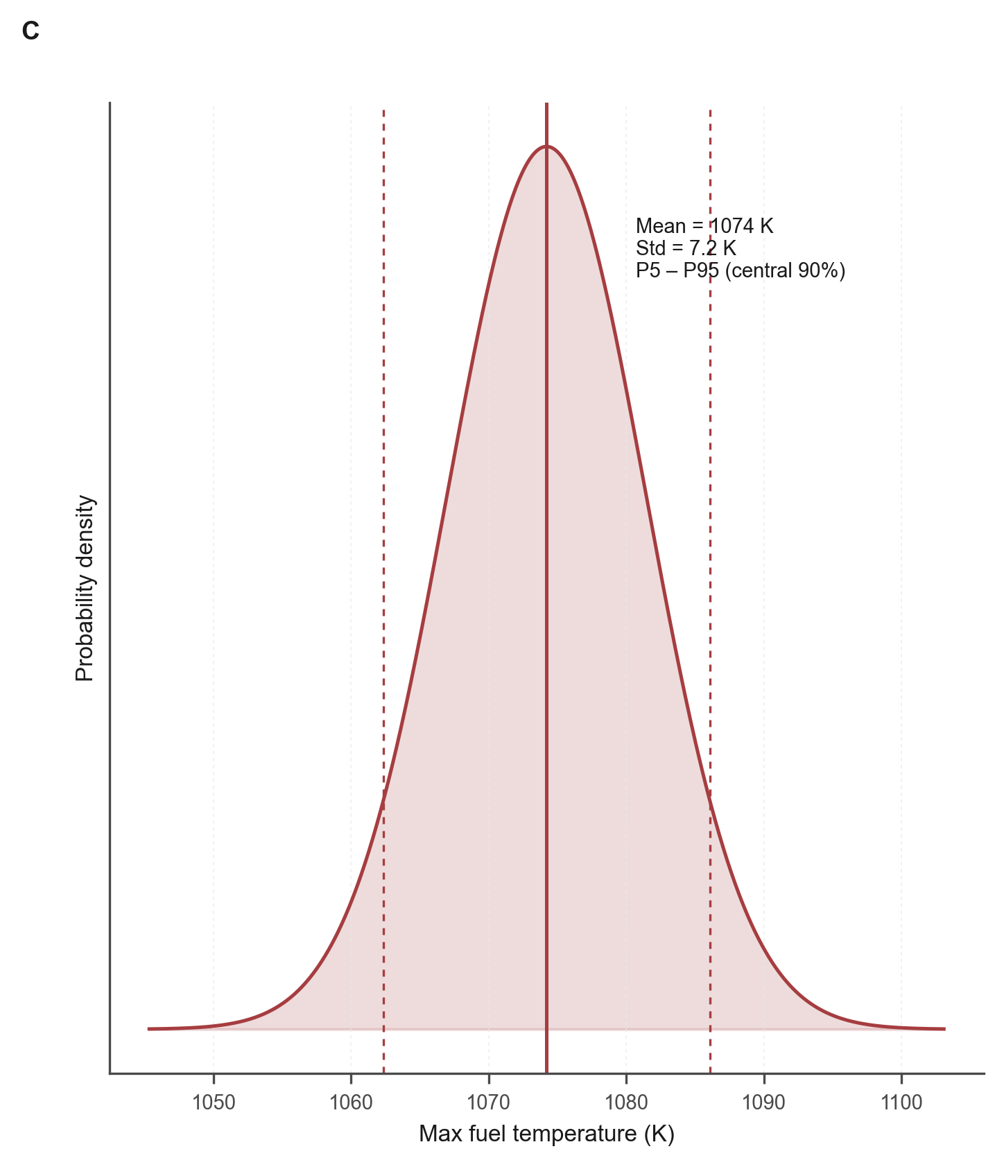
Figure 3C | Coupled max fuel temperature distribution
C

Slide 5
Figure 3 — Editable text elements
A. Coupling reshapes stress distribution
B. Coupled k_eff distribution
C. Coupled max fuel temperature distribution
Axis labels (editable):
• Panel A x-axis: Coupled steady-state max stress (MPa)
• Panel A legend: Uncoupled pass / Coupled steady state / 131 MPa threshold
• Panel B x-axis: k_eff (coupled)
• Panel C x-axis: Max fuel temperature (K)
• All y-axes: Density
Caption: Coupling-induced forward response shift. (A) Max stress: uncoupled pass vs coupled steady state, with 131 MPa threshold. (B) Coupled k_eff. (C) Coupled max fuel temperature. All distributions from BNN predictive draw (20,000 input samples × 50 MC weight draws).

