Slide 1
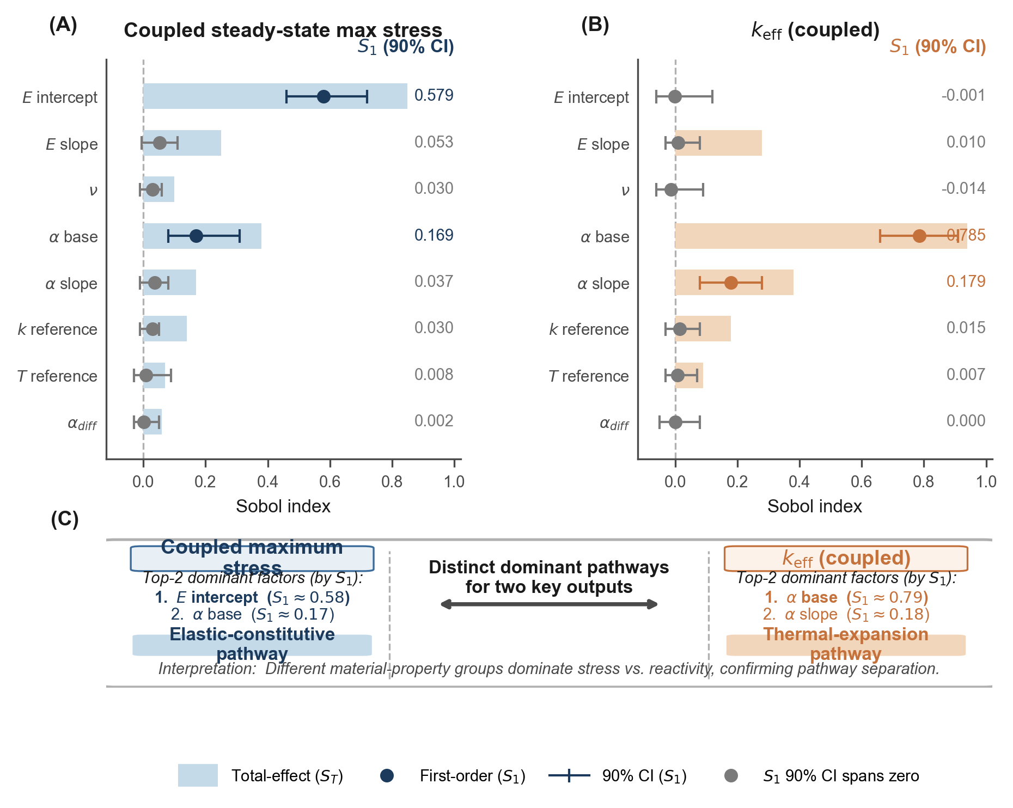
Figure 4 | Sobol variance decomposition
A
C
B
Notes:
Figure 4: Sobol variance decomposition.
Panel A: stress, Panel B: k_eff, Panel C: summary.
Panel C on slide 4 is fully native — every box and text is editable.

Slide 2
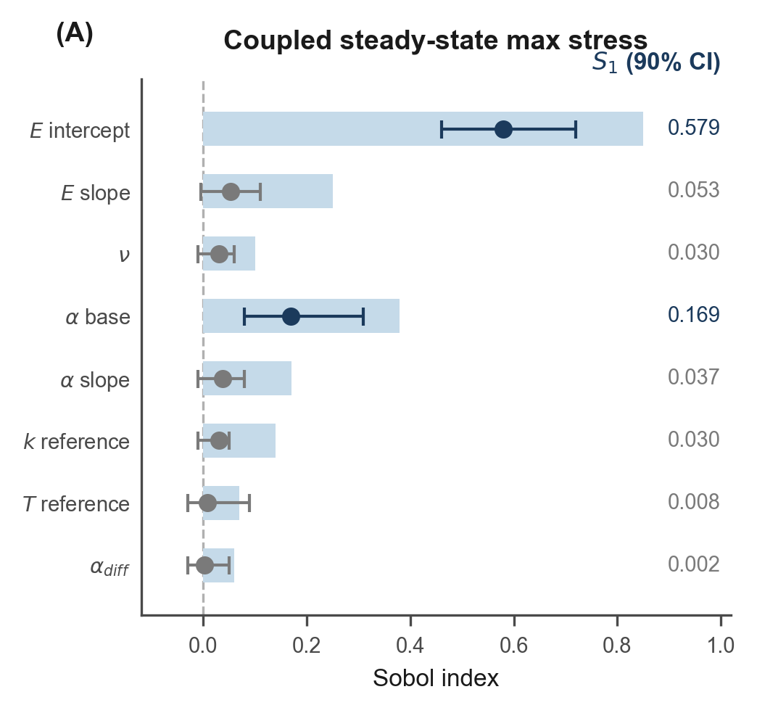
Figure 4A | Coupled steady-state max stress — Sobol indices
A

Slide 3
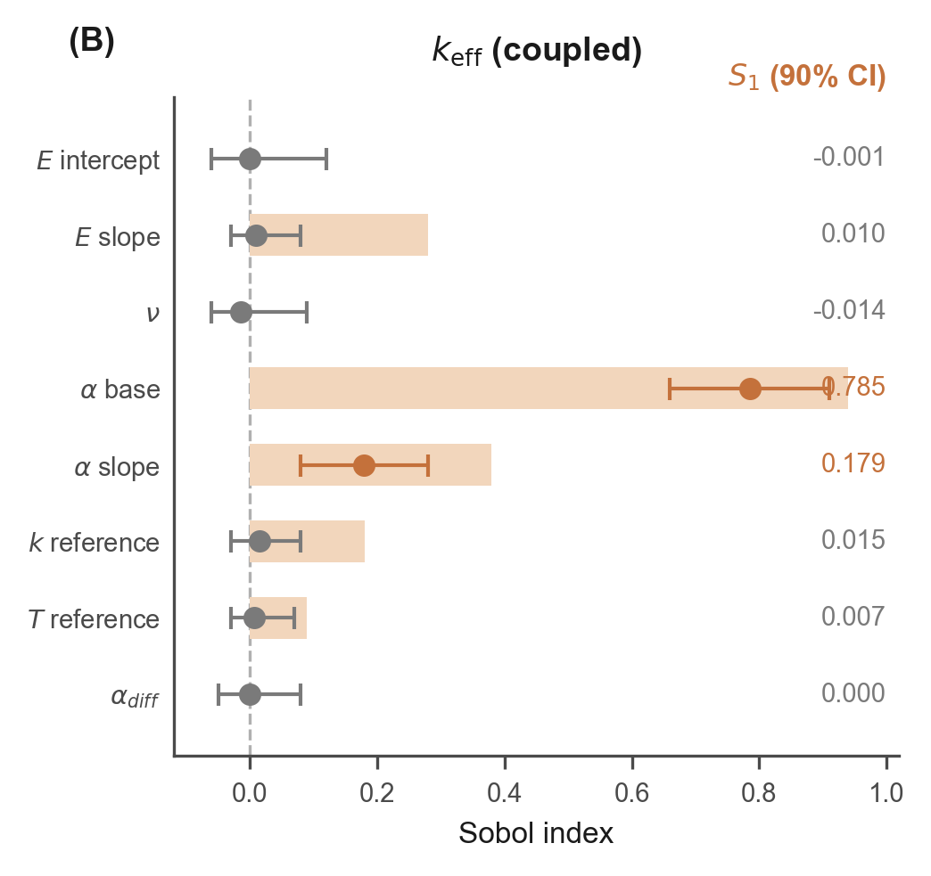
Figure 4B | k_eff (coupled) — Sobol indices
B

Slide 4
Figure 4C | Dominant-factor separation (native editable)
C. Dominant-factor separation summary
Stress pathway
k_eff pathway
• Dominant factor: E intercept
• S₁ ≈ 0.54–0.58 (first-order)
• S_T ≈ 0.60–0.65 (total-order)
• Elastic modulus governs coupled
• steady-state peak stress
• Secondary: α_base (thermal
• expansion, via coupling)
• Dominant factor: α_base
• S₁ ≈ 0.74–0.78 (first-order)
• S_T ≈ 0.78–0.84 (total-order)
• Thermal expansion base drives
• temperature-dependent k_eff
• Secondary: SS316_k_ref
• (conductivity reference)
Different material parameters dominate each output pathway, enabling targeted uncertainty reduction strategies.

Slide 5
Figure 4 — Editable text elements
A. Coupled steady-state max stress — Sobol indices (S₁ / S_T)
B. k_eff (coupled) — Sobol indices (S₁ / S_T)
C. Dominant-factor separation summary
Key findings (editable):
• E intercept dominates stress (S₁ ≈ 0.54–0.58)
• α_base dominates k_eff (S₁ ≈ 0.74–0.78)
• Distinct sensitivity pathways enable targeted uncertainty reduction
• 95% bootstrap CI from 4 independent BNN chains
Caption: Sobol variance decomposition reveals distinct dominant factors for stress (elastic modulus) and k_eff (thermal expansion), suggesting that targeted experimental characterization of these material properties would most effectively reduce response uncertainty.

