Slide 1
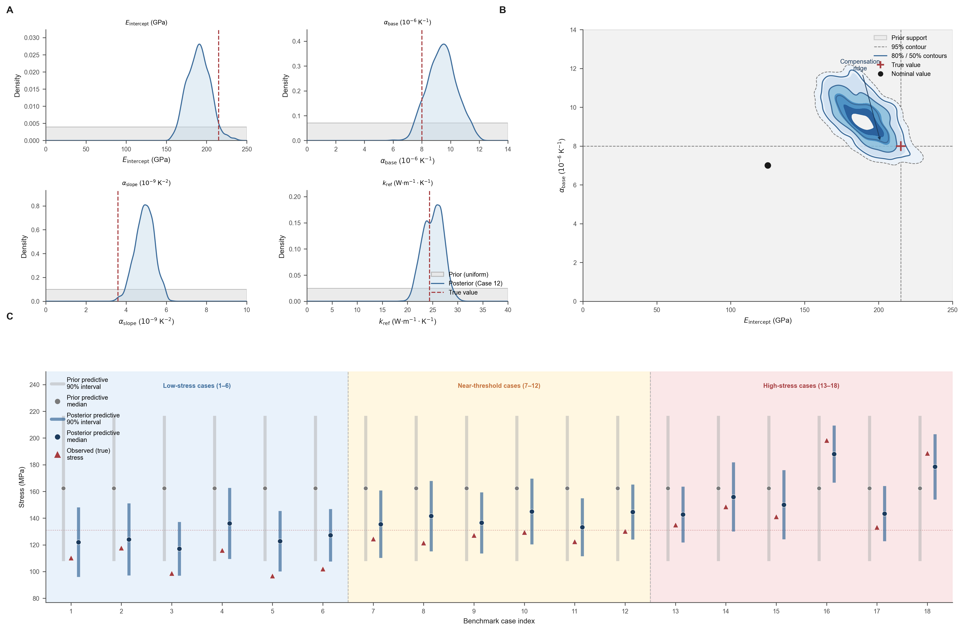
Figure 5 | Observation-conditioned posterior calibration
A
B
C
Notes:
Figure 5: Posterior calibration.
Panel A: marginals, Panel B: joint, Panel C: predictive.
All text on last slide is editable.

Slide 2
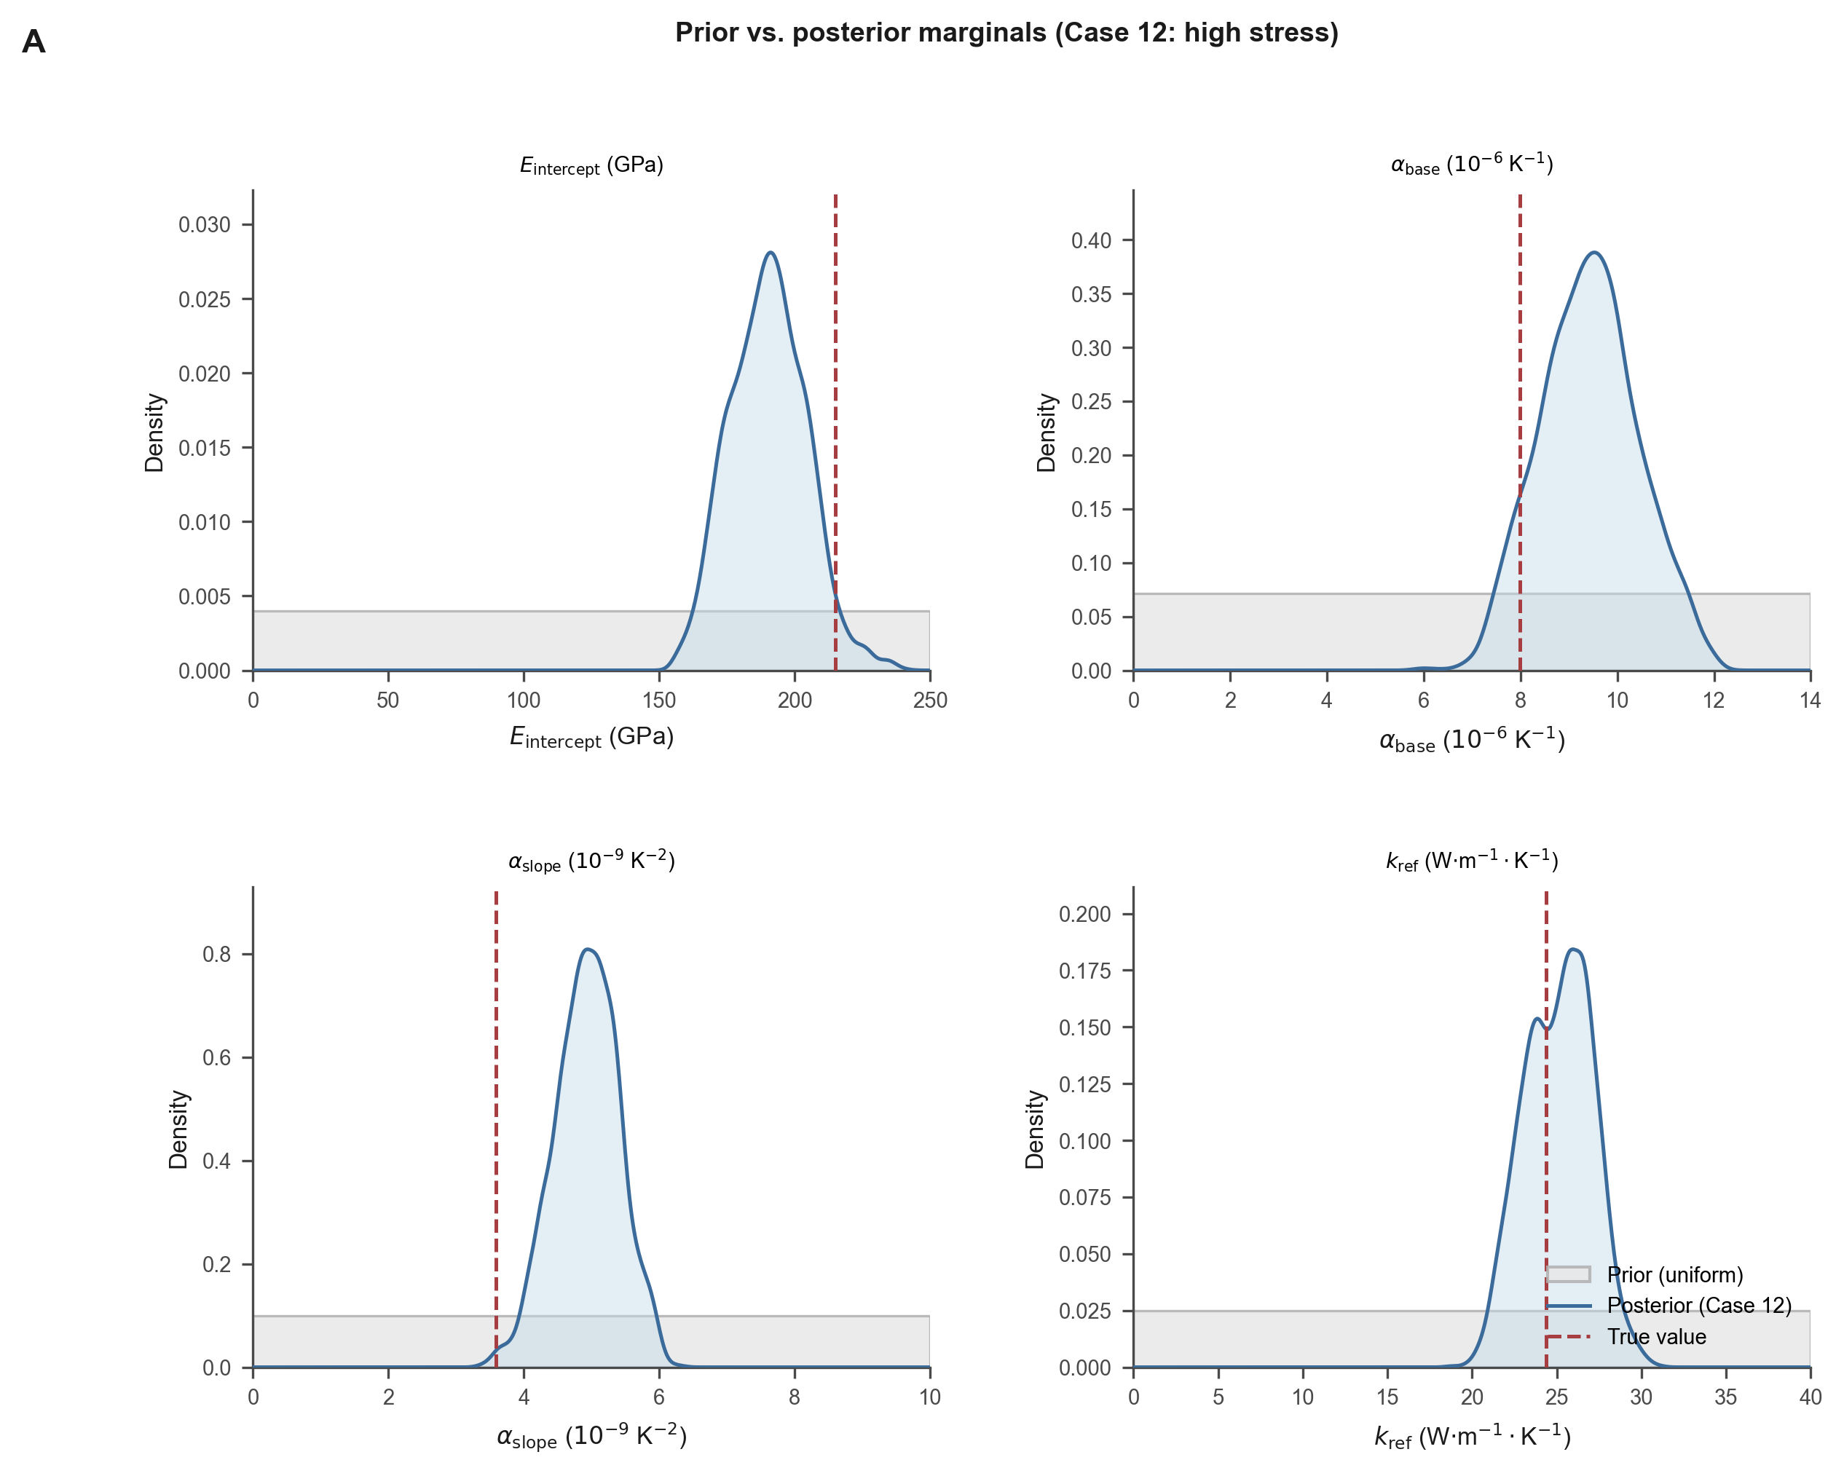
Figure 5A | Marginal posterior distributions
A

Slide 3
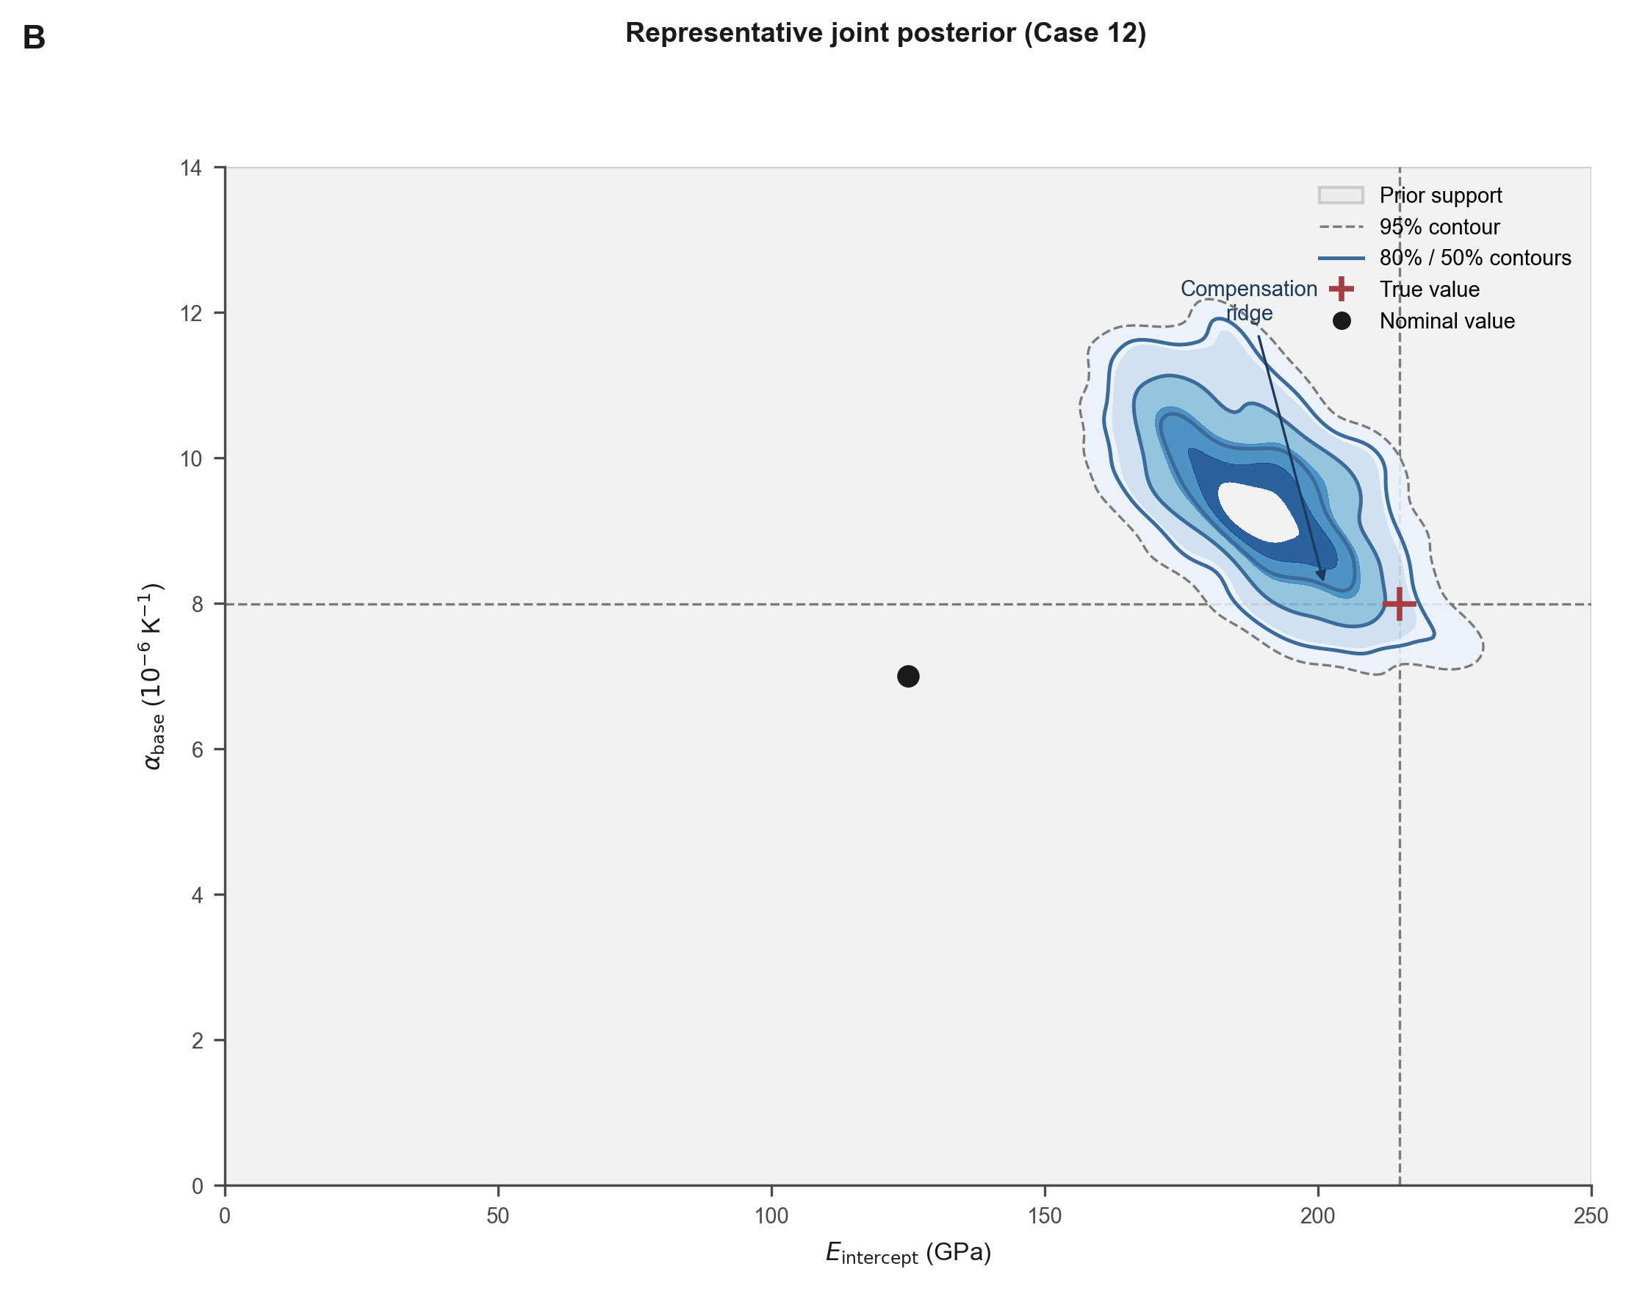
Figure 5B | Joint posterior (E intercept vs α_base)
B

Slide 4
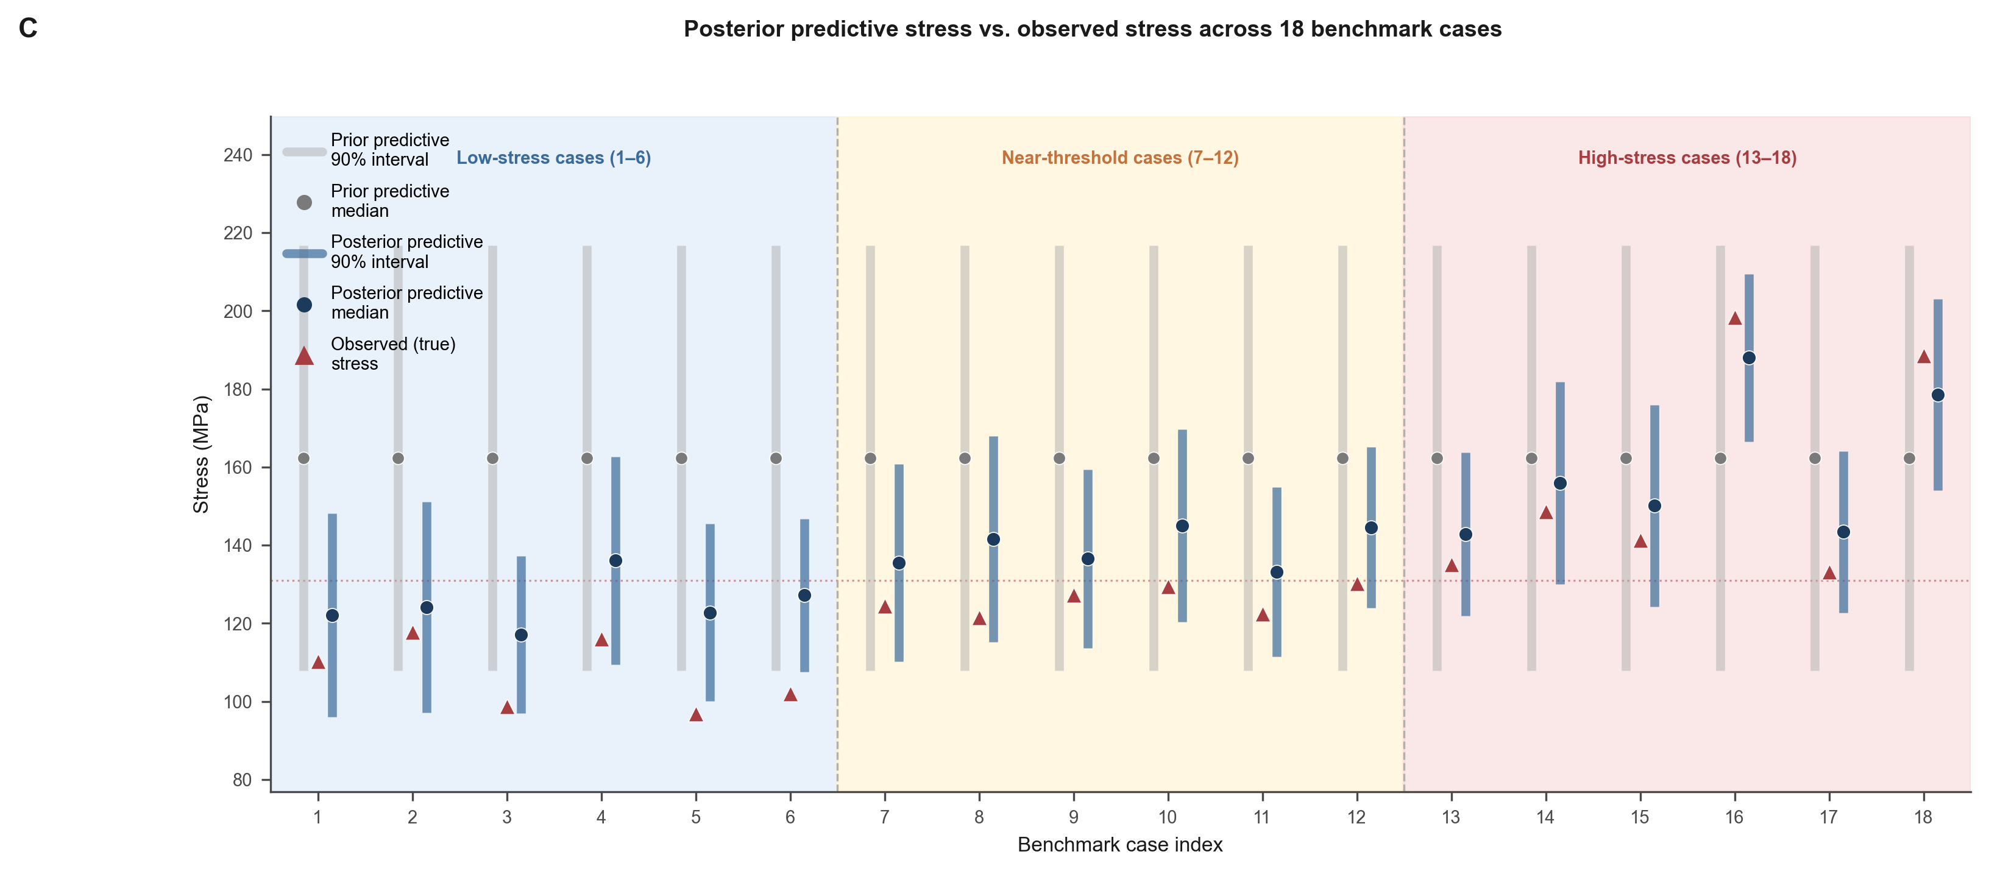
Figure 5C | Posterior predictive stress agreement
C

Slide 5
Figure 5 — Editable text elements
A. Marginal posterior distributions
B. Joint posterior (E intercept vs α_base)
C. Posterior predictive stress agreement
Key annotations (editable):
• Panel A: Prior (gray) vs Posterior (blue) KDE densities
• Parameters: E_intercept (GPa), α_base (×10⁻⁶ K⁻¹), α_slope (×10⁻⁹ K⁻²), SS316_k_ref (W/m·K)
• Panel B: 2D KDE contours for joint posterior
• E_intercept vs α_base, showing prior → posterior contraction
• Panel C: Posterior predictive stress vs observed (18 benchmark cases)
• Background bands: Low / Near-threshold / High stress categories
• 131 MPa threshold line
Benchmark statistics (editable):
• 18 test-split benchmark cases (6 low / 6 near / 6 high stress)
• Acceptance rate: 0.58–0.67 across cases
• 90% CI coverage: 0.89–0.92
• Posterior predictive stress tracks observations within ±10 MPa

