Slide 1



Meaning across cultures: /s/ duration and perceptions of sexual orientation
York Lavender Linguistics
24 February 2017
Andy Law (they/them/their)
Queen Mary University of London
a.j.law@qmul.ac.uk @andylaw31

Slide 2
Outline
Background
Previous research
Research questions
Methodology
Speech data
Perceptual experiment
Results
Discussion
Conclusions

Slide 3








Previous research
Historical North American English (NAE) focus in research on sociophonetics of sexuality, but recent diversification of sampling with speakers from:
Denmark (Pharao et al. 2014)
France and the Netherlands (in L2 English; Boyd 2015)
Mexico and Puerto Rico (Walker et al. 2014)
United Kingdom (Law 2015, Levon 2014)
Indexicality and perception
Foci: accuracy; phonetic variables (indexical resources/cues)
Common variables:
/s/, sometimes /z/: duration; spectral measures, particularly skew and peak frequency; fronting/lisp
Vowels: overall space; specific positioning/formant frequencies
Pitch: mean and range
Perceptions of clarity/precision/standardness
Frames

Slide 4
Previous research (cont.)
Longer /s/ correlates with perception as gay (Linville 1998; Smyth and Rogers 2002) or has no significant effect (Levon 2006, 2007)
Culture, perception and stereotypes:
Rácz and Shepácz (2013) suggest perception of sexuality is culturally situated and tied to levels of acceptance
Levon (2014) suggests stereotypes can have strong influence on perception of phonetic variation

Slide 5
Research questions
Does /s/ duration hold the same indexical value in speakers outside of North America?
How do cultural background* and stereotypes affect the perception of sexual orientation through the voice?
* i.e. levels of acceptance within a listener’s culture for non-normative sexual orientations

Slide 6

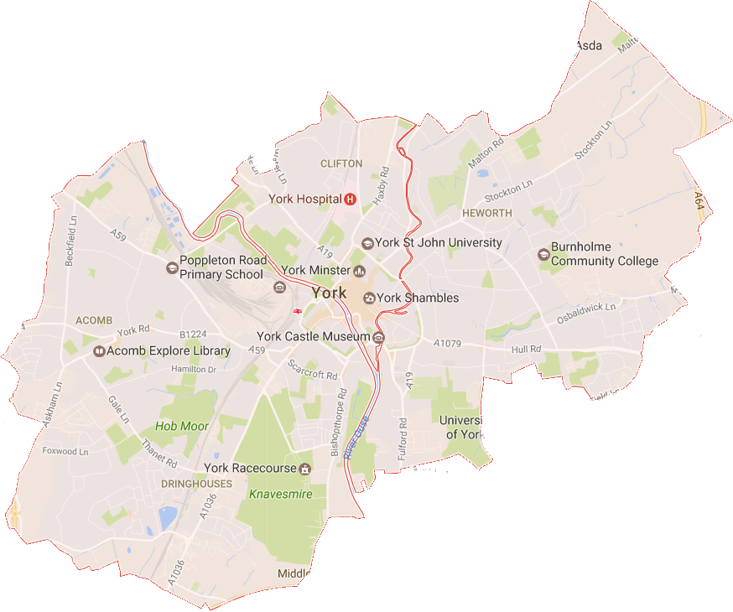

Speech data: overview
From earlier broader study (Law 2015, MA thesis)
Method
Speakers made aware of focus before recording
Laboratory-style environment
Read passage plus short conversation on politics in pre-acquainted, same sexual orientation pairs
30-second clip per speaker per environment (isolated from interlocutor in conversation)
/s/ duration measured in Praat using automated script
Speakers
Four gay, four straight men
Northern England English (NEE) (York-based)
Controls: age; age entered Northern England (if not born and raised); ethnicity; gender assigned at birth; physique
Recruited from existing contacts
Three gay speakers involved in LGBT activism
Map data ©2017 Google

Slide 7

Speech data: /s/ examples
59ms
78ms
104ms
215ms

Slide 8




Perceptual experiment
Method
Google Forms
Seven-point semantic-differential scale: “definitely gay” to “definitely straight” (yes, problematic!)
Variety of question types on other characteristics
Translated into Malay and Russian
Distribution: university administrators; Facebook (e.g. university groups)
Statistics: linear mixed-effects regression models (R, lmer4 package)
Listeners
Total: 45
17 from United Kingdom, 8 from each of Belarus and Malaysia, 9 from elsewhere – represent starkly different points on Social Progress Index, particularly with regard to “tolerance for homosexuals” (Porter et al. 2016; Social Progress Imperative 2016)
2/3 straight; 2/3 women; >2/3 18-35; only one trans

Slide 9
Results: perception of /s/ duration
Relationship between perception of sexual orientation and mean /s/ duration
Random effect: listener
Fixed effect (independent variable): /s/ duration
Dependent variable: perceived sexual orientation
NAE findings suggest longer /s/ correlates with perception as gay
In the NEE data, however…

Slide 10
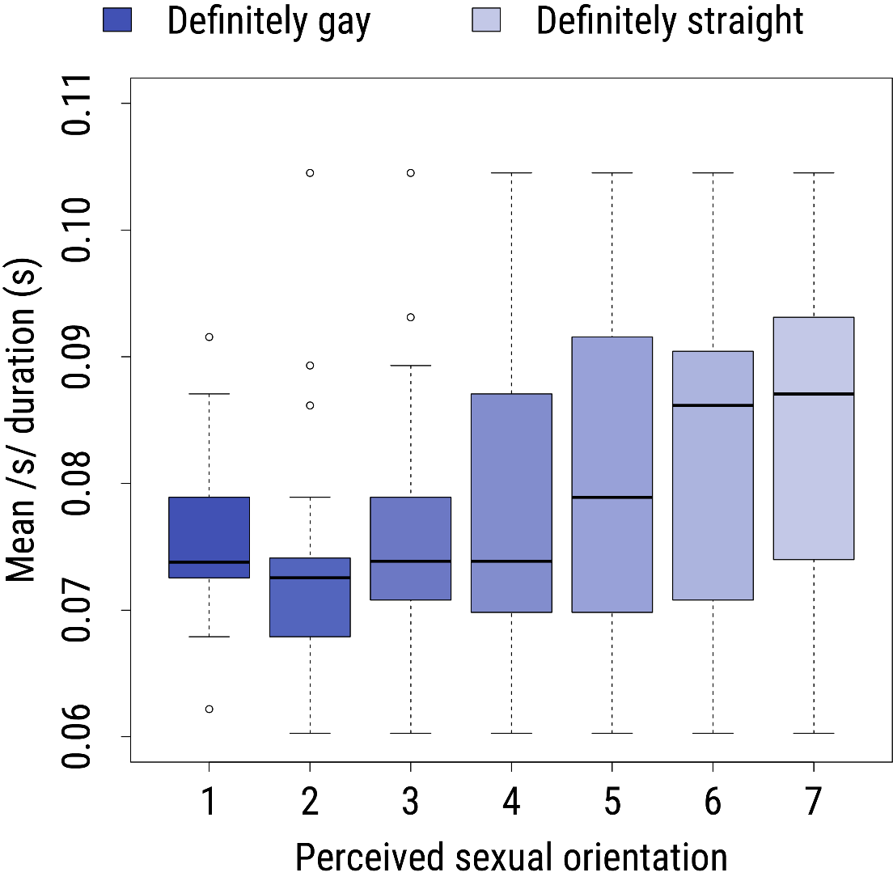
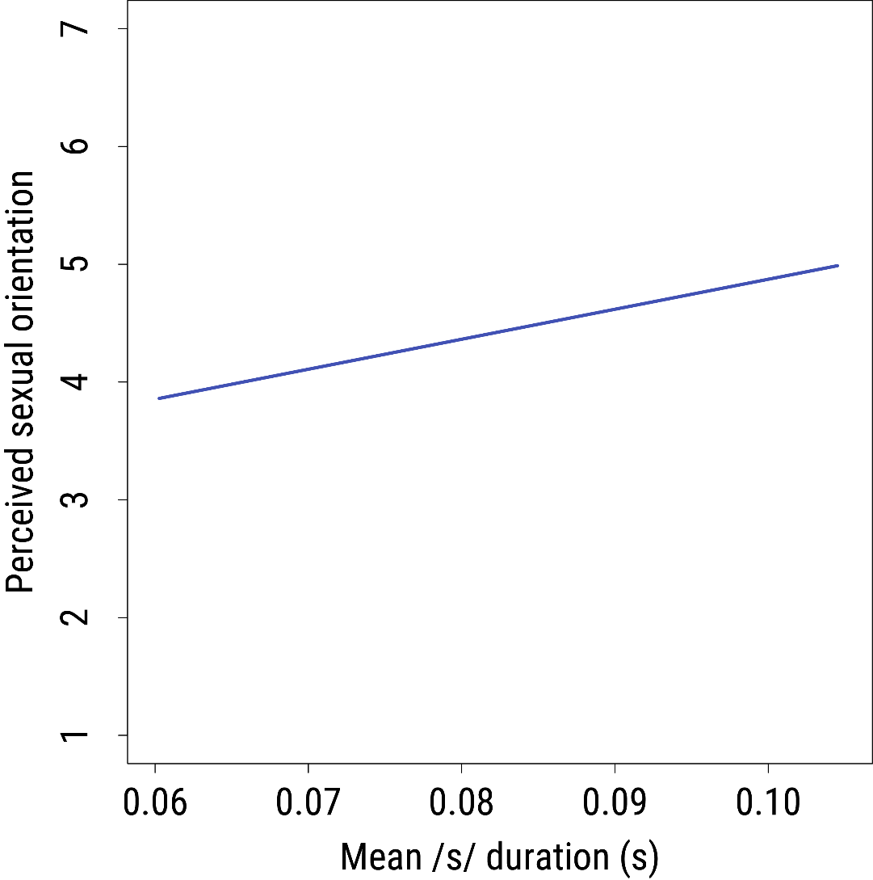
Results: perception of /s/ duration (cont.)

Slide 11
Results: interaction with cultural background
Interactions between mean /s/ duration and listener country of origin (fixed effects/independent variables), latter broken down in two ways:
United Kingdom, Belarus, Malaysia and other
United Kingdom and other (including Belarus and Malaysia)
Random effect: listener
Dependent variable: perceived sexual orientation
Interaction nonsignificant in both models: indexical value of /s/ duration unaffected by listener’s country of origin

Slide 12
Impact of frames
Cultural background of listener unimportant in perception…
BUT cultural background of speaker affects indexical value placed on specific variables
Support for theory that a variable’s frame affects its indexical perception (e.g. Campbell-Kibler 2007, 2011; Pharao et al. 2014)…
BUT without tight control of potential confounding variables and greater sample size, evidence should be taken as light
Notes:
“indexical value placed on specific variables”: i.e. inverse meaning of longer /s/ in NEE than NAE

Slide 13
Intersectional perceptual variation
Variation is not one-dimensional: people are the composite of many attributes; no single attribute alone determines speech
Law (2015) found similarities and differences between NEE and NAE in interaction between sexual orientation and speech
Difference between perception of /s/ in NEE and NAE suggests listeners draw on multiple interacting inputs to perceive sexual orientation
What constitutes normative /s/ duration is dependent on intersection of culture and sexual orientation: intersectional perceptual variation
Notes:
“multiple interacting inputs”: speech variety – coded for cultural background – plus sociolinguistic variable

Slide 14
Effect of culture and stereotypes
Intercultural perceptual consistency: culture/cultural acceptance of non-normative sexuality nonsignificant in sexual orientation perception, contrary to prediction by Rácz and Shepácz (2013)
Support for combination of earlier claims regarding stereotypes:
Stereotypes can have significant impact on phonetic variation perception (Levon 2014)
Contrary to common expectations, effect of sociocultural values on sexual orientation stereotypes is nonsignificant (Blashill and Powlishta 2009)
Everyone is drawing on same indexical resources (stereotypes), therefore making same perceptual evaluations…

Slide 15

The global gay
… ties with rise of the global gay (e.g. Altman 1997, 2002; Boellstorff and Leap 2004; Heinz et al. 2002; Leap 2010; Manalansan 2003; Phillips 2000)
Cultural imperialist advancement in East/Global South of Western/Northern concepts and language of sexual identity
Ideological assumption of global applicability/homogeneity of category “gay”
Consistency across listener cultural background: “gay” means the same everywhere so everyone can recognise gay speech…
BUT effect of frame suggests some appreciation of cultural/local differences in embodiment

Slide 16
Conclusions
Contribution to greater understanding of complexity of perception, stereotypes and indexicality and their relation to sexuality and culture
Prior work on sociophonetics of sexuality not necessarily representative beyond its sample: NEE perceived differently
Non-effect of listener cultural background: intercultural consistency of sociophonetic sexual orientation stereotypes; effect of the “global gay”
Follow-up work could use digital manipulation or matched guise for tighter control of confounding variables (greater validity)

Slide 17
Meaning across cultures: /s/ duration and perceptions of sexual orientation
York Lavender Linguistics
24 February 2017
Andy Law (they/them/their)
Queen Mary University of London
a.j.law@qmul.ac.uk @andylaw31

Slide 18
A few notes
Gay speakers did have shorter /s/ production (contrary to previous studies and stereotypes, but in alignment with listener perceptions in this study), but statistically significant only in read passage environment, not overall or in conversation
Speaker sample only of cis gay and straight men limits what the study can say about sociophonetics of sexuality and queer speech more broadly

Slide 19
Perception of /s/ duration: model results
 | Estimate | Std. Error | df | t value | Pr(>|t|)
(Intercept) | 2.3266 | 0.2979 | 688.2 | 7.81 | 2.13E-14
Mean /s/ duration | 25.4611 | 3.5781 | 674 | 7.116 | 2.85E-12

Slide 20
Interaction with cultural background: model results
 | Estimate | Std. Error | df | t value | Pr(>|t|)
(Intercept/Mean /s/ duration * UK) | 1.8556 | 0.4921 | 649.4 | 3.770 | 0.000178
Mean /s/ duration | 28.8665 | 5.9483 | 628 | 4.853 | 1.54E-06
Not UK | 0.702 | 0.6379 | 649.4 | 1.101 | 0.27152
Mean /s/ duration * not UK | -4.9473 | 7.7098 | 628 | -0.642 | 0.521313

Slide 21
Interaction with cultural background: model results (cont.)
 | Estimate | Std. Error | df | t value | Pr(>|t|)
(Intercept/Mean /s/ duration * UK) | 1.8556 | 0.4888 | 654.1 | 3.797 | 0.00016
Mean /s/ duration | 28.8665 | 5.9537 | 626 | 4.849 | 1.57E-06
Belarus | 1.1586 | 0.864 | 654.1 | 1.341 | 0.18039
Malaysia | 0.6094 | 0.864 | 654.1 | 0.705 | 0.48085
Other | 0.3784 | 0.8307 | 654.1 | 0.456 | 0.64889
Mean /s/ duration * Belarus | -9.5384 | 10.5247 | 626 | -0.906 | 0.36513
Mean /s/ duration * Malaysia | 1.4398 | 10.5247 | 626 | 0.137 | 0.89123
Mean /s/ duration * other | -6.5437 | 10.1193 | 626 | -0.647 | 0.51809

Slide 22
Perceptual accuracy and cultural background
For forced-choice judgements, listeners right (1) or wrong (0)
For scalar judgements, decimal accuracy score calculated based on match between perception and speaker identity
Perceived orientation | Accuracy score
 | Gay speaker | Straight speaker
1 (definitely gay) | 1 | 0
2 | 0.83 | 0.17
3 | 0.67 | 0.33
4 | 0.5 | 0.5
5 | 0.33 | 0.67
6 | 0.17 | 0.83
7 (definitely straight) | 0 | 1

Slide 23
Perceptual accuracy and cultural background (cont.)
Interactions between mean /s/ duration and listener country of origin (fixed effects/independent variables), latter broken down in two ways:
United Kingdom, Belarus, Malaysia and other
United Kingdom and other (including Belarus and Malaysia)
Random effect: listener
Dependent variable: perceptual accuracy
Interaction nonsignificant in both models: success at guessing speaker’s sexual orientation unaffected by listener’s country of origin

Slide 24
Perceptual accuracy and cultural background: model results
 | Estimate | Std. Error | df | t value | Pr(>|t|)
(Intercept/UK) | 0.56033 | 0.01674 | 40 | 33.471 | <2e-16
Not UK | -0.01641 | 0.02170 | 40 | -0.756 | 0.454
 | Estimate | Std. Error | df | t value | Pr(>|t|)
(Intercept/UK) | 0.560331 | 0.017144 | 38 | 32.684 | <2e-16
Belarus | -0.018690 | 0.030306 | 38 | -0.617 | 0.541
Malaysia | -0.008768 | 0.030306 | 38 | -0.289 | 0.774
Other | -0.021164 | 0.029139 | 38 | -0.726 | 0.472

Slide 25
References
Altman, Dennis. 1997. Global gaze/global gays. GLQ: A Journal of Lesbian and Gay Studies 3(4): 417-436.
Altman, Dennis. 2002. Globalization and the international gay/lesbian movement. In Diane Richardson and Steven Seidman (eds). Handbook of Lesbian and Gay Studies. London: Sage.
Blashill, Aaron J. and Kimberley K. Powlishta. 2009. Gay stereotypes: the use of sexual orientation as a cue for gender-related attributes. Sex Roles 61(11): 783–793.
Boellstorff, Tom and William L. Leap. 2004. Introduction: globalization and “new" articulations of same-sex desire. In William L. Leap and Tom Boellstorff (eds). Speaking in Queer Tongues: Globalization and Gay Language. Urbana: University of Illinois Press.
Boyd, Zac. 2015. Indexing sexual orientation in non-native speakers of English. Oral presentation at UK Language Variation and Change 10. 1-3 September, University of York.
Campbell-Kibler, Kathryn. 2007. Accent, (ING), and the social logic of listener perceptions. American Speech 82(1): 32–64.

Slide 26
References (cont.)
Campbell-Kibler, Kathryn. 2011. Intersecting variables and perceived sexual orientation in men. American Speech 86(1): 52–68.
Heinz, Bettina, Li Gu, Ako Inuzuka and Roger Zender. 2002. Under the rainbow flag: webbing global gay identities. International Journal of Sexuality and Gender Studies 7(2): 107-124.
Law, Andy. 2015. Sexual orientation, phonetic variation and the roots and accuracy of perception in the speech of Northern England English-speaking men. Unpublished MA thesis, University of York.
Leap, William L. 2010. Globalization and gay language. In Nikolas Coupland (ed). The Handbook of Language and Globalization. Oxford: Wiley-Blackwell.
Levon, Erez. 2006. Hearing “gay”: prosody, interpretation, and the affective judgments of men’s speech. American Speech 81(1): 56–78.

Slide 27
References (cont.)
Levon, Erez. 2007. Sexuality in context: variation and the sociolinguistic perception of identity. Language in Society 36(4): 533–554.
Levon, Erez. 2014. Categories, stereotypes and the linguistic perception of sexuality. Language in Society 43(5): 539–566.
Linville, Sue Ellen. 1998. Acoustic correlates of perceived versus actual sexual orientation in men's speech. Folia Phoniatrica et Logopaedica 50(1): 35–48.
Manalansan IV, Martin F. 2003. Global Divas: Filipino Gay Men in the Diaspora. Durham: Duke.
Pharao, Nicolai, Marie Maegaard, Janus Spindler Møller and Tore Kristiansen. 2014. Indexical meanings of [s+] among Copenhagen youth: social perception of a phonetic variant in different prosodic contexts. Language in Society 43(1): 1–31.
Phillips, Oliver. 2000. Constituting the global gay: issues of individual subjectivity and sexuality in southern Africa. In Carl Stychin and Didi Herman (eds). Sexuality in the Legal Arena. London: The Athlone Press.

Slide 28
References (cont.)
Porter, Michael E., Scott Stern and Michael Green. 2016. Social Progress Index 2016. Washington, D.C.: Social Progress Imperative.
Rácz, Péter and András Shepácz. 2013. The perception of high frequency sibilants in Hungarian male speech. Acta Linguistica Hungarica 60(4): 457–468.
Smyth, Ron and Henry Rogers. 2002. Phonetics, gender, and sexual orientation. In Sophie Burelle and Stanca Somesfalean (eds). Proceedings of the 2002 annual conference of the Canadian Linguistic Association. 299–301.
Social Progress Imperative. 2016. Social Progress Index. Available from: http://www.socialprogressimperative.org/global-index [accessed 27 September 2016]
Walker, Abby, Christina García, Yomi Cortés and Kathryn Campbell-Kibler. 2014. Comparing social meanings across listener and speaker groups: the indexical field of Spanish /s/. Language Variation and Change 26(2): 169–189.

