Slide 1
Understanding Patent Documents and Data Fields
Paul Oldham (Ph.D.)
WIPO Open Source Patent Analytics Project

Slide 2
What is a Patent?
A patent can be described in two main ways:
1. As a particular form of intellectual property right.
2. As a type of document.

Slide 3
As a form of intellectual property right
1. A patent is a temporary grant of an exclusive right to a patentee to prevent others from making, using, offering for sale, or importing, a patented invention without their consent, in a country where a patent is in force.
2. Patent rights are territorial rights - they are only valid in the territory of the country where granted.
3. Patents are typically granted for a period of 20 years from the filing data of an application but may be opposed or revoked.
4. To be eligible a claimed invention must: a) Involve patentable subject matter; b) Be new or novel; c) Involve an inventive step; d) Be susceptible to industrial application or useful.

Slide 4
Patents as a type of document
For patent analytics we need to concentrate on patents as documents and to understand:
1. The structure of patent documents and their data fields.
2. The strengths and weaknesses of patent databases as a means for obtaining patent data.
In this session we deal with the basics of patent documents and their data fields.

Slide 5
Basic Data Types
When performing patent analysis we are dealing with data of seven different types:
1. Dates (priority, application and publication dates)
2. Numbers (priority number, application number, publication number, family members, citations)
3. Names (Applicants - also known as Assignees - and Inventors)
4. Classification codes (e.g. International Patent Classification/Cooperative Patent Classification)
5. Text fields (Title, Abstract, Description, Claims, Sequence data)
6. Images (Diagrams)
7. Additional Information (Legal Status, Public Registry etc)

Slide 6
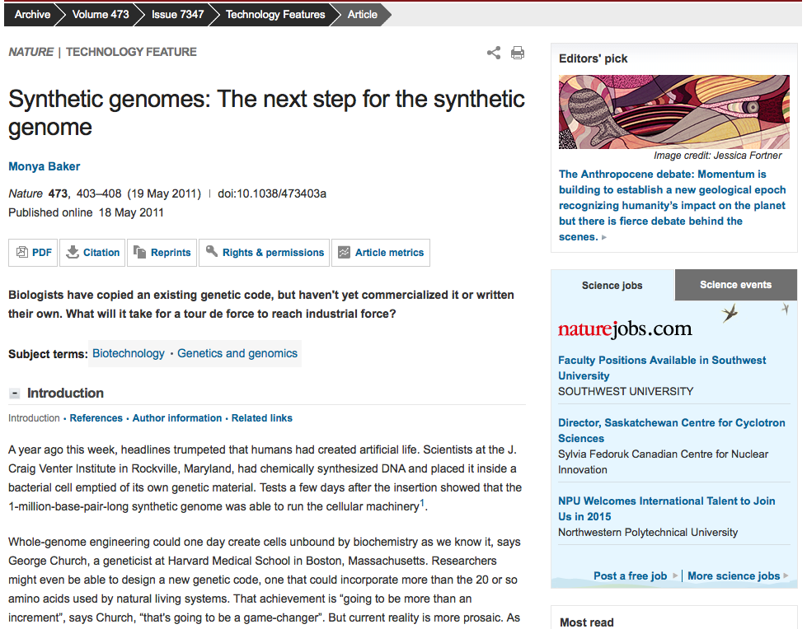
Nature News

Slide 7
Original Front Page

Slide 8
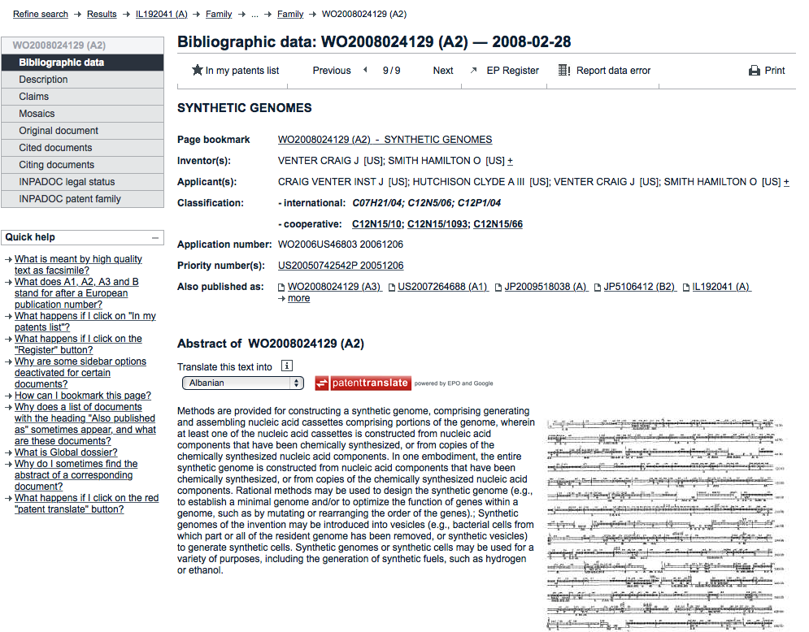
Espacenet Front Page

Slide 9
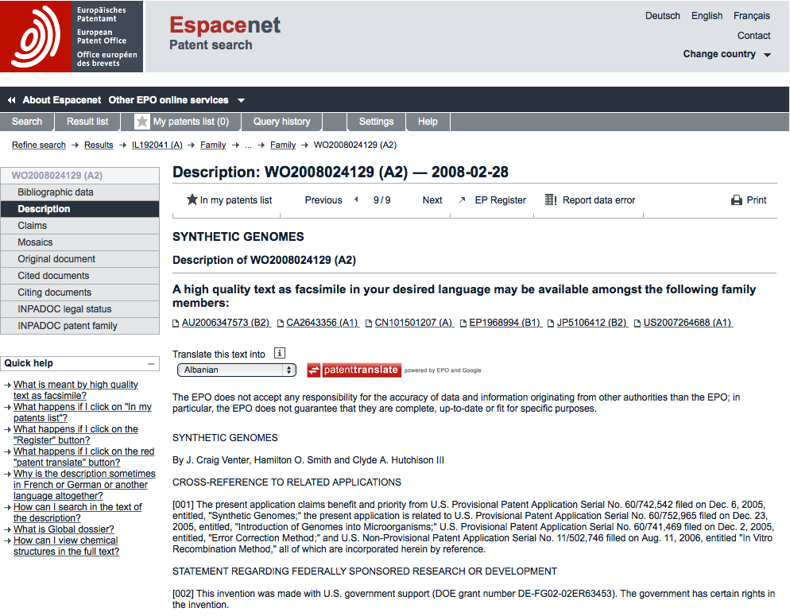
Patent Description

Slide 10
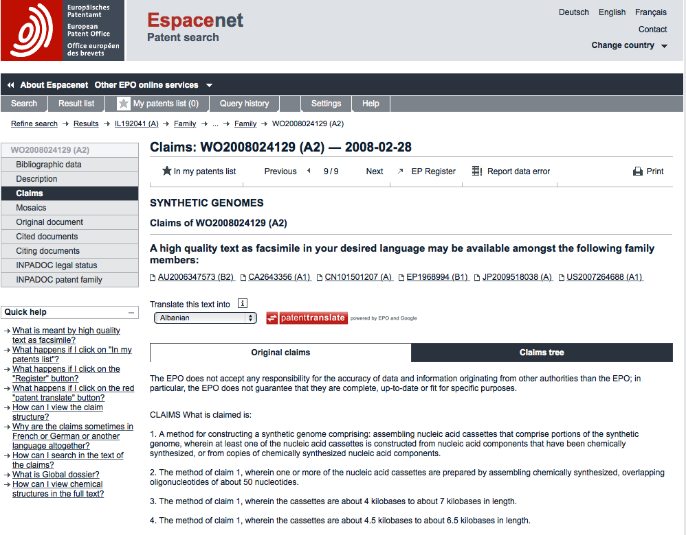
Patent Claims

Slide 11
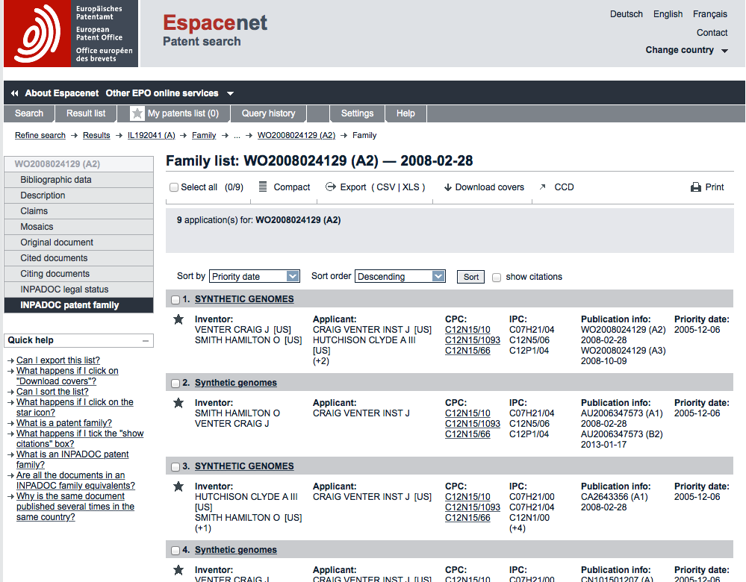
Patent Family

Slide 12
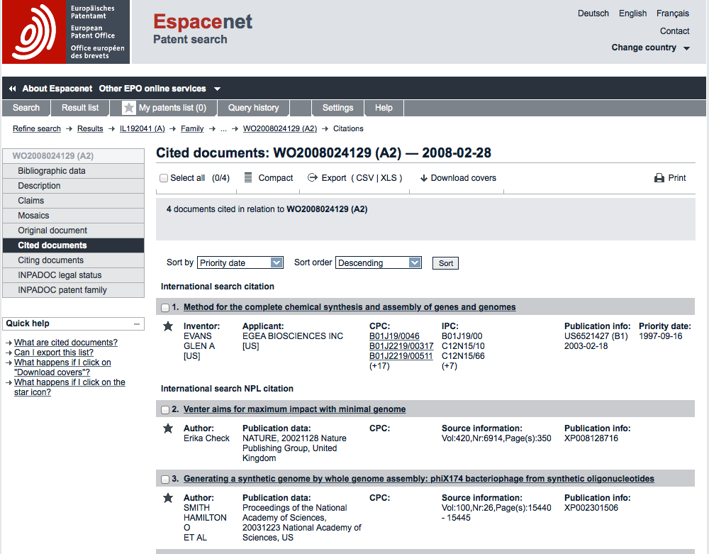
Cited Documents

Slide 13
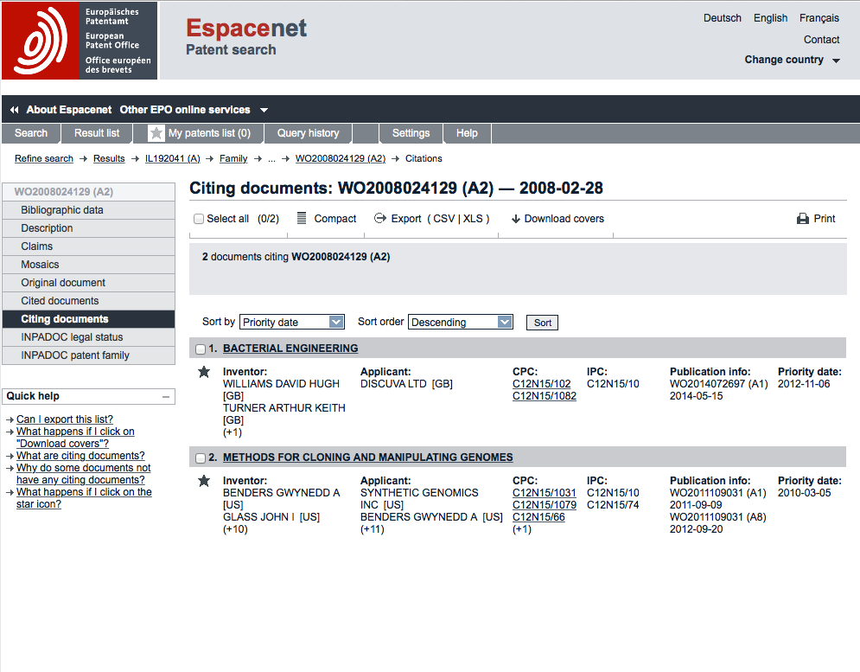
Citing Documents

Slide 14
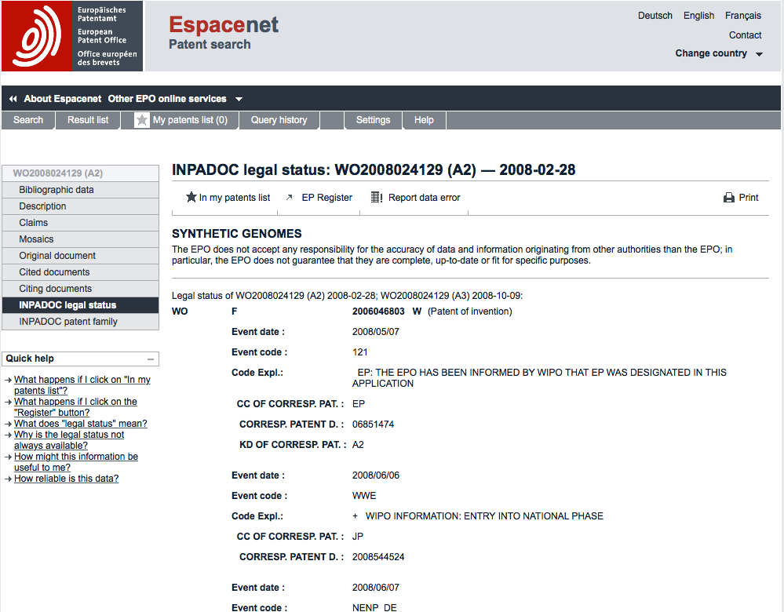
Legal Status

Slide 15
Round Up
In this session we have walked through some of the most important patent data fields.
These fields are the building blocks for sophisticated patent analysis. In future sessions we will focus on:
- Retrieving data with these fields
- Cleaning up the data in these fields
- Mapping trends
- Network Mapping
- Geographic Mapping

Slide 16
Learn More
Visit the Git hub project home page.
Access the materials direct on Github here and add your own.
Email me with comments, corrections or suggestions.

