Slide 1


International Bioinformatics Workshop on Molecular Epidemiology and Phylodynamics
Yu-Nong Gong, Ph.D.
Assistant Professor
2024-04-25

Slide 2
About me
Assistant Professor, Chang Gung University (CGU), Taiwan (2021.02–)
Research Center for Emerging Viral Infections 新興病毒感染研究中心
International Master Degree Program for Molecular Medicine in Emerging Viral Infections 新興病毒分子醫學國際碩士學位學程
Assistant Research Fellow, National Health Research Institutes, Taiwan (2023.04–)
National Institute of Infectious Diseases and Vaccinology 感染症與疫苗研究所
Yu-Nong Gong (龔于農), Ph. D.
Email: yngong@mail.cgu.edu.tw
yngong0519@gmail.com
Tel: 03-2118800 ext. 3040
1
Education
Ph.D. Department of Electrical Engineering, CGU, Taiwan
2
Research Interests
Bioinformatics, Viral Evolution, Next-Generation Sequencing, Deep Learning

Slide 3
Research directions
Centers of Excellence for Influenza Research and Surveillance/Response (CEIRS/CEIRR)
Inferring epidemiological and evolutionary processes of emerging viruses
Next-generation sequencing data analysis pipeline to Detect unknown pathogens
Using deep learning to probe novel genetic signatures
the application of sequence and phylogenetic tree analyses
International collaboration with Johns Hopkins University, USA
the implementation of NGS data analysis pipeline
the development and application of deep learning models

Slide 4
Course Overview
Goals of this workshop
Introduce a lots of bioinformatics tools, and a little bit about…theories, commands, and Linux shell script
Analyze evolutionary data to answer (epidemiological) questions
How to interpret your tree!!!

Slide 5
About you
Background and where you received your training
Have ever created a phylogenetic tree?
Research interest regarding emerging viruses (e.g, SARS2, Dengue)?
Is there a specific tool or method that you’d like to learn?
A Mac or PC user? Done any coding before this workshop?

Slide 6
Schedule – Day 1
Lecturer: Dr. Yu-Nong Gong
Time: 1:30-2:30 PM
Course overview
Environment setup and study design
Lecturer: Dr. Kuo-Ming Lee
Time: 3:00-5:00 PM
Topic:
DNA technology and evolution of the Central Dogma
cDNA library preparation and next-/third-generation sequencing platform

Slide 7
Schedule – Day 2
Time: 9:00-12:00 PM
Linux basics and shell script
commonly-used commands and useful tips in Linux
Sequence database
NCBI GenBank
A global initiative on sharing avian flu data (GIASID)
Bacterial and Viral Bioinformatics Resource Center (BV-BRC)
Multiple sequence alignments
Understand the algorithms behind multiple sequence alignment.
Tools of pairwise and multiple sequence alignments

Slide 8
Time: 01:30-5:00 PM
Topics:
Phylogenetic tree analysis and data analysis pipeline
Understand the principles of molecular evolution.
Online bioinformatic and phylogenetic tree tools
Construct and interpret phylogenetic trees.
Recap and discussion
Data visualization (if time allows)
Design study and bring your data tomorrow!

Slide 9

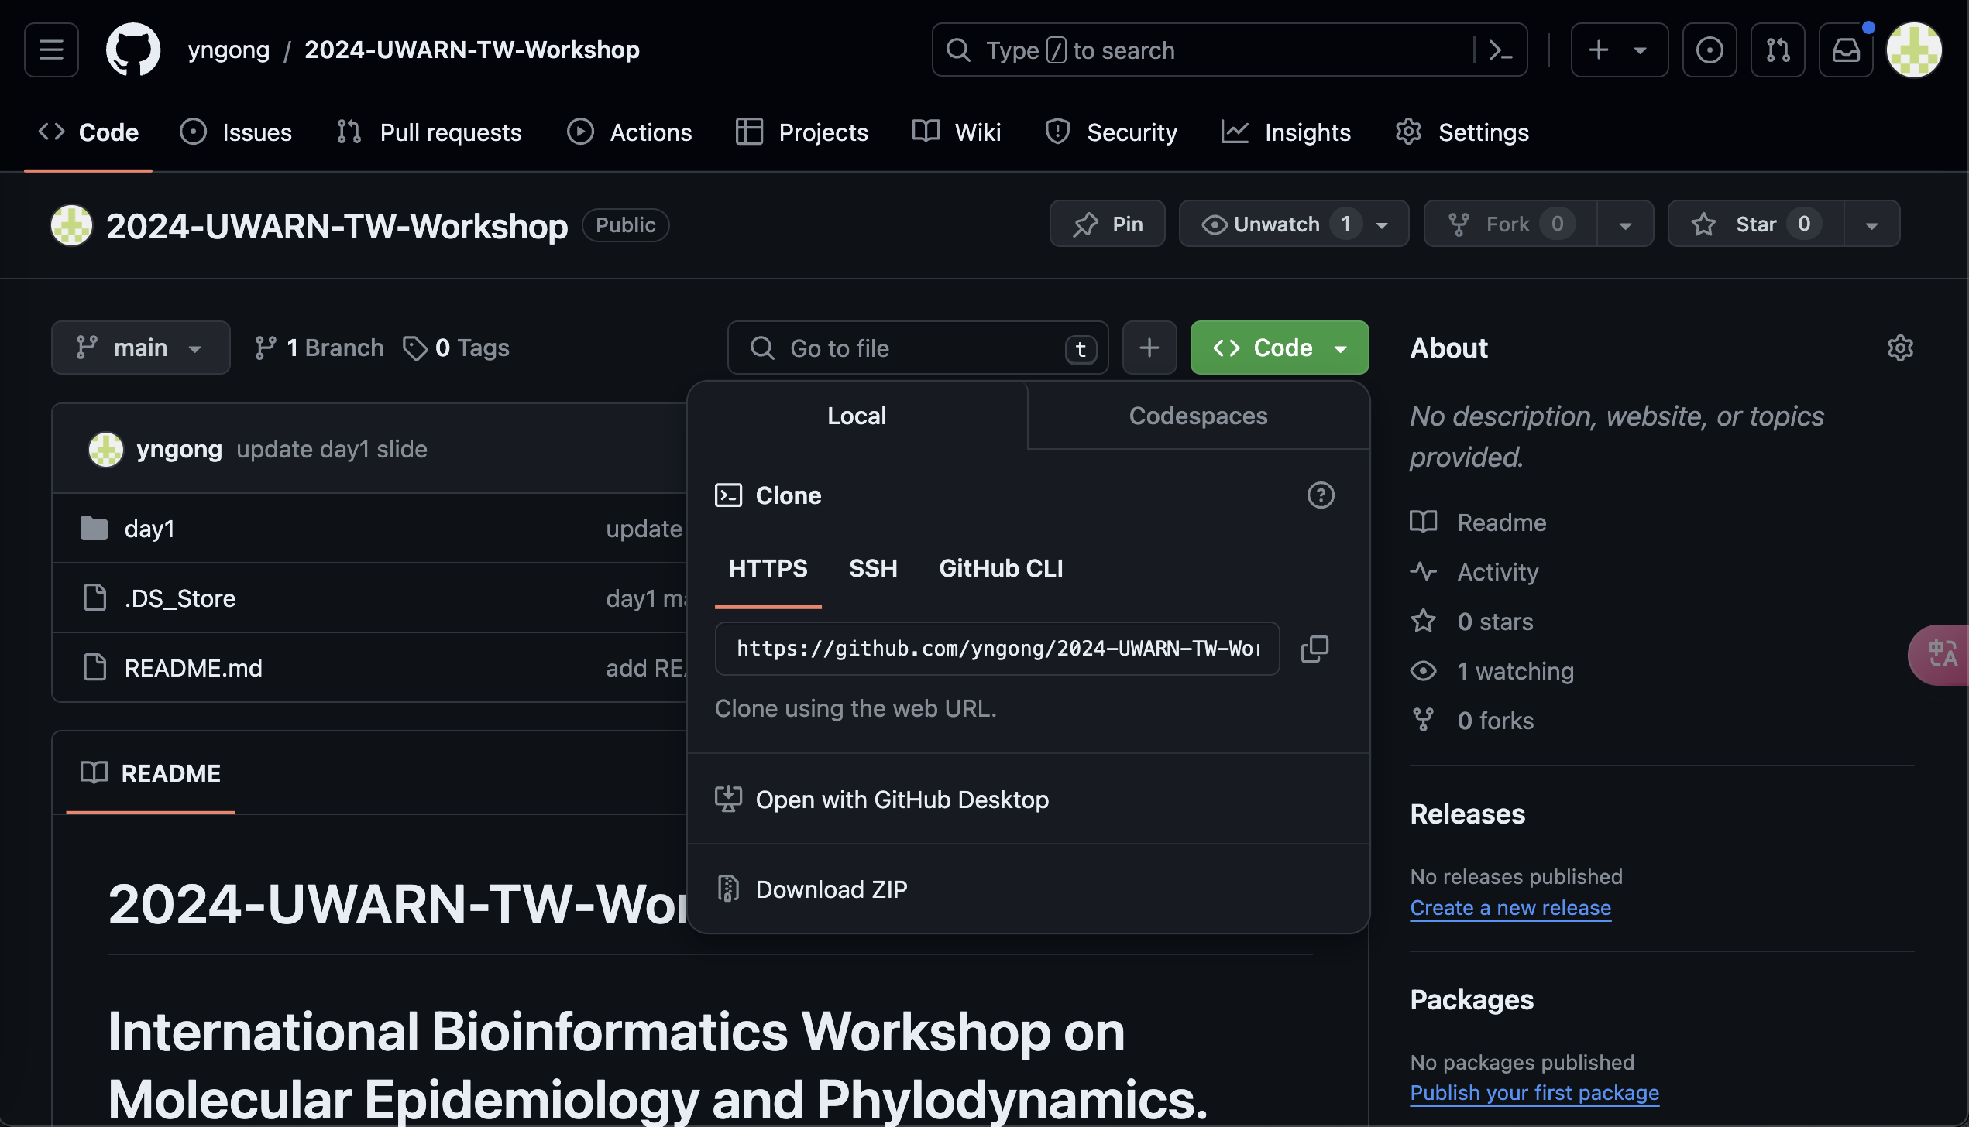
All of materials @ github
https://github.com/yngong/2024-UWARN-TW-Workshop
Open your Terminal app and type “git clone https://github.com/yngong/2024-UWARN-TW-Workshop”, and then will obtain the whole repo
Or just click “Download ZIP”

Slide 10
Environment setup

Slide 11
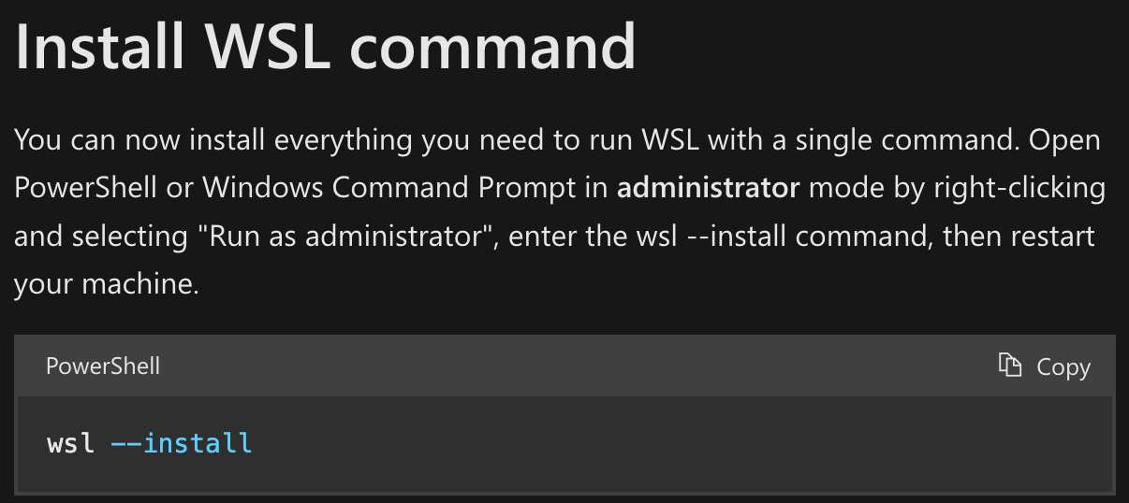
Step 1. Command line environment
Mac user
PC user
Open “Terminal” app
Install Linux on Windows with WSL
https://learn.microsoft.com/en-us/windows/wsl/install#install-wsl-command
Open PowerShell.exe and type …

Slide 12
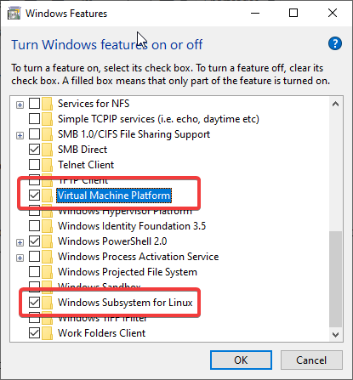
Troubleshooting (PC user)
Open these two features before installing WSL
https://gailloty.net/Rstudio-server-windows/install-wsl-2-and-configure-it-on-windows-10.html

Slide 13
More troubleshooting
If “wsl --install” doesn’t work, please update wsl first by typing “wsl --update”.
Learn more from https://learn.microsoft.com/en-us/windows/wsl/troubleshooting

Slide 14
Step 2. Install Conda
Mac user
PC user
Open “Terminal” app
Install Linux on Windows with WSL
https://learn.microsoft.com/en-us/windows/wsl/install#install-wsl-command
Open PowerShell.exe and type …

Slide 15
Step 2. Install Conda
PC user
“Miniconda is a free minimal installer for conda. It is a small bootstrap version of Anaconda that includes only conda, Python, the packages they both depend on, and a small number of other useful packages (like pip, zlib, and a few others).” from https://docs.anaconda.com/free/miniconda/index.html
Download the installer from “https://docs.anaconda.com/free/miniconda/miniconda-install/”
Please Install Linux version of miniconda on WSL, because you are in a linux env, not windows.
https://learn.microsoft.com/en-us/windows/wsl/install#install-wsl-command
Open WSL and type “bash Minicode_xxx.sh”

Slide 16
Step 3. Create a conda environment and your (first) alignment
# check the version
$ conda –V
# list the envs
$ conda env list
# create a new one
$ conda create --name 2024uwarn
# activate this env
$ conda activate 2024uwarn
# Comment
$ You code

Slide 17
# install mafft, https://anaconda.org/bioconda/mafft
$ conda install -c bioconda mafft=7.490
# check version
$ mafft –v
# create the first alignment
$ mafft demo.fas > demo.fasta
# deactivate the env
$ conda deactivate
Congratulations and you are all set!

Slide 18
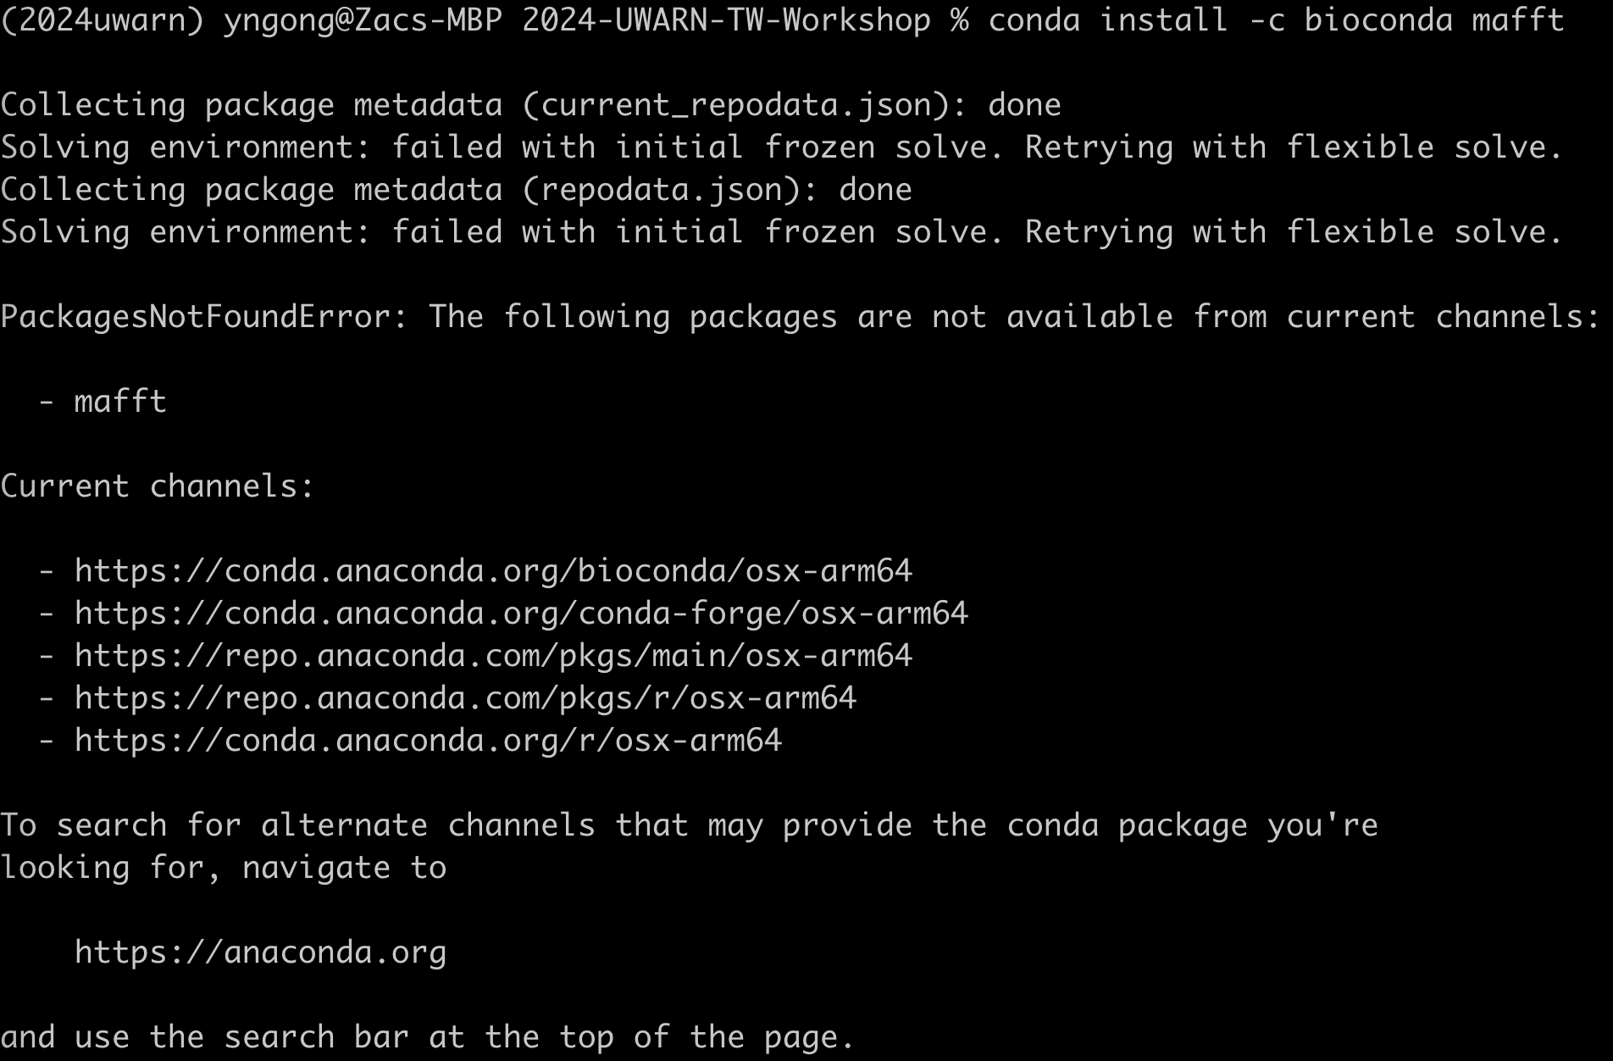
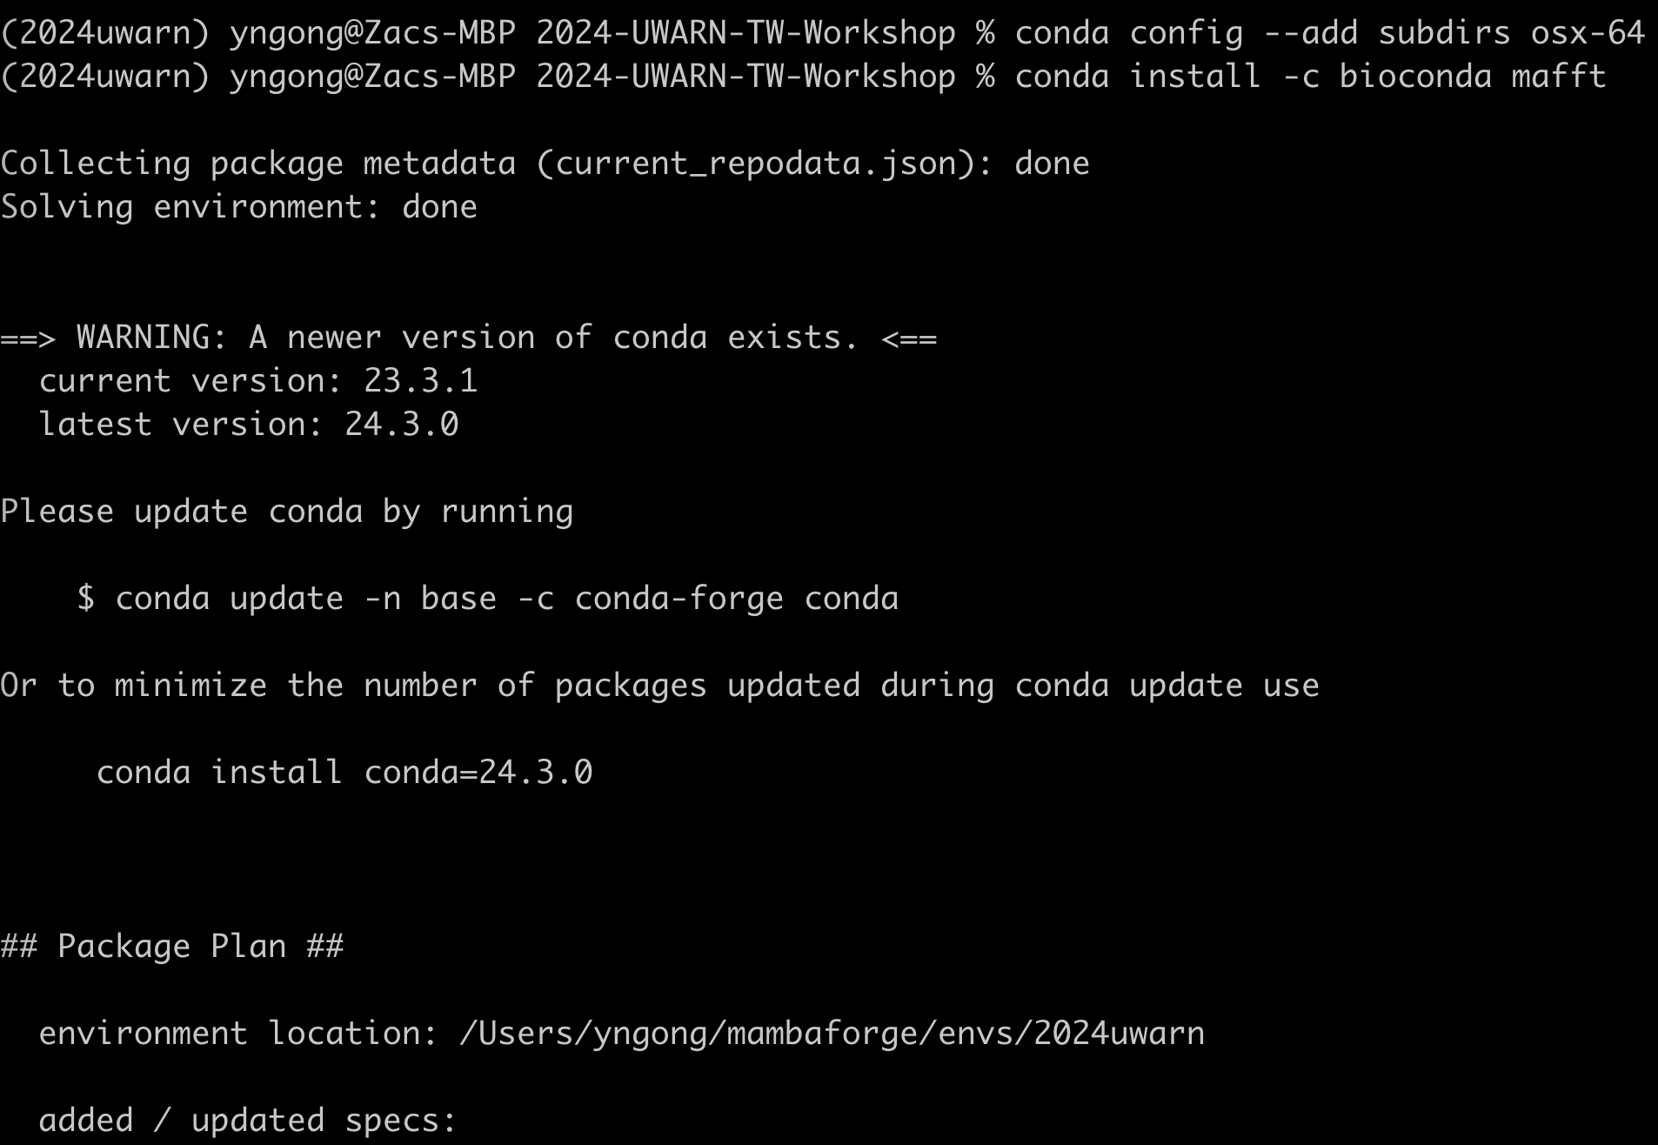
Troubleshooting for MAFFT (Mac M1 user)
$ conda config --add subdirs osx-64
$ conda install -c bioconda mafft

