Slide 1
Practical Introduction to Spark
Shang Gao

Slide 2
About Me
PhD Student in the Bredesen Center Data Science Program
Work with Arvind at ORNL
Area of research: Deep Learning for Natural Language Processing
Develop methods to automatically process information from cancer pathology reports
I’m not an expert in Spark
I’ve used Spark before on several projects
Deployed Spark clusters on Amazon Web Services
If you have questions, I might not know the answer immediately but I’ll try my best to find the answer

Slide 3
Distributed ML Background
In 2004, Google invented MapReduce, a programming framework that could distributed algorithms across a compute cluster
Split your dataset across multiple machines
Map – apply the same operation to each entry in parallel
Reduce – combine the results back together
In 2006, Hadoop was created with the MapReduce algorithm built into the framework
Big companies like Twitter, Facebook, and LinkedIn started using Hadoop
In 2008, Hadoop is acquired by Apache

Slide 4
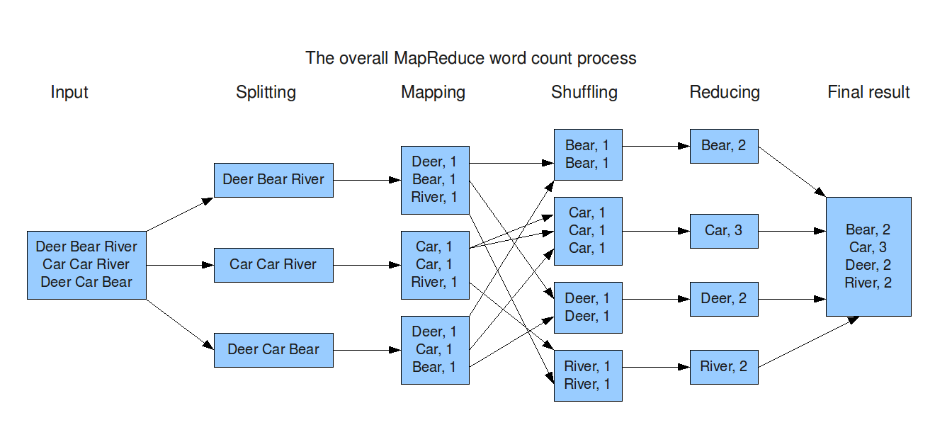
MapReduce Example

Slide 5
Benefits of MapReduce
MapReduce is not the fastest method for implementing parallelism, there are distributed databases that run faster
Despite that, MapReduce has several major advantages:
Simple coding method – programmer doesn’t need to distribute the data or implement the parallelism
Scalable – can scale easily across thousands of nodes
Supports unstructured data – images, sound, text files, etc
Fault tolerance – failure of individual nodes doesn’t stop the process from completing

Slide 6
What is Spark?
Spark started in 2009 in UC Berkeley as a class project on cluster management
Spark was purchased by Apache in 2013
Spark has some overlap with Hadoop, but there are also differences
Hadoop has a very robust distributed filesystem, and MapReduce allows for easy distributed data manipulation
MapReduce can be clunky for complex data analytics and machine learning tasks
Spark was designed to fill in this niche of speeding up complex distributed data analytics operations
Because Spark was designed with the Hadoop filesystem in mind, many companies use Hadoop for storing data and Spark for data analysis
Spark has built-in support for SQL queries, streaming data operations, and machine learning algorithms

Slide 7
Spark vs. Hadoop
Hadoop’s MapReduce writes to hard-disk after every MapReduce operation
Most complex problems require many MapReduce operations
Hadoop will read data from the cluster, perform an operation, write results to the cluster, read updated data from the cluster, perform next operation, write next results to the cluster, etc…
Spark performs most operations in memory
Spark will read data from the cluster, perform all of the requisite analytic operations at once in memory, and write final results to the cluster
Spark can be up to 10x – 100x faster than Hadoop for complex data analytics operations

Slide 8
Lazy Evaluation
Spark uses lazy evaluation, which means that operations are not run until the final output is requested
For example, suppose we have a dataset with 20 preprocessing steps followed by a print command
Eager evaluation – run each preprocessing step as soon as it is called, saving the result to memory
Lazy evaluation – save the instructions for each preprocessing step until the output is required (print), then optimize the instructions and run the minimal required for the output
Lazy evaluation allows for additional optimization of operations to save memory and computing time

Slide 9
Language Support
Spark is written in Scala
Spark also supports Java, Python, and R
Python (and R) code runs slower on Spark than Scala
However, Python remains a popular choice for Spark because Python has many more libraries for machine learning and natural language processing than Scala
This tutorial will focus on PySpark

Slide 10
RDD vs DataFrames
Spark has two ways of storing data:
Resilient Distributed Dataset (RDDs)
DataFrames (DFs)
RDDs:
Rows of unstructured data
Operations are done on the entire row
Good for functional programming like map, filter, and reduce operations
DataFrames:
Similar to a database table (or Pandas DataFrame)
Each column has a type
Operations can be done on specific columns
Good for SQL-like queries
Faster and more optimized than RDDs

Slide 11
RDD vs DataFrames
When data is imported into Spark, it is saved into an RDD or DataFrame
All subsequent Spark operations are done either the RDD or DataFrames
RDDs can easily be converted in DataFrames, and vice versa
RDDs and DataFrames have ML different libraries
RDDs use MLlib
Dataframes use ML
This tutorial will focus on DataFrames
Dataframes are newer than RDDs
Dataframes are a bit easier to use (require less programming)

Slide 12
Getting Started
Running PySpark locally:
Install Java
Install Anaconda
Download Spark
Pip install pyspark
Set environment variables
Setting up a cluster is a lot more complicated
Maybe use flintrock if setting up temporary clusters

Slide 13
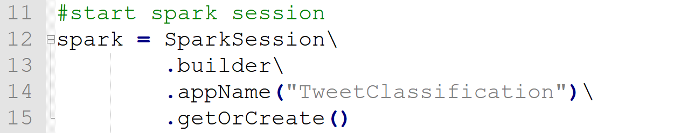
Spark Session
Must initiate a Spark Session before you can use anything Spark related in your script
Allows you to use DataFrames
Not to be confused with SparkContext, which allows you to use RDDs
Configuring your Spark Session:
Basic requirements: name
Lots and lots of advanced configuration options available, see PySpark documentation
Follow along at https://github.com/iamshang1/Projects/tree/master/Misc/PySpark_Tutorial

Slide 14
Importing Data
Spark can directly import a wide range of data formats:
Csv
Json
Text
Spark.read directly converts raw data into a Spark DataFrame
Can infer datatypes when importing
Follow along at https://github.com/iamshang1/Projects/tree/master/Misc/PySpark_Tutorial

Slide 15
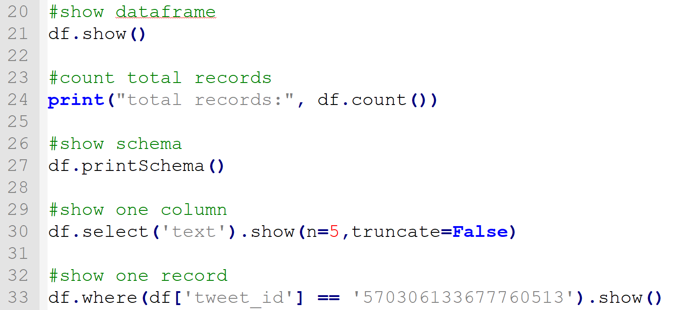
Examining Data
Spark DataFrames have built in commands to let you examine the contents of the DataFrame
Follow along at https://github.com/iamshang1/Projects/tree/master/Misc/PySpark_Tutorial

Slide 16
Casting Data
Spark doesn’t always capture the correct data types when importing data
You can manually cast a column from one datatype to another
Important because machine learning operations require integers or floats as input, not strings
Common Spark datatypes:
string, integer, float, double, Boolean, date, timestamp, array
Follow along at https://github.com/iamshang1/Projects/tree/master/Misc/PySpark_Tutorial

Slide 17
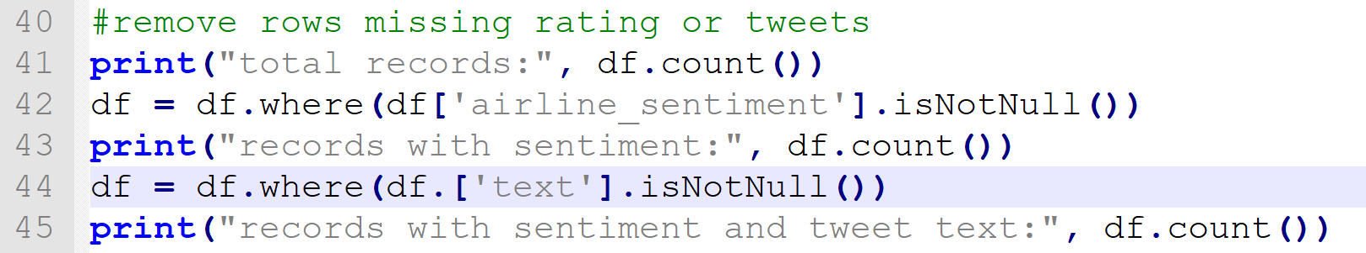
Removing Missing Data
df.where allows you to filter data by criteria
Example usage:
df.where(df[‘column’] > 5)
df.where(df[‘column’] != 0)
df.where(df[‘column’].isNull())
df.where(df[‘column’].isNotNull())
Follow along at https://github.com/iamshang1/Projects/tree/master/Misc/PySpark_Tutorial

Slide 18
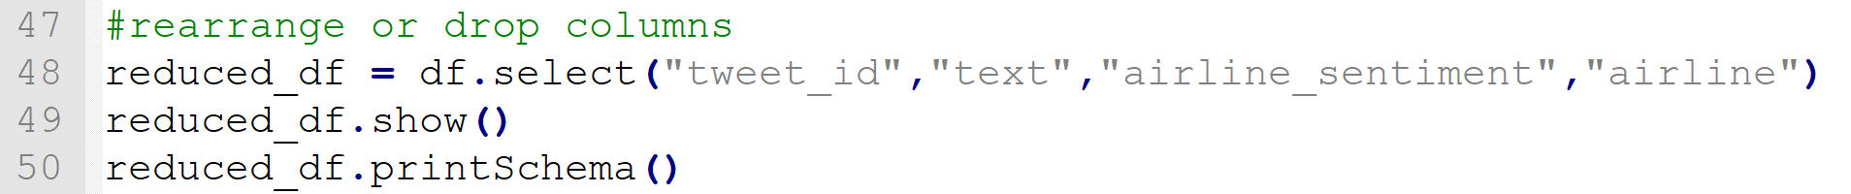
Restructuring DataFrames
df.select(‘col1’, ‘col2’) allows you to create a new DataFrame using the selected columns from an existing DataFrame
df.drop (‘col1’, ‘col2’) allows you to create a new DataFrame by dropping columns from an existing DataFrame
df.join(df2, df1[‘index’] == df2[‘index’]) allows you to create a new DataFrame by joining two existing DataFrames on an index column
Follow along at https://github.com/iamshang1/Projects/tree/master/Misc/PySpark_Tutorial

Slide 19
User Defined Functions
User defined functions allow you to apply a custom Python function to every entry in a specified column of a DataFrame
Similar to mapping in RDDs
Useful for tasks like data transformation and data cleaning
Step 1: define a Python function
Should take in one argument if operating on one column
Can take in one argument for each column if operating on multiple columns
Step 2: convert it into a Spark UDF (user defined function)
udf_function = udf(python_function,DataType())
Step 3: apply the UDF to a DataFrame
df = df.withColumn(“output_col", udf_function(“input_col"))
Follow along at https://github.com/iamshang1/Projects/tree/master/Misc/PySpark_Tutorial

Slide 20
Data Statistics
df.count() counts the total number of records in a DataFrame
Can be used in conjunction with df.where to count entries satisfying specific criteria
df.describe() generates summary statistics for each column in a DataFrame
df.agg({‘column’:‘statistic’}) calculates a statistic on a specified column
Replace ‘statistic’ with ‘max’, ‘min’, or ‘avg’
df.groupBy(‘col1’).agg({‘col2’:‘statistic’}) groups records in a specific column, then calculates a statistic for each group on another column
Follow along at https://github.com/iamshang1/Projects/tree/master/Misc/PySpark_Tutorial

Slide 21
Saving DataFrames
DataFrames can be saved to disk in parquet format (stores type information, headers, and other metadata) or other formats:
df.write.parquet(‘filename.parquet’)
df.write.csv(‘filename.csv’)
DataFrames can be reloaded using the spark.read method
df = spark.read.parquet(‘filename.parquet’)
df = spark.read.csv(‘filename.csv’)
Follow along at https://github.com/iamshang1/Projects/tree/master/Misc/PySpark_Tutorial

Slide 22
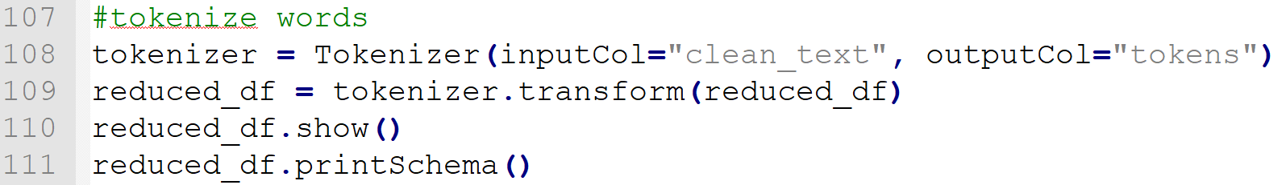
Data Preprocessing Library
The pyspark.ml.feature module has many useful feature transformation tools:
Tokenizer and N-Grams
Word counts and TF-IDF
One-hot encoding
Feature Scaling
PCA and Feature Selection
Follow along at https://github.com/iamshang1/Projects/tree/master/Misc/PySpark_Tutorial

Slide 23
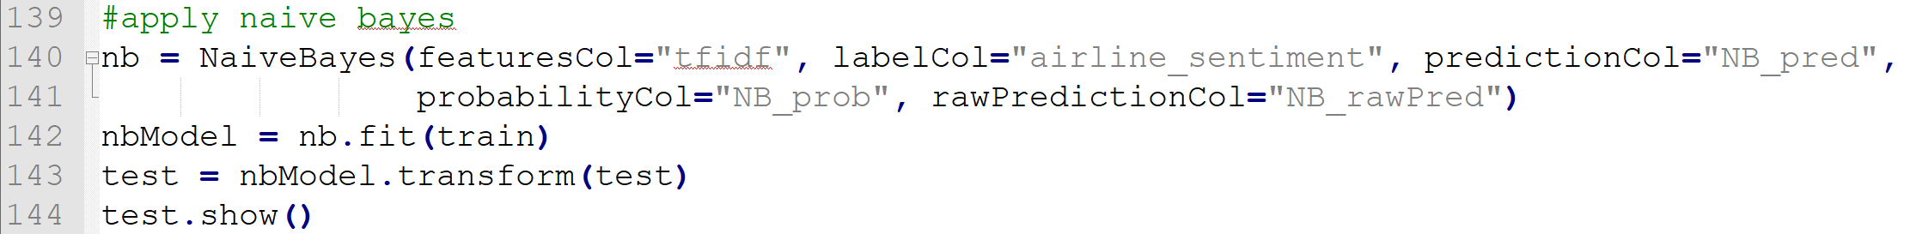
Machine Learning Library
The pyspark.ml.classification module contains many useful machine learning algorithms for classification
Naïve Bayes
Logistic Regression
Random Forests
Support Vector Machines
PySpark ML library also has modules for regression and clustering
Follow along at https://github.com/iamshang1/Projects/tree/master/Misc/PySpark_Tutorial

Slide 24
Launching Jobs on Spark Clusters
Python can be used to run a PySpark script locally on one machine
The spark-submit command is used to run a PySpark job on a Spark Cluster
The arguments passed to the spark-submit command determine the number of nodes and configuration settings used to run the job
Example: spark-submit --master 192.12.34.56 --deploy-mode client --driver-memory 30g --executor-memory 7g --num-executors 16 --executor-cores 2 --files script.py
For additional information on how to use spark-submit, see https://spark.apache.org/docs/latest/submitting-applications.html

Slide 25
Additional Resources
PySpark documentation is thorough and has many examples
http://spark.apache.org/docs/latest/api/python/
https://spark.apache.org/docs/latest/quick-start.html
https://spark.apache.org/docs/latest/sql-programming-guide.html
DataCamp also offers helpful tutorials for PySpark
https://www.datacamp.com/community/tutorials/apache-spark-tutorial-machine-learning
https://www.datacamp.com/courses/introduction-to-pyspark

