Slide 1

Department of Computer Science and Engineering
ABES Engineering College, Ghaziabad, UP
PROJECT PRESENTATION​
SESSION 2022-23​
Our Team
Name-​Nikhil Kumar Yadav
Class & Section:​ CSE-DS
Roll No. – ​2000321540037
Admission No. - ​2020B1541051
Name-​Ankita Gupta
Class & Section:​ CSE-DS
Roll No. – ​2000321540010
Admission No. - 2020B1541042​

Slide 2

IMAGE STEGANOGRAPHY

Slide 3

Problem Statement
How can we increase the security of our communication in this era where data breaches occur frequently in our daily lives?

Slide 4
What is Steganography?
Cryptography is a science of writing a secret code.
Basically, Cryptography makes a message meaning less to the casual reader by encrypting the data using a set of rules which is known to both sender and receiver. Only the intended receiver with the decryption key can extract the actual message. Thus, when an attacker get the message, it is still difficult for him to get the secret message.

Slide 5
What is Steganography?
Steganography is the art of science and embedding secret messages in cover messages in such a way that no one, apart from the sender and intended recipient, suspect the existence of the messages.

Slide 6
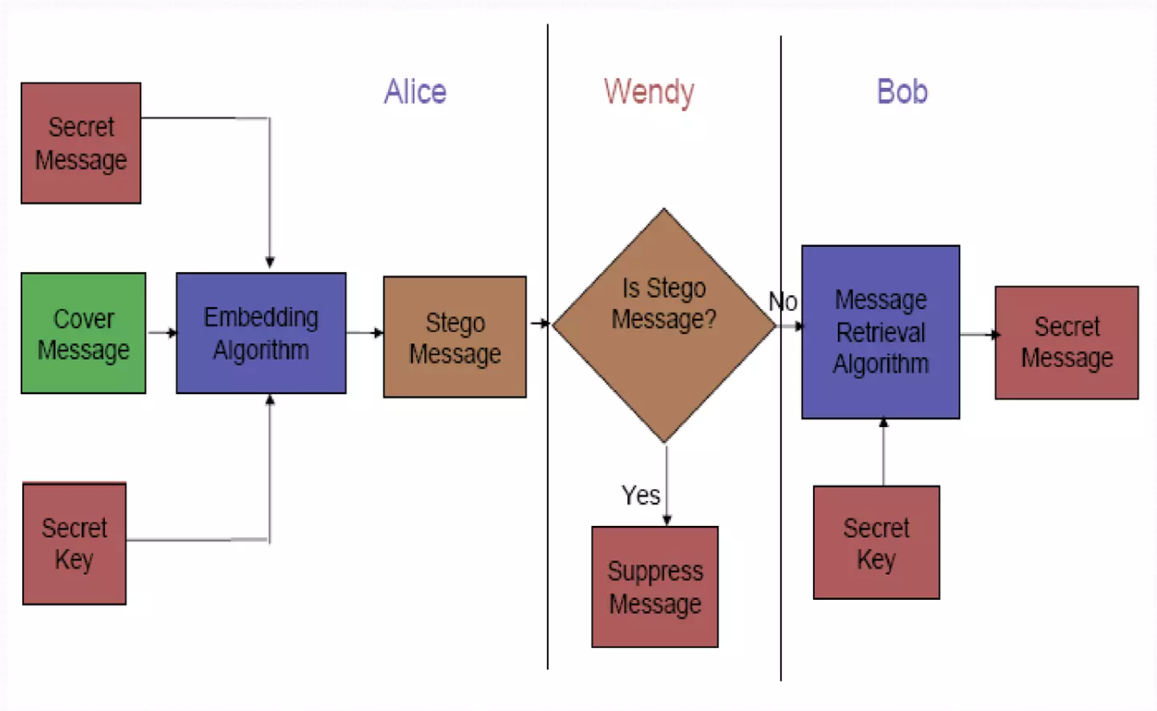
Steganography Framework

Slide 7
Image Domain
What Images are made up of ? :-
Images are made up of lots of little dots called pixels. Each pixel is represented as 3 bytes - one for Red, one for Green and one for Blue.
11111000 11001001 00000011
248 201 3
Each byte is interpreted as an integer number, which is how much of that color is used to make the final color of the pixel.
248 201 3 Orange Color

Slide 8
Image Domain
A common approach of hiding data within an image file is Least Significant Bit (LSB) Substitution. In this method, we can take the binary representation of the hidden data and overwrite the LSB of each byte within the cover image.
Suppose we have the following binary representation for the Cover Image.
10010101 00001101
10010110 00001111
Suppose we want to "hide" the following 4 bits of data: 1011, we get the following,
10010101 00001101
10010110 00001111
Where the each data bits are accommodated in the least significant bits of each byte of the image.

Slide 9
Image Compression
> Image compression offers a solution to large image files. Two kinds of image compression are lossless and lossy compression. Both methods save storage space but have differing effects on any uncompressed hidden data in the image.
> “Lossy” JPEG(Joint Photographic Experts Group) format files, offers high compression, but may not maintain the original image's integrity. Hence it is called “lossy”.
> “Lossless” compression maintains the original image data exactly; It is thus more favored by steganographic techniques. Example: (BMP ),(GIF) Formats.

Slide 10
Image Encoding Techniques
The most common approaches to information hiding in images
> Least Significant bit insertion(LSB) :
> Masking and Filtering :
> Algorithms and transformations :

Slide 11
ADVANTAGES
ADVANTAGES :
Difficult to detect and Only receiver can detect.
It can be done faster with large no. of software.
Provides better security for sharing data in LAN,MAN & WAN.

Slide 12
Research Reference
https://en.wikipedia.org/wiki/Steganography
https://www.ukessays.com/essays/computer-science/the-types-and-techniques-of-steganography-computer-science-essay.php
https://www.ques10.com/p/33259/explain-steganography-and-its-types/
https://searchsecurity.techtarget.com/definition/steganography#:~:text=Steganography%20is%20the%20technique%20of,for%20hiding%20or%20protecting%20data.
https://www.spiedigitallibrary.org/conference-proceedings-of-spie/6074/60740G/Wireless-steganography/10.1117/12.650263.short?SSO=1

Slide 13
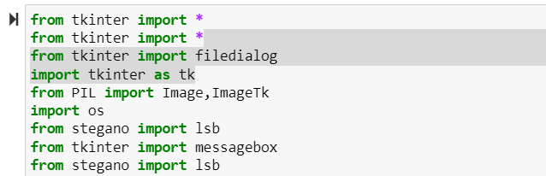
CODE SNIPPETS
LIBRARY USED:

Slide 14
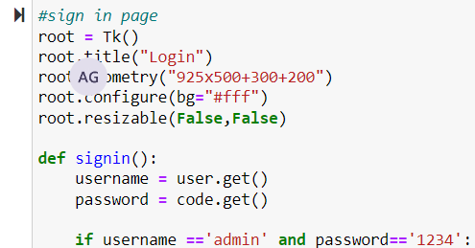
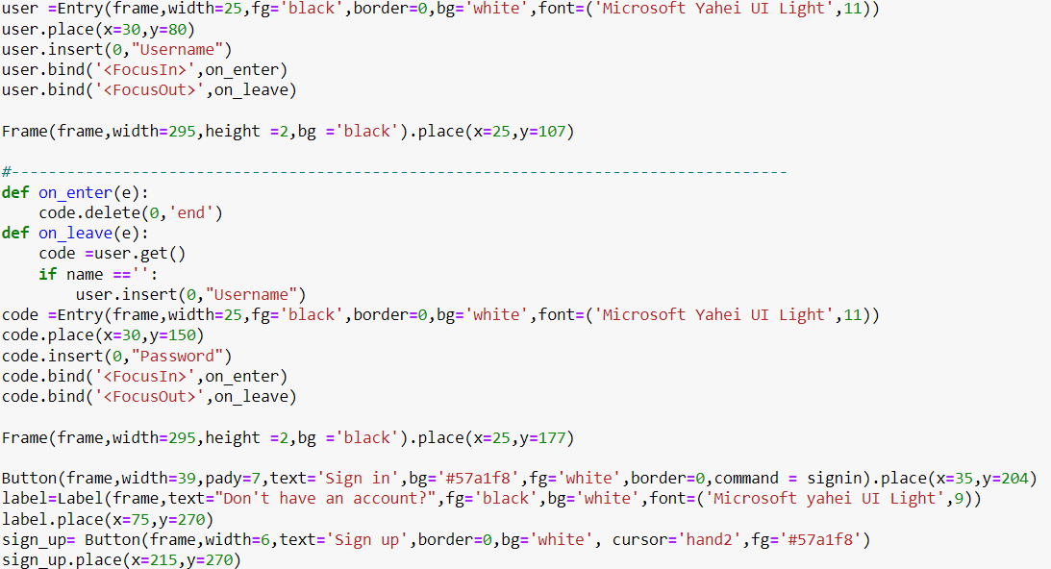
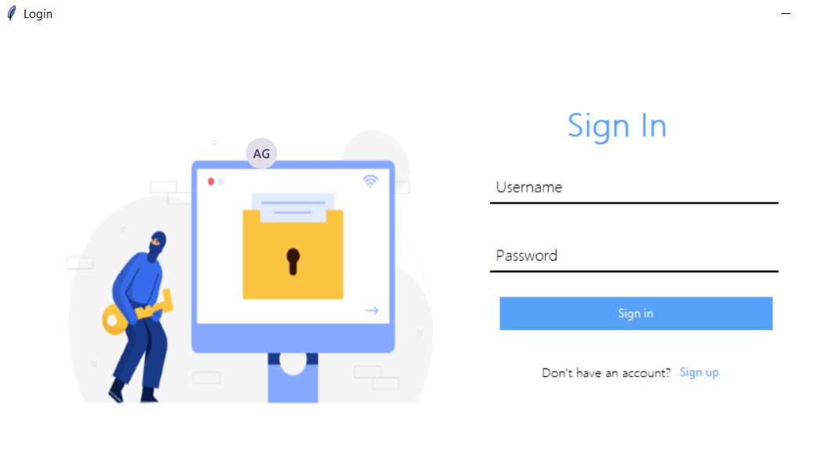
CODE SNIPPETS

Slide 15
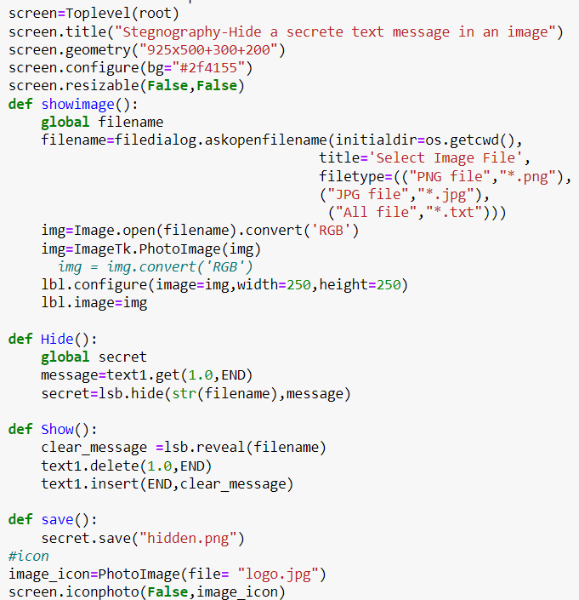
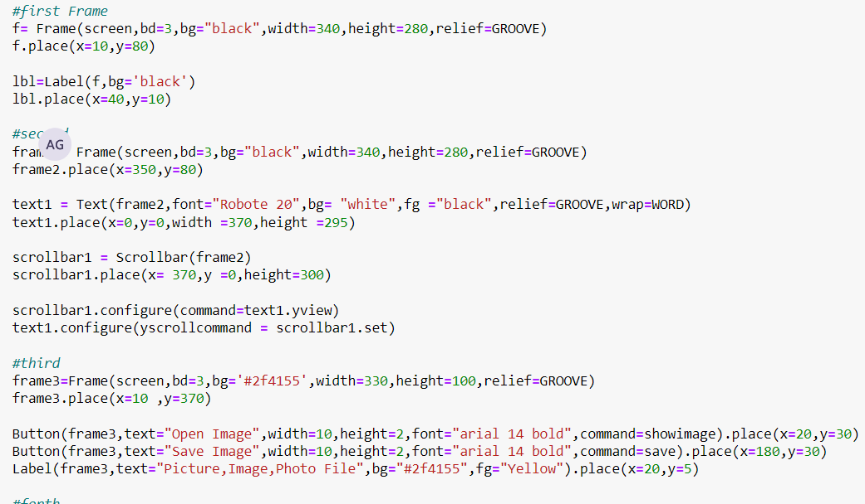
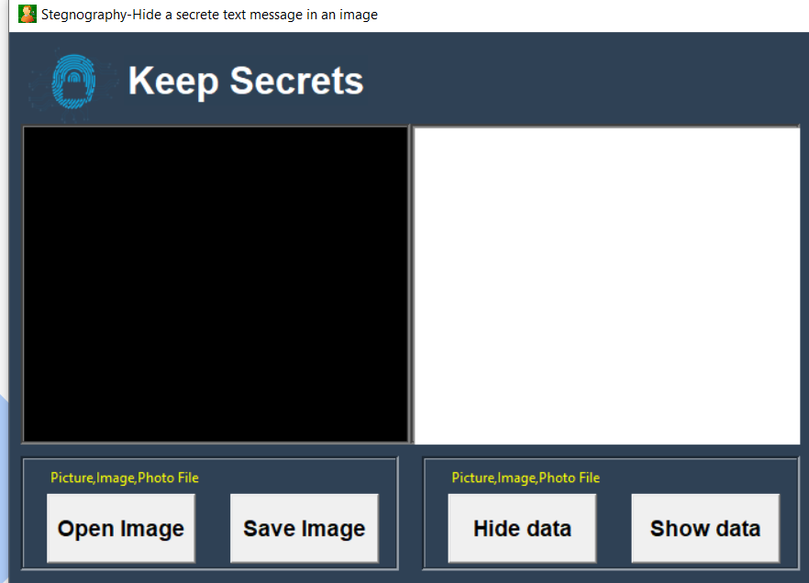
CODE SNIPPETS

Slide 16
CONCLUSIONS
Although only some of the main image steganographic techniques were discussed in this document, one can see that there exists a large selection of approaches to hiding information in images. All the major image file formats have different methods of hiding messages, with different strong and weak points respectively.
Least significant bit (LSB) in both BMP and GIF makes up for this, but both approaches result in suspicious files that increase the probability of detection when in the presence of a warden.
The application creates a stego image in which the personal data is embedded inside the cover file image.
Used the Least Significant Bit algorithm in this project for developing the application which is faster and reliable and compression ratio is moderate compared to other algorithms.

Slide 17


Slide 18
Thank you

Slide 20
FUTURE RECOMMENDATIONS
The major limitation of the application is designed for images cover files. It accepts only images as a carrier file. The future work on this project is to improve the compression ratio of the image to the text. This project can be extended to a level such that it can be used for the different types of multimedia files

Slide 21
CONTENTS
ABOUT THE COMPANY/PLATFORM
OBJECTIVES OF INTERNSHIP/COURSE
TRAINING/INTERNSHIP OVERVIEW
PROJECT BASED LEARNING UNDER THE INTERNSHIP/COURSE
5. CHALLENGES AND LIMITATIONS OF PROJECT
6. CONCLUSION
ANNEXURES:
CERTIFICATE(S)
CODE SNIPPETS
PROJECT DEMO SNIPPETS

