Slide 1
To See is To Believe
Jose Cezar Ynion
Khoa Pham

Slide 2
Project Description
A light bulb can be remotely controlled by an app on iOS device. The user can then verify if action has been successful by getting an image back of the bulb. The image is then displayed on the same iOS app.

Slide 3
System Design Diagram

Slide 4
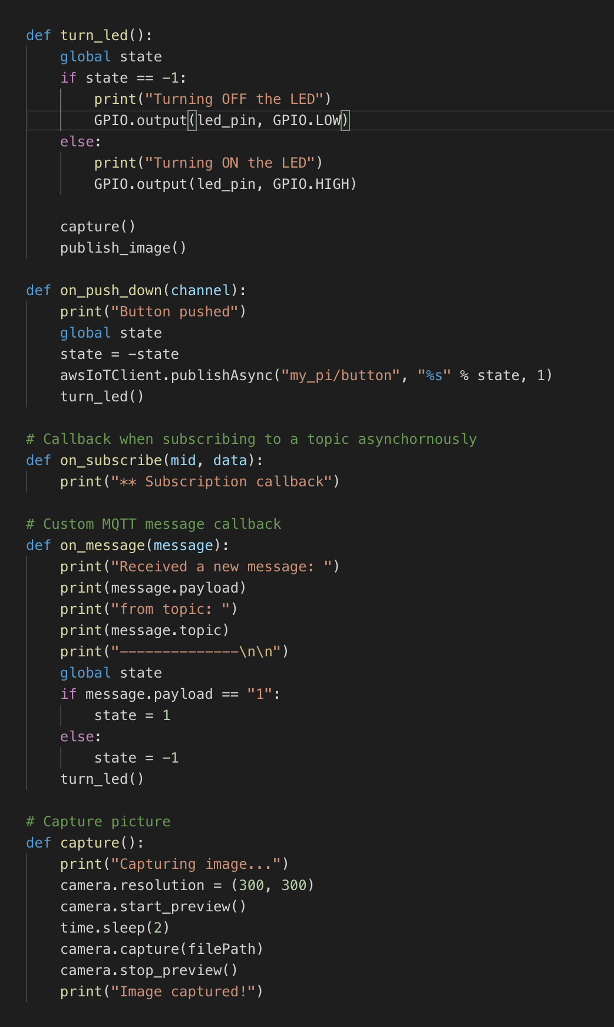
Implementation

Slide 5
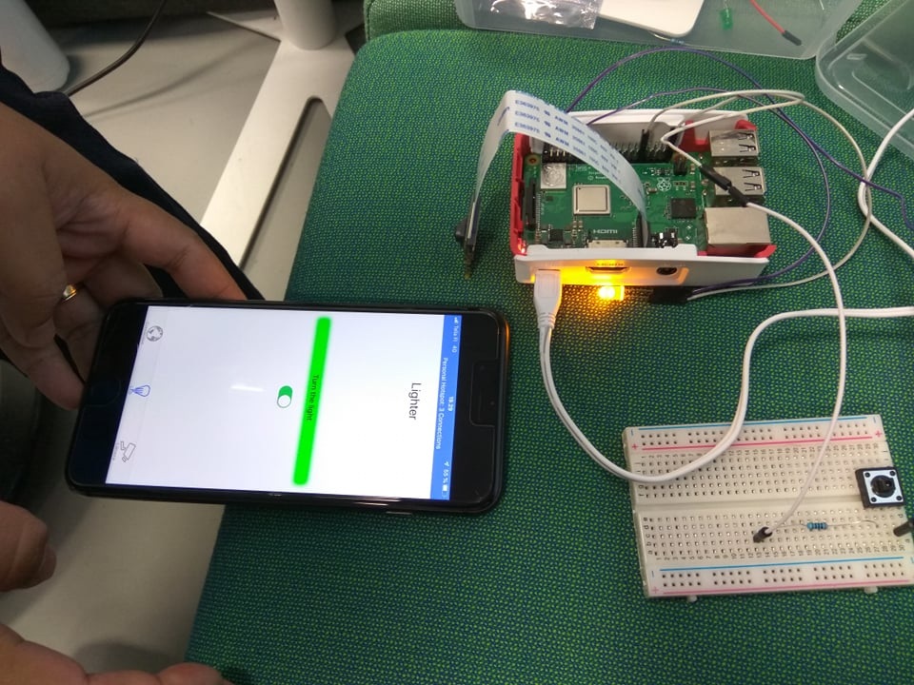
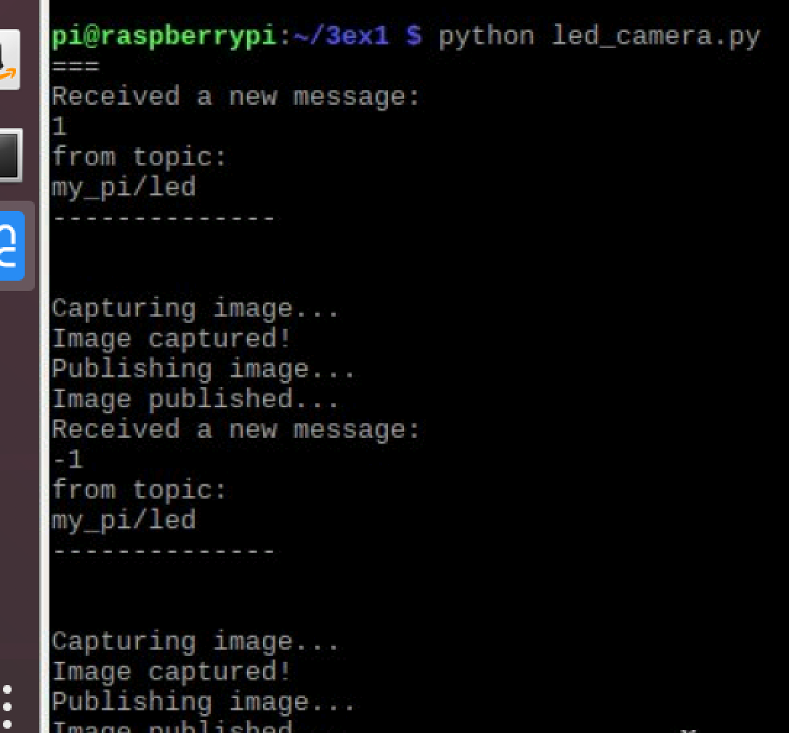
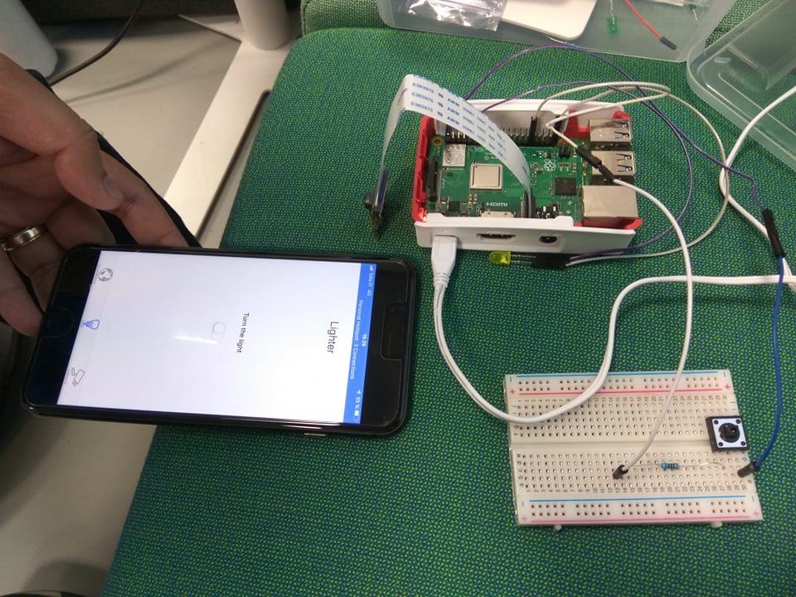
Screenshots of Test Runs

Slide 6
Conclusions
The ease of use of services like AWS IoT and the availability of cheap sensors will contribute of IoT boom.
IoT devices will make our lives easier and sooner we will be more dependent on it.
Risk is also increasing, as security is always an afterthought for IoT devices

Slide 7
What can be improved
Must be added: AWS IoT shadow should be used to set and retrieve the state

Slide 8
References
https://github.com/awslabs/aws-sdk-ios-samples
https://projects.raspberrypi.org/en/projects/getting-started-with-picamera
https://s3.amazonaws.com/aws-iot-device-sdk-python-docs/sphinx/html/index.html
https://s3.amazonaws.com/aws-iot-device-sdk-python/aws-iot-device-sdk-python-latest.zip

