Slide 1

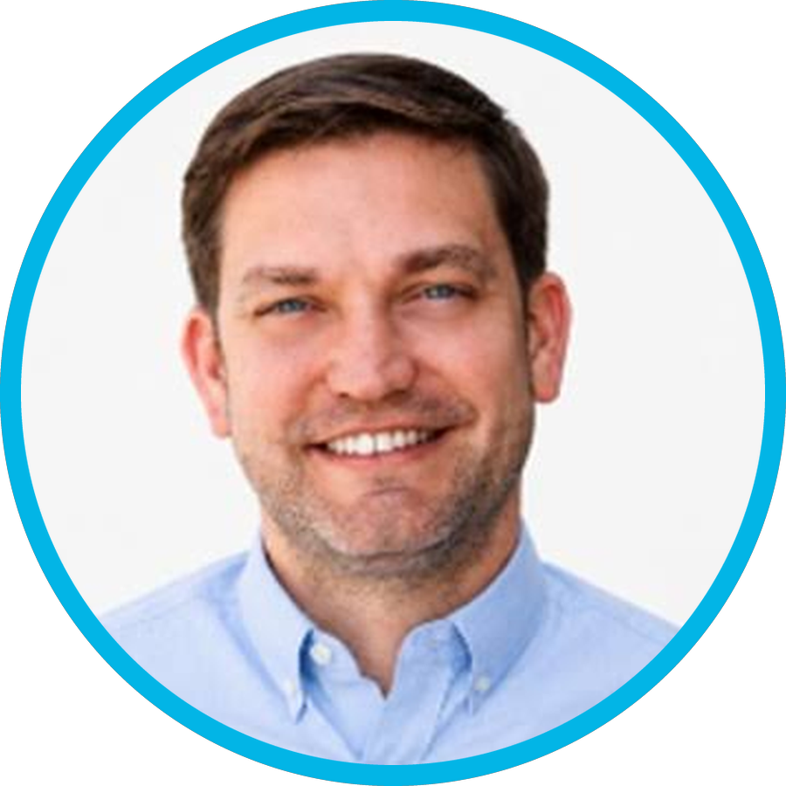
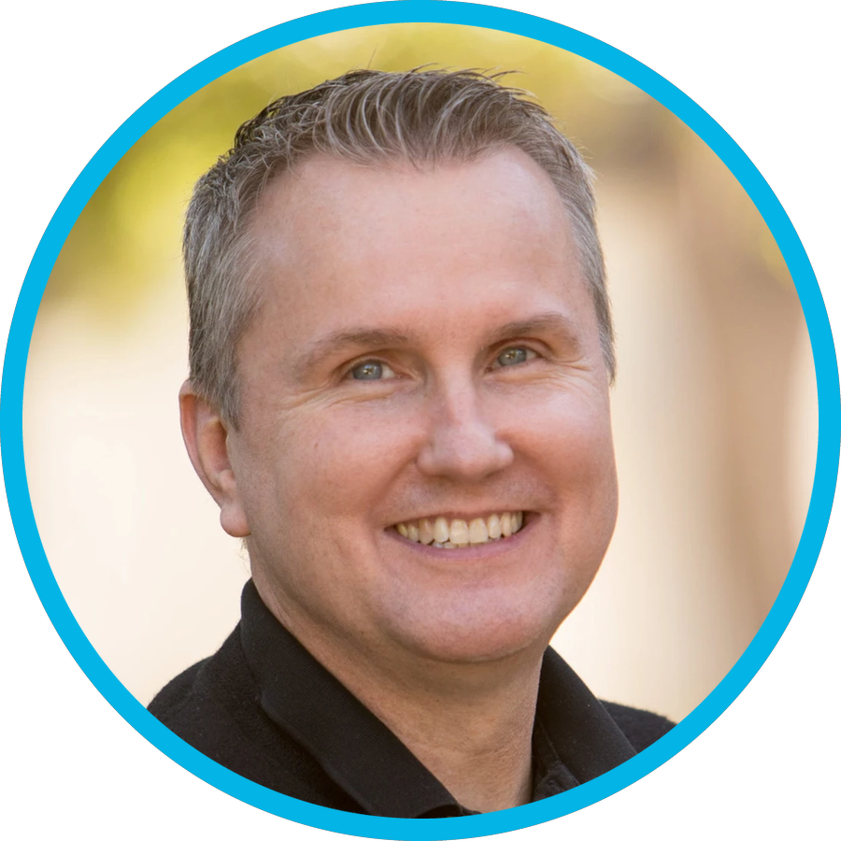
FEATURING
LIVE WEBINAR
AI and the
Agency of the
Future
Dan Hinckley
Rob Coleman
Herringbone
Hennessey Digital
Thursday, November 5
12:00 PM EST | 9:00 AM PST

