Slide 1
Cross Device Tracking
Anastasiia Iakovleva & Yannick Westermann
A privacy analysis

Slide 2
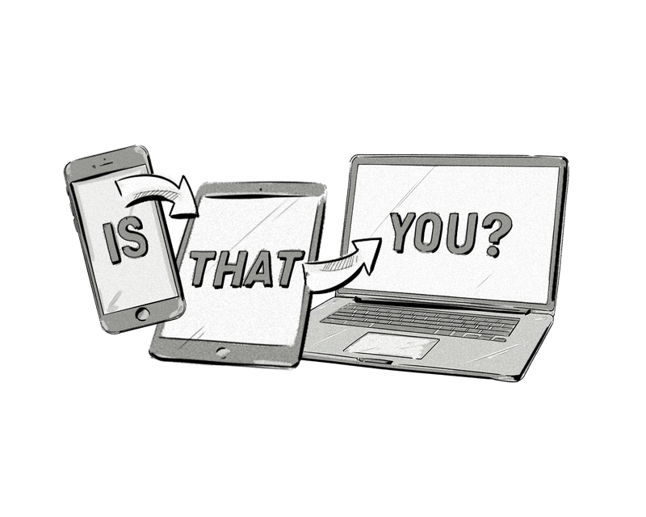
What is Cross Device Tracking?
Creation of accurate usage profiles
Monitoring user behavior across various devices

Slide 3
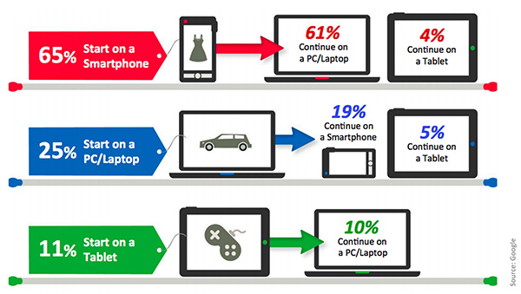

Slide 4

Privacy Concerns
Lack of Transparency
Third-Party Involvement
User Identifiability
User Consent

Slide 5
Objectives
Examination of Methodologies, technologogies, applications
Analysis of outgoing Requests
Interesting follow-up questions
Cross-country comparison
Cross-platform comparison (mobile vs. desktop)
Comparison of different types of websites (e.g news vs social media websites)

Slide 6
Methodology
Pre-select websites
Data Collection (OpenWPM, BeautifulSoup, Selenium,. ..)
Analyze dataset regarding origin, frquency, target and purpose

Slide 7


