Slide 1
What is Pricing?
Adam Kemp
Pricing Analyst
15th August 2016

Slide 2
Agenda
What is Pricing?
Risk
Why don’t we charge everyone the same price?
Measures of performance
How has Pricing changed?
Generalised Linear Models (GLMs)

Slide 3
What is Pricing?
Insurance companies must decide how much to charge their customers
Their aim is to write the best business possible (i.e. people who are less of a risk) at a price that will maximise profits and be more attractive than its competitors’ prices
This is a difficult balance to achieve; how do we determine whether someone is a good or bad risk and how much to charge?
For this reason, insurance companies employ pricing actuaries

Slide 4
What is Pricing?
Pricing actuaries use various methods (which we will cover in detail later on) in order to determine whether someone is a good or bad risk
Based on the level of risk, the actuaries come up with a price to charge the customers
Generally speaking, people who are higher risks will pay a greater premium (as you would expect!)

Slide 5
Dynamic Underwriting Structure
Barry Hawkins
Head of Dynamic Underwriting & Pricing
Lee Nicholson
Dynamic Underwriting & Portfolio Manager
Pete Skippins
Assistant Manager, Motor
John Jones
Dynamic Technical Pricing Manager
Matthieu Bergere
Technical Pricing Specialist
Luke Vassell
Senior Portfolio Analyst
David Burley
Senior Motor Underwriter
Abi Upfield
Senior Pricing Analyst
Adam Kemp
Pricing Analyst
Sarah Plumer
Portfolio Analyst
Charlotte Ball
Pricing Analyst
Omaid Qaiser
Senior Pricing Analyst
Eamonn Geoghegan
Portfolio Analyst
Michael Dulson
(Transfer from Finance / Actuarial)
Stephen Shepherd
Pricing Analyst
Simon Turner
Portfolio Analyst

Slide 6
Pricing Process
Corporate Governance/
Strategy/Plans etc
Relationship Management
Product Proposition
Portfolio Management/ Tactical Price Reviews
Calculate Price
(Tech. Pricing)
Deliver Rates/Wordings to market
(Price Delivery)
Consider terms & wordings
(Tech. UW)
Strategic Pricing (External Data, Methodology, Tools, R&D etc)

Slide 7
What makes someone a good or bad risk?
When giving a quote for a policy, an insurance company will want to find out as much about you as possible
This is in order to determine your individual level of risk
The more an insurance company can find out about you, the more appropriate the premium they charge is
These questions form the rating factors discussed in Introduction to Insurance

Slide 8
Examples of a good risk?
Motor
Being an experienced driver
Having a record of no/few claims
Being older

Slide 9
Examples of a good risk?
Life
Regular Exercise
Being a non-smoker
Having a good medical record

Slide 10
Examples of a bad risk?
Motor
Being an inexperienced driver
Having a record of claims
Being younger

Slide 11
Examples of a bad risk?
Life
Not exercising regularly
Being a smoker
Having a poor medical record

Slide 12
Attitudes towards risk
Naturally, different individuals have different attitudes towards risk
Firstly, let us define a fair gamble as follows: A fair gamble is one where the odds of any expected loss or gain are equal, e.g. flipping a coin and betting on heads/tails there is a 50/50 chance of either outcome

Slide 13
Attitudes towards risk
A Risk Taking person likes risk and will always accept a fair gamble
A Risk Averse person dislikes risk and will always reject a fair gamble
Which type do you think is more likely to take out insurance?
As you would expect, a risk averse person is more likely to take out insurance!

Slide 14
Retaining the best risks
As well as attracting new customers, an insurance company will be concerned about retaining existing business
Clearly, those customers who have not made claims are preferable to those who have
One method to reward customers for not making any claims and encouraging them to remain with the insurer is by offering a No Claims Discount

Slide 15
No Claims Discount
A no claims discount system works by rewarding customers who have not made a claim in the previous year Example:
When a policy comes up for renewal, an insurance company may offer discounts of 10%, 25% and 40% for customers with 0, 1, 2 years without claiming respectively.
This discount encourages the customer to remain with the insurer and means the insurer keeps its best risks

Slide 16
Difficulties faced when pricing?
A common problem actuaries face when pricing is a lack of data
The more data you have, the more likely you are to have an accurate model
Lack of data is especially an issue in niche markets (such as those written by Lloyds), as opposed to a major insurance pricing motor
Agreement with Underwriters!

Slide 17
Adverse Selection
Adverse selection is where individuals who take out insurance do so because they know that they are a greater risk
Conversely, individuals who know they are better risks do not take out insurance Example:
Say you know you are clumsy and likely to drop your mobile phone. As a result of this, you decide it would be sensible to take out insurance

Slide 18
Adverse Selection
However, say you know you are a careful individual, who looks after your possessions. As a result, you do not take out insurance for your mobile phone

Slide 19
Adverse Selection
What effect do you think adverse selection has on insurance policies?
It makes insurance more expensive!
It may push the price of insurance above what an individual is prepared to pay

Slide 20
Moral Hazard
Moral hazard is where a policyholder acts in such a way that makes the insured event more likely to occur because they have insurance
Example 1:
Suppose you have insurance for your mobile phone
Since you know that the insurance company will pay for your phone to be repaired (if it breaks) you decide not to spend money on a protective case
Not purchasing the case makes the insured event more likely to happen

Slide 21
Moral Hazard
Example 2:
You leave your house in the morning to go to work
Shortly after leaving, you realise you have left the front door unlocked
If you have your contents insured against theft, you may decide not to go back and lock the door (because you know you are insured)
Leaving the door unlocked makes it more likely that you will be robbed (i.e. that the insured event will occur)

Slide 22
Why don’t we just charge everyone the same price?
What would happen if we charged all customers the same price? Example:
Lets assume 50% of properties in the UK are houses and the remainder flats
Also assume that we know we should charge £200 for flats and £400 for houses
Also, we are the only insurer in the UK
What happens if we charge everyone £300?

Slide 23
Why don’t we just charge everyone the same price?
Now let’s assume a competitor is set up and they charge £200 for flats and £400 for houses. What happens?
They write all the flats in the UK and make money. We write all the houses in the UK for £300 and go bust
This basic example is known as anti-selection
However, this can be expanded to actual market conditions. Consider what happens if a risk factor exists that a competitor uses to rate and we do not. For example, a fairly basic panels question set that is used on aggregators

Slide 24
Measures of Performance
In order for an insurance company to remain in business, it must write enough business to cover its overheads and expenses (such as employee salaries, rent, heating and lighting etc)
It must also be able to pay any claims incurred from policyholders
The measure of money raised from policies sold is Gross Written Premium (GWP)

Slide 25
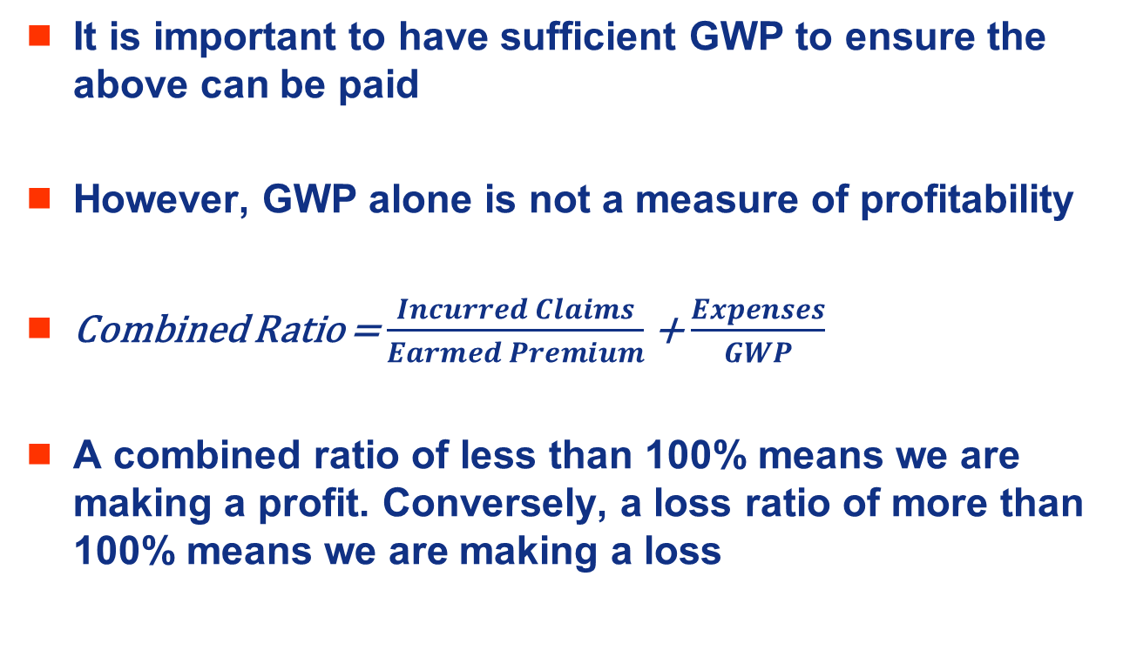
Measures of Performance
It is important to have sufficient GWP to ensure the above can be paid
However, GWP alone is not a measure of profitability
Combined Ratio = $\frac{Incurred Claims}{Earmed Premium}$ + $\frac{Expenses}{GWP}$
A combined ratio of less than 100% means we are making a profit. Conversely, a loss ratio of more than 100% means we are making a loss

Slide 26
How did GI Pricing look 20 years ago?
Traditionally pricing for insurance was not sophisticated – modelling was not used
Most home insurance sold either as an add on to mortgage or face to face with broker
People rarely changed insurance provider each year
Less competition with no aggregator sites

Slide 27
How did GI Pricing look 20 years ago?
Often, premium calculated as a rate per mille (per £000 sum insured) with no additional rating factors used.
Underwriting teams set premium rates – pricing teams did not exist

Slide 28
Classic Linear Models
These remove the effect of correlations/aliasing between factors that are present in one way analysis
A GLM (the models we build in EMBlem) is a generalised form of a linear model
Linear models are of the form: Y_{i} = μ _{i} + error
Y_{i} is the observed experience (we are trying to build a model that matches this as closely as possible)
μ _{i} is the modelled estimate of each factor
the error term is the random element/noise
A key assumption is all observations are independent and each comes from a normal distribution with mean 0 and constant variance σ².
The μ _{i} terms are the covariates (estimates of each rating factor)

Slide 29
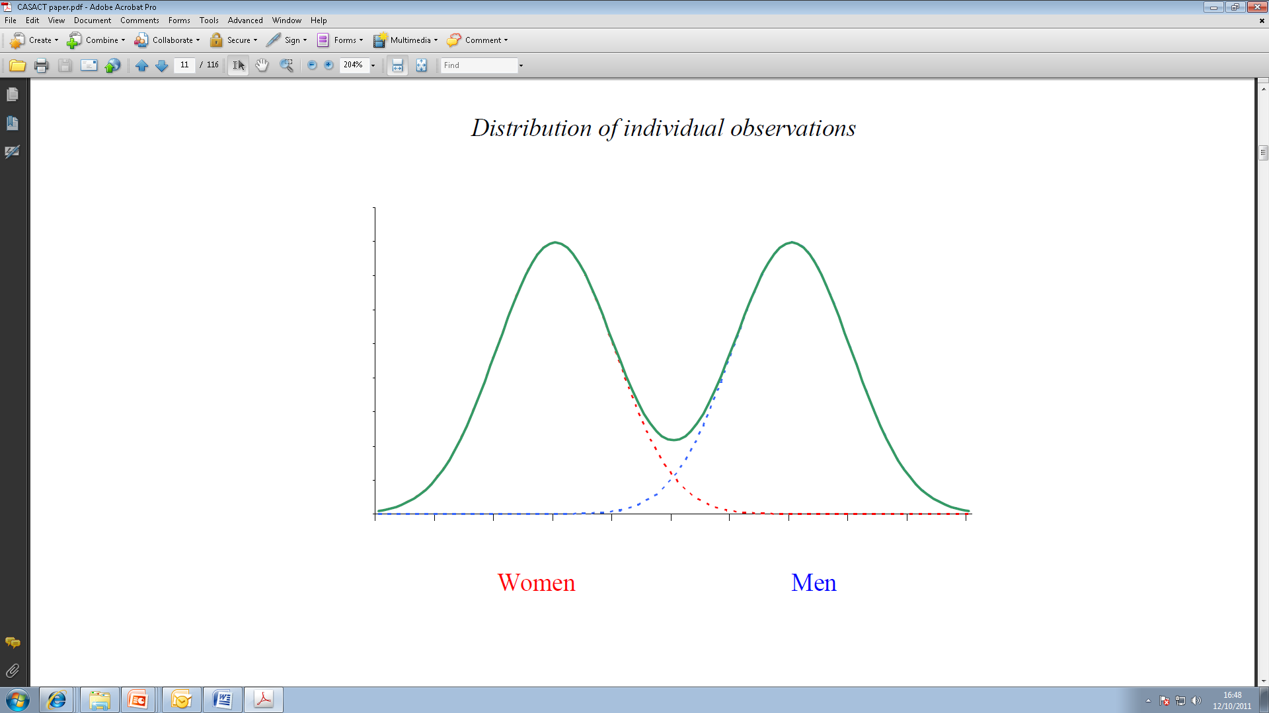
Classic Linear Models
Average claim amounts by gender may be normally distributed for males and females and the mean of the distribution for men is twice that for women. The total distribution of average claim amounts across all men and women is not normally distributed
Linear models assume that the mean is a linear combination of the covariates and each component of the random variable is assumed to have a common variance

Slide 30
Classic Linear Models
Lets once again assume that just two rating factors exist and they both have two levels (the same factors as used in the one way analysis example)
Suppose the observed average claim severities are:
 | HOUSE | FLAT
OLD | 1,250 | 500
YOUNG | 2,000 | 1,000
A linear model of the above can be built of the form:
Y=β1X1+ β2X2+β3X3+ε
This model assumes there is an average response for old policyholders (β1) and an average response for young policyholders (β2), with the effect of living in a house (as opposed to a flat) having an additive effect (β3) which is the same regardless of age

Slide 31
Classic Linear Models
Thus our four observations can be expressed as:
Y1=1250=β1+0+β3+ε1
Y2=500=β1+0+0+ε2
Y3=2000=0+β2+β3+ε1
Y4=1000=0+β2+0+β3+ε1
The parameters β1, β2, β3 are then selected that best explain the observed data. This is done by minimising the sum of squared errors (SSE)
SSE =ε1²+ ε2²+ ε3²+ ε4²
= (1250-β1-β3)²+(500- β1)²+(2000- β2-β3)²+(1000-β2-β3)²
The above is solved by taking derivatives with respect to β1, β2, β3 and setting each to zero

Slide 32
Classic Linear Models – Vector Notation
The example used thus far is simplistic. In practice, many rating factors and observations are used and the above equations quickly become complex. Vector notation is often used instead
1250 101 . β1 + ε 1
500 = 100 β2 ε2
2000 011 β3 ε3
1000 010 ε4
This is called the
design matrix
The system of equations takes the form:
Y=Xβ+ε

Slide 33
Classic Linear Models – Why don’t we use them?
The key assumptions do not hold when modelling insurance claims
Classical linear models assume all observations are independent and each comes from a normal distribution
This assumption of normality violates the restriction of positive predictions. Our premiums should be positive!
The normal distribution has a constant variance. Intuitively, this will not work when modelling average costs – variance will be smaller for lower average costs

Slide 34
Generalised Linear Models
These are used for insurance pricing and overcome the restrictions of classic linear models
GLMs are of the form:
E[Y] = μ = gˉ¹(X.β + ξ)
Link function (user defined)
Offset – e.g. NCD
Parameters to be estimated (the answer!)
Some matrix based on the data (user defined)
Observed thing (data)
REMEMBER: We are trying to build models that fit our past/observed data

Slide 35
Generalised Linear Models
Each observation (our past data) i is from distribution μi. The distribution is assumed to be from the exponential family (gamma, binomial, normal, inverse Gaussian, Poisson)
Yi= gˉ¹(X.β)+error
The distributional assumption ensures the variance is appropriate for our data (removes the assumption of constant variance from classic linear models). See later slide for more detail
The g function is known as the link function. For burn cost modelling will use a log link function (transforms additive into multiplicative). This has the appealing property that the covariates are multiplicative (in other words the GLM estimates logs of multiplicative effects – it is easier to interpret a multiplicative model). Also the log-link ensures we do not have negative values:
If μi=gˉ¹(β1xi1+....+βpxip)=exp(β1xi1).exp(β2xi2)...exp(βpxip)
f

Slide 36
What exactly is X.β ?!
X are the parameters and β the estimate of each parameter
Age
Prop Type
20s 30s 40+
H F
α
1
1
0 1 0
1 0
β
2
1
1 0 0
1 0
1
β
3
1
1 0 0
0 1
2
1
0 0 1
1 0
β
4
3
1
0 1 0
0 1
γ
5
1
..........................
γ
.
2
..........................

Slide 37
Non Technical recap: What we are trying to achieve ?
We are aiming to find the rating factors that are significant and the relativity’s of each level for each rating factor
Age
Factor
Prop Age
Factor
Bedrooms
Factor
17
2.52
1-5
0.54
1-2
1.00
18
2.05
6-10
0.64
3+
1.25
19
1.97
11-20
0.73
20
1.85
21-50
1.00
21-23
1.75
51-100
1.10
Area
Factor
£
85.30 x
1
0.95
24-26
1.54
101+
1.25
27-30
1.42
2
1.00
31-35
1.20
3
1.09
36-40
1.00
4
1.15
41-45
0.93
5
1.18
46-50
0.84
6
1.27
50-60
0.76
7
1.36
60+
0.78
8
1.44

Slide 38
Variance Function
Var(Yi)=ϕ.Var(μi)/ωi
Generally fit a Poisson to frequency models (so variance=mean) and a gamma to severity models (so variance=mean²). We have started to find Tweedie is a better fit for severity (variance=meanˣ)
ω is a credibility weight. Generally use exposure for frequency and number of claims for severity models
Φ is the scale parameter – see later slide

Slide 39
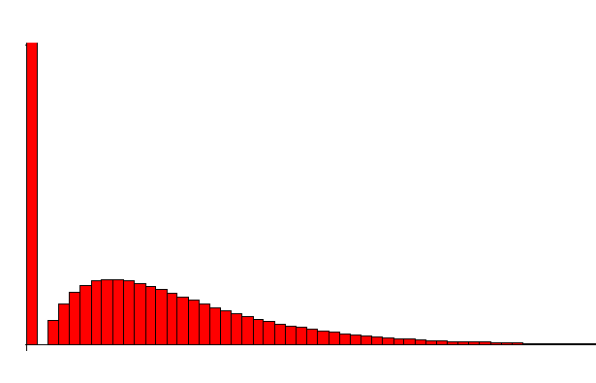
Choice of distribution
Y | Claims frequency | Claims number | Severity | Lapses | Burning cost
g(x) | ln(x) | ln(x) | ln(x) | ln(x/(1-x)) | ln(x)
Error | Poisson | Poisson | Gamma | Binomial | Tweedie
Scale | 1 | 1 | Estimate | 1 | Estimate
V(x) | x | x | x² | x(1-x) | x^{power} ^{Usually power=1.5}
weight | Exposure | 1 | Nb claims | 1 | exposure
Offset | 0 | Ln(exposure) | 0 | 0 | 0
φ
ξ
Tweedie distribution has a variance function proportional to μ ^{p}, with p parameter.
If 1<p<2,Tweedie distribution has a point mass at zero and corresponds to the compound distribution of a Poisson and a Gamma distribution.
The distribution can be Poisson-like (as p → 1) or Gamma-like (as p → 2).
If p>2, the distribution will have a higher variance than gamma, and tends to an inverse Gaussian if p → 3

Slide 40
Error Structure
10
In this simple example, three different GLMs have been fitted to three data points. The GLM with a Normal variance function assumes each obs. has the same fixed variance, Poisson has the variance increasing with the mean and Gamma has variance increasing with the square of the mean. For gamma, the model will produce fitted values that are more influenced by obs. on the left (as lower assumed variance)
8
6
4
2
0
1
2
3
Data
Normal
Poisson
Gamma

Slide 41
Example – how choosing correct variance function improves accuracy
In this fictional example, assume true effect is known for a particular rating factor. The GLM with an assumed gamma variance function is closest to the true effect (for higher average costs)

Slide 42
How does EMBlem solve GLMs (where do the β estimates come from)?
The betas are derived by maximum likelihood estimation.
In essence this means the method finds parameters which when applied to the assumed model form (remember – the user decides which rating factors to fit in any model), produce the observed data with the highest probability.
Numerical iterative techniques are used to optimise likelihood – remember we have millions of data observations in our models. Newton-Raphson techniques are one example of this:
βn+1 = βn - Hˉ¹.s
βn is the nth iterative estimate of the vector of parameter estimates β, s is the vector of the first derivatives of the log-likelihood (of the current estimate) and H is the matrix containing the second derivatives of the log-likelihood (of the current estimate).
If you want to learn more, the McCullagh and Nelder paper is probably the most widely used

Slide 43
Recap on Maximum Likelihood Estimation
It is a method for estimating the parameters of a statistical model
The statistical distribution must be specified
MLE takes an observed dataset and attempts to estimate unknown parameters of the statistical distribution defined. In our case we have a set of average claim amounts for fire based on Axa’s written policies and wish to build a model that predicts the average fire claim amount for every property in the UK. Our parameters are factors that effect the average fire claim amount (e.g. location and size of property)
To solve, take the log of the likelihood function (distribution chosen) and differentiate with respect to each parameter you are trying to solve
IT IS IN CT3!

Slide 44
Tech Reps GCV – Age of Vehicle
Product : Light Goods Vehicles (GCV)
Rating Factor : Age of vehicle
 | Age of vehicle | Risks Written | Gross Written Premium | Average Written Premium | Commission Rate | Large Claims Loss Ratio | Expected Claim Frequency | Expected Average Cost per Claim | Expected Loss Ratio
 | 0 | 2,298 | 1,357,809 | 591 | 7.4% | 0.00% | 22.25% | 1,957 | 53.8%
 | 1 | 2,448 | 1,628,876 | 665 | 7.0% | 0.00% | 26.19% | 2,006 | 68.6%
 | 2 | 2,133 | 1,540,485 | 722 | 6.5% | 7.67% | 26.61% | 2,092 | 70.9%
 | 3 | 2,370 | 1,660,496 | 701 | 6.7% | 0.00% | 27.78% | 1,773 | 63.0%
 | 4 | 2,363 | 1,436,353 | 608 | 6.3% | 7.06% | 23.67% | 2,027 | 69.9%
 | 5 | 2,647 | 1,604,366 | 606 | 6.4% | 124.39% | 20.59% | 5,484 | 176.5%
 | 6 | 2,690 | 1,401,165 | 521 | 6.3% | 0.00% | 19.16% | 2,220 | 76.4%
 | 7 | 3,341 | 1,567,612 | 469 | 6.5% | 0.00% | 16.33% | 1,462 | 49.6%
 | 8 | 2,605 | 1,171,890 | 450 | 6.8% | 0.00% | 16.33% | 1,519 | 53.5%
 | 9 | 2,541 | 1,035,456 | 408 | 6.4% | 0.00% | 13.12% | 2,037 | 64.8%
 | ]10-15] | 9,331 | 3,217,310 | 345 | 6.7% | 20.32% | 10.16% | 2,678 | 82.9%
 | ]15-20] | 991 | 299,392 | 302 | 6.7% | 0.00% | 5.81% | 1,934 | 38.6%
 | More than 20 | 113 | 39,360 | 347 | 3.7% | 0.00% | 0.10% | 8,802 | 2.6%
 | Total | 35,951 | 17,977,705 | 500 | 6.6% | 15.81% | 17.76% | 2,348 | 76.7%

Slide 45
Tech Reps GCV – No Claim Years
Product : Light Goods Vehicles (GCV)
Rating Factor : No Claims Years (NCD)
 | NCD Years | Risks Written | Gross Written Premium | Average Written Premium | Commission Rate | Large Claims Loss Ratio | Expected Claim Frequency | Expected Average Cost per Claim | Expected Loss Ratio
 | 0 | 1,406 | 1,674,144 | 1,191 | 6.8% | 7.22% | 24.25% | 3,308 | 63.2%
 | 1 | 1,272 | 1,215,803 | 956 | 6.7% | 0.00% | 23.58% | 2,054 | 46.3%
 | 2 | 1,347 | 1,129,701 | 839 | 6.3% | 164.69% | 23.11% | 8,695 | 225.5%
 | 3 | 2,120 | 1,515,759 | 715 | 6.1% | 0.00% | 23.47% | 1,843 | 56.8%
 | 4 | 2,691 | 1,465,536 | 545 | 6.0% | 0.00% | 18.91% | 1,691 | 55.6%
 | 5 | 6,590 | 2,607,570 | 396 | 6.9% | 0.00% | 16.63% | 1,696 | 66.5%
 | 6 | 6,275 | 2,399,201 | 382 | 7.5% | 13.11% | 17.07% | 2,093 | 87.3%
 | 7 | 3,908 | 1,564,100 | 400 | 7.0% | 0.00% | 16.21% | 1,650 | 62.3%
 | 8 | 9,643 | 3,821,820 | 396 | 5.9% | 8.77% | 14.93% | 1,964 | 71.0%
 | 9 and more | 699 | 584,072 | 836 | 8.2% | 0.00% | 15.02% | 3,193 | 53.0%
 | Total | 35,951 | 17,977,705 | 500 | 6.6% | 15.81% | 17.76% | 2,348 | 76.7%

Slide 46
Tech Reps GCV – Fuel Type
Product : Light Goods Vehicles (GCV)
Rating Factor : Fuel Type
 | Fuel Type | Risks Written | Gross Written Premium | Average Written Premium | Commission Rate | Large Claims Loss Ratio | Expected Claim Frequency | Expected Average Cost per Claim | Expected Loss Ratio
 | Diesel | 28,097 | 14,671,742 | 522 | 6.6% | 5.55% | 18.83% | 1,982 | 65.3%
 | Petrol | 5,658 | 1,926,813 | 341 | 7.2% | 0.00% | 11.06% | 2,103 | 68.7%
 | Other | 2,196 | 1,379,150 | 628 | 6.0% | 125.89% | 20.62% | 6,284 | 188.5%
 | Total | 35,951 | 17,977,705 | 500 | 6.6% | 15.81% | 17.76% | 2,348 | 76.7%

Slide 47
Tech Reps GCV – Number of Seats
Product : Light Goods Vehicles (GCV)
Rating Factor : Number of seats
 | Seating Capacity | Risks Written | Gross Written Premium | Average Written Premium | Commission Rate | Large Claims Loss Ratio | Expected Claim Frequency | Expected Average Cost per Claim | Expected Loss Ratio
 | 1 | 35 | 20,695 | 595 | 3.5% | 0.00% | 8.93% | 597 | 9.4%
 | 2 | 20,815 | 10,040,615 | 482 | 6.7% | 7.05% | 16.79% | 2,107 | 69.4%
 | 3 | 14,446 | 7,539,021 | 522 | 6.5% | 27.67% | 19.14% | 2,677 | 86.8%
 | 4 | 360 | 212,245 | 589 | 6.1% | 0.00% | 17.34% | 1,852 | 53.5%
 | 5 | 284 | 155,346 | 548 | 6.8% | 0.00% | 21.04% | 2,429 | 81.0%
 | 6 | 7 | 6,503 | 892 | 2.6% | 0.00% | 33.89% | 1,028 | 48.3%
 | Total | 35,951 | 17,977,705 | 500 | 6.6% | 15.81% | 17.76% | 2,348 | 76.7%

