Slide 1
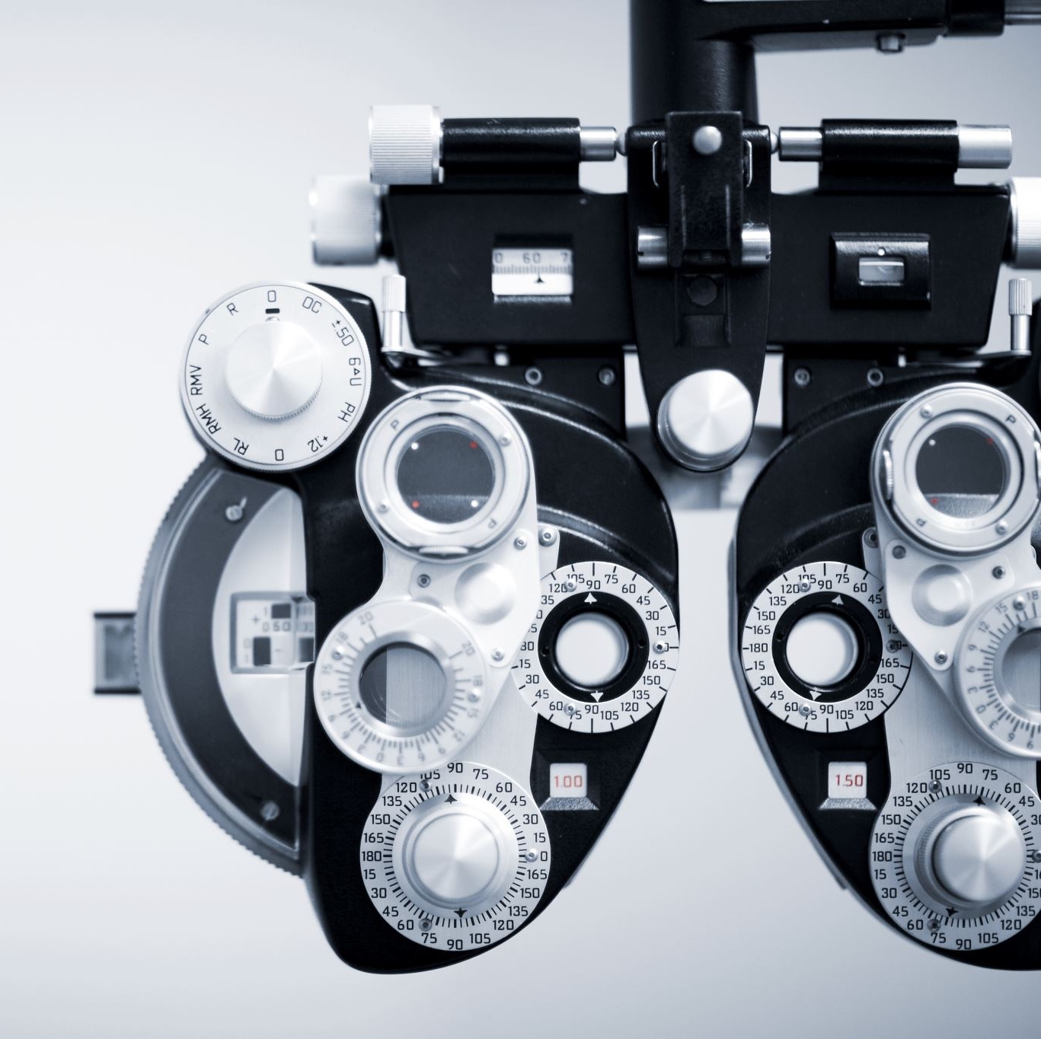
Totango Testing Workshop
Ynon Perek
ynon@ynonperek.com
https://www.tocode.co.il

Slide 2
Agenda
Why is it hard to ship working code?
What can you test?
Architecture

Slide 3
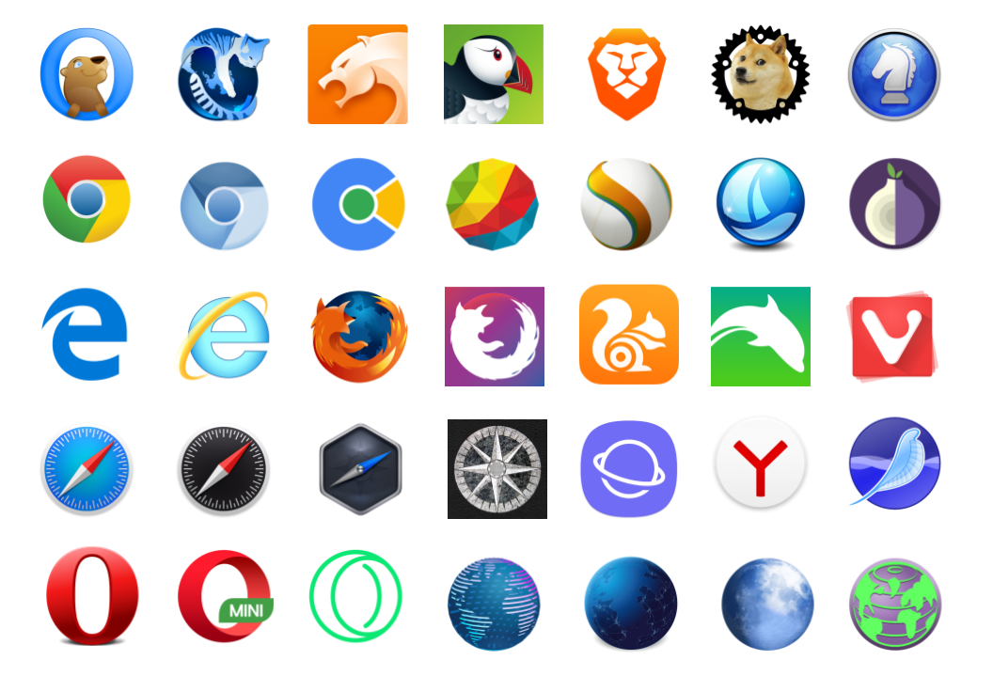
Why Is It Hard?
Each browser is different, each can fail in its own way

Slide 4

Why Is It Hard?
Web applications are using ever more code and include ever more logic

Slide 5
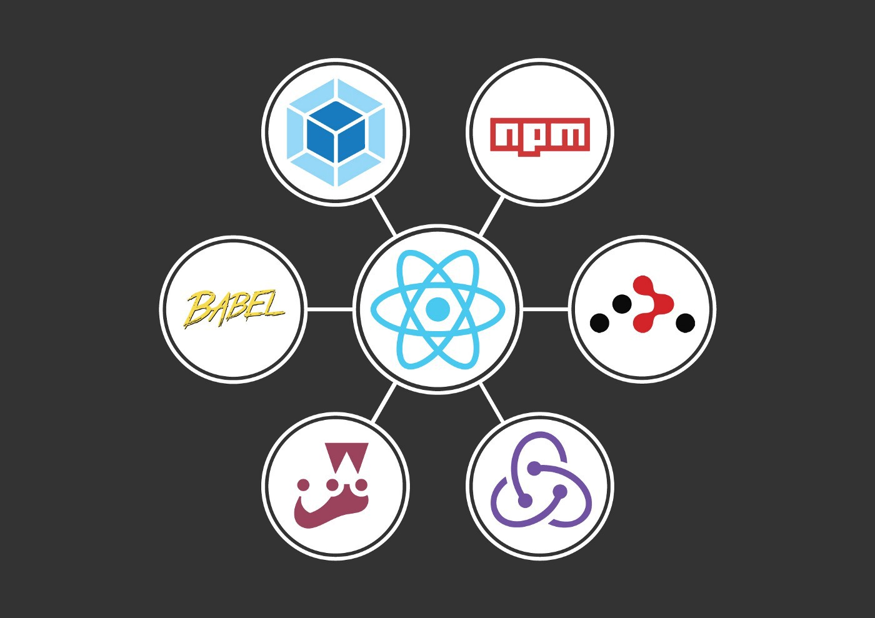
Why Is It Hard?
JavaScript dependencies change all the time, bringing a big moving part into our lives

Slide 6
Automatic Tests Are The Only Solution
Detect bugs before they happen
Short feedback loop
Reduce human mistakes
Write better code TDD style
Use a CI to never ship bad code

Slide 7
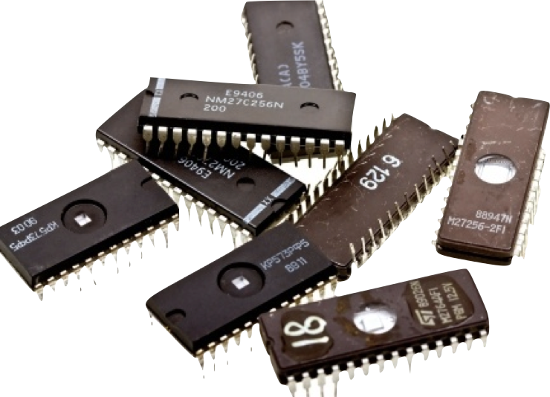

Two Main Types Of Tests
Unit Tests
System Tests

Slide 8
Unit Tests
For the developer
Instant feedback
Relatively easy to maintain

Slide 9
The goal of unit tests is to find the specific line of code that breaks

Slide 10
System Tests
For the client
Test entire flow
Easy To Write

Slide 11
The goal of system tests is to increase trust in the system

Slide 12

Q & A

Slide 13
What Can You Test?

Slide 14
What Should You Test
Bugs from the past
Intended Behavior
Edge Cases
Business logic
Smart code
Sensitive code

Slide 15

Testing Architecture

Slide 16
How It Works
Demos: react-testing-library vs. cypress

Slide 17
Testing Framework
react-testing-library
Jasmine
Mocha
jest

Slide 18
End To End Testing Frameworks
Selenium
Cypress
Capybara

Slide 19
Test Runners
Jest
Karma
Yeti
Teaspoon

Slide 20
Continuous Integration
Travis
Jenkins
TeamCity

Slide 21
Code Coverage
% of the code being tested
70-80% is good
Numbers can be deceiving
Demo

Slide 22
Balancing Tests
Few system/scenario tests for important scenarios
Many unit tests
Write and delete unit tests all the time
Maintain system tests

Slide 23
Q & A

