Slide 1

Application of deep learning models to model the behavior of runoff in places of mining activity using remote sensors
Yessica Ramirez Yara
PHd student of Faculty of Geo-data Science, Geodesy and Environmental Engineering
Akademia Górniczo-Hutnicza im. Stanisława Staszica w Krakowie
AGH University of Krakow
Jun 6th, 2024

Slide 2
Content
Introduction
Proposed workflow
Paper review
Repository
Literature review

Slide 3
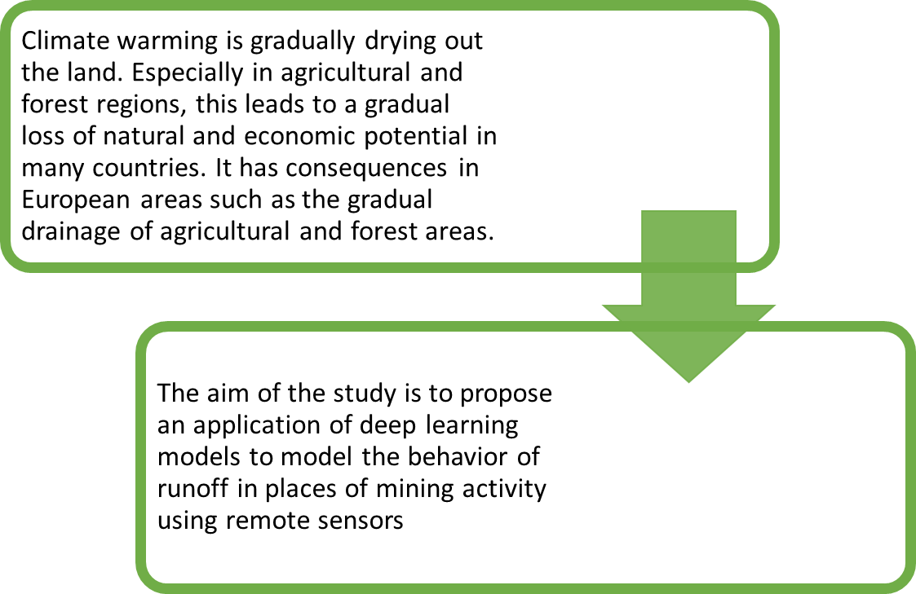
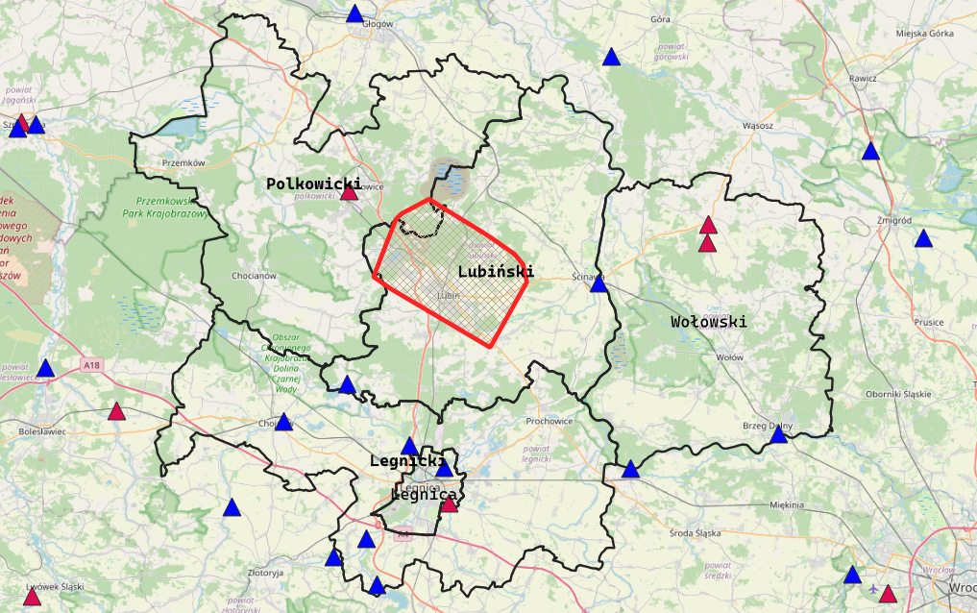
Introduction
Study Area: Area covered by the polygons of Legnica Powiat, Legnica City, Polkowice Powiat, Lubin Powiat and Wołowski-Powiat

Slide 4
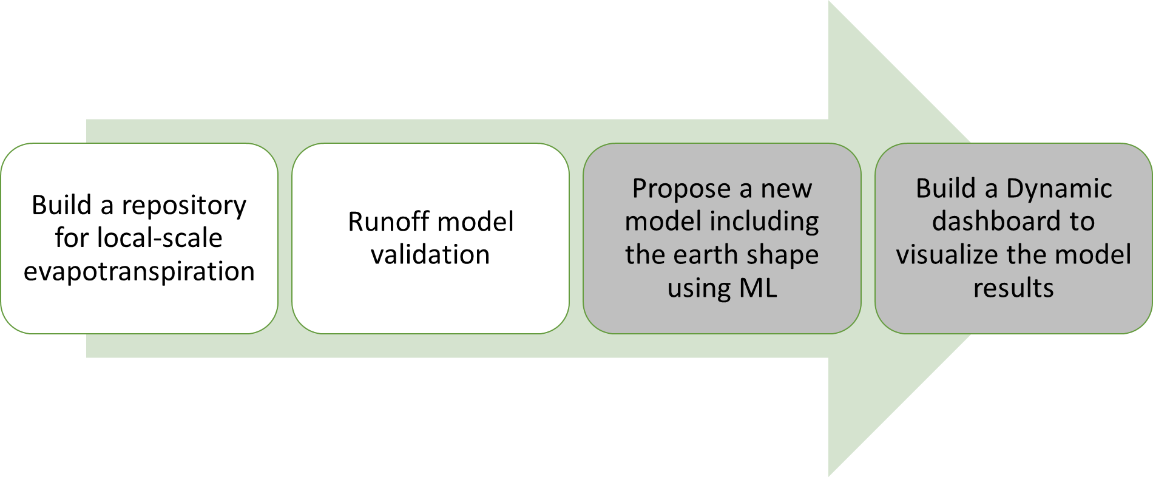

Proposed workflow
On progress

Slide 5
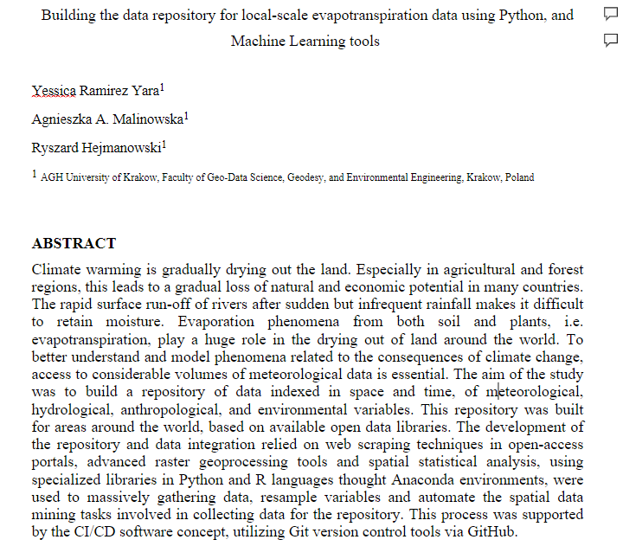
Paper review
The centralization of information on evapotranspiration, precipitation, and water infiltration according to soil type and land cover in a GitHub repository will enable users to directly access geoprocessed data in a common planar reference system, with the same local spatial and temporal resolution for Poland. This will allow high-quality and high-resolution data to be available, measuring the speed of water from when it falls to the ground until it is absorbed by its intrinsic characteristics. As a result, tools will be available to investigate surface runoff, water balance, and other related factors in the country.

Slide 6
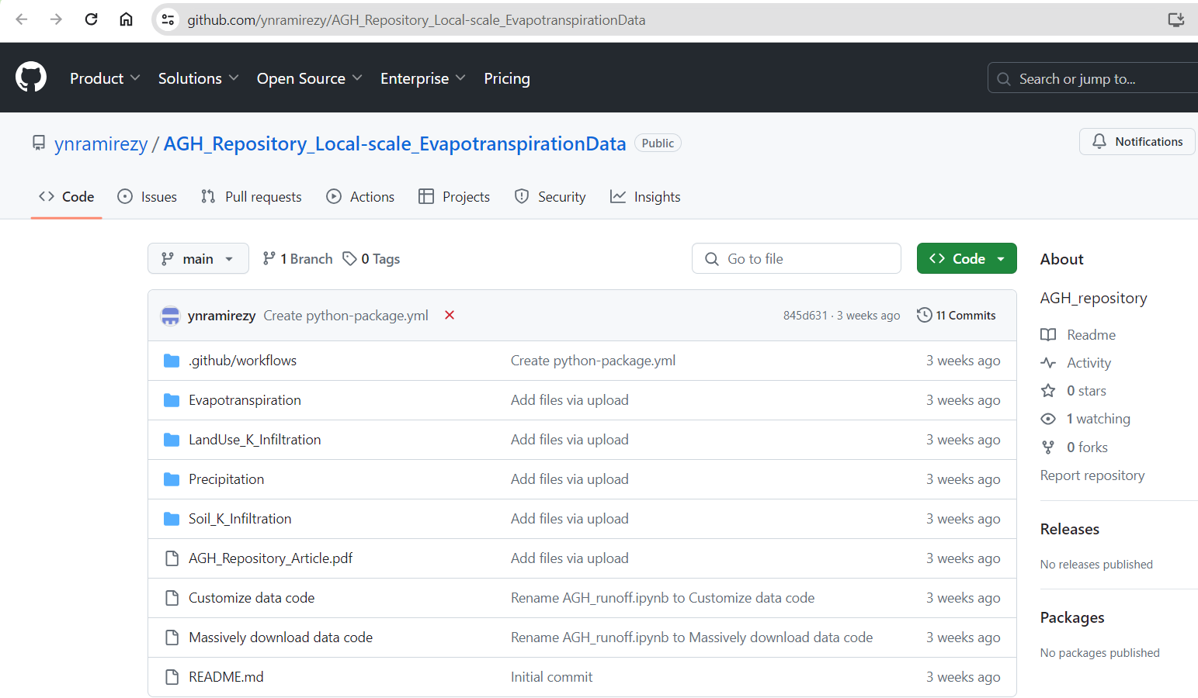
Repository

Slide 7
Literature review
Tondaś, D., Integration of GNSS and InSAR observations for monitoring deformations in mining areas. Wroclaw University of Environmental and Life Sciences. 2023 (PHd Thesis).
Displacement Forecasting in Mining Areas using Satellite SAR Interferometry and Machine Learning. Wroclaw University of Science and Technology. 2023 (PHd Thesis).

Slide 8
Proposal
Combining functional data analysis (FDA) and neural networks
Using functional clustering and functional depth measurements to characterize the runoff in mining areas
Build an interactive free access dashboard to monitoring the runoff focus on the land subsidence due to mining activities

Slide 9
Machine learning with time series data
Recurrent Neural Networks (RNNs): Long Short-Term Memory (LSTM)
DeepAR
N-BEATS

