Slide 1
TDG – TEST DATA GENERATOR

Slide 2
Pain Areas of Data generation
Volume of Data
Configuration challenges
Consult to data Model
Maintain referential Integrity across multiple DB’s

Slide 3
Test Data Generator
Testing a data- conscious application is one of the most important but time consuming tasks. It is always important to test any application with REAL data. To fill your database with test data, you need a generator. Test data Generator is the tool through which user can easily generate realistic data based on the column characteristics and or based on what the user defines. Currently, database developers and administrators often have to spend hours of dull work to create test data sets before examining database or application performance. TDG makes all this unnecessary by automatically creating database data.
Test data generator will be a powerful data generator tool that will allow users to easily populate data with thousands of records of meaningful and synthetically correct test data for database testing purpose. The tool focuses on testers with or without database knowledge who needs to generate test data from scratch or from existing data. Only few simple entries are necessary to generate comprehensive test data.

Slide 4
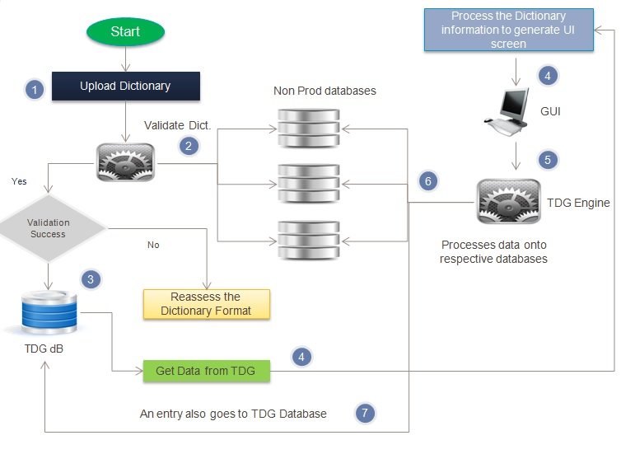
TDG_Solution Architecture
Solution : In scenarios where Live like data in production is not available, but is needed for the execution, Synthetic data generation comes in handy which manufactures data with similar features & attributes as available in production, ensuring the referential integrity kept intact. The Solution architecture, sequence of activities & few intelligence aspects have been captured in this slide below:
SEQUENCE OF ACTIVITIES:
A Database Dictionary is uploaded into the Engine.
The engine validates the metadata pattern in the dictionary against the Non prod dB Meta data.
Upon successful validation, an entry is made into TDG database.
The data from dictionary is then gathered to produce a logical Search screen (GUI)
A user would give the inputs using the GUI.
Logical search again hits the Engine which would make an appropriate entry into the relevant columns of the non prod dB.
An entry would also be made into the TDG database for tracking & reporting purposes.
ENGINE INTELLIGENCE:
** The engine generates default Unique values in the fields, if the field definition is (Not null) – Especially where field entry is essential & not selected in Input criteria.
** Gets all the relevant tables from the dB & arranges them in a sequence for data input based on the relationships defined in the dictionary.
** Generates Primary keys from the dictionary defined values or else considers Max+1 value from the dB tables.

Slide 5
TDG_Differentiators
With highly efficient Data generation mechanism embedded into the Utility, the Test Data Generator can significantly reduced the efforts invested in synthetic data manufacturing.
Quicker turn around
With highly robust logic of data generation from referential integrity perspective, TDG ensures a data of top quality, which mocks the live like content to cater “fit for purpose” test data.
Higher quality
Reduced Infrastructure
With understanding of test data requirements in advance to customize the essential data dictionaries, TDG gives the leverage to eliminate the production copies, ETLs involved alongside addressing the test data needs effectively.
TDG with its rich live like data set generation capability, eliminates the need of production data in most of the scenarios. This would minimize the risk of live data exposure thus enforcing a “live data exception model”
Data Security
Cost effective & higher savings
With a quicker understanding of data requirements, an unambiguous data provisioning strategy can be designed for a quicker data generation using TDG. This can expedite the time taken for the product to “go to market”

Slide 6
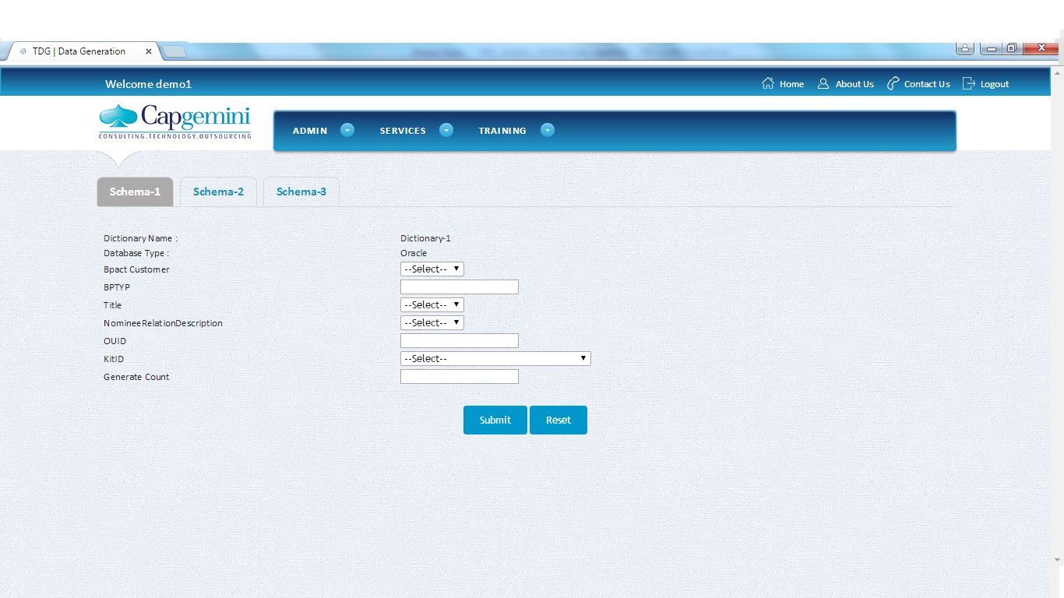
TDG Prototype

Slide 7
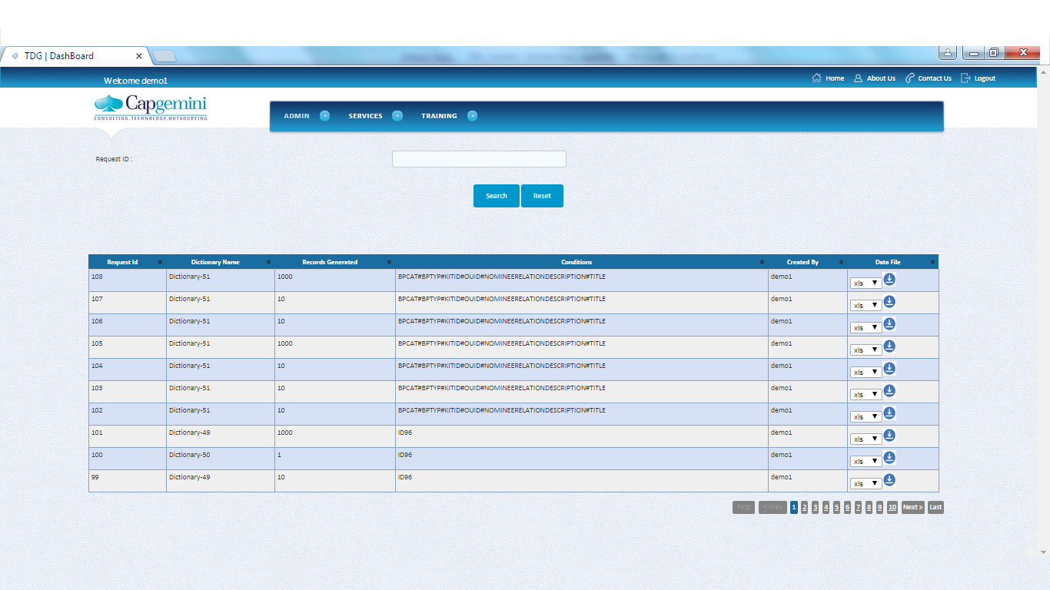
TDG Prototype

