Slide 1


E-Commerce, E-Medicine, and
E-Governance
Prepared by Anjal Rana Class: 12-D

Slide 2
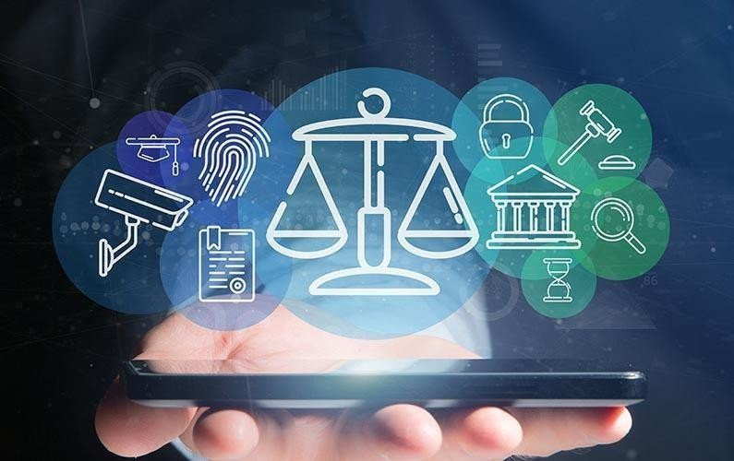
Introduction to E-Services
E-services are digital services delivered via the internet. They significantly transform various sectors by enhancing convenience, efficiency, and accessibility, impacting businesses, healthcare, and government services positively.

Slide 3

About
E-Commerce
Electronic commerce (e-Commerce) is a process of buying and selling or exchanging products, services, and information using electronic media. It encompasses various transactions, including online shopping, digital payments.

Slide 4

Advantages and Disadvantages of E-Commerce
Advantages:
Convenience
Global reach
Time saving
24/7 availability
Wider product choice
Disadvantages:
Security & privacy risks
No physical inspection
Delivery issues
Dependence on internet & technology
Limited customer trust
Returns can be inconvenient

Slide 5

About
E-Medicine
E-Medicine is an online clinical medical knowledge database, which is an approach to providing health care service to a large number of people spread in different locations.

Slide 6

Advantages and Disadvantages of E-Medicine
Advantages:
Easy access to doctors
Saves time and money
24/7 availability
Safe during infectious diseases
Disadvantages:
Lack of physical examination
Misdiagnosis risk
Data privacy concerns
Technology barriers
Over-reliance on self-reported symptoms

Slide 7

About
E-Governance
E-Governance is the use of information and communication technology (ICT) to enhance the access and delivery of government services to benefit citizens, business partners, and employees.

Slide 8
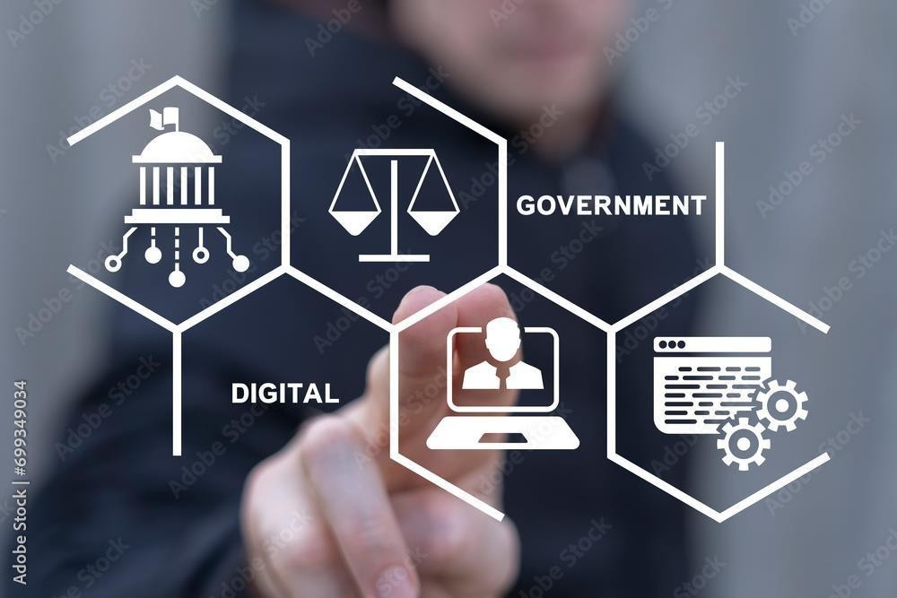
Advantages and Disadvantages of E-Governance
Advantages:
Transparency
Efficient service delivery
Improved accessibility
24/7 availability of services
Better data management
Disadvantages:
Digital divide
Cybersecurity threats
System failures
Lack of personal interaction
High implementation cost
Privacy concerns

Slide 9

Conclusion
E-commerce, e-medicine, and e-governance are powerful tools of digital transformation. While they offer many advantages such as convenience, efficiency, and accessibility, they also come with challenges like security risks and digital inequality.
Proper policies, awareness, and technological improvements are necessary to maximize their
benefits and minimize their drawbacks.

Slide 10
Thank You!

