Slide 1
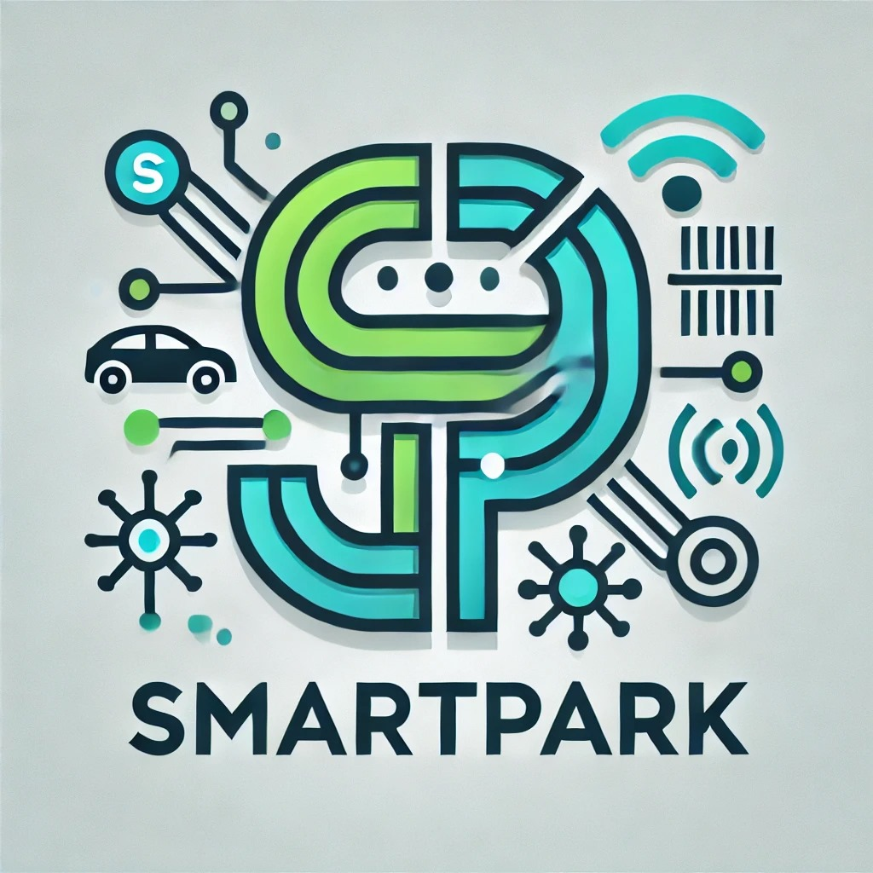
SmartPark: Environmental Monitoring
By Hussien Ismail

Slide 2
Introduction
Objective:
To create a smart parking detection system that can monitor and adapt to environmental conditions (temperature, humidity, and light levels) using a DHT22 sensor, LEDs and LDR.
Interface this system with a graphical user interface (GUI) for real-time data monitoring.
System Components:
DHT22 sensor for temperature and humidity monitoring.
LDR (Light Dependent Resistor) for light intensity measurement.
LED indicator for light-based feedback.
App interface for data monitoring.

Slide 3
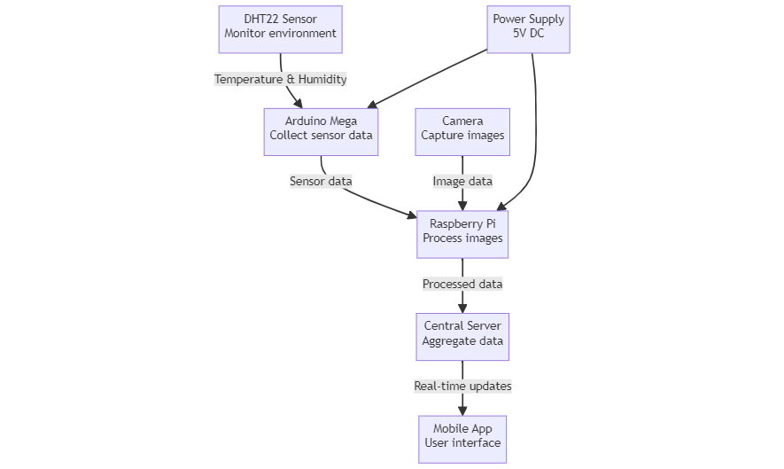
System Architecture Overview

Slide 4
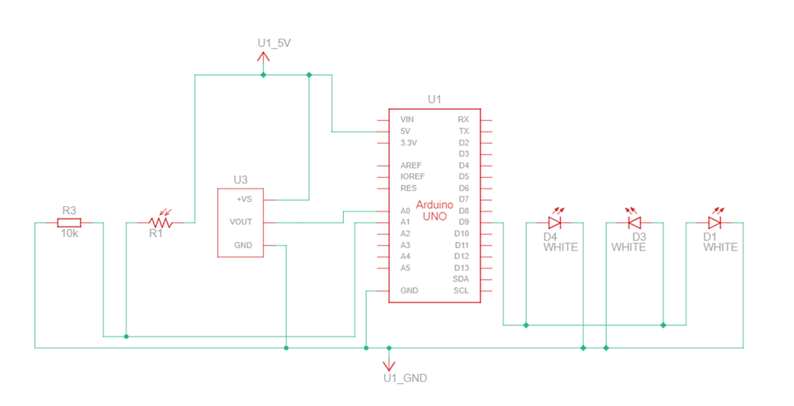
Arduino Architecture Overview

Slide 5

Hardware Setup
DHT22 Sensor:
Measures temperature and humidity.
Connected to analog pin A0 of the Arduino.
Communicates using a digital protocol for data exchange.
LDR Sensor:
Measures ambient light levels.
Connected to analog pin A1.
Simple voltage divider circuit with a fixed resistor.
LED Indicator:
LED is connected to digital pin 9.
It turns on in low light conditions (parking environment).

Slide 6
Code Explanation

Slide 7
Arduino Code Overview
Objective:
The Arduino code reads from the DHT22 and LDR sensors, controls the LED, and sends data to the serial port for the GUI to visualize.
Code Breakdown:
Sensor Initialization: Defines DHT22 and LDR sensor pins, sets up sensors.
Main Loop: Reads temperature, humidity, and light levels, and controls the LED based on the LDR threshold.
Data Output: Sends temperature, humidity, and light data to the serial port in CSV format for GUI input.
Key Features:
Handles real-time environmental monitoring.
Sends structured data for the GUI to display in real-time.

Slide 8
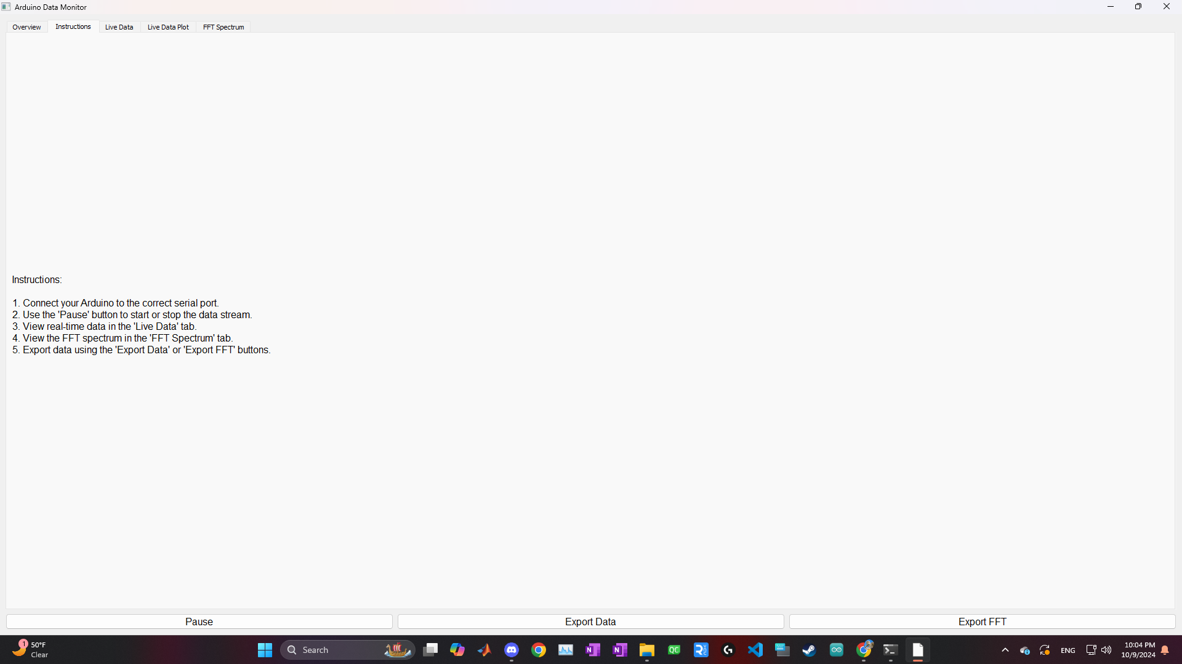
GUI Overview: Objectives and Design
Objective:
The GUI will provide real-time data visualization of environmental conditions, such as temperature, humidity, and light levels, coming from the Arduino.
Design Features:
Tab 1: Live Data Display: Shows temperature, humidity, and light levels in real time.
Tab 2: FFT Spectrum Analysis: Visualizes frequency components of the data.
Data Logging: Option to log data for further analysis.
Pause/Resume Functionality: Users can pause and resume the data stream.

Slide 9
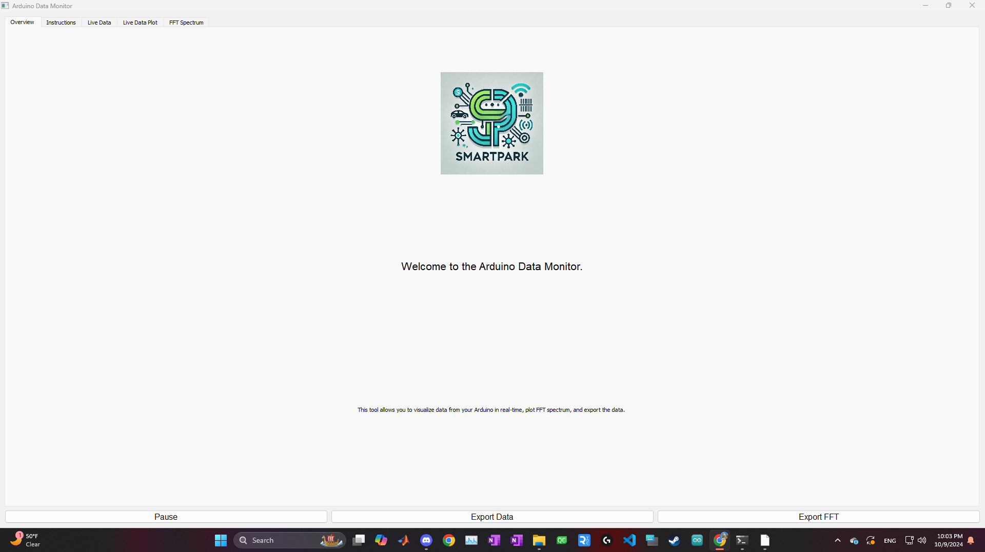
GUI Implementation: Technologies Used
Python Libraries:
PyQt5: For the GUI framework and layout, creating windows, tabs, and buttons.
Matplotlib: For plotting real-time graphs of sensor data.
Numpy: For numerical analysis and performing the FFT (Fast Fourier Transform).
PySerial: For reading data from the Arduino via serial communication.
System Flow:
The Arduino sends data (temperature, humidity, and light levels) to the Python program via serial communication.
The PyQt5 GUI processes the incoming data, updates live text displays and real-time plots, and performs FFT spectrum analysis on light sensor data.

Slide 10
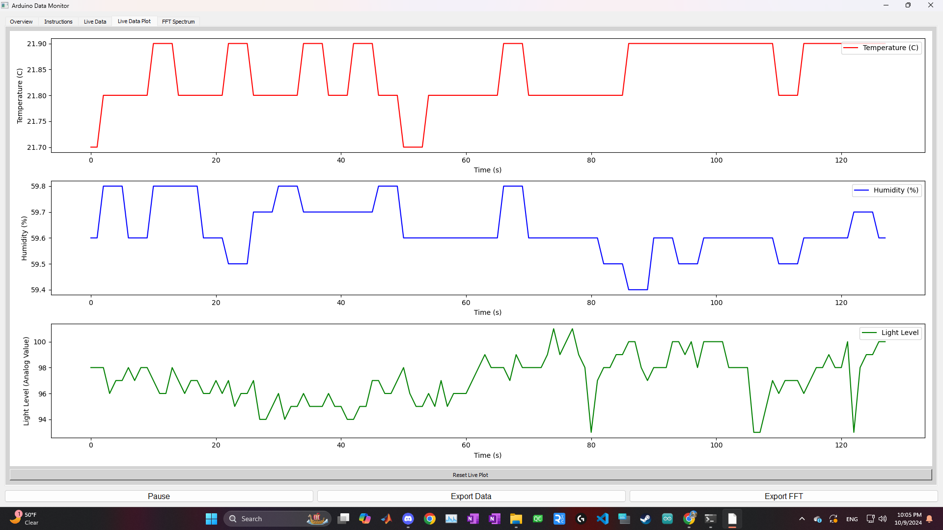
GUI: Real-Time Data Visualization
Real-Time Plots:
Display real-time graphs of temperature, humidity, and light levels.
Features:
Auto-updating graphs with adjustable refresh rates.
Color-coded lines for each parameter (temperature, humidity, and light).
Pause/Resume Feature:
Users can pause data intake, useful for capturing specific time intervals of parking conditions.

Slide 11
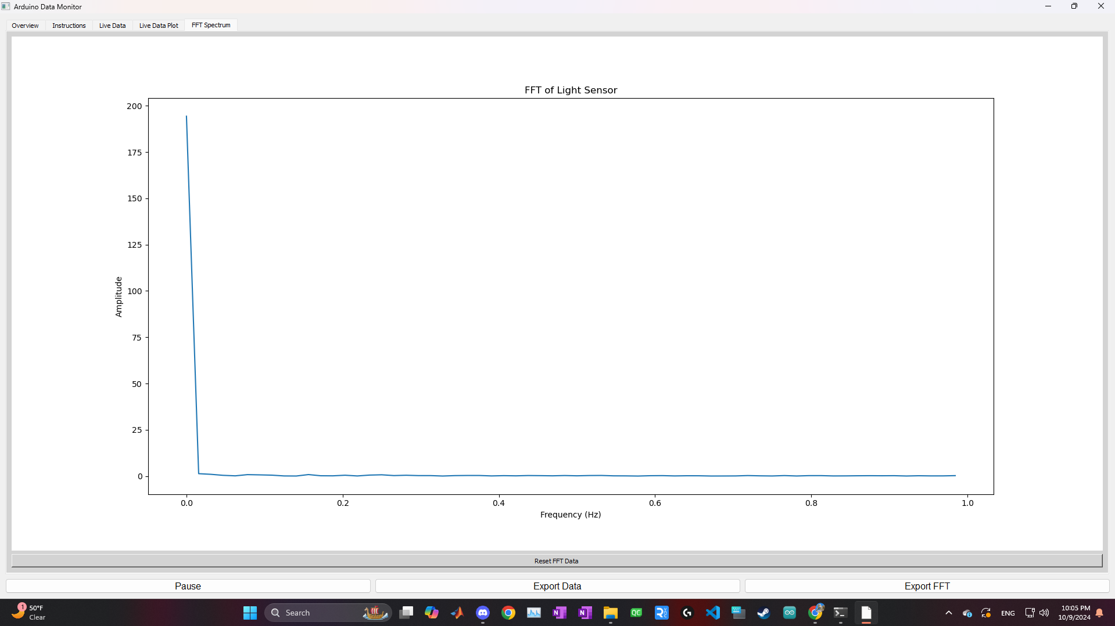
FFT Spectrum Analysis
Purpose:
Analyze the frequency domain representation of the data (temperature, humidity, or light).
FFT Implementation:
Uses the Numpy library to perform a Fast Fourier Transform (FFT) on the incoming data.
Visualization:
Real-time spectrum analysis graph showing dominant frequency components of sensor readings.

Slide 12
Data Logging and Export
Data Logging:
Option to log all real-time sensor data into CSV files.
Allows for historical analysis and export for further insights.
Export Functionality:
Users can export data logs and FFT results for further analysis or integration into other software platforms.

Slide 13
Conclusion and Next Steps
Key Achievements:
Successfully integrated Arduino sensors with a Python-based GUI.
Real-time data monitoring and visualization.
FFT spectrum analysis of environmental data for deeper insights.
Next Steps:
Optimize the GUI for mobile and tablet admin usage, improving app-based interactions.

